Slide 1
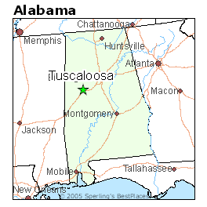
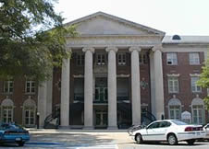
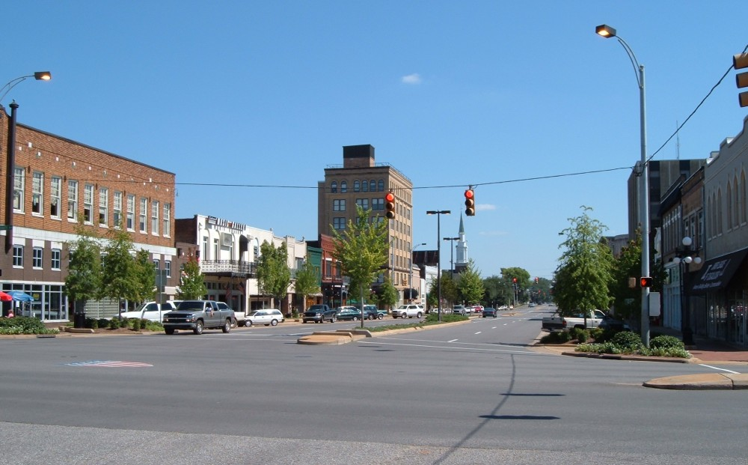
Spreading The Gospel In Northport and Tuscaloosa

Slide 2
"I have great heaviness and continual sorrow in my heart; for I could wish that I myself were accursed from Christ for my brethren, my kinsmen according to the flesh" (Romans 9:2-3).
"Winning one person creates the hunger for more, and on it goes until the soul winner is consumed with a burning passion to win others to Christ."
2 Cor 5:14- "The love of Christ compels us.
Matthew 9:37-38 "The harvest is plentiful but the workers are few. Ask the Lord of the harvest, therefore, to send out workers into his harvest field."

Slide 3
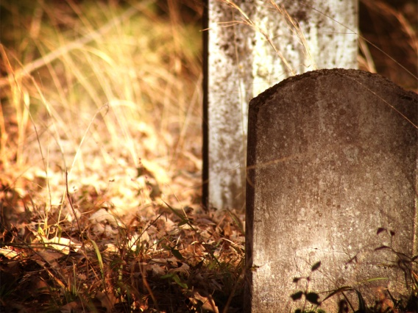
- The Bible Tells Us Multiple Times That God Brought The Dead Back To Life
⁸ Why should it be thought incredible by you that God raises the dead? Acts 26

Slide 4

- The Bible Gives Multiple Times God Brought The Dead Back To Life
- Only God Has The Power To Do This
14 As it is written, “I have made you the father of many nations”—in the presence of the God in whom he believed, who gives life to the dead and calls into existence the things that do not exist. Romans 4

Slide 5
- The Bible Gives Multiple Times God Brought The Dead Back To Life
- Only God Has The Power To Do This
- People Who Speak To Us From The Grave Help Us Prepare For Eternity

Slide 6
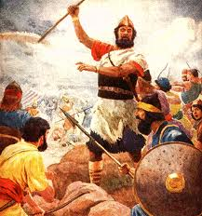
I. Samuel And Saul
1 Sam 28:15-18

Slide 7
A. Lost Connection with God
1. He Was A Great King At First
¹⁵ So all the people went to Gilgal, and there they made Saul king before the LORD in Gilgal. There they made sacrifices of peace offerings before the LORD, and there Saul and all the men of Israel rejoiced greatly. 1 Sam. 11

Slide 8
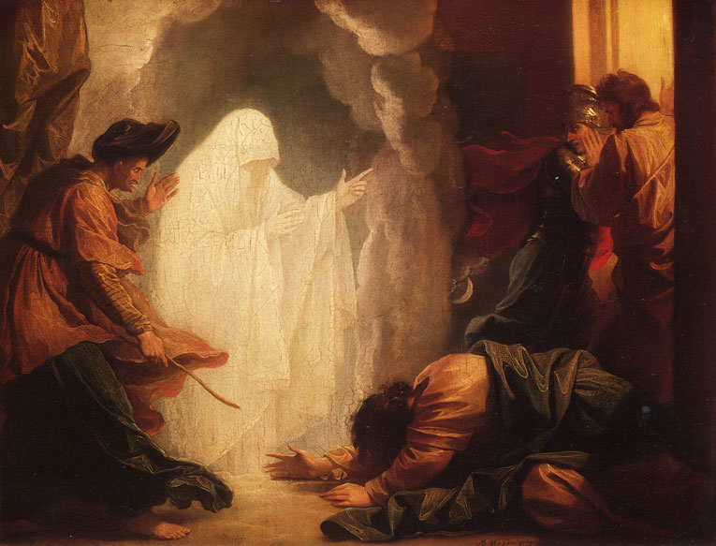
A. Lost Connection with God
1. He Was A Great King At First
2. He Ignored God’s Commands
¹³ And Samuel said to Saul, “You have done foolishly. You have not kept the commandment of the LORD your God, which He commanded you. For now the LORD would have established your kingdom over Israel forever. ¹⁴ But now your kingdom shall not continue. 1 Sam 13

Slide 9
A. Lost Connection with God
1. He Was A Great King At First
2. He Ignored God’s Commands
3. His Crown Was Taken Away
¹³ And Samuel said to Saul, “You have done foolishly. You have not kept the commandment of the LORD your God, which He commanded you. For now the LORD would have established your kingdom over Israel forever. ¹⁴ But now your kingdom shall not continue. 1 Sam 13

Slide 10

A. Lost Connection with God
B. Re-Connecting With God
1. Give Our Crowns To God First
¹⁰ the twenty-four elders fall down before Him who sits on the throne and worship Him who lives forever and ever, and cast their crowns before the throne, saying:¹¹ “ You are worthy, O Lord, To receive glory and honor and power; For You created all things, And by Your will they exist and were created.” Rev. 4

Slide 11
A. Lost Connection with God
B. Re-Connecting With God
Give Our Crowns To God First
Don’t Allow The devil To Influence Our Life
³ Now Samuel had died, and all Israel had mourned for him and buried him in Ramah, his own city. And Saul had put the mediums and the necromancers out of the land.
⁷ Then Saul said to his servants, "Seek out for me a woman who is a medium, that I may go to her and inquire of her." And his servants said to him, "Behold, there is a medium at En-dor.“ 1 Sam 28
Eph. 4:27

Slide 12
A. Lost Connection with God
B. Re-Connecting With God
Give Our Crowns To God First
Don’t allow the devil to influence our life
Understand How he Tries
He knows what we like
He knows what we think

Slide 13
¹³ So Saul died for his unfaithfulness which he had committed against the LORD, because he did not keep the word of the LORD, and also because he consulted a medium for guidance. ¹⁴ But he did not inquire of the LORD.. I Chronicles 10

Slide 14
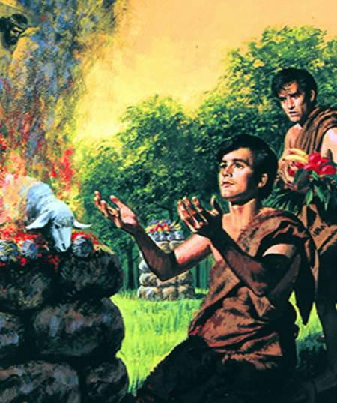
II. Abel
Heb 11:4

Slide 15
⁴ By faith Abel offered to God a more excellent sacrifice than Cain, through which he obtained witness that he was righteous, God testifying of his gifts; and through it he being dead still speaks. Heb. 11
Why Does His Sacrifice Speak To Us Today?

Slide 16
A. He Offered It “BY FAITH.”
¹⁷ So then faith comes by hearing, and hearing by the word of God. Rom. 10
He Heard What God Said, And Got To Work
13 And we also thank God continually because, when you received the word of God, which you heard from us, you accepted it not as the word of men, but as it actually is, the word of God, which is at work in you who believe. 1 Thes. 2

Slide 17
A. He Offered It “BY FAITH.”
B. His Sacrifice Was Different
1. Heart
³And in the process of time it came to pass that Cain brought an offering of the fruit of the ground to the LORD. ⁴Abel also brought of the firstborn of his flock and of their fat. Gen. 4
1 Sam. 15:19–23- Saul

Slide 18
A. He Offered It “BY FAITH.”
B. His Sacrifice Was Different
1. Heart
2. Spoke Good Things
²⁴to Jesus the Mediator of the new covenant, and to the blood of sprinkling that speaks better things than that of Abel. Heb 12.

Slide 19
A. He Offered It “BY FAITH.”
B. His Sacrifice Was Different
1. Heart
2. Spoke Good Things
3. Looked Forward
²²And according to the law almost all things are purified with blood, and without shedding of blood there is no remission. Heb. 9
¹²Therefore Jesus also, that He might sanctify the people with His own blood, suffered outside the gate. Heb. 13

Slide 20
“Death is never the last word in the life of a righteous man”.
¹³…‘Blessed are the dead who die in the Lord from now on.’” “Yes,” says the Spirit, “that they may rest from their labors, and their works follow them.” Rev 14

