Slide 1
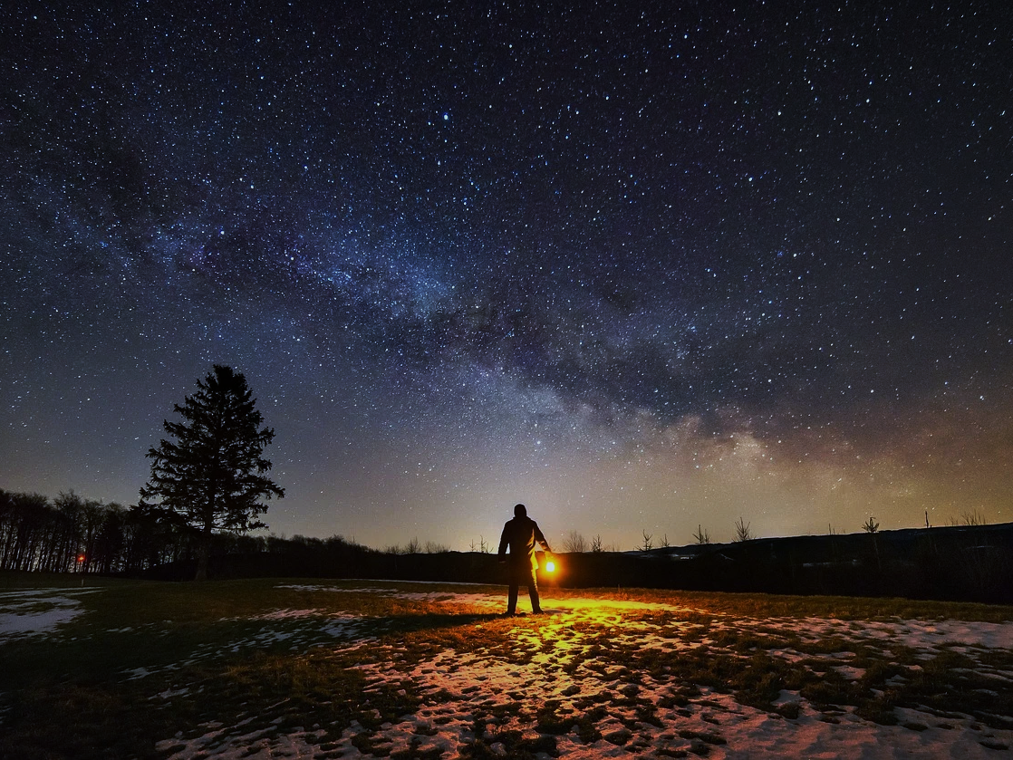
Our God is Bigger Than
The Sum of our Fears
1 Kings 8:27
Notes:
Our perception of God’s size depends on how near we are to Him, and that in turn determines our perception of the size of our problems and fears. The bigger our God is, the smaller our fears will be. Let us MAGNIFY GOD.

Slide 2

Magnifying God
Psalm 34:1-6
Magnifying God is something we do for others (v. 2; Jude 20-21)
Magnifying God is something we do together (v. 3)
Magnifying God is something we do because He has delivered us from our fears (vs. 4-6)
  In Psalm 27:1-5 we see that…
  God guides us in our present.
  God has helped us in our past.
  God will be with us in future trouble IF our one desire is to be with Him.

Slide 3
There is no Trouble too Big for God
Psalm 46:1-7
He is a “very present help,” and His presence quells our fears (vs. 1-2; Psalm 23:4; 56:3-4)
God can handle the worst that can happen (vs. 2-3; 2 Corinthians 7:5-7; Revelation 2:10)
God enables us to conquer the unconquerable and overcome the overwhelming (vs. 4-7, Num. 13:33; Isa. 40:2; Deut. 1:29)

Slide 4
The Lord be Magnified!
“Let all those who seek You rejoice and be glad in You. Let such as love Your salvation say continually, ‘The LORD be magnified!’” (Psalm 40:16)
Our God is bigger than the sum of our fears!

