Slide 1
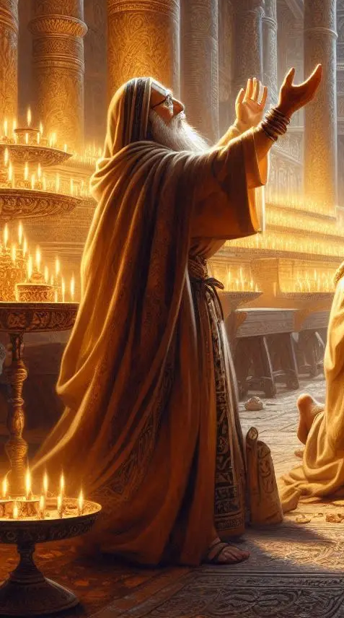
Exceeding their righteousness
Pursuing the Righteousness Required to Enter the Kingdom of Heaven
(Matthew 5-7)
Notes:
In order to enter the kingdom heaven, our righteousness must exceed the righteousness of the scribes and Pharisees. Their righteousness was meant to meet a human standard, but our righteousness must meet the Divine standard. It begins by acknowledging our own unrighteousness and relying on God to “be just and the justifier of the one who has faith in Jesus.” It is pursued in life by doing the will of our Father in heaven from the heart, instead of merely doing that which appears to men to be righteous.

Slide 2
Righteousness and Commandment-Keeping
Superior righteousness is required to enter the kingdom of heaven (Matthew 5:20).
The context relates to keeping commandments (Matthew 5:17-19).
The scribes and Pharisees appeared to be righteous, but Jesus exposed their hypocrisy (Matthew 6:1-16; 23:13-29).
Our righteousness must exceed theirs in both kind and degree (Luke 18:9-14; 2 Corinthians 10:12; Romans 3:24-26).

Slide 3
A Higher Level of Righteousness
Anger and unkind words demand reconciliation, not ritual (Matthew 5:21-24).
Sexual sins must be curtailed in the heart (Matthew 5:27-30).
Rationalizing breaking oaths must be prevented by not taking them to begin with (Matthew 5:33-37).
Personal vengeance is not taken because an evil person is not resisted to begin with (Matthew 5:38-42).
Hating enemies is replaced with loving kindness toward all (Matthew 5:43-48).

Slide 4
A Higher Level of Righteousness
Doing good to be seen by others is replaced by doing good that others can’t see (Matthew 6:1-4, 5-8, 16-18).
Putting the Lord and heavenly things ahead of material things (Matthew 6:19-34).
Self-righteous judging is replaced by self-examination (Matthew 7:1-5).
Do unto others as you would have done to you (Matthew 7:12).
Enter by the narrow gate – not the popular one (Matthew 7:13-14).

Slide 5
Jesus teaches that
the one who can enter
the kingdom of heaven
is the one whose
“righteousness exceeds the righteousness of the scribes and Pharisees,”
and who “does the will of
my Father in heaven.”
(Matthew 5:20; 7:21)

