Slide 1
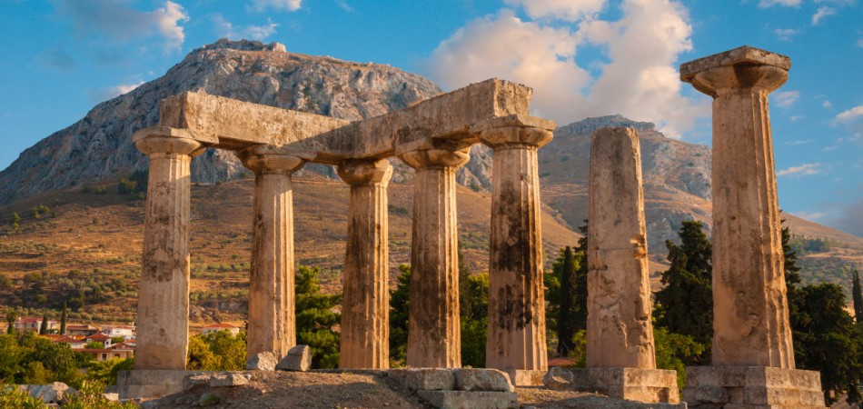
The Epistle of First Corinthians

Slide 2
Outline of 1 Corinthians
SECTION ONE: Dealing with reported problems (1:1—6:20)
A. Unity based on God’s wisdom (1:10—4:21)
Greeting, thanksgiving, and exhortation to unity (1:1-17)
God’s wisdom & power vs. human pride (1:18-31)
Paul’s Example – relying on God’s wisdom and power (2:1-16)
God’s foundation and building (3:1-23)
The quality of Paul’s apostleship (4:1-21)
B. Dealing with sin in the church (5-6)
Dealing with the immoral (5:1-13)
Dealing with those filing lawsuits (6:1-11)
Flee Sexual Immorality (6:12-20)

Slide 3
Outline of 1 Corinthians
SECTION TWO: Dealing with questions and concerns of the Corinthians (7:1--16:9)
C. Their Concerns (7-9)
Marriage problems & issues for singles (7:1-16)
Live as you are called (7:17-40)
Things offered to idols (8:1-13)
The rights and responsibilities of preachers (9:1-27)
D. Common Concerns (10-11)
Old Testament warnings about temptation (10:1-13)
Flee idolatry (10:14-33)
Respecting headship when praying or prophesying (11:1-16)
The Lord’s Supper (11:17-34)

Slide 4
Outline of 1 Corinthians
SECTION TWO: Dealing with questions and concerns of the Corinthians (7:1--16:9)
E. Spiritual Gifts (12-14)
Gifts of Spirit (12:1-31)
The superiority of love (13:1-13)
Keeping tongues in perspective (14:1-22)
Order and decorum in the assembly (14:23-40)
F. The Gospel of the Resurrection (15)
The Gospel and the FACT of the resurrection (15:1-20)
The Character of Resurrection (15:21-58)
G. Closing Words (16)
Concerning the collection and Paul’s future plans (16:1-24)

Slide 5
Roots of Division in Corinth
The division in the church at Corinth could be seen in the claims some made to having a special connection with a given preacher (Paul, Cephas, Apollos, or Christ, 1:12). Their division is attributed to carnality (3:3) and thinking too highly of men (4:6).
“The explanation that best explains the situation in Corinth is to understand that the Corinthian Christians (may have) looked upon their preachers in the same light as they formerly viewed itinerant philosophers. They viewed the preachers as bringing their own personal wisdom (sophia); they were more concerned with polished oration than with significant content. Allegiance focused on the preacher rather than the Christ.” (Mike Willis, 1 Corinthians BTB, p. 9)

Slide 6
God’s Wisdom & Power VERSUS Human Pride (1:18-31)
Wisdom and Foolishness (1:18-25)
The saved and the lost have different views of the message of the cross (1:18; 2 Cor. 2:15-17)
The Lord renders useless the wisdom of the proud who won’t hear Him (1:19; Isa. 29:13-14)
NOTE: Paul quotes from the Septuagint.
God has made worldly wisdom foolish! (1:20-21a; Isaiah 44:25).
Those who possess it, record it, and declare it, do not know God by it!
Notes:
Isaiah 29:13-14 Therefore the Lord said: "Inasmuch as these people draw near with their mouths And honor Me with their lips, But have removed their hearts far from Me, And their fear toward Me is taught by the commandment of men, 14 Therefore, behold, I will again do a marvelous work Among this people, A marvelous work and a wonder; For the wisdom of their wise men shall perish, And the understanding of their prudent men shall be hidden.“ (cf. Matthew 15:8-9)
Isaiah 44:24-25 Thus says the LORD, your Redeemer, And He who formed you from the womb: "I am the LORD, who makes all things, Who stretches out the heavens all alone, Who spreads abroad the earth by Myself; 25 Who frustrates the signs of the babblers, And drives diviners mad; Who turns wise men backward, And makes their knowledge foolishness;

Slide 7
God’s Wisdom & Power VERSUS Human Pride (1:18-31)
Wisdom and Foolishness (1:18-25)
God is pleased to save believers through “the foolishness of the message preached” (1:21b-25)
Neither Jews nor Greeks were looking for this.
The message of “Christ crucified” is a stumbling block to Jews and foolishness to Greeks (Romans 9:31-33; 1 Peter 2:7-8; Matt. 13:54-57; Acts 17:32)
But to the called, it is the wisdom & power of God.
God’s foolishness is wiser than men, and His weakness is stronger than men.
Notes:
Romans 9:31-33 but Israel, pursuing the law of righteousness, has not attained to the law of righteousness. 32 Why? Because they did not seek it by faith, but as it were, by the works of the law. For they stumbled at that stumbling stone. 33 As it is written: "BEHOLD, I LAY IN ZION A STUMBLING STONE AND ROCK OF OFFENSE, AND WHOEVER BELIEVES ON HIM WILL NOT BE PUT TO SHAME.“
1 Peter 2:7-8 Therefore, to you who believe, He is precious; but to those who are disobedient, "THE STONE WHICH THE BUILDERS REJECTED HAS BECOME THE CHIEF CORNERSTONE," 8 and "A STONE OF STUMBLING AND A ROCK OF OFFENSE." They stumble, being disobedient to the word, to which they also were appointed.
Matthew 13:54-57 When He had come to His own country, He taught them in their synagogue, so that they were astonished and said, "Where did this Man get this wisdom and these mighty works? 55 Is this not the carpenter's son? Is not His mother called Mary? And His brothers James, Joses, Simon, and Judas? 56 And His sisters, are they not all with us? Where then did this Man get all these things?" 57 So they were offended at Him. But Jesus said to them, "A prophet is not without honor except in his own country and in his own house.“
Acts 17:32 And when they heard of the resurrection of the dead, some mocked, while others said, "We will hear you again on this matter."

Slide 8
God’s Wisdom & Power VERSUS Human Pride (1:18-31)
God’s Glory not Man’s Greatness (1:26-31)
Our calling is not based on human greatness – the Lord doesn’t need our fleshly status or abilities to save us (1:26; Romans 5:6)
God purposely chose things regarded as foolish, weak, base, despised and nonexistent to eliminate human pride & boasting (1:27-28) Galatians 6:14)
Weak (2 Corinthians 13:4)
Base (low-born, Luke 2:7; Matthew 13:55)
Despised (Isaiah 53:2-3)
Nonexistent
Notes:
Romans 5:6 For when we were still without strength, in due time Christ died for the ungodly.
Galatians 6:14 But God forbid that I should boast except in the cross of our Lord Jesus Christ, by whom the world has been crucified to me, and I to the world.
2 Corinthians 13:4 For though He was crucified in weakness, yet He lives by the power of God. For we also are weak in Him, but we shall live with Him by the power of God toward you.
Luke 2:7 And she brought forth her firstborn Son, and wrapped Him in swaddling cloths, and laid Him in a manger, because there was no room for them in the inn.
Matthew 13:55 Is this not the carpenter's son? Is not His mother called Mary? And His brothers James, Joses, Simon, and Judas?
Ephesians 2:8-9 For by grace you have been saved through faith, and that not of yourselves; it is the gift of God, 9 not of works, lest anyone should boast.

Slide 9
God’s Wisdom & Power VERSUS Human Pride (1:18-31)
God’s Glory not Man’s Greatness (1:26-31)
Jesus Christ became for us…
Wisdom (Colossians 2:3)
Righteousness (Philippians 3:9)
Sanctification (1 Corinthians 1:2; Hebrews 10:10)
Redemption (Romans 3:24)
This is the Lord’s doing, and it is marvelous in our eyes! (Matthew 21:42)
Since is God who has provided all this, the one who glories should “glory in the Lord” (1:31; 4:7; Ephesians 2:9; 2 Corinthians 3:5)
Notes:
Colossians 2:3 in whom are hidden all the treasures of wisdom and knowledge.
Philippians 3:9 and be found in Him, not having my own righteousness, which is from the law, but that which is through faith in Christ, the righteousness which is from God by faith;
Hebrews 10:10 By that will we have been sanctified through the offering of the body of Jesus Christ once for all.
Romans 3:24 being justified freely by His grace through the redemption that is in Christ Jesus,
Matthew 21:42 Jesus said to them, "Have you never read in the Scriptures: 'THE STONE WHICH THE BUILDERS REJECTED HAS BECOME THE CHIEF CORNERSTONE. THIS WAS THE LORD'S DOING, AND IT IS MARVELOUS IN OUR EYES' ?
2 Corinthians 3:5 Not that we are sufficient of ourselves to think of anything as being from ourselves, but our sufficiency is from God,
Ephesians 2:8-9 For by grace you have been saved through faith, and that not of yourselves; it is the gift of God, 9 not of works, lest anyone should boast.

Slide 10
Lesson Schedule for our study of First Corinthians Eastside Auditorium Fall Quarter 2017

