Slide 1
…
Notes:
Title: Successfully Serving God by Serving Others: We let so many things distract us from using our time to be successful in our 2014 goal of “serve God by serving others”. This lesson is intended to remind us that planning to do it but failing to follow through is the same at the end of the day as refusing to do anything at all.

Slide 2
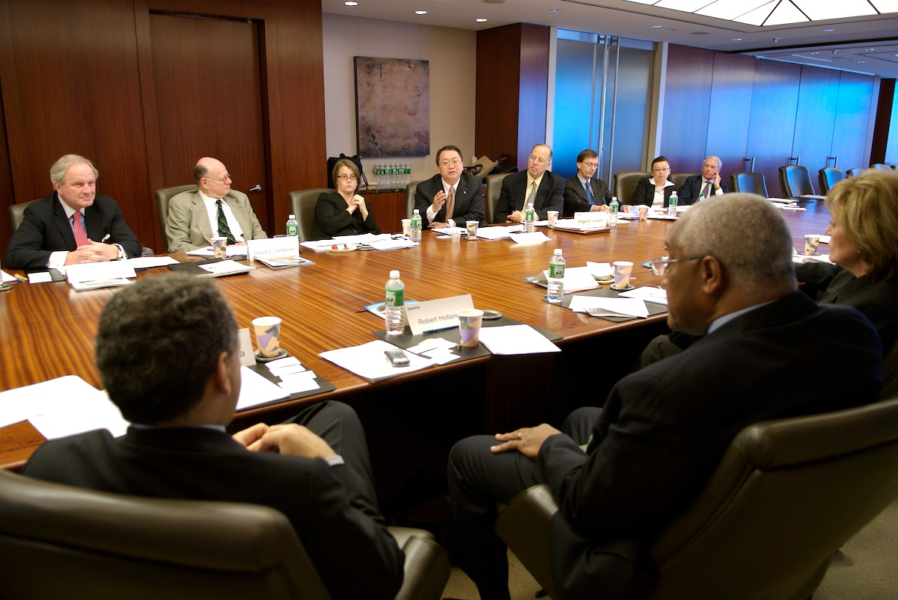
Are we ready to give a status on “Serving God by Serving Others”?

Slide 3

1Jo 3:23 And this is His commandment: that we should believe on the name of His Son Jesus Christ and love one another, as He gave us commandment.
Serving God by Serving One Another

Slide 4
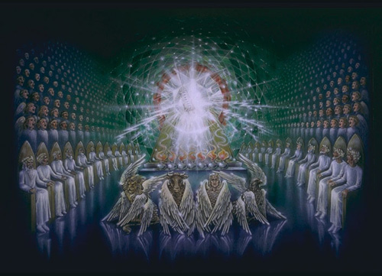

Slide 5
Who Is My Brother?
Biological Brother (Family)
Spiritual Brother (Christians)
Fellow Human
Serving God by Serving One Another

Slide 6
1Jo 4:20 If someone says, "I love God," and hates his brother, he is a liar; …

Slide 7
1Jo 3:18 My little children, let us not love in word or in tongue, but in deed and in truth.
Christianity is *NOT* Merely an Educational Pursuit

Slide 8
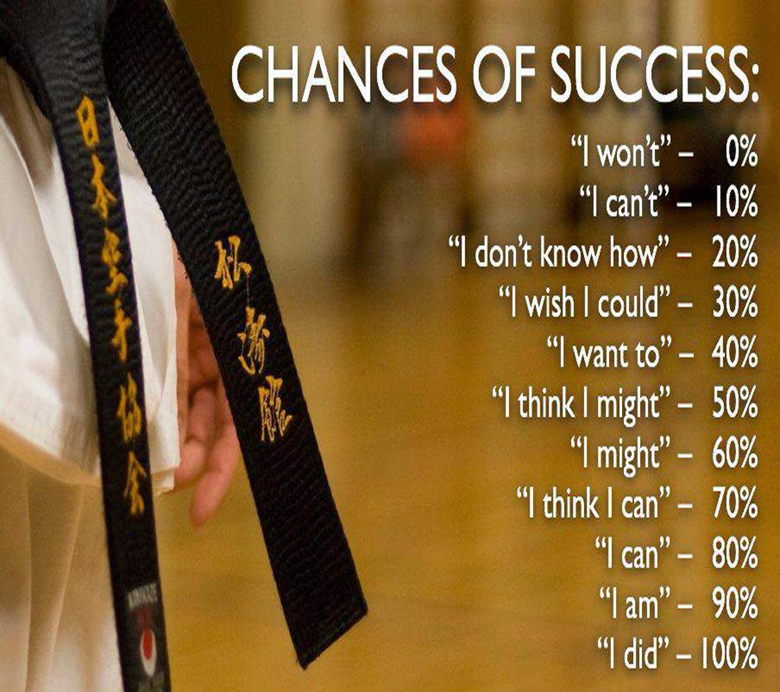
Failure
Excuses
Would have
Could have
Should have
Success

Slide 9
I Won’t (Refusal)
Pharaoh – Who is God that I should Obey Him?
Priest and Levite – Parable of the Good Samaritan (Luke 10:25-37)
1Jo 3:17 But whoever has this world's goods, and sees his brother in need, and shuts up his heart from him, how does the love of God abide in him?
What about me?

Slide 10
I Can’t (Excuses)
Moses
But suppose they will not believe me or listen …
What is in your hand? (Rod became a serpent)
O my Lord, I am not eloquent … I am slow of speech …
Who made your mouth?
What about me?

Slide 11

Failure
Excuses
Would have
Could have
Should have
Success

Slide 12
Knowing What to Do Isn’t Enough
As soon as any goal is set, immediately you start thinking of what you should do (education)
Saul
Doesn’t wait for Samuel to offer sacrifices
Brings back King Agag and spoils
Knowing what to do and not doing it may be worse
What about me?

Slide 13
Failure
Excuses
Would have
Could have
Should have
Success

Slide 14
I Can, I Will, I Did
David and Goliath (1 Sam. 17:32-37, 45-46)
Notice how our entire chart is illustrated by this story
Paul
I can do all thing through Christ who strengthens me (Phil. 4:10-13)
Examples all around
Early Christians sold their possessions, took the Gospel to the lost, dealt with conflict, etc…
Grandparents
Many more here today
College students
“I Can, I Will, I Did” is what is rewarded
2 Tim. 4:6-8: I have fought the good fight, I have finished the race
What about me?

Slide 15
How Am I Doing on the Goal?
“Serving God By Serving Others”
Failure
Success

