Slide 2
The reason God caused Israel go into captivity
Jer 15:4 And I will cause them to be removed into all kingdoms of the earth, because of Manasseh the son of Hezekiah king of Judah, for that which he did in Jerusalem.
Jer 19:3 'Hear the word of the LORD, O kings of Judah and inhabitants of Jerusalem. Thus says the LORD of hosts, the God of Israel: Behold, I will bring such a catastrophe on this place, that whoever hears of it, his ears will tingle.
4 "Because they have forsaken Me and made this an alien place, because they have burned incense in it to other gods whom neither they, their fathers, nor the kings of Judah have known, and have filled this place with the blood of the innocents

Slide 3
Review of Captivity, Return and Years of Silence
1st captives taken (Daniel & 3 friends) 606 B C
Judah falls to Babylon; captivity begins 586 B C
Medo-Persia defeats Babylon 539 B C
1st Return – Zerubbabel (temple) 536 B C
Nebuchadnezzar’s 2nd year Ruler in Babylon Dan 2: 1
Still during Daniel’s “training period” along with others 1:5
Nebuchadnezzar’s dream we looked at near the first of class

Slide 4
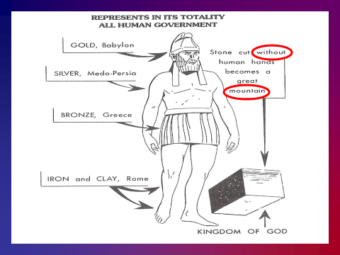

Slide 5
Lessons from Daniel
Nothing good will occur until we first “make up
our minds” to do God’s will no matter what
Actions always follow thoughts
Mr 7:18 So He said to them, "Are you thus without understanding also? Do you not perceive that whatever enters a man from outside cannot defile him,
19 "because it does not enter his heart but his stomach, and is eliminated, thus purifying all foods?"
20 And He said, "What comes out of a man, that defiles a man.
21 "For from within, out of the heart of men, proceed evil thoughts, adulteries, fornications, murders,
22 "thefts, covetousness, wickedness, deceit, lewdness, an evil eye, blasphemy, pride, foolishness.
23 "All these evil things come from within and defile a man."

Slide 6
Lessons from Daniel and Ezekiel
The Messianic kingdom Dan 2
Important in establishing the identity of the N.T.
church of Christ
Four primary objectives God had in mind for Ezekiel’s work:
To dispel any hope that the yoke of Babylon might soon be broken.
To present God’s case against Israel, to show how deeply they had sinned.
To help move His people to repentance.
To offer His people hope, to encourage them to turn to Him and to renew their efforts to serve Him.

Slide 7
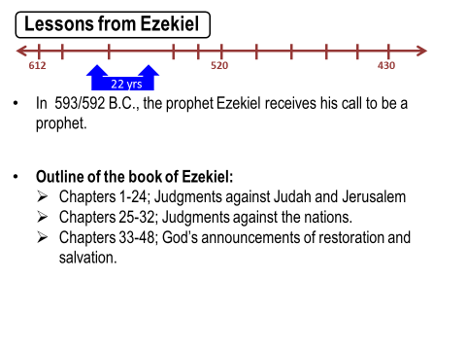

Slide 8
Ezekiel’s is made a watchman (Chap. 3:16-27):
(vs. 17) “Son of man, I have made you a watchman for the house of Israel; therefore hear a word from My mouth and give them warning from Me…”
Wicked:
If no warning given, the wicked would die in their iniquities but God would require their blood at his hand.
If warning was given, the wicked would still die in their iniquities if they did not turn, but the watchman would have delivered his soul.

Slide 9
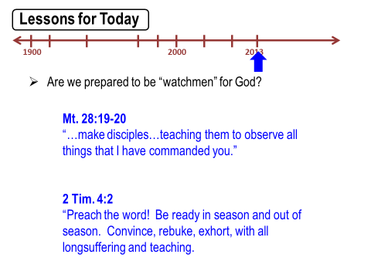

Slide 10
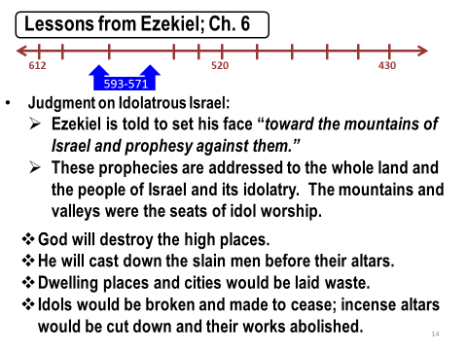

Slide 11
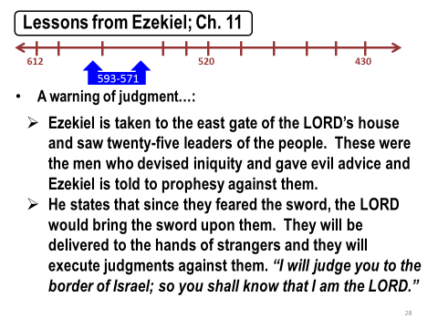

Slide 12
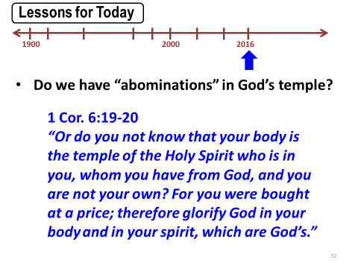

Slide 13
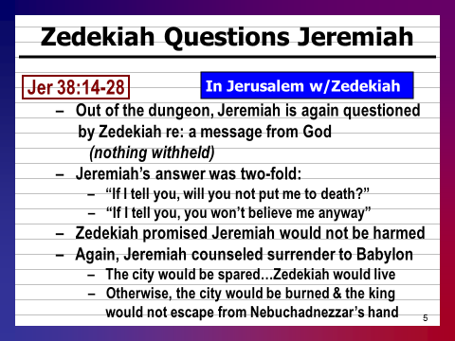

Slide 14
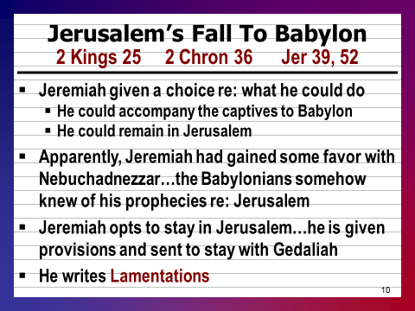

Slide 15
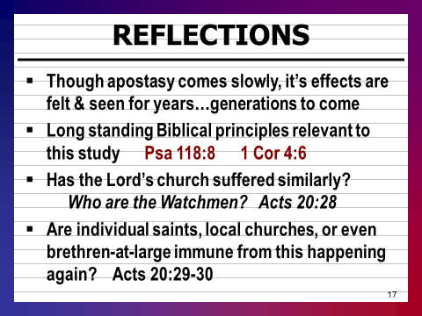
Ac 19:2 he said to them, "Did you receive the Holy Spirit when you believed?" So they said to him, "We have not so much as heard whether there is a Holy Spirit."
3 And he said to them, "Into what then were you baptized?" So they said, "Into John's baptism."

Slide 16
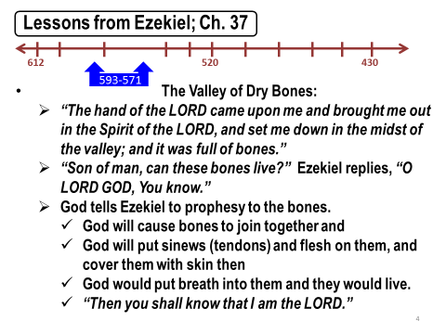

Slide 17
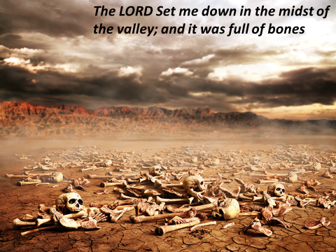

Slide 18
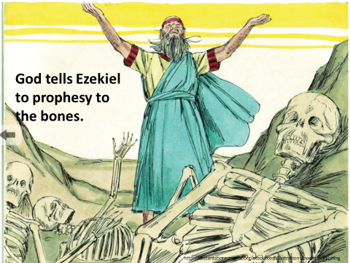

Slide 19
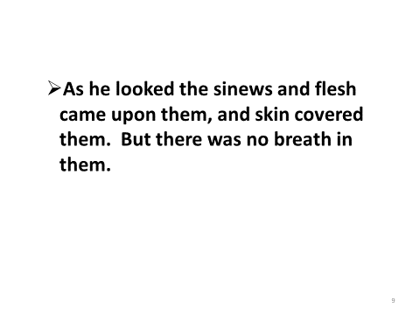

Slide 20
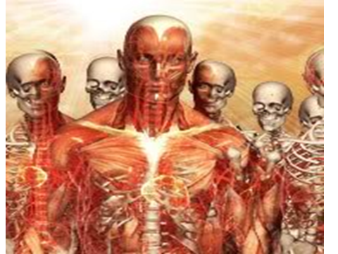

Slide 21
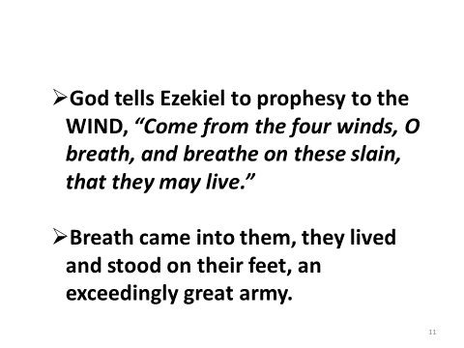

Slide 22
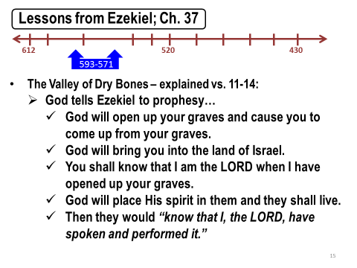

Slide 23
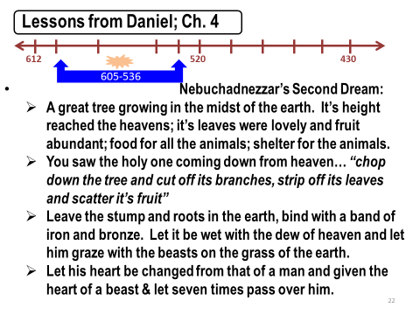

Slide 24
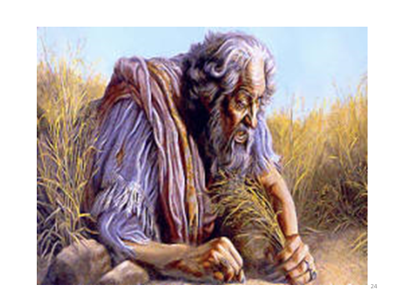

Slide 25
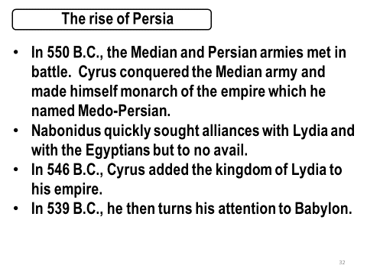

Slide 26
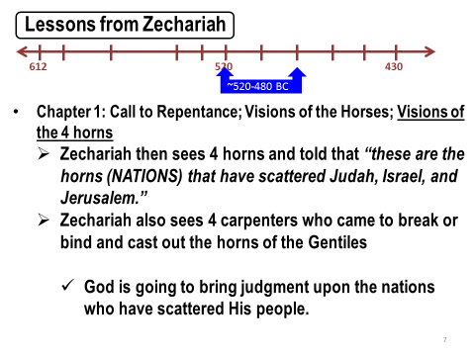

Slide 27
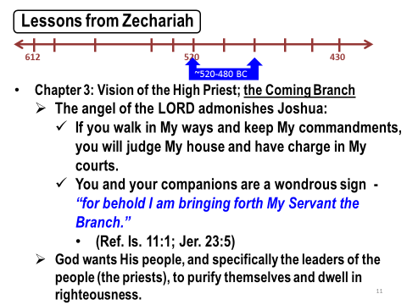

Slide 28
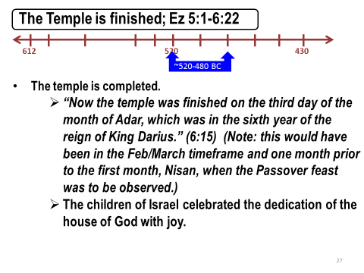

Slide 29
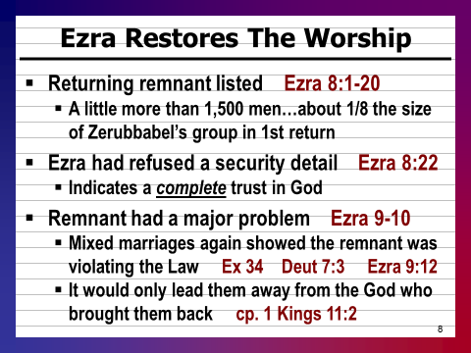

Slide 30
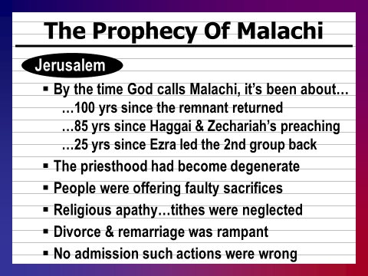

Slide 31
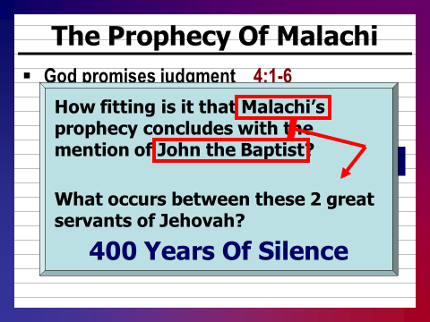

Slide 32
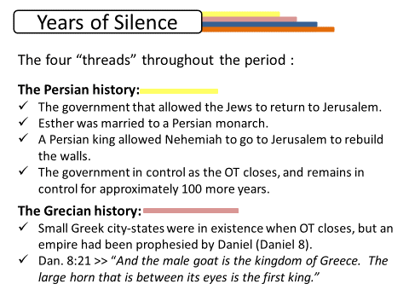
The next great empire of the world

Slide 33
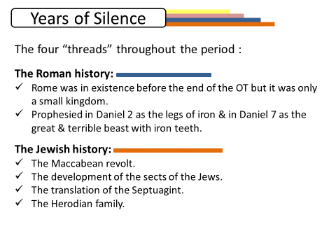

Slide 34
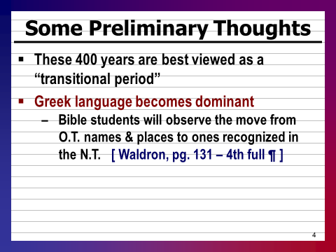

Slide 35
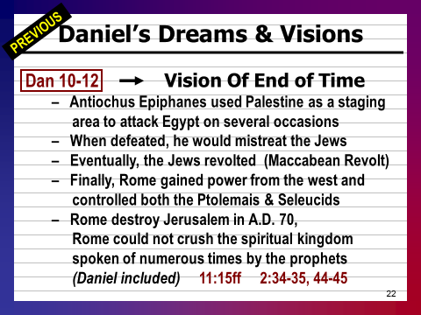

Slide 36
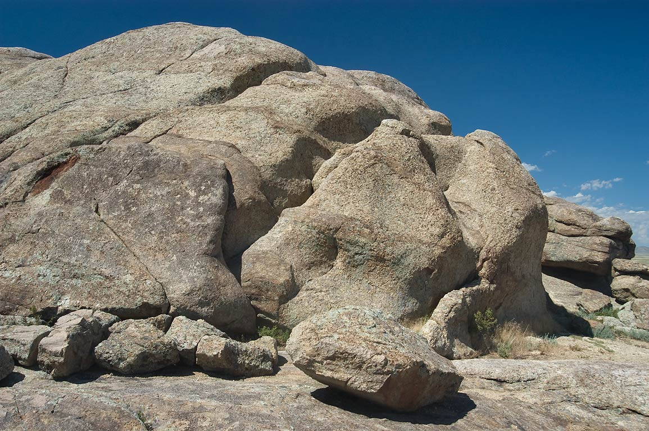
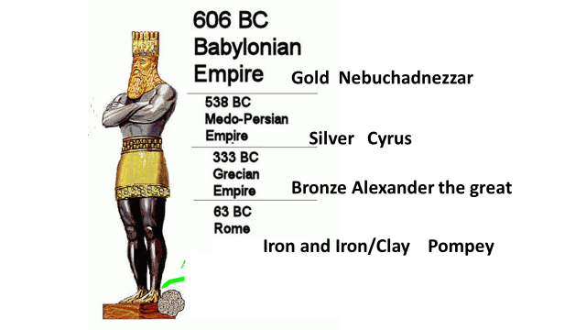
The Kingdom of God filled the whole earth and will never be destroyed like other
kingdoms

Slide 37
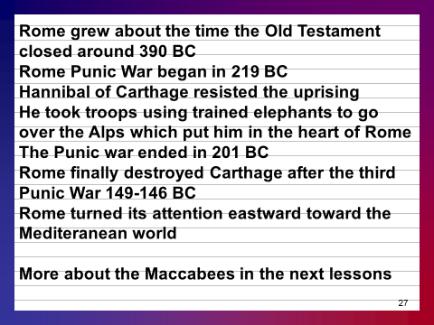

Slide 38
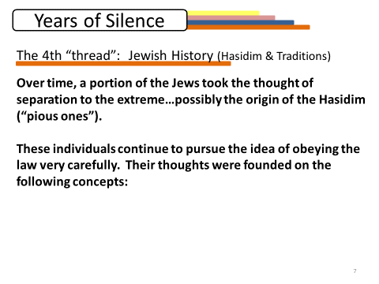

Slide 39
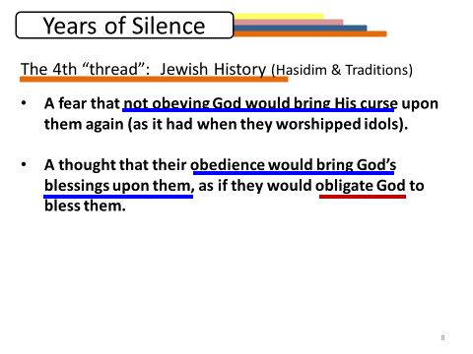

Slide 40
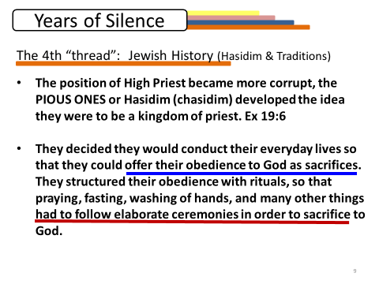

Slide 41
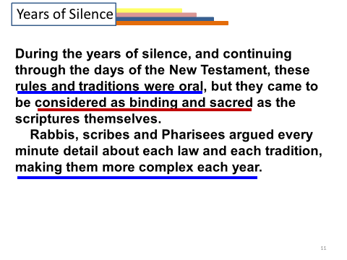

Slide 42
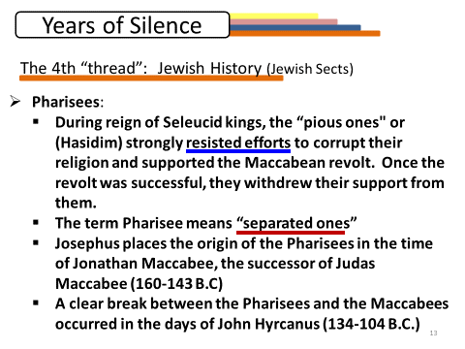
It is almost certain the Pharisees grew out of the Hasidim or “Pious ones” but the Hasidim began before the Pharisees came into the picture.

Slide 43
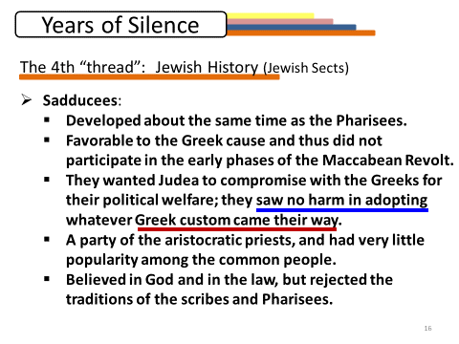

Slide 44
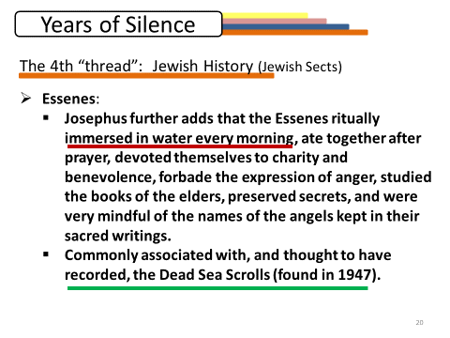

Slide 45
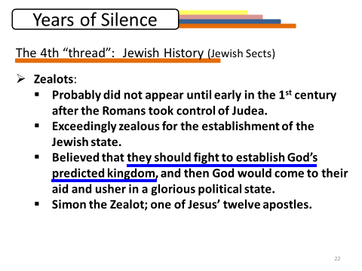

Slide 46
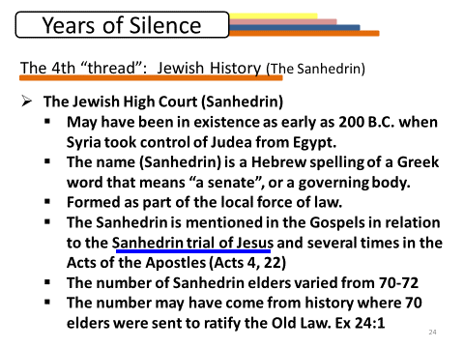

Slide 47
God was in Control then and is NOW
Obey His laws to the letter
Do not add to or take away from the word of God
Live a life acceptable to God throughout your life no matter what persecution might come

