Slide 1
…
Notes:
Slides created by W Holt; reviewed by J George (you will see comments in notes from Johnny plus other comments have been incorporated into slides).

Slide 2
Life of Christ, part 3
Last Week
Lesson 1
Matthew 21:1-22, 26:6-13
Mark 11:1-19, 14:1-11
Luke 19:28-48
John 11:55-12:19

Slide 3
Most of the pictures in this presentation are copyrighted material. Please observe the rights of the publisher.
Many of the pictures were purchased from BiblePlaces.com.
Visit their website for more information.

Slide 4
Intro
review
Years of preparation – 30 yrs
Beginning of ministry – 6 mos
Great Galilean ministry – 18 mos
Period of retirement – 6 mos
Close of ministry – 6 mos
Last week
Resurrection and exaltation

Slide 5
Rich young ruler
review
Jesus looked at him and loved him
Go sell all you have and give to the poor and you will have treasure in heaven
Come follow me
The young man turned away sorrowfully
He had great possessions

Slide 6
Teaching His disciples
review
Hard for a rich man to enter the kingdom of heaven
“Who then can be saved?”
“With God all things are possible”
The rich man would not give up his possession and follow Christ, but God has the power through the gospel to touch even the hearts of the rich

Slide 7
Nobleman
review
At the end of the day he pays each worker
  Starting from the most recent hired
  He gives each a penny (all the same)
Notes:
The vineyard represents the Lord’s field of work in the world. The evening is the close of the Christian dispen­sation, and the coming of Christ to judgment. The parable as it unfolds and develops suggests that in no case was the reward earned by the inherent merits and toil of the laborers, but was rather bestowed because of a desire on the part of the house­holder to that effect, just as eternal life is bestowed, not by merit, but by covenant grace (Rom. ii. 6, 7; iv. 3-5; v. 16-21). The main object of the parable is
to show that longer labor does not necessarily, as the apostles and others might think, establish a claim to higher reward. Degrees of difference there no doubt will be, but they form no account in the general covenant of grace in which the one great gift is offered to us all. As the gift can be no less than eternal life, there must of necessity be a difference in the ratio of service which is ren­dered for it, since it will be bestowed on the octogenarian and the child, upon Paul who made good the confession of his faith through years of toil, and the dying thief who passed to his reward while his voice of confession was, as it were, still ringing in the ears of those who heard it (I. Cor. xv. 8-11; II.Tim. iv. 6-9). The murmuring and envy of those who had labored longest is merely part of the parabolic drapery, intro­duced to bring out the answer of the householder, and to make plain the point to be illustrated. There will be no envy among those who inherit eternal life. (Italic by wmh)
McGarvey, J. W. (2010-01-10). The Fourfold Gospel or A Harmony of the Four Gospels (The Christian classic!) (Kindle Locations 8559-8569). fallen leaves press (TM) and ignacio hills press (TM) IgnacioHillsPress.com. Kindle Edition.
Mt 20:16 "So the last will be first, and the first last. For many are called, but few chosen."
Albert Barnes' NT Commentary:
Verse 16. So the last shall be first, etc. This is the moral or scope of the parable. To teach this, it was spoken. Many that, in the order of time, shall be brought last into the kingdom, shall be first in the rewards. Higher proportionate rewards shall be given to them than to others. To all justice shall be done. To all to whom the rewards of heaven were promised, they shall be given. Nothing shall be withheld that was promised. If among this number who are called into the kingdom I choose to raise some to stations of distinguished usefulness, and to confer on them peculiar talents and higher rewards, I injure no other one. They shall enter heaven as was promised. If amidst the multitude of Christians, I choose to signalize such men as Paul, and Martyn, and Brainerd, and Spencer, and Summerfield--to appoint some of them to short labour, but to wide usefulness, and raise them to signal rewards--I injure not the great multitude of others who live long lives less useful, and less rewarded. All shall reach heaven, and all shall receive what I promise to the faithful.

Slide 8
Nobleman
review
Those who worked all day complain
  Did you not receive what was promised?
God has promised eternal life to all who serve Him
  Whether many years or few
Notes:
The vineyard represents the Lord’s field of work in the world. The evening is the close of the Christian dispen­sation, and the coming of Christ to judgment. The parable as it unfolds and develops suggests that in no case was the reward earned by the inherent merits and toil of the laborers, but was rather bestowed because of a desire on the part of the house­holder to that effect, just as eternal life is bestowed, not by merit, but by covenant grace (Rom. ii. 6, 7; iv. 3-5; v. 16-21). The main object of the parable is
to show that longer labor does not necessarily, as the apostles and others might think, establish a claim to higher reward. Degrees of difference there no doubt will be, but they form no account in the general covenant of grace in which the one great gift is offered to us all. As the gift can be no less than eternal life, there must of necessity be a difference in the ratio of service which is ren­dered for it, since it will be bestowed on the octogenarian and the child, upon Paul who made good the confession of his faith through years of toil, and the dying thief who passed to his reward while his voice of confession was, as it were, still ringing in the ears of those who heard it (I. Cor. xv. 8-11; II.Tim. iv. 6-9). The murmuring and envy of those who had labored longest is merely part of the parabolic drapery, intro­duced to bring out the answer of the householder, and to make plain the point to be illustrated. There will be no envy among those who inherit eternal life. (Italic by wmh)
McGarvey, J. W. (2010-01-10). The Fourfold Gospel or A Harmony of the Four Gospels (The Christian classic!) (Kindle Locations 8559-8569). fallen leaves press (TM) and ignacio hills press (TM) IgnacioHillsPress.com. Kindle Edition.
Mt 20:16 "So the last will be first, and the first last. For many are called, but few chosen."
Albert Barnes' NT Commentary:
Verse 16. So the last shall be first, etc. This is the moral or scope of the parable. To teach this, it was spoken. Many that, in the order of time, shall be brought last into the kingdom, shall be first in the rewards. Higher proportionate rewards shall be given to them than to others. To all justice shall be done. To all to whom the rewards of heaven were promised, they shall be given. Nothing shall be withheld that was promised. If among this number who are called into the kingdom I choose to raise some to stations of distinguished usefulness, and to confer on them peculiar talents and higher rewards, I injure no other one. They shall enter heaven as was promised. If amidst the multitude of Christians, I choose to signalize such men as Paul, and Martyn, and Brainerd, and Spencer, and Summerfield--to appoint some of them to short labour, but to wide usefulness, and raise them to signal rewards--I injure not the great multitude of others who live long lives less useful, and less rewarded. All shall reach heaven, and all shall receive what I promise to the faithful.

Slide 9
Death and resurrection
review
Disciples are fearful going to Jerusalem
Jesus takes twelve aside

Slide 10
Death and resurrection
review
Matthew 20:18-19 "Behold, we are going up to Jerusalem, and the Son of Man will be betrayed to the chief priests and to the scribes; and they will condemn Him to death, "and deliver Him to the Gentiles to mock and to scourge and to crucify. And the third day He will rise again."

Slide 11
Selfish request
review
James and John want positions of prominence
Other ten were angry with them
You want to be first—serve others
Jesus did not come to this earth to be served, but to give His life as a ransom for many

Slide 12
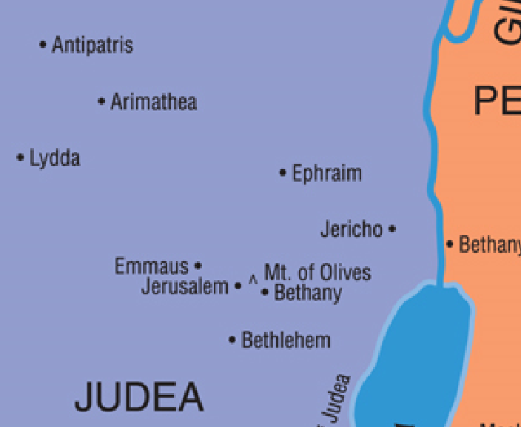
Approaching Jericho
review

Slide 13
Zacchaeus
review
Crowd said He was going to eat with a sinner
Zacchaeus offered half his goods to the poor and would make restitution fourfold to any he had wronged
Jesus said he had gained salvation
Jesus came to seek and save the lost
Contrast with choice by rich young ruler to keep his riches.

Slide 14
Parable of pounds
review
At master’s return
  Two servants had gained more
  Both were praised and rewarded
Another servant was punished
  Was afraid
  Hid the master’s money
  Was rebuked for not putting it to use
Doing less than expected brings punishment

Slide 15
Life of Christ, part 3
Last Week
Lesson 1
Matthew 21:1-22, 26:6-13
Mark 11:1-19, 14:1-11
Luke 19:28-48
John 11:55-12:19

Slide 16
Last week
Jesus is about to do what He came to the earth to do
Matthew 1:21 "And she will bring forth a Son, and you shall call His name JESUS, for He will save His people from their sins.“
Has said—
  Hour has not yet come…
  No one takes my life…

Slide 17
Last week
Friday—makes the climb from Jericho to Bethany
Saturday (Sabbath)—rest, anointing by Mary at Simon’s house
Sunday—Triumphant Entry or Coronation
Monday—cleansing Temple
Tuesday—conflict and teaching in the Temple

Slide 18
Last week
Wednesday—no record
Thursday—last day with disciples, Passover
Friday—trials, sufferings, crucifixion, death
Saturday—in the tomb
Sunday—resurrection

Slide 19
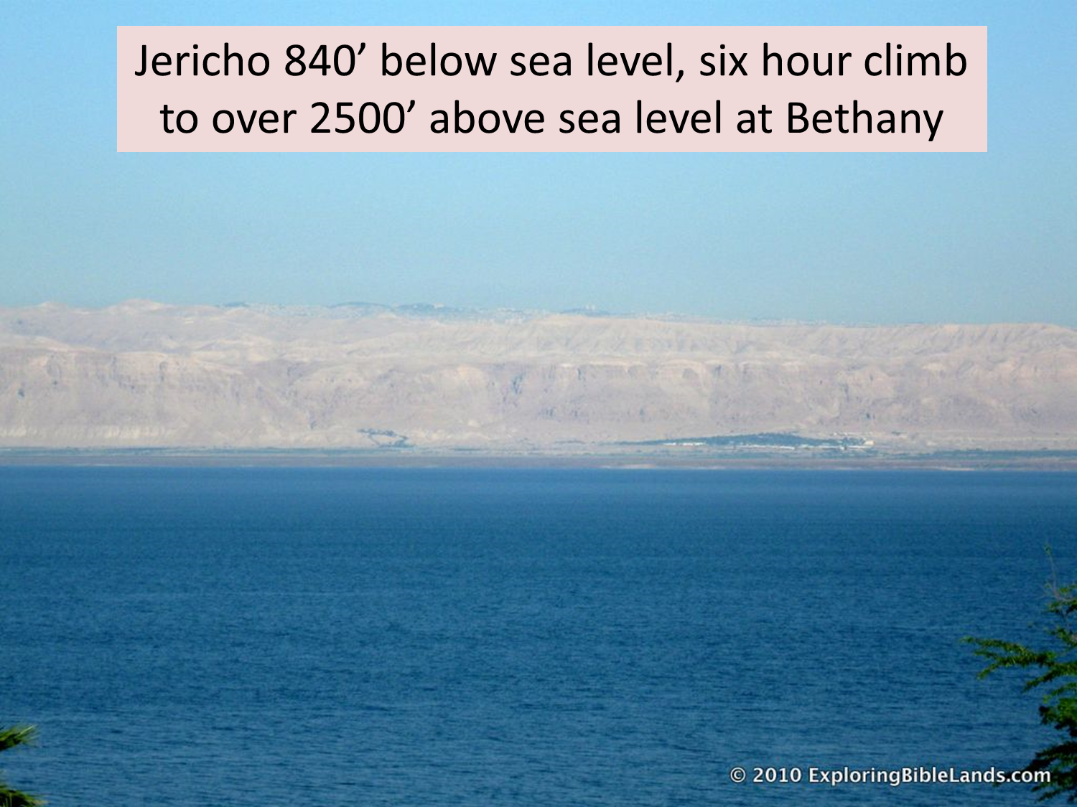
copyrighted
…

Slide 20
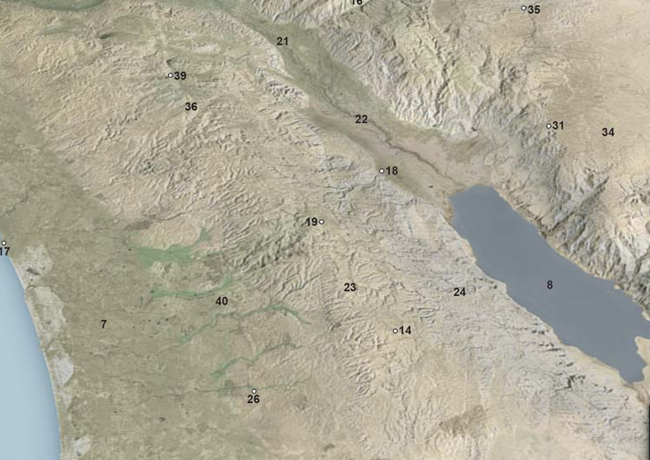
…
Jericho 840’ below sea level, six hour climb to over 2500’ above sea level at Bethany
Notes:
Climbing from #18 to #19; this slide just to show terrain

Slide 21
Jesus in Bethany
Matthew 26:6-13; Mark 14:1-9; John 12:1-11
Home of Mary, Martha, and Lazarus
Probably arrived on Friday before sunset
  Jews would not have made the trip on the Sabbath
Dinner at house of Simon, the leper
  No longer had leprosy
  Possibly healed by Jesus (??)

Slide 22
Jesus in Bethany
Martha helped serve
Mary and Lazarus were present
Mary anoints Jesus’ head and feet with very costly precious ointment
  Worth 300 day’s wages
  ‘expensive oil’
  ‘worth a fortune’
Judas objects
The alabaster is a species of marble, distinguished for being light, and of a beautiful white color, almost transparent. It was much used by the ancients for the purpose of preserving various kinds of ointment in. (Barnes)
Notes:
Mr 14:3 And being in Bethany at the house of Simon the leper, as He sat at the table, a woman came having an alabaster flask of very costly oil of spikenard. Then she broke the flask and poured it on His head.
4 But there were some who were indignant among themselves, and said, "Why was this fragrant oil wasted?
5 "For it might have been sold for more than three hundred denarii and given to the poor." And they criticized her sharply.

Slide 23
Jesus in Bethany
Jesus said Mary had done a good deed and was preparing for His burial
Mark 14:8 "She has done what she could. She has come beforehand to anoint My body for burial.
  Used what she had
  Great cost to her
  Embarrassment?
  Let her alone. Why do you trouble her?
Couple this with the parable of the pounds…

Slide 24
Jesus in Bethany
This story would be told as a memorial to her
Crowd was there
  To see Jesus
  To see the raised Lazarus
Chief priest wanted to put Lazarus to death
  Judas goes to them to betray Him (Mark 14:10-11)
Notes:
Joh 12:9 Now a great many of the Jews knew that He was there; and they came, not for Jesus' sake only, but that they might also see Lazarus, whom He had raised from the dead.
10 But the chief priests plotted to put Lazarus to death also,
11 because on account of him many of the Jews went away and believed in Jesus.
Mr 14:10 Then Judas Iscariot, one of the twelve, went to the chief priests to betray Him to them.
11 And when they heard it, they were glad, and promised to give him money. So he sought how he might conveniently betray Him.

Slide 25
Path From Bethany/Bethphage to Jerusalem
The distance from Bethany to Jerusalem would be ~1.8 miles
Biblical texts, archaeology and historical documents all place the paths from the ancient Jerusalem - Jericho road to Bethany, and Bethany to Jerusalem as alternate paths from the main route.

Slide 26
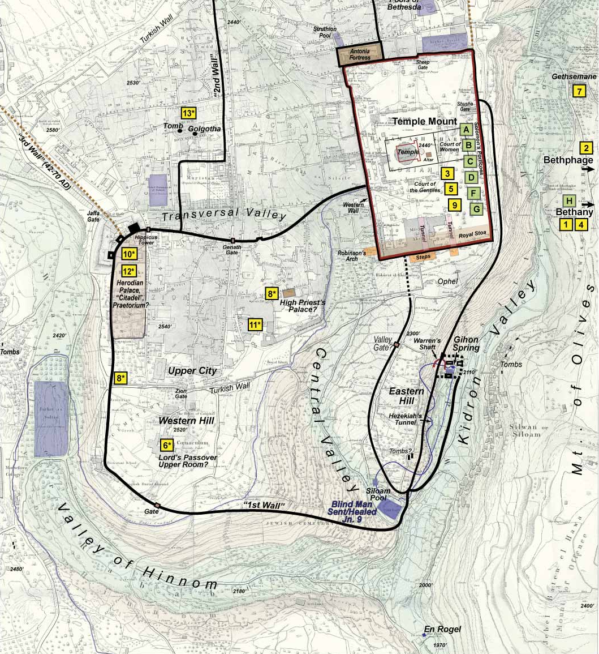
View of the Mount of Olives from the Gihon Spring area, on the Jerusalem side of the Kidron Valley.
Notes:
[note—the arrow in this slide is as you were standing at the base and looking in the direction of the arrow. The pic on the next slide is what you would see.]

Slide 27
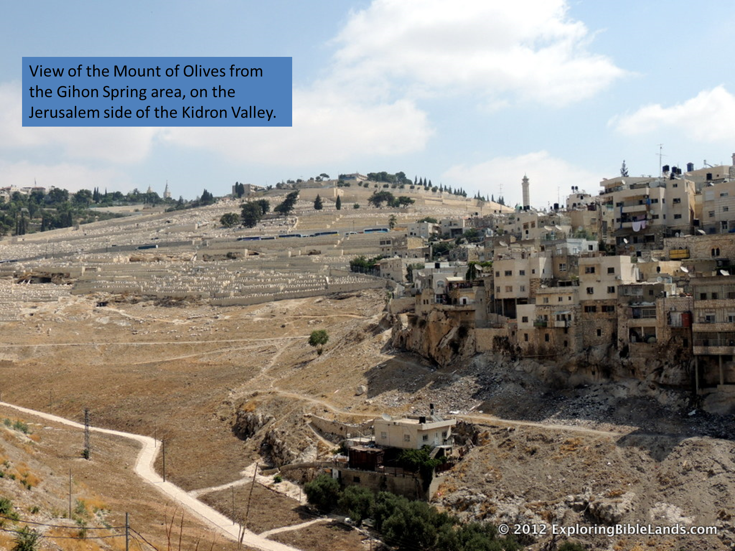
copyrighted
…

Slide 28
View of the Temple Mount area from the path Jesus would have most likely approached.

Slide 29

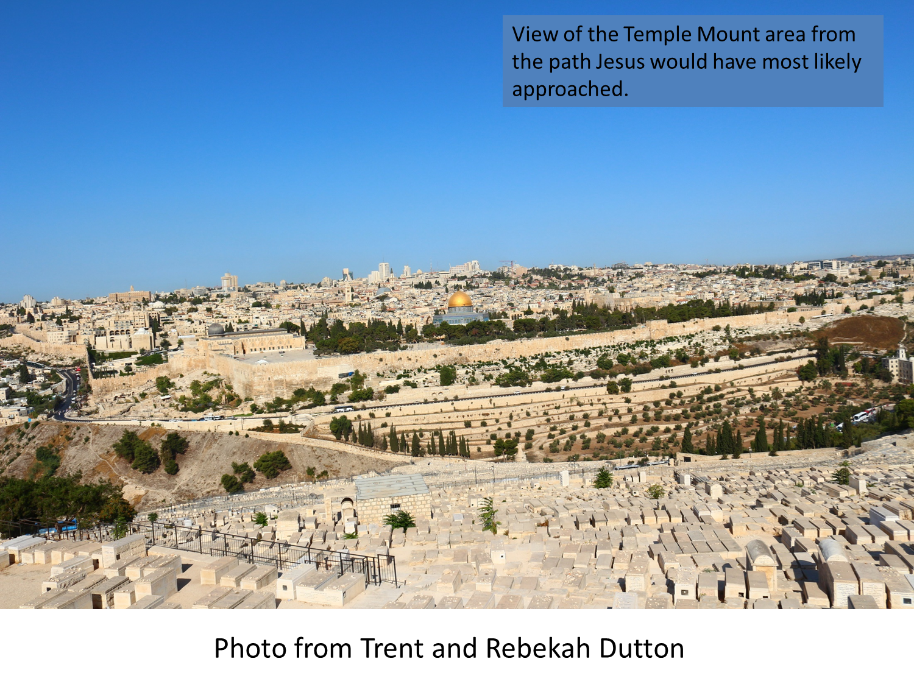
View of the Temple Mount area from the path Jesus would have most likely approached.
…

Slide 30
Coronation
Matthew 21:1-11; Mark 11:1-11;
Luke 19:28-44; John 12:12-19
Sunday
Jesus sends two disciples to a nearby village (Bethphage) to get a donkey’s colt
If anyone ask why they are taking it, they should say ‘the Lord has need of it’
The disciples put garments on the donkey for Jesus to ride
BETH – fage
BEHTH – fuh - dzhee
Notes:
Steve’s preference of Coronation rather than the usual “Triumphal Entry”
Definition of coronation
: the act or occasion of crowning also : accession to the highest office
History and Etymology for coronation
Middle English coronacioun, borrowed from Anglo-French coronacion, borrowed from Medieval Latin corōnātiōn-, corōnātiō (Late Latin, "wreathing"), from Latin corōnare "to deck with flowers, wreathe, CROWN entry 2" + -tiōn-, -tiō, suffix of verbal action
Bethphage – BETH-fage or BEHTH-fuh-dzhee

Slide 31
Coronation
Zechariah 9:9 "Rejoice greatly, O daughter of Zion! Shout, O daughter of Jerusalem! Behold, your King is coming to you; He is just and having salvation, Lowly and riding on a donkey, A colt, the foal of a donkey.
Later the disciples realized this as fulfillment of this prophecy

Slide 32
Coronation
Many follow Jesus into Jerusalem
  Many going for feast of Passover
They spread their garments and palm branches in His path
Mark 11:9 Then those who went before and those who followed cried out, saying: "Hosanna! 'Blessed is He who comes in the name of the LORD!'

Slide 33
Coronation
Hosanna
‘please save’
Joyful exclamation of praise
An appeal for deliverance
It came to serve as an expression of joy and praise for deliverance granted or anticipated

Slide 34
Coronation
Pharisees upset that their efforts to stop Jesus had failed
  Caiaphas, a Sadducee more determined

Slide 35
Coronation
As Jesus approaches Jerusalem He weeps for the city
  Looking down on the city
He is aware of the destruction that is coming
  At the hands of Rome in A.D. 70

Slide 36
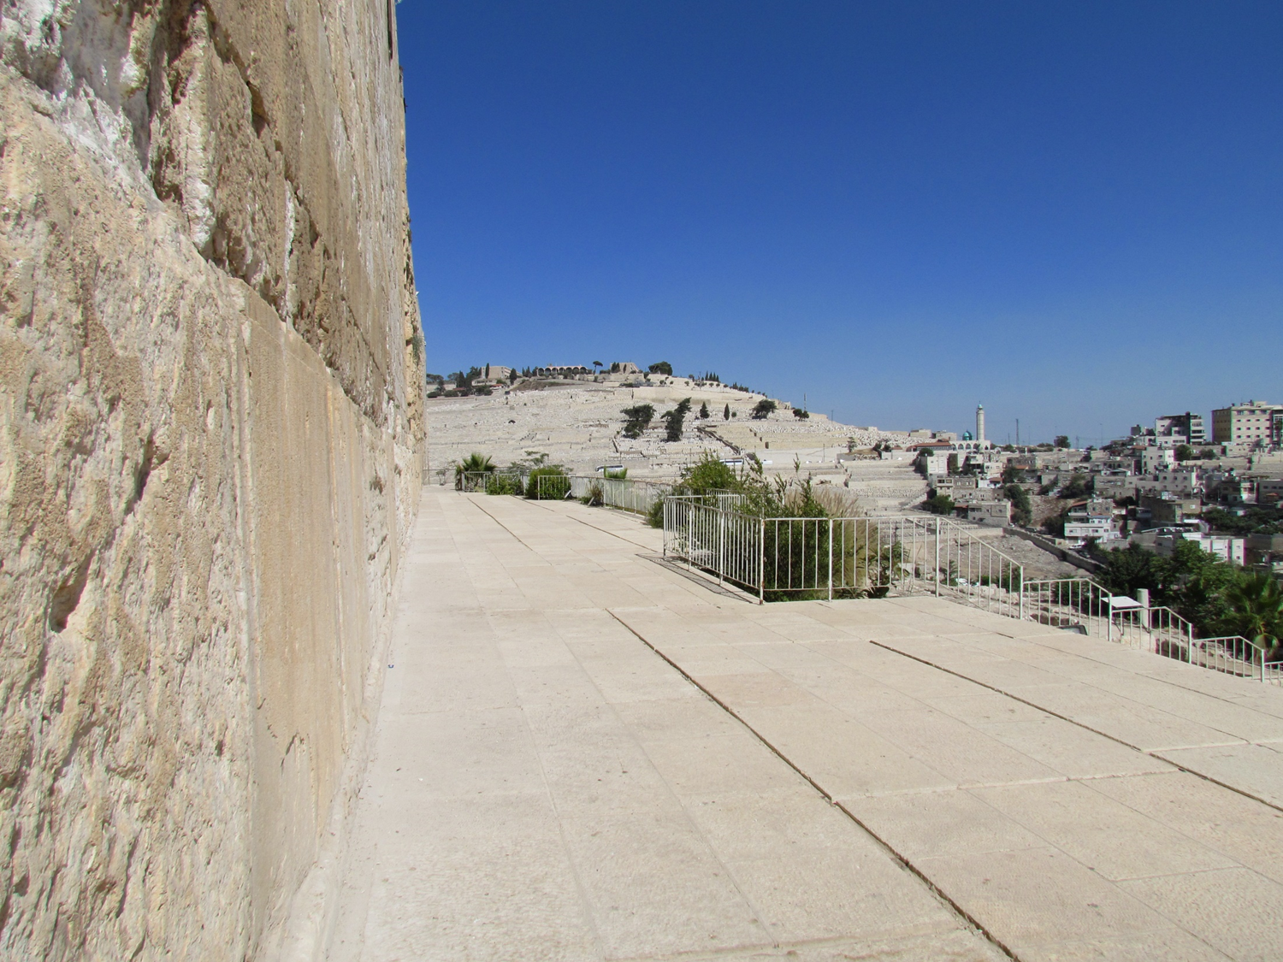
Mount of Olives from base of Temple wall
…
Photo from Trent and Rebekah Dutton

Slide 37
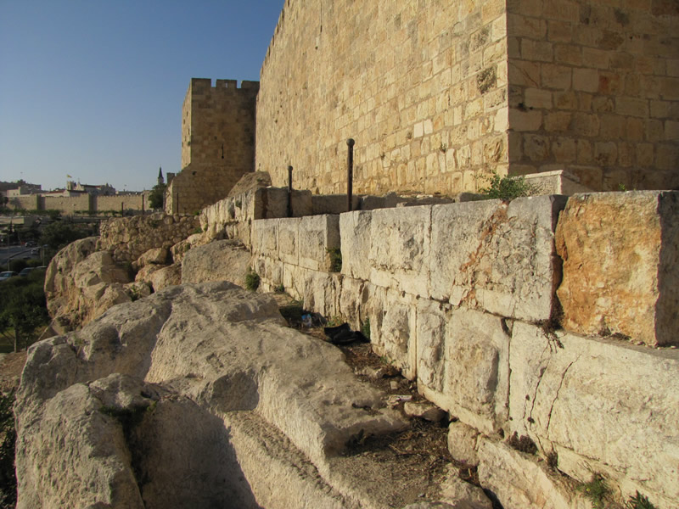
Notes:
Stones from the destruction by the Romans

Slide 38
Coronation
Luke 19:43-44 "For days will come upon you when your enemies will build an embankment around you, surround you and close you in on every side, and level you, and your children within you, to the ground; and they will not leave in you one stone upon another, because you did not know the time of your visitation."
Notes:
In the year 66 AD the Jews of Judea rebelled against their Roman masters. In response, the Emperor Nero dispatched an army under the generalship of Vespasian to restore order. By the year 68, resistance in the northern part of the province had been eradicated and the Romans turned their full attention to the subjugation of Jerusalem. That same year, the Emperor Nero died by his own hand, creating a power vacuum in Rome. In the resultant chaos, Vespasian was declared Emperor and returned to the Imperial City. It fell to his son, Titus, to lead the remaining army in the assault on Jerusalem. The Roman legions surrounded the city and began to slowly squeeze the life out of the Jewish stronghold. By the year 70, the attackers had breached Jerusalem's outer walls and began a systematic ransacking of the city. The assault culminated in the burning and destruction of the Temple that served as the center of Judaism.
In victory, the Romans slaughtered thousands. Of those sparred from death: thousands more were enslaved and sent to toil in the mines of Egypt, others were dispersed to arenas throughout the Empire to be butchered for the amusement of the public. The Temple's sacred relics were taken to Rome where they were displayed in celebration of the victory.

Slide 39
Coronation—into Jerusalem
He is recognized as Jesus, the prophet from Nazareth
The children were praising Him
The chief priest asked Him, ‘Do you not hear what the children are saying?’
Notice how many prophecies are being fulfilled

Slide 40
Coronation
Psalms 8:2 Out of the mouth of babes and nursing infants You have ordained strength, Because of Your enemies, That You may silence the enemy and the avenger.
That evening Jesus returned to Bethany
  Down through the Kidron valley and up over the Mount of Olives

Slide 41
The barren fig tree
Matthew 21:18-22; Mark 11:12-14
Monday
Going back from Bethany to Jerusalem
Jesus sees a fig tree full of leaves
He goes to it looking for fruit
  He was hungry
  It was not normal fig season
Jesus places a curse on the tree
  May no one eat fruit from you again

Slide 42
Cleansing of the temple
Matthew 21:12-17; Mark 11:15-19; Luke 19:45-48
This is the second time
  John 2:13-22
Jesus arrives in Jerusalem and goes to the temple area
He finds merchants selling animals for sacrifice
And money-changers
  Shekels were required for the temple tax

Slide 43
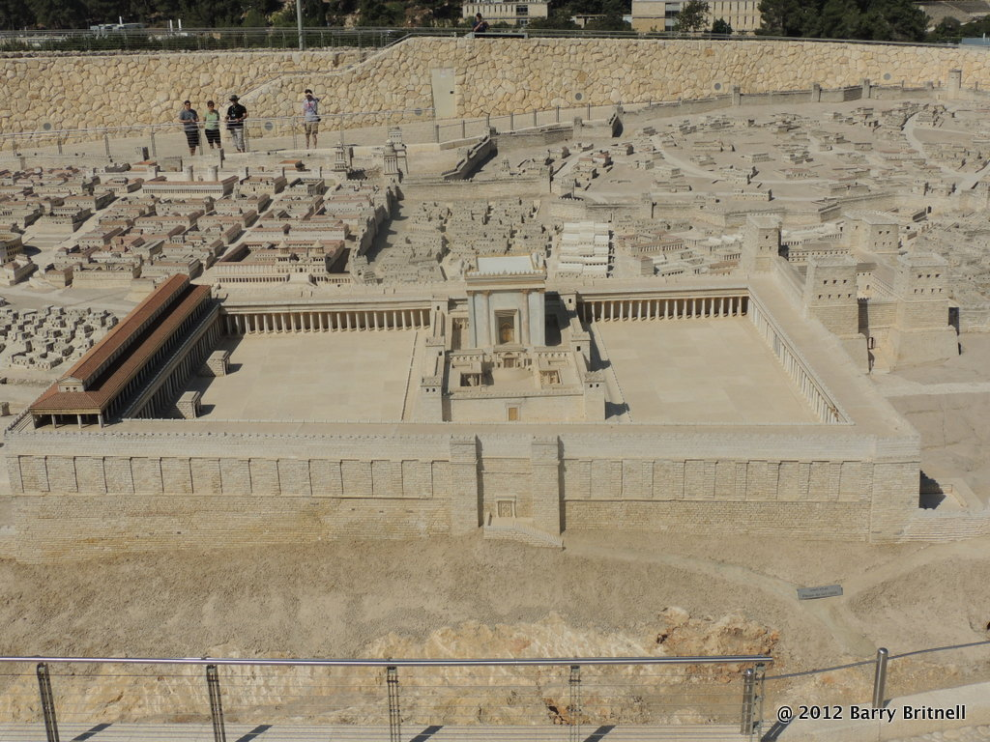
copyrighted

Slide 44
Cleansing of the temple
Jesus drove the people out
He overturned the tables of the money-changers
The temple was to be a house of prayer
He charged them with stealing
  You have made it a den of thieves
The Jewish leaders are afraid to
seize Him in public because of
the people
Think about where/when they finally did take Him…

Slide 45
Two great lessons
lessons
‘She has done what she could’
Range of emotions
  Weeping over the city
  Overturning tables
  Driving out animals
Notes:
Coffman on Matthew—
Jesus intervened in Mary's behalf and uttered a strong approval of this "good work" upon his person. Of special note is the definition of a "good work." Some apparently believe that "good work“ in the church is a matter of leading public prayers or passing the collection plate; but the fact that sacrificial giving is also a good work should not be overlooked. Those who truly want to perform a "good work" for Christ will not find the application hard to make.

Slide 46
Purpose of Jesus coming to earth
thoughts
Luke 19:10 For the Son of man is come to seek and to save that which was lost.
Matthew 20:28 Even as the Son of man came not to be ministered unto, but to minister, and to give his life a ransom for many.

Slide 47
Prophecies fulfilled
thoughts
Story of Mary being told
Riding on a colt
Destruction of Jerusalem
Children praising Him

Slide 48
Purpose of the temple
thoughts
Place where God met the people
Place of worship
House of prayer
Jesus said its use was being abused
Church building is not holy
It does have a specific purpose
Notes:
When we are at the “house of prayer” we are there for one purpose—prayer/worship God. Not entertainment or anything else.
Jesus zeal for God and how He used His knowledge of God’s will—Romans 10:1-2
Ro 10:1 Brethren, my heart's desire and prayer to God for Israel is that they may be saved.
2 For I bear them witness that they have a zeal for God, but not according to knowledge.

Slide 49
…

Slide 50
…

Slide 51
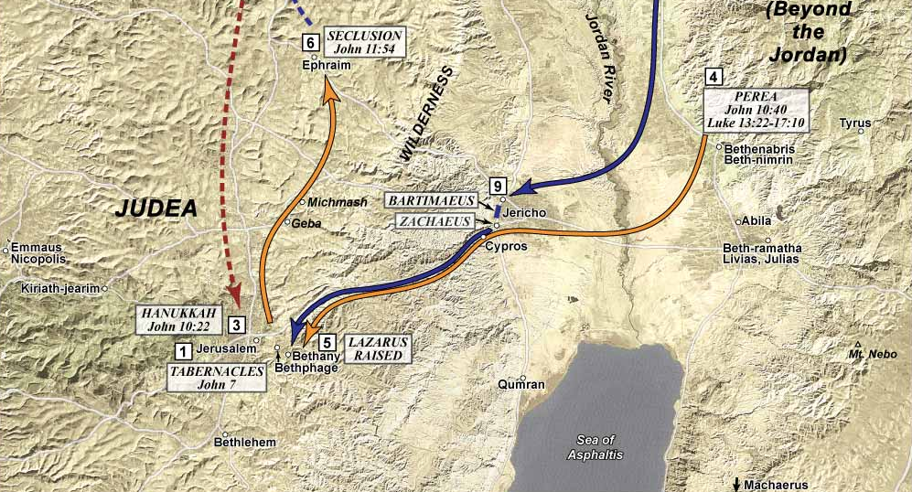
Jericho 840’ below sea level, six hour climb to over 2500’ above sea level at Bethany

Slide 52
