Slide 1
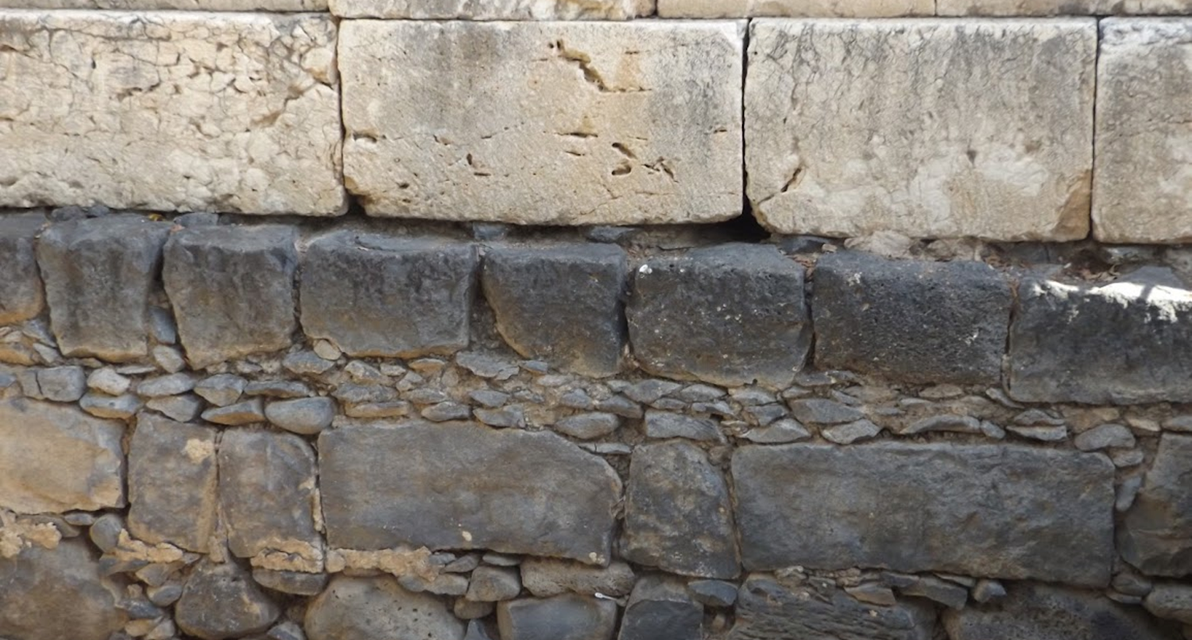

Studies in the Epistles
Foundations  Quarter 14
Lesson Thirteen: 1 Corinthians 1-4

Slide 2
Background of 1 Corinthians
In Paul’s day, Corinth was a city of about 400,000 inhabitants.
  The population of Corinth included people of many nationalities and cultures. Jews were present in sufficient numbers to have a synagogue (Acts 18:4).
Paul writes to the Corinthians from Ephesus during his lengthy stay there (1 Corinthians 16:8).
  Paul worked in Corinth for 18 months during his second journey (Acts 18:11).
  Paul stayed in Ephesus for 2 years and 3 months on his third journey (Acts 19:8; Acts 19:10).
  1 Corinthians was probably written around the year 55 A.D.

Slide 3
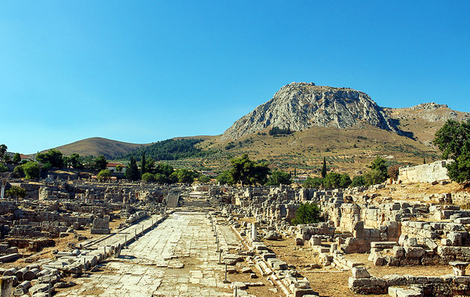
The Lechaion Road in Corinth with a clear view of the Acrocorinth in the distance.

Slide 4
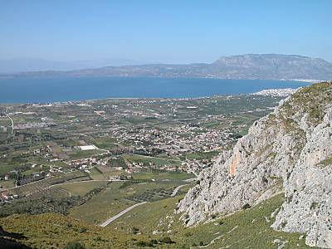
Corinth
The Corinth area as viewed from atop the Acrocorinth. The remains of the ancient city are located in the center of the photo (in the midst of a modern village). Note the proximity to the sea. Corinth had access to ports on both the Aegean and the Adriatic Seas.
Notes:
The “Gulf of Corinth” opening to the Adriatic and the “Saronic Gulf” opening to the Aegean.
Cenchrea was one of these ports.

Slide 5
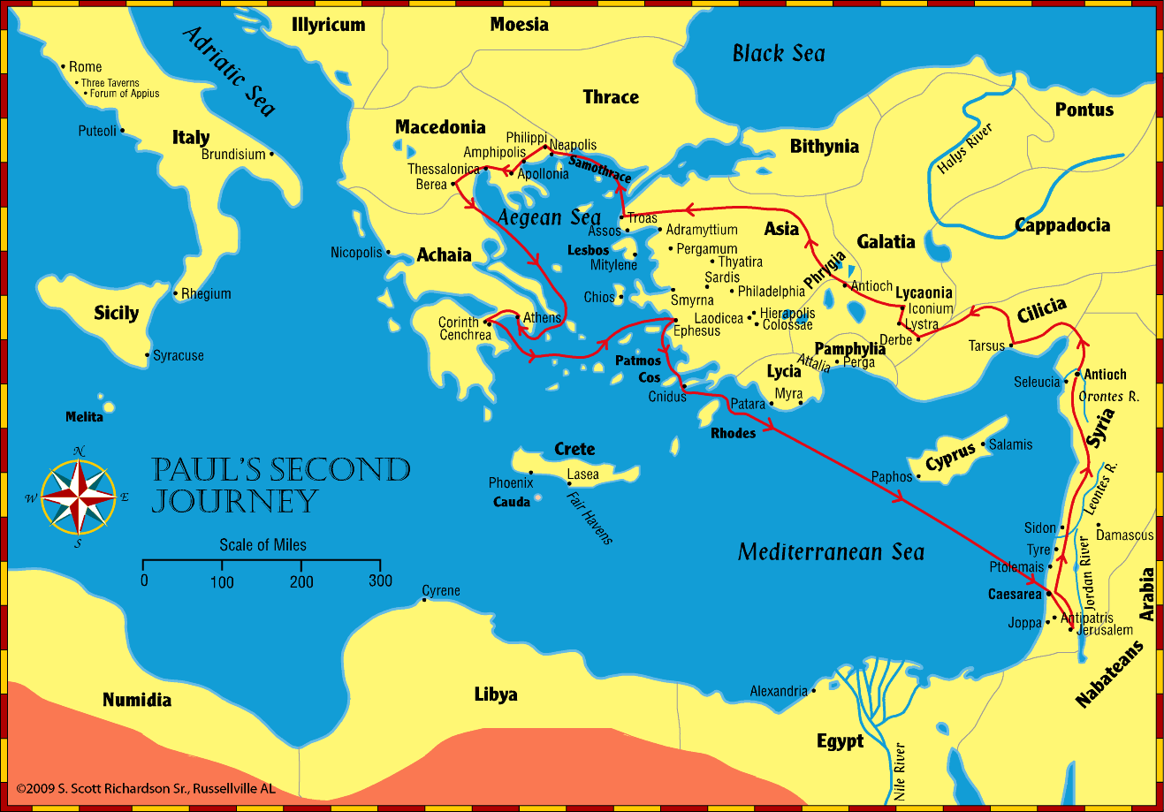
Corinth
Paul first visited Corinth on his Second Journey (ACTS 18)

Slide 6
The Beginning of the Church in Corinth (Acts 18:1-11)
On Paul’s second journey, he travels from Athens to Corinth where he meets Aquila and Priscilla and labors with them at tentmaking (18:1-3).
  Paul’s association with Aquila and Priscilla continues for many years (Acts 18:18; Romans 16:3; 1 Corinthians 16:19; 2 Tim. 4:19).
Paul reasons in the synagogue every Sabbath.
  When Timothy and Titus come from Macedonia, he presses the case for Jesus being the Christ (18:4-5)
  When the Jews oppose him and blaspheme, he turns to the Gentiles and enters the house of Justus (18:6-7)
Many Corinthians “believed and were baptized” (18:8).
Encouraged by the Lord, Paul continues to preach in Corinth for a year and a half (18:9-11; 1 Kings 19:18)
Notes:
Acts 18:18 – “Then he took leave of the brethren and sailed for Syria, and Priscilla and Aquila were with him.”
Romans 16:3 – “Greet Priscilla and Aquila, my fellow workers in Christ Jesus”
1 Corinthians 16:19 “Aquila and Priscilla greet you heartily in the Lord, with the church that is in their house.”
2 Timothy 4:19 – “Greet Prisca and Aquila

Slide 7
The Beginning of the Church in Corinth
The Jews bring Paul before Gallio (Acts 18:12-17)
The Jews rise up against Paul and bring him before the judgment seat of Gallio, the Roman Proconsul (18:12-13).
Gallio refuses to hear their complaint, judging it to be a matter of religious tradition rather than civil law (18:14-16).
Sosthenes (a ruler of the synagogue) is beaten before Gallio, but he takes no notice (18:17).
Notes:
The beating may have been carried out by Greeks (cf. KJV) to express their contempt for being troubled with a Jewish religious problem.
Sosthenes may or may not be the same individual mentioned in 1 Corinthians 1:1.

Slide 8
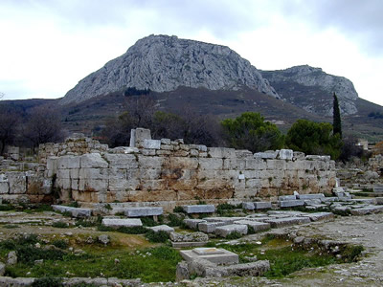
Gallio’s Judgment Seat
The bema or judgment seat was situated in the agora. It served as the platform on which Roman officials stood when making public appearances.
Gallio would have sat in judgment at this spot.

Slide 9
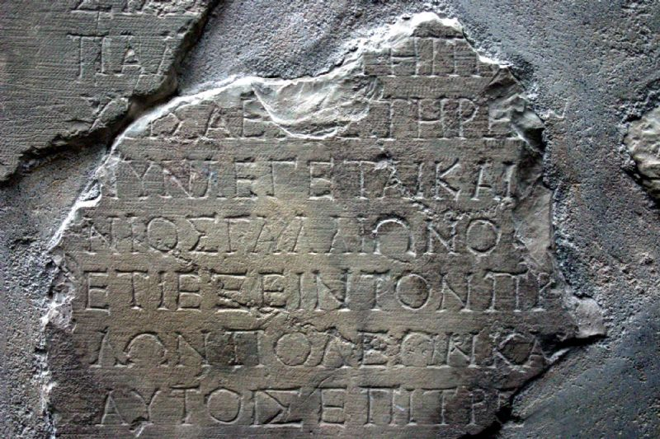
The Gallio Inscription (circa 52 A.D.)
Notes:
The Delphi Inscription, or Gallio Inscription (IG, VII, 1676; SIG, II, 801d),[1] is the name given to the collection of nine fragments of a letter written by the Roman emperor Claudius c. 52 CE which was discovered early in the 20th century at the Temple of Apollo in Delphi, Greece.[2][3]

Slide 10
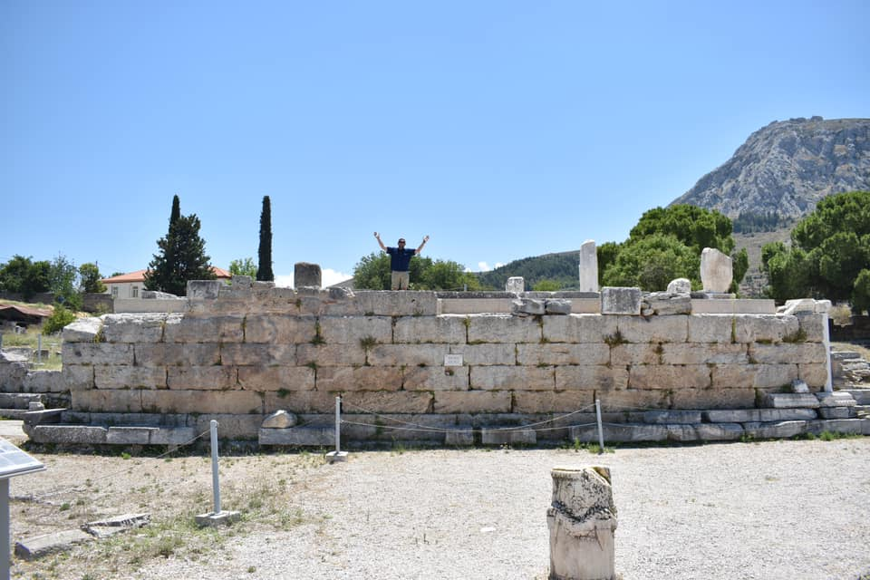
Cameron Abernathy as Gallio

Slide 11
Reasons for writing First Corinthians
To address problems in a local church—Corinth.
To restore the church in Corinth to its foundation—Jesus Christ.
To counter worldly wisdom with godly wisdom.
To correct contentions in the church brought to Paul’s attention by Chloe’s household (1--6; cf. 1:11) so as to bring about unity.
To address certain questions brought from Corinth for Paul (7:1, 25; 8:1; 12:1; 16:1; 16:12).

Slide 12
Outline of 1 Corinthians
Introduction: Salutation & Thanksgiving (1:1-9)
I. Dealing with reported problems (1:10 — 6:20)
  A. Unity based on God’s wisdom (1:10 — 4:21)
  B. Dealing with sin in the church (5-6)
II. Dealing with questions and concerns of the Corinthians (7:1--16:9)
  A. Their Concerns (7-9) [Marriage issues, eating meat sacrificed to idols]
  B. Common Concerns (10-11) [Idolatry, headship, the Lord’s supper]
  C. Spiritual Gifts (12-14)
  D. Closing Words (16)

Slide 13
Salutation and Thanksgiving
(1 Corinthians 1:1-9)
Paul is an apostle by the will “OF GOD” (1:1; 9:1-6; 2 Cor. 11:22-33; 12:1-12).
  It is unclear if Sosthenes is the same as in Acts 18:17.
Paul is writing to the church OF GOD at Corinth.
  To those who are “sanctified…called to be saints” (2 Thess. 2:13-14; 2 Timothy 1:9).
  Along with all who call on the name of the Lord Jesus (Acts 2:21; 22:16; Romans 10:12-13).
Paul sends greetings of “grace” & “peace” FROM GOD.
Paul is thankful for what GOD’s GRACE has accomplished among the Corinthians; they had been fully supplied and could wait eagerly for the coming of the Lord (1:4-9).
Notes:
The greeting “grace” and “peace” suggest an admixture of Greeks and Jews, or of individuals who appreciate both greetings.

Slide 14
Exhortation to Unity Based on God’s Wisdom
(1 Corinthians 1:10—4:21)
Paul pleads in the name of the Lord Jesus for the Corinthians to be joined in mind and judgment (1:10).
  He had learned from Chloe’s household of contentions among them based on their claim of connection to a given evangelist (1:11-12).
  Christ is not divided (1:13-16)!
Paul’s was sent to preach the pure gospel – to point men to the power of the cross without relying on “wisdom of words” (1:17).
Notes:
NOTE: Roots of the Division(s) in Corinth
The division in the church at Corinth could be seen in the claims some made to having a special connection with a given preacher (Paul, Cephas, Apollos, or Christ, 1:12). Their division is attributed to carnality (3:3) and thinking too highly of men (4:6).
Division in the church existed in several other incidences :
Brethren taking each other to law (6:1-8)
Brethren were divided over eating meats sacrificed to idols (8-10)
Lack of unity in eating the Lord’s supper (11:21)
Confusion over the exercise of spiritual gifts (12-14)

Slide 15
Exhortation to Unity Based on God’s Wisdom
(1 Corinthians 1:10—4:21)
The Focus must be God’s Wisdom and Glory, not Man’s (1:18-31).
The saved and the lost have different views of the message of the cross (1:18; 2 Cor. 2:15-17).
The Lord renders useless the wisdom of the proud who won’t hear Him (1:19; Isa. 29:13-14 [NOTE: Paul quotes the Septuagint here]).
God has made worldly wisdom foolish! (1:20-21a; Isaiah 44:25).
God saves by “the foolishness of the message preached” (1:21b-25).*
Our calling is not based on human greatness or status (1:26; Rom. 5:6).
God purposely chose things regarded as foolish, weak, base, despised and nonexistent to eliminate human pride and boasting (1:27-28; Gal 6:14).
In CHRIST we are “wisdom, righteousness, sanctification and redemption” so that the one who glories should “glory in the Lord” (1:31; 4:7; Eph 2:9).
Notes:
*Neither Jews nor Greeks were looking for this.
The message of “Christ crucified” is a stumbling block to Jews and foolishness to Greeks (Romans 9:31-33; 1 Peter 2:7-8; Matt. 13:54-57; Acts 17:32)
But to the called, it is the wisdom & power of God. God’s foolishness is wiser than men, and His weakness is stronger than men.
Romans 9:31-33 but Israel, pursuing the law of righteousness, has not attained to the law of righteousness. 32 Why? Because they did not seek it by faith, but as it were, by the works of the law. For they stumbled at that stumbling stone. 33 As it is written: "BEHOLD, I LAY IN ZION A STUMBLING STONE AND ROCK OF OFFENSE, AND WHOEVER BELIEVES ON HIM WILL NOT BE PUT TO SHAME.“
1 Peter 2:7-8 Therefore, to you who believe, He is precious; but to those who are disobedient, "THE STONE WHICH THE BUILDERS REJECTED HAS BECOME THE CHIEF CORNERSTONE," 8 and "A STONE OF STUMBLING AND A ROCK OF OFFENSE." They stumble, being disobedient to the word, to which they also were appointed.
Matthew 13:54-57 When He had come to His own country, He taught them in their synagogue, so that they were astonished and said, "Where did this Man get this wisdom and these mighty works? 55 Is this not the carpenter's son? Is not His mother called Mary? And His brothers James, Joses, Simon, and Judas? 56 And His sisters, are they not all with us? Where then did this Man get all these things?" 57 So they were offended at Him. But Jesus said to them, "A prophet is not without honor except in his own country and in his own house.“
Acts 17:32 And when they heard of the resurrection of the dead, some mocked, while others said, "We will hear you again on this matter."
Romans 5:6 For when we were still without strength, in due time Christ died for the ungodly.
Galatians 6:14 But God forbid that I should boast except in the cross of our Lord Jesus Christ, by whom the world has been crucified to me, and I to the world.
2 Corinthians 13:4 For though He was crucified in weakness, yet He lives by the power of God. For we also are weak in Him, but we shall live with Him by the power of God toward you.
Ephesians 2:8-9 For by grace you have been saved through faith, and that not of yourselves; it is the gift of God, 9 not of works, lest anyone should boast.
Matthew 13:55 Is this not the carpenter's son? Is not His mother called Mary? And His brothers James, Joses, Simon, and Judas?
Ephesians 2:8-9 For by grace you have been saved through faith, and that not of yourselves; it is the gift of God, 9 not of works, lest anyone should boast.

Slide 16
Exhortation to Unity Based on God’s Wisdom
(1 Corinthians 1:10—4:21)
Paul’s Example: He had preached Christ crucified without persuasive words of human wisdom (2:1-5).
The wisdom Paul spoke came directly from the mind of God (2:6-16).
  Paul spoke wisdom that had previously been unavailable to humanity for it was hidden in the mind of God (2:6-9).
  God revealed this wisdom to the apostles in words through the Holy Spirit (2:10-16).

Slide 17
Exhortation to Unity Based on God’s Wisdom
(1 Corinthians 1:10—4:21)
The Corinthians’ carnality limited Paul’s speech to the basics (3:1-2).
Their carnality is seen in their strife over preacher preferences (3:3-4).
  Preachers are mere men who plant the seed and nourish its growth; God gives the increase (3:5-7).
  Preachers will be rewarded according to their work in “God’s field” and “God’s building” (3:8-9).
  Successive builders must take care as to how they build on the foundation of Christ (3:10-15)
  If anyone defiles God’s temple, God will destroy him (3:16-17).
    Any potential builder must not deceive himself into thinking that he can build with his own wisdom and not be caught! (3:18-20).
Human pride has no place! God has provided all things (3:22)!
Notes:
Those deceived by human wisdom imagine they can do what they please with the church (3:18)
The Lord will catch such futile thinkers in their own craftiness! (3:19-20; Job 5:13; Psalm 94:11)
Do not rely on human wisdom, but avail yourself of all that God has supplied! (3:21-23)

Slide 18
Exhortation to Unity Based on God’s Wisdom
(1 Corinthians 1:10—4:21)
Evaluating preachers.
  They must be faithful as servants and stewards (4:1-2; 2 Tim. 1:13-14; 2:2).
  God is the ultimate Judge of the evangelist and of “each one” (4:2-5).
Through Paul’s illustration, the Corinthians were to learn that pride in men MUST NOT be elevated above “what is written” (4:6-8; 1 Peter 4:11).
The humiliation of the apostles demonstrates that God’s true servants are the least glorified by men, yet God works through them (4:9-13).
Paul’s language was designed to warn (4:14).
The Corinthians should follow Paul’s fatherly plea and example (4:15-16).
  Timothy was to remind them of Paul’s ways and teaching, which were the same in every church (4:17; cf. Philippians 2:19-24).
Paul would return to Corinth and sort out the prideful talkers who had no real power (4:18-21).
Notes:
A clear conscience does not necessarily mean that one is right with God (Acts 23:1; 26:9)
God alone is qualified to judge, because He knows what’s been hidden and He tests the hearts (Hebrews 4:12; Proverbs 21:2; 24:12)
Humans who preempt God’s judgment are out of place.

Slide 19
Key concepts:
Paul’s history with the Corinthian church serves as an important backdrop to this epistle.
This Lord’s people should be united in the same mind and in the same Judgment based on God’s wisdom, not man’s wisdom.
In working to build the church, no worker should go beyond what is written and use human wisdom.
The words of the apostles are words of Divine wisdom given by the Holy Spirit.

