Slide 1
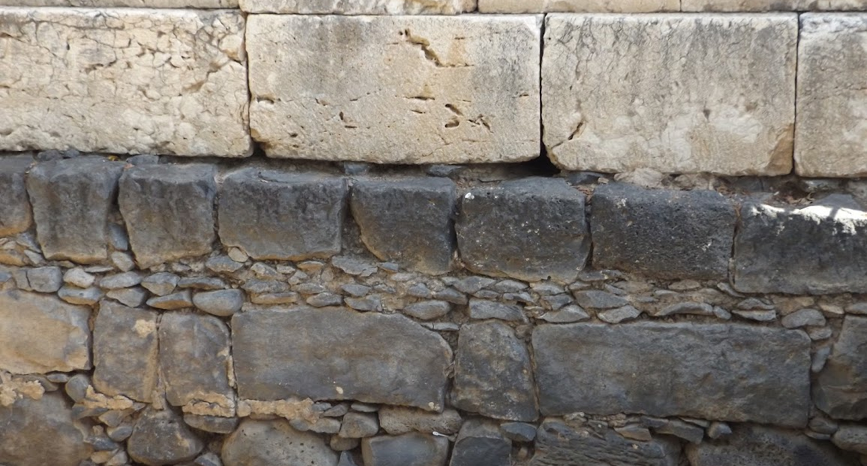

Studies in the Epistles
Foundations  Quarter 14
Lesson Sixteen: 1 Corinthians 10-11

Slide 2
Outline of 1 Corinthians
Introduction: Salutation & Thanksgiving (1:1-9)
I. Dealing with reported problems (1:10 — 6:20)
  A. Unity based on God’s wisdom (1:10 — 4:21)
  B. Dealing with sin in the church (5-6)
II. Dealing with questions and concerns of the Corinthians (7:1--16:9)
  A. Their Concerns (7-9) [Marriage issues, eating meat sacrificed to idols]
  B. Common Concerns (10-11) [Idolatry, headship, the Lord’s supper]
  C. Spiritual Gifts (12-14)
  D. Closing Words (16)

Slide 3
Flee Idolatry
(1 Corinthians 10)
NOTE: In this chapter, Paul continues to deal with the question of meat “offered to idols” (cf. 8:1) in the larger context of choices Christians must make as they live in a culture permeated with idolatry.
The experience of the Israelites’ deliverance from Egypt is paralleled to the experience of Christians (10:1-5).
  Both are baptized into a leader through whom God provides sustenance.
  But with most of them, God was not pleased.
These things are our examples (10:6-11)
  We should not lust as they lusted, or become idolaters as they did, or commit sexual immorality, or complain.
Overconfidence in dealing with temptation is dangerous, but God will provide a way of escape, enabling us to bear temptation (10:12-13).
Notes:
Chapters 8-10 repeatedly show the value of forfeiting personal rights for the benefit of others. Paul is answering concerns about “things offered to idols”
The Israelites are EXAMPLES of what NOT to do!
“Lust as they lusted” – Probably in reference to craving for meat (Numbers 11:4 Now the mixed multitude who were among them yielded to intense craving; so the children of Israel also wept again and said: "Who will give us meat to eat?
“Become idolaters as were some of them” as in the golden calf incident at Sinai (Exodus 32:1-6)
“Commit sexual immorality” as Israel did with Moabite women at Baal Peor (Numbers 25:1-8)
Nor “tempt Christ” as some did in their discouragement near Edom and were destroyed by serpents (Numbers 21:1-9)
Nor “complain” as they did and were destroyed by the destroyer (Numbers 14). The “destroyer” is death or the angel of death (cf. Exodus 12:23)

Slide 4
Flee Idolatry
(1 Corinthians 10)
“Therefore…flee from idolatry” (10:14).
“I speak as to wise men…YOU JUDGE” (10:15).
  When we partake of the Lord’s supper, do we not commune with Christ (10:16-17)?
  When Israelites eat the sacrifices, are they not jointly participating in an act of worship to the same God (10:18)?
  Even so, if we eat things sacrificed in idolatry to demons, we have fellowship with demons (10:19-21).
    “You cannot partake of the Lord's table and of the table of demons.”

Slide 5
Flee Idolatry
(1 Corinthians 10)
Conclusions concerning things offered to idols (10:23-33):
  Some things that are lawful are not helpful or edifying (10:23).
  Don’t just seek your own wellbeing; seek the wellbeing of others (10:24).
  When it comes to eating meat sacrificed to idols… (10:25-30).
    Eat what is sold in the marketplace or served at an unbeliever’s dinner, asking no questions.*
    If you are informed that “This was offered to idols,” do not eat for the sake of the one who told you and for the conscience of the other.
      YOU make this determination because of YOUR consideration of the other person’s conscience.
  Whatever you do, do all to the glory of God (10:31-33)!
    Give NO OFFENCE.
    Do not seek your own profit, but the profit of the many.
Notes:
NOTE: If you do not know that the meat was sacrificed to idols, you cannot and are not partaking in the table of demons – it is the intent of the heart and the meaning attached in the mind that gives the act significance – not the meat itself.

Slide 6
Honoring Headship
(1 Corinthians 11:1-16)
As an apostle and follower of Christ, Paul set examples and handed down teaching which should be followed by all disciples (11:1-2; Phil. 3:17; 2 Thess. 3:7-9).
  In this context, that would include his willingness to forego his rights .and privileges for the welfare of others (8:13; 9:11-12, 19-22; 10:31-33).
  It would also apply to what is about to be discussed regarding respecting headship.
Paul praises the Corinthians for remembering him and keeping the apostolic traditions just as he delivered them (2 Thess. 2:15; 3:6).
Notes:
With the phrase “but I want you to know,” Paul now hands to the Corinthians additional apostolic tradition

Slide 7
Honoring Headship
(1 Corinthians 11:1-16)
There is an order of “headship” (11:3).
  God > Christ > Man > Woman
Every man praying or prophesying having his head covers dishonors his head – Christ (11:4).
Every woman praying or prophesying with her head uncovered dishonors her head (11:5).
  If the woman prays uncovered, it is as if her head were shaved!
      “She may as well shave her head” (CEV, 11:5b).
  “If a woman is not covered, let her also be shorn,” but since it is shameful for a woman to be shorn or shaved, she is to be covered when praying or prophesying (11:6).
Notes:
Praying is communication to God and Prophesying is communication from God.
Are prayer and prophecy spiritual gifts here?
In general, prayer IS NOT a spiritual gift; prophesying IS, but not always (cf. Titus 1:12)
Barnes and others assert that “The word ‘prophesying’ here means, evidently, ‘teaching;’ or publicly speaking to the people on the subject of religion.”
Others assert that both praying and prophesying here refer to actions that involved spiritual gifts (a topic introduced in 12:1).

Slide 8
Honoring Headship
(1 Corinthians 11:1-16)
A man ought not to cover his head since he is in the image and glory of God (11:7-9).
  Man is not from woman, but woman is from man.
  Man was not created for the woman, but the woman for the man (Genesis 2:18, 21-23).
For this reason a woman ought to have a symbol authority on her head (11:10).
  “Because of the angels” may refer to angels “as watchers over the natural order” (TDNT, v. 2, p. 574).
The order of headship does not alter the mutual dependence of man and woman (11:11-12).

Slide 9
Honoring Headship
(1 Corinthians 11:1-16)
The Corinthians are challenged to “judge” for themselves:* Is it proper for a woman to pray to God with her head uncovered (11:13)?
  Nature teaches that if a man has long hair it is a shame, but if a woman has long hair, it is a glory (11:14-15).
    “Nature” typically refers to how things are ordered by God in the physical creation (Rom. 1:26; 11:21),
      “Nature” can also refer to something established by long habit (Eph. 2:3),
      In either case, it teaches what is “proper” here (Matt. 3:15; Eph. 5:3; 1 Tim. 2:10; Heb. 2:10; 7:26).
    Nature teaches that the woman’s “hair is given to her for a covering.”
  “But if anyone seems to be contentious, we have no such custom, nor do the churches of God” (11:16).
Notes:
*In 1 Corinthians 10:15, Paul used this same phrase and approach to help the Corinthians reason for themselves why it was wrong to knowingly eat meat sacrificed to idols.
Use of “Nature” (Gr. Φύσις) in scripture:
Romans 1:26 For this reason God gave them up to vile passions. For even their women exchanged the natural use for what is against nature.
Romans 11:21 For if God did not spare the natural branches, He may not spare you either.
Ephesians 2:3 among whom also we all once conducted ourselves in the lusts of our flesh, fulfilling the desires of the flesh and of the mind, and were by nature children of wrath, just as the others.
The word translated “comely” or “proper” is the same word (prepo, πρέπω) refers to that which fitting, right or proper, and it is found in the following passages:
Matthew 3:15 But Jesus answered and said to him, "Permit it to be so now, for thus it is fitting for us to fulfill all righteousness." Then he allowed Him.
Ephesians 5:3 But fornication and all uncleanness or covetousness, let it not even be named among you, as is fitting for saints;
1 Timothy 2:10 (women are to adorn themselves in modest apparel) which is proper for women professing godliness, with good works.
Hebrews 2:10 For it was fitting for Him, for whom are all things and by whom are all things, in bringing many sons to glory, to make the captain of their salvation perfect through sufferings.
Hebrews 7:26 For such a High Priest was fitting for us, who is holy, harmless, undefiled, separate from sinners, and has become higher than the heavens;
What is the “custom” referred to in this verse? Is it women wearing the covering, or is it being contentious over whether women should wear the covering?
“But if one is inclined to be contentious, we have no other practice, nor have the churches of God” (NASB)
“This is how things are done in all of God's churches, and that's why none of you should argue about what I have said.” (CEV)

Slide 10
The Lord’s Supper
(1 Corinthians 11:17-34)
Paul had praised the Corinthians for keeping apostolic traditions (11:2), but he does not praise them for their Lord’s supper practices.
When they “come together*” it is “for the worse” (11:17-22).
  There are divisions among them (11:18-19).
  They were taking their own supper, and doing so selfishly, without concern for those who had nothing (11:20-21)
  Eating common meals should be done in their own houses (11:22).
The instructions Paul had handed down from the Lord (11:23-26)
The problem of eating in an unworthy manner (11:27-32).
  We must examine ourselves to ensure we partake in a way that discerns between eating a common meal and remembering the Lord’s body.
“When you come together to eat, wait for one another” (11:33-34).
Notes:
“Come together” is used FIVE times in this context; the Lord’s supper is to be taken when the church comes together.
“Discerning” is from διακρίνω (diakrinō). Thayer Definition: 1) to separate, make a distinction, discriminate, to prefer

Slide 11
Key concepts:
The Israelites in the wilderness serve as examples for us regarding the disastrous consequences of not taking temptation seriously.
God will not allow us to be tempted beyond what we can bear but will provide a way of escape.
We should seek the wellbeing of others, not just our own wellbeing.
Do all to the glory of God
God has ordained headship/submission which must be honored; covering the head while praying a prophesying honors the head of woman but dishonors the head of man.
The Lord’s Supper is to be taken in a worthy manner when the church comes together.

