Slide 1
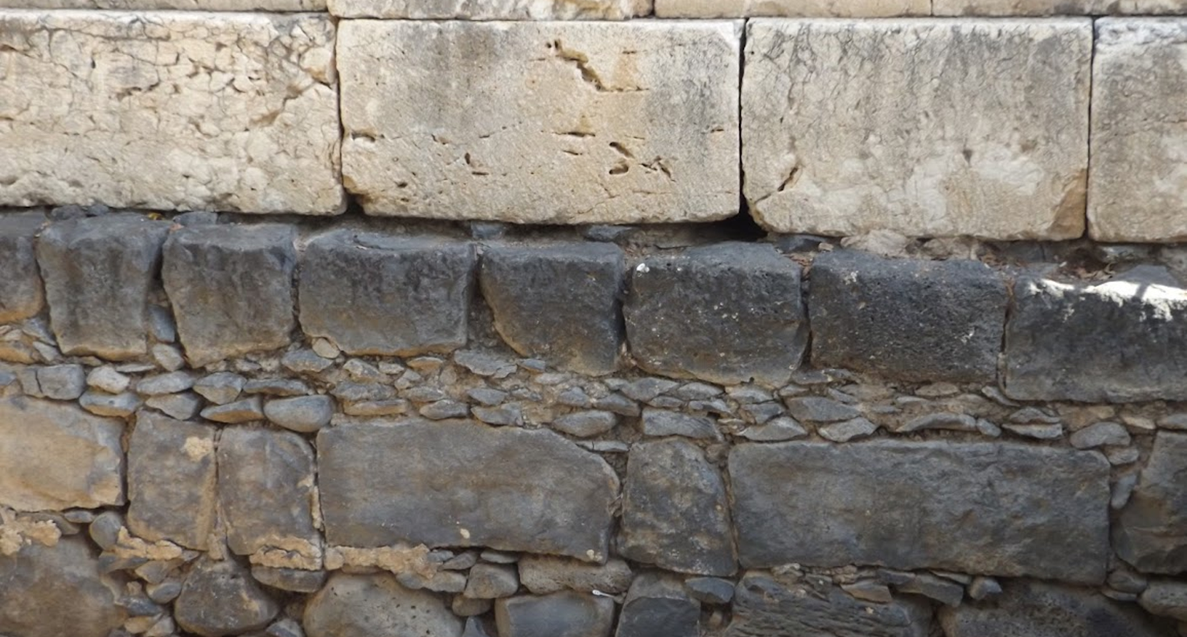

Studies in the Epistles
Foundations  Quarter 14
Lesson Two: Romans 4-6

Slide 2
Theme of Romans The Gospel is God’s Power to Save!
“For I am not ashamed of the gospel of Christ, for it is the power of God to salvation
for everyone who believes,
for the Jew first and also for the Greek.
For in it the righteousness of God is revealed from faith to faith; as it is written,
“the just shall live by faith.”
(Romans 1:16-17)

Slide 3
Outline of Romans
I. DOCTRINAL: How the gospel saves the sinner
Introduction (1:1-17)
All have sinned and need salvation (1:18—3:31)
The gospel saves by grace through faith (4:1—5:21)
Faith requires and acquires a changed life (6:1—8:39)
II. NATIONAL: How the gospel relates to Israel
It does not annul God’s purpose for Israel (9:1-33)
It fulfills God’s promises to Israel (10:1-21)
It presents a great opportunity for Israel (11:1-36)
III. PRACTICAL: How the gospel bears on conduct
In society (12:1—13:14)
Among brethren (14:1—15:33)
Conclusion: Exhortations and salutations (16:1-25)

Slide 4
Abraham & David Illustrate Justification by Faith (Romans 4:1-8)
Abraham was justified by faith apart from works of the Law or works of merit (4:1-5).
Abraham did not earn his justification; God justified Abraham because Abraham believed in God and showed it! (cf. Gen. 15:6)
Abraham had been living by faith for many years before this declaration (Acts 7:2-4; Hebrews 11:8; Galatians 3:6).
His justification by faith per Genesis 15:6 is evident in his later life also (James 2:20-24; Gen. 22:1-18).
In each of these instances, Abraham’s faith obeyed (worked).
David describes justification apart from works as being “forgiven” (4:6-8).
Notes:
Acts 7:2-4 And he said, "Brethren and fathers, listen: The God of glory appeared to our father Abraham when he was in Mesopotamia, before he dwelt in Haran, 3 and said to him, 'GET OUT OF YOUR COUNTRY AND FROM YOUR RELATIVES, AND COME TO A LAND THAT I WILL SHOW YOU.' 4 Then he came out of the land of the Chaldeans and dwelt in Haran. And from there, when his father was dead, He moved him to this land in which you now dwell.
Hebrews 11:8 By faith Abraham obeyed when he was called to go out to the place which he would receive as an inheritance. And he went out, not knowing where he was going.
Galatians 3:6 just as Abraham "BELIEVED GOD, AND IT WAS ACCOUNTED TO HIM FOR RIGHTEOUSNESS.“
James 2:20-24 But do you want to know, O foolish man, that faith without works is dead? 21 Was not Abraham our father justified by works when he offered Isaac his son on the altar? 22 Do you see that faith was working together with his works, and by works faith was made perfect? 23 And the Scripture was fulfilled which says, "ABRAHAM BELIEVED GOD, AND IT WAS ACCOUNTED TO HIM FOR RIGHTEOUSNESS." And he was called the friend of God. 24 You see then that a man is justified by works, and not by faith only.

Slide 5
Abraham Illustrates Justification by Faith (Romans 4:9-25)
Abraham was justified before and without circumcision (4:9-12).
Jews thought this fleshly ritual justified them and made them true children of Abraham, but that was not the case (2:28-29; 3:29-30).
Abraham’s faith was counted for righteousness at least 14 years before he was circumcised (Gen. 15:6; 16:16; 17:1, 11).
The promise to Abraham was given apart from the Law and was received by faith (4:13-15).*
Abraham was to be the father of many nations (4:16-18). The promise is to all the seed of Abraham, not just those who received the Law
Abraham’s strong faith is illustrated in his belief that God would give him a son in his old age (4:19-22).
These facts concerning Abraham’s justification were recorded for OUR benefit! (4:23-25).
Notes:
Genesis 15:6 And he believed in the LORD, and He accounted it to him for righteousness.
Genesis 16:16 Abram was eighty-six years old when Hagar bore Ishmael to Abram.
Genesis 17:1 When Abram was ninety-nine years old, the LORD appeared to Abram and said to him, "I am Almighty God; walk before Me and be blameless.
Genesis 17:11 and you shall be circumcised in the flesh of your foreskins, and it shall be a sign of the covenant between Me and you.
*If the inheritance is obtained by keeping law then (1) the promise is of no value, and (2) no one would receive the inheritance because the law brings sin and wrath (7:7; 1 John 3:4).

Slide 6
Those Justified by Faith Know Peace and Hope through God’s Grace and Love (Romans 5:1-11)
The Justified have Peace with God (5:1).
Since justification removes the reason for God’s wrath, the justified are now at peace with Him (Romans 8:7; James 4:4; Eph. 2:13-16).
The Justified have access by Faith into Grace (5:2).
By faith, the justified now “stand” in grace having accessed it by a living faith in baptism (Gal. 3:26-27)
The Justified have Hope (5:2b-5).
We rejoice in the hope of the glory of God (cf. Rom. 3:23), and our hope becomes firm as we endure trials and experience God’s love.
The Justified know God’s Love and are Reconciled to Him (5:6-11)
God demonstrates His own love toward us, in that while we were still sinners, Christ died for us (John 3:16; 1 John 4:9-10).
Notes:
Romans 8:7 Because the carnal mind is enmity against God; for it is not subject to the law of God, nor indeed can be.
James 4:4 Adulterers and adulteresses! Do you not know that friendship with the world is enmity with God? Whoever therefore wants to be a friend of the world makes himself an enemy of God.
Ephesians 2:13-17 But now in Christ Jesus you who once were far off have been brought near by the blood of Christ. 14 For He Himself is our peace, who has made both one, and has broken down the middle wall of separation, 15 having abolished in His flesh the enmity, that is, the law of commandments contained in ordinances, so as to create in Himself one new man from the two, thus making peace, 16 and that He might reconcile them both to God in one body through the cross, thereby putting to death the enmity. 17 And He came and preached peace to you who were afar off and to those who were near.
Galatians 3:26-27 For you are all sons of God through faith in Christ Jesus. 27 For as many of you as were baptized into Christ have put on Christ.
1 Peter 5:1 Peter refers to himself as, “a partaker of the glory that will be revealed”

Slide 7
The Extent of God’s Grace (Romans 5:12-21)
Adam’s sin brought death into the world and death spread to all men because all sinned (5:12-18).
All do not die spiritually due to Adam’s sin any more than all live spiritually due to Christ’s death; sin under law and obedience to the faith are individual choices.
NOTE: Adam also introduced physical death (1 Cor. 15:20-21), but physical death is not the primary consequence of sin (cf. 6:21, 23; 7:10, 24; 8:2, 6).
The consequences of “law/sin” and “grace/faith” are death and life respectively (Eph. 2:1-8; Col. 2:13).
“Grace abounded” much more than sin.
“As sin reigned in death, even so grace might reign through righteousness to eternal life through Jesus Christ our Lord.”
Notes:
(Adam is patient zero in the deadly epidemic of sin and spiritual death)
Colossians 2:13 And you, being dead in your trespasses and the uncircumcision of your flesh, He has made alive together with Him, having forgiven you all trespasses,
1 Corinthians 15:20-21 But now Christ is risen from the dead and has become the firstfruits of those who have fallen asleep. 21 For since by man came death, by Man also came the resurrection of the dead.

Slide 8
The effects of Adam’s actions are encompassed and surpassed by the effects God’s grace through Christ.
Type | Likeness | Antitype
Adam | Two Men | Christ
Sin | Two Acts | Obedience
Condemnation | Two Results | Justification
Death | Two Effects | Life
Abounded | Two Extents | Abounded much more

Slide 9
Grace brings New Life (Romans 6:1-21)
Shall we continue in sin that grace may abound? (6:1-3)
Since grace abounds more as sin abounds more (5:20) “shall we continue in sin that grace may abound?”
Certainly not! We have died to sin by being baptized into the death Christ Jesus (cf. Gal. 2:20).
Baptism into Christ’s death brings new life! (6:4-6)
The death, burial, and resurrection of Christ corresponds to what we experience in baptism.
Being raised with Christ in baptism is the beginning of a new life that we have accessed by through faith by being baptized (6:4; Col. 2:12-13; 1 Pet. 1:22-23; John 3:3, 5).
Our old man was crucified.
The body of sin is done away with.
We should no longer be slaves of sin.
Notes:
Colossians 2:12-13 buried with Him in baptism, in which you also were raised with Him through faith in the working of God, who raised Him from the dead. 13 And you, being dead in your trespasses and the uncircumcision of your flesh, He has made alive together with Him, having forgiven you all trespasses,
1 Peter 1:22-23 Since you have purified your souls in obeying the truth through the Spirit in sincere love of the brethren, love one another fervently with a pure heart, 23 having been born again, not of corruptible seed but incorruptible, through the word of God which lives and abides forever,
John 3:3, 5 Jesus answered and said to him, "Most assuredly, I say to you, unless one is born again, he cannot see the kingdom of God." … 5 Jesus answered, "Most assuredly, I say to you, unless one is born of water and the Spirit, he cannot enter the kingdom of God.

Slide 10
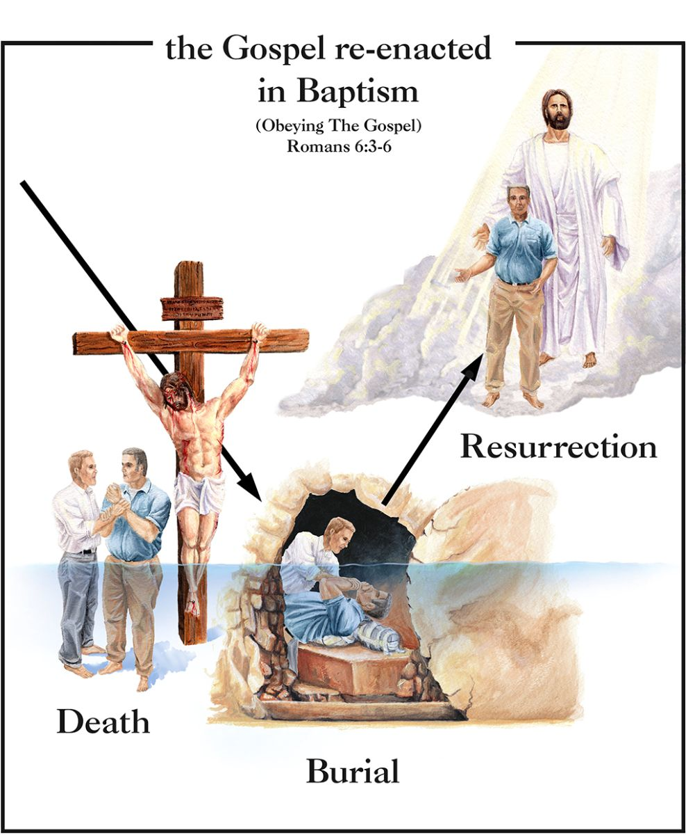
Baptism is a Death, Burial, and Resurrection
The purpose of baptism is clearly stated in the Bible.
It is “for the remission of sins” (Acts 2:38).
To “wash away sins” (Acts 22:16).
To “save us” (1 Pet. 3:21).
It is God who saves us through baptism. It is His operation, not ours (Rev. 1:5; Col. 2:11-13).
Notes:
Revelation 1:5 and from Jesus Christ, the faithful witness, the firstborn from the dead, and the ruler over the kings of the earth. To Him who loved us and washed us from our sins in His own blood,
Colossians 2:11-13 In Him you were also circumcised with the circumcision made without hands, by putting off the body of the sins of the flesh, by the circumcision of Christ, 12 buried with Him in baptism, in which you also were raised with Him through faith in the working of God, who raised Him from the dead. 13 And you, being dead in your trespasses and the uncircumcision of your flesh, He has made alive together with Him, having forgiven you all trespasses,

Slide 11
Grace brings New Life (Romans 6:1-21)
Having died with Christ, we are freed from sin (6:7-14).
Just as Christ’s resurrection freed Him from death, we are freed from sin and death by being raised to a new life in Christ (6:7-9; Hebrews 2:14-15; John 8:32-36; 1 Peter 4:1-3).
Having died to sin, we are obligated to live for God! (6:10-11; 2 Corinthians 5:15, 17; Col. 3:1-15)
We must not allow sin to reign over us! (6:12-14)
We do no present ourselves to sin but to God as “instruments of righteousness.”
Notes:
Hebrews 2:14-15 Inasmuch then as the children have partaken of flesh and blood, He Himself likewise shared in the same, that through death He might destroy him who had the power of death, that is, the devil, 15 and release those who through fear of death were all their lifetime subject to bondage.
John 8:32-36 And you shall know the truth, and the truth shall make you free." 33 They answered Him, "We are Abraham's descendants, and have never been in bondage to anyone. How can You say, 'You will be made free'?" 34 Jesus answered them, "Most assuredly, I say to you, whoever commits sin is a slave of sin. 35 And a slave does not abide in the house forever, but a son abides forever. 36 Therefore if the Son makes you free, you shall be free indeed.
1 Peter 4:1-3 Therefore, since Christ suffered for us in the flesh, arm yourselves also with the same mind, for he who has suffered in the flesh has ceased from sin, 2 that he no longer should live the rest of his time in the flesh for the lusts of men, but for the will of God. 3 For we have spent enough of our past lifetime in doing the will of the Gentiles—when we walked in lewdness, lusts, drunkenness, revelries, drinking parties, and abominable idolatries.
2 Corinthians 5:15-17 and He died for all, that those who live should live no longer for themselves, but for Him who died for them and rose again… 17 Therefore, if anyone is in Christ, he is a new creation; old things have passed away;

Slide 12
Grace brings New Life (Romans 6:1-21)
Freedom from sin is not freedom to sin (6:15-23).
We CERTAINLY DO NOT have the freedom to disobey God just because we are under grace (6:15).
We have chosen to become servants of a different Master, and we must be true to that choice (6:16-18).
Sin and righteousness both demand all from their servants (6:19-23)!
When we were slaves of sin, one sin led to another, and we felt no compulsion to do right. The fruit of that shameful life ended in death!
In contrast, servants of God produce “fruit to holiness” ending in everlasting life!
“For the wages of sin is death, but the gift of God is eternal life in Christ Jesus our Lord” (Romans 6:23).

Slide 13
Questions over key concepts:
How does faith access grace? How does the example of Abraham illustrate this?
How has God demonstrated His love for us?
Compare and contrast the effects of Adam’s sin with the effects of God’s grace through Christ.
How does baptism correspond to the death, burial, and resurrection of Jesus?
What are some reasons that those who are saved by God’s grace should not continue in sin?

