Slide 1
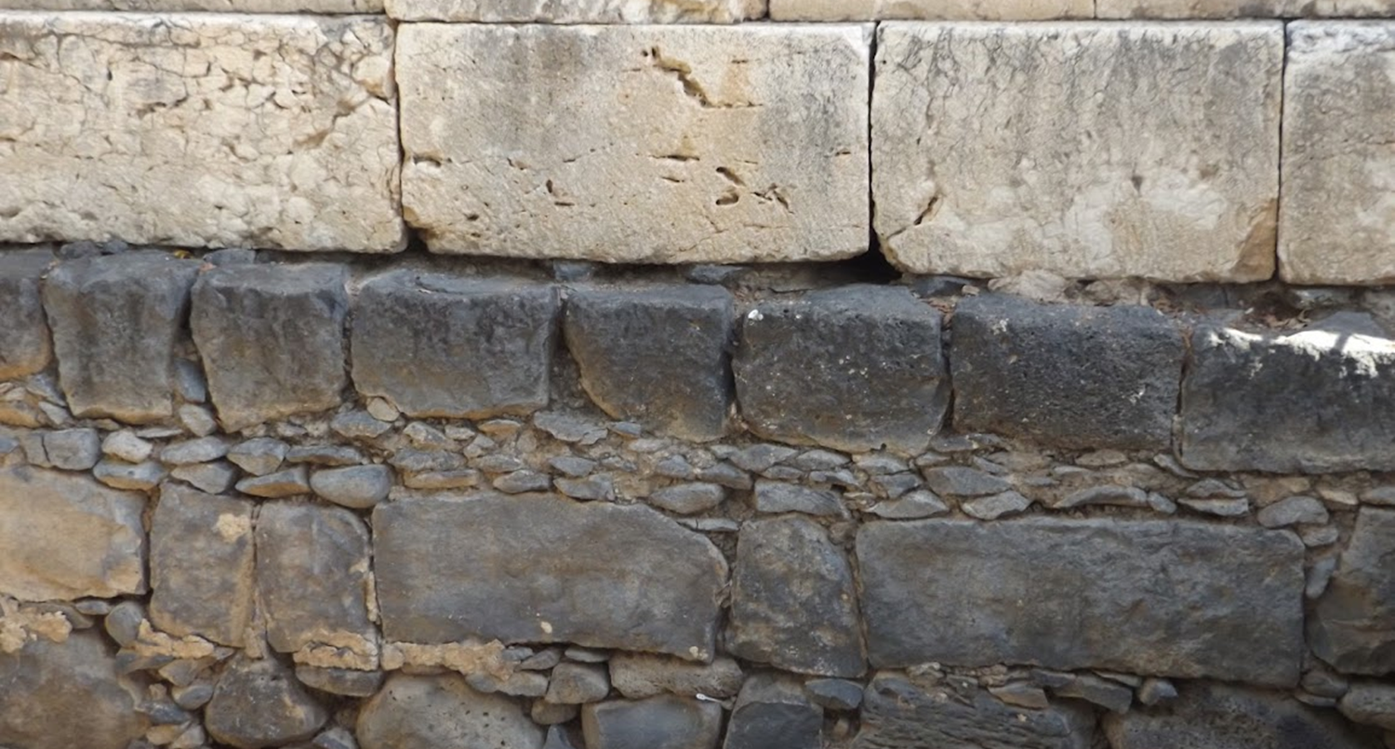

Studies in the Epistles
Foundations  Quarter 14
Lesson Three: Romans 7-8

Slide 2
Freedom From the Law and from Sin
(Romans 7 & 8)
Delivered from the Dominion of Law (7:1-6)
The law has dominion as long as one lives (7:1-4).
  Death with Christ freed us from sin because it freed us from the law (cf. 6:2, 6-7).
  Marriage law illustrates how death frees from law (cf. Matt. 19:3-6).
  Having died to law, we may now be joined to Christ (cf. Col. 2:13).
Death to the law has given us a new life (7:5-6).
  When we were “in the flesh,” the law aroused sinful passions that led to death (3:20; 5:13, 20; 6:23).
  But now, having been delivered from the law by dying with Christ, we serve in the “newness of the Spirit.”
    NOTE: The contrasting mindsets of “flesh” and “spirit.”*
Notes:
Colossians 2:13-14 And you, being dead in your trespasses and the uncircumcision of your flesh, He has made alive together with Him, having forgiven you all trespasses, 14 having wiped out the handwriting of requirements that was against us, which was contrary to us. And He has taken it out of the way, having nailed it to the cross.
*Note: Here for the first time in Romans, “flesh” and “spirit” are brought into contrast as conflicting mindsets of the inner man.
To live “in the flesh” is to have one’s mind set on earthly desires (8:5).
To serve the Spirit is to have one’s mind set on things above (8:5; Col. 3:1-7; Gal. 5:16-19)

Slide 3
Freedom From the Law and from Sin
(Romans 7 & 8)
The Law was good, but it brought sin to life (7:7-11)
The law is not sin or sinful, but it did bring the knowledge of sin, and sin used law to multiply itself.
  The law enabled us to know right from wrong (7:7; Exodus 20:17).
  “Sin” here is spoken of as if it were a person who seizes the opportunity to produce “all manner of evil desire”* (7:8) .
  Thus, sin used law to produce death (7:9-11).
    Paul would only have been “alive…without the law” when he was a child (7:9; Matt. 19:14; Isa. 7:16).
  The law is good, but sin showed itself to be exceedingly sinful by using the law to bring death (7:12-13).
Notes:
The noun translated “covetousness” (NKJV) or “lust” (KJV) or “covet” (ESV) is epithumia; the verb translated “covet at the end of verse 7 is epithumeō
In verse 8, epithumia is translated “all manner of evil desire” or *“concupiscence” (KJV) or “covetousness” (ESV)
ESV Romans 7:7-8 What then shall we say? That the law is sin? By no means! Yet if it had not been for the law, I would not have known sin. For I would not have known what it is to covet if the law had not said, “You shall not covet.” 8 But sin, seizing an opportunity through the commandment, produced in me all kinds of covetousness. For apart from the law, sin lies dead.
The noun is found 38 times in the NT, the vast majority of the time translated “lust” or “desires” in a negative sense (e.g. 1 John 2:16-17)
Isaiah 7:16 “For before the Child shall know to refuse the evil and choose the good…”
“Exceedingly sinful” is translated from καθ΄ υπερβολην αμαρτωλος. The ESV has “sinful beyond measure.”

Slide 4
Freedom From the Law and from Sin
(Romans 7 & 8)
Sin and the war between Flesh and Spirit (7:14-25)
Getting into and out of a “body of death”
  God gives a law that is good and spiritual (7:7, 12, 14), but Paul says that sin uses the law against “me”* (7:14-20, 24).
Within Paul, there is a fight between flesh and spirit (7:15-23; Gal. 5:17).
  "Flesh" is a person's earthly, carnal, physically-bent side. It is not "sinful nature" (NIV), but "sinful side." Flesh is not all that makes up a person.
  There is also spirit -- a spiritual side, which is attuned to things above and has an interest in heavenly things (7:21-22).
  The flesh can be a problem for both the saved and the unsaved if they choose to walk in it (cf. Gal. 5:13-18; Eph. 2:3).
  Through the flesh, sin wins the battle within and takes Paul captive (7:23).
Christ delivers Paul (and us) from “this body of death” (7:24-25).
Notes:
*The use of personal pronouns in the present tense indicates that this is Paul’s experience.
"I" occurs 26 times and "me" occurs 9 times.
Paul identifies the "me" in this text as his "flesh" (v. 18) and the "I" as "carnal" (v. 14)
While it is evident that by verse 25 Paul again refers to himself in a fuller sense, he plainly has a specific compartment of himself in view in verse 18

Slide 5
Freedom From the Law and from Sin
(Romans 7 & 8)
In Christ we are Freed from Sin & Death (8:1-4)
The law of the Spirit of life sets us free (8:1-2).
  We are freed from the law of sin and death which used our fleshly desires to bind us; we now live by a spiritual law that relies on grace.
Jesus provided what the law could not (8:3-4).
  The law had no provision to take away sin (Heb. 10:4). Its weakness was actually man’s weakness in violating it (Heb. 8:7-9).
  Christ’s sinless life and atoning death fulfilled the requirement of the law in us so that we are freed from trying to be justified by keeping the law (Isa. 53:4-6; Col. 1:21-23).
Notes:
*The use of personal pronouns in the present tense indicates that this is Paul’s experience.
"I" occurs 26 times and "me" occurs 9 times.
Paul identifies the "me" in this text as his "flesh" (v. 18) and the "I" as "carnal" (v. 14)
While it is evident that by verse 25 Paul again refers to himself in a fuller sense, he plainly has a specific compartment of himself in view in verse 18

Slide 6
Freedom From the Law and from Sin
(Romans 7 & 8)
Living by Flesh VS. Living by Spirit (8:5-13)
Your mindset determines whether you are living by flesh or by the Spirit (8:5).
The choice between flesh and Spirit determines your relationship with God (8:6-11).
  The flesh results in sin, death, and enmity; it cannot please God.
  The Spirit results in peace with God and life in Him (Gal. 5:16-18; Col. 3:1-3, 4-15).
We are debtors to live according to the Spirit (8:12-13).
  This is not optional for the child of God.
  If we choose to live according to the flesh, we die!
  If we put to death the deeds of the body, we live!
Notes:
Galatians 5:16-19 I say then: Walk in the Spirit, and you shall not fulfill the lust of the flesh. 17 For the flesh lusts against the Spirit, and the Spirit against the flesh; and these are contrary to one another, so that you do not do the things that you wish. 18 But if you are led by the Spirit, you are not under the law.
Colossians 3:1-3 If then you were raised with Christ, seek those things which are above, where Christ is, sitting at the right hand of God. 2 Set your mind on things above, not on things on the earth. 3 For you died, and your life is hidden with Christ in God.

Slide 7
Freedom From the Law and from Sin
(Romans 7 & 8)
Our Heavenly Paternity (8:14-17)
As many as are led by the Spirit are sons of God (8:14).
  The Spirit leads us through the Word which He revealed (John 16:13; 1 Cor. 2:11-13; Eph. 3:3-5).
The Spirit identifies us as truly God’s children (8:15-16).
  When we follow our spiritual side and are led by the Spirit’s word, we are sons of God.
  We have been given the “Spirit of adoption” which enables us to have a close child-parent relationship with God (Gal. 4:6).
If we are children, then we are heirs! (8:17).
  We willingly suffer with God’s Son so that we might also be glorified with Him (1 Peter 1:4-6; Col. 1:12).
Notes:
John 16:13 However, when He, the Spirit of truth, has come, He will guide you into all truth; for He will not speak on His own authority, but whatever He hears He will speak; and He will tell you things to come.
1 Corinthians 2:11-13 For what man knows the things of a man except the spirit of the man which is in him? Even so no one knows the things of God except the Spirit of God. 12 Now we have received, not the spirit of the world, but the Spirit who is from God, that we might know the things that have been freely given to us by God. 13 These things we also speak, not in words which man's wisdom teaches but which the Holy Spirit teaches, comparing spiritual things with spiritual.
Ephesians 3:3-5 how that by revelation He made known to me the mystery (as I have briefly written already, 4 by which, when you read, you may understand my knowledge in the mystery of Christ), 5 which in other ages was not made known to the sons of men, as it has now been revealed by the Spirit to His holy apostles and prophets:
Galatians 4:6 And because you are sons, God has sent forth the Spirit of His Son into your hearts, crying out, "Abba, Father!“
1 Peter 1:4-6 to an inheritance incorruptible and undefiled and that does not fade away, reserved in heaven for you, 5 who are kept by the power of God through faith for salvation ready to be revealed in the last time. 6 In this you greatly rejoice, though now for a little while, if need be, you have been grieved by various trials,
Colossians 1:12 giving thanks to the Father who has qualified us to be partakers of the inheritance of the saints in the light.
Ephesians 1:18 the eyes of your understanding being enlightened; that you may know what is the hope of His calling, what are the riches of the glory of His inheritance in the saints,

Slide 8
Freedom From the Law and from Sin
(Romans 7 & 8)
Current Suffering VS. The Hope of Glory (8:18-25)
Our fellowship with Christ includes fellowship with His sufferings (8:17; Phil 3:10; 1 Peter 4:13).
  But our present sufferings are not worthy to be compared with our expectation of glory (8:18)
  Even creation (personified) eagerly anticipates redemption! (8:19-22; cf. Joel 1:10, 18-20)
  We who have the first fruits of the Spirit eagerly wait to see our hope -- the redemption of our body (8:23-25; Gal. 5:5; Phil. 3:20-21)
    “First fruits” may refer to initial blessings from the Spirit which give us an expectation of more to come (cf. 1 Cor. 15:20)
    Hope and perseverance feed off each other!
Notes:
Philippians 3:10 that I may know Him and the power of His resurrection, and the fellowship of His sufferings, being conformed to His death,
1 Peter 4:13 but rejoice to the extent that you partake of Christ's sufferings, that when His glory is revealed, you may also be glad with exceeding joy.
Joel 1:10 The field is wasted, The land mourns; For the grain is ruined, The new wine is dried up, The oil fails.
Joel 1:18-20 How the animals groan! The herds of cattle are restless, Because they have no pasture; Even the flocks of sheep suffer punishment. 19 O LORD, to You I cry out; For fire has devoured the open pastures, And a flame has burned all the trees of the field. 20 The beasts of the field also cry out to You, For the water brooks are dried up, And fire has devoured the open pastures.
Galatians 5:5 For we through the Spirit eagerly wait for the hope of righteousness by faith.

Slide 9
Freedom From the Law and from Sin
(Romans 7 & 8)
God’s Eternal Intention is to Glorify Us (8:26-30)
The Spirit helps with our weaknesses (8:26-27)
  Just as the first fruits of the Spirit solidify our hope, “likewise” the Spirit’s assistance in our prayers helps us persevere.
All things work together for good to those who love God and are called according to His purpose (8:28)
  Those who love God obey Him (John 14:15; 15:14)
  They are called by the gospel (2 Thess. 2:14)
  Even things that require us to persevere and groan in prayer can ultimately result in good. (Psalm 119:67, 71)
    Persecution spread the gospel! (Acts 8:4; Phil. 1:12)
    Trials purify faith (1 Peter 1:6-7)
    Death takes us home to God (Phil. 1:23; 2 Cor. 5)
Notes:
Hebrews 7:25 Therefore He is also able to save to the uttermost those who come to God through Him, since He always lives to make intercession for them.
1 Timothy 2:5-6 For there is one God and one Mediator between God and men, the Man Christ Jesus, 6 who gave Himself a ransom for all, to be testified in due time,

Slide 10
Freedom From the Law and from Sin
(Romans 7 & 8)
God’s Eternal Intention is to Glorify Us (8:26-30)
God’s eternal intention was to have many sons conformed to the image of His only begotten Son (8:29).*
God has carried out His eternal intention or “purpose” according to what He Foreknew > Predestined > Called > Justified > Glorified (8:30).
  Those who answer the call of the gospel are justified (by grace through faith) and are conformed to the image of Christ (Eph. 1:3-9; 2 Cor. 3:18; Phil. 3:21).
  Christ died for “all,” but many choose not to accept His grace (Heb. 2:9; 1 John 2:2).
Notes:
Hebrews 7:25 Therefore He is also able to save to the uttermost those who come to God through Him, since He always lives to make intercession for them.
1 Timothy 2:5-6 For there is one God and one Mediator between God and men, the Man Christ Jesus, 6 who gave Himself a ransom for all, to be testified in due time,

Slide 11
Freedom From the Law and from Sin
(Romans 7 & 8)
God’s Love makes us “more than Conquerors” (8:31-39)
Since God is for us, who can prevail against us? (8:31)
  Since He has already given us the ultimate gift, He will not hold back in giving all He has purposed (8:32)
  Before God’s judgment throne, no charge can be successfully prosecuted against His elect! (8:34-35).
    The Judge has declared us justified! Christ has paid our ransom by His death! He is at God’s right hand pleading our case!
Nothing can separate us from the love of Christ (8:35-37)
  The most dreadful persecutions, afflictions, and martyrdoms cannot separate us from Christ’s love, though we endure them “all day long” (Psalm 44:22; Heb. 11:35-38; Rev. 6:9; 12:11)
We are more than conquerors! No death, power, or created thing is stronger than God’s love for us! (8:38-39).
Notes:
Psalms 44:22 Yet for Your sake we are killed all day long; We are accounted as sheep for the slaughter.
Hebrews 11:35-38 Women received their dead raised to life again. Others were tortured, not accepting deliverance, that they might obtain a better resurrection. 36 Still others had trial of mockings and scourgings, yes, and of chains and imprisonment. 37 They were stoned, they were sawn in two, were tempted, were slain with the sword. They wandered about in sheepskins and goatskins, being destitute, afflicted, tormented— 38 of whom the world was not worthy. They wandered in deserts and mountains, in dens and caves of the earth.
Revelation 6:9 When He opened the fifth seal, I saw under the altar the souls of those who had been slain for the word of God and for the testimony which they held.
Revelation 12:11 And they overcame him by the blood of the Lamb and by the word of their testimony, and they did not love their lives to the death.

Slide 12
Questions over key concepts:
A woman is bound to her husband as long as he lives. How does the death of a woman’s husband illustrate becoming free from the Law?
How did the Law bring the knowledge of sin?
How did sin use the Law to bring men into bondage?
How did God free us? (8:1-3)
Describe the difference between walking according the “flesh” and walking according to the “Spirit” (8:5).
How does the Spirit lead us and enable us to become sons and heirs of God?
For whom do “all things work together for good?”
What can separate us from the love of God?

