Slide 1
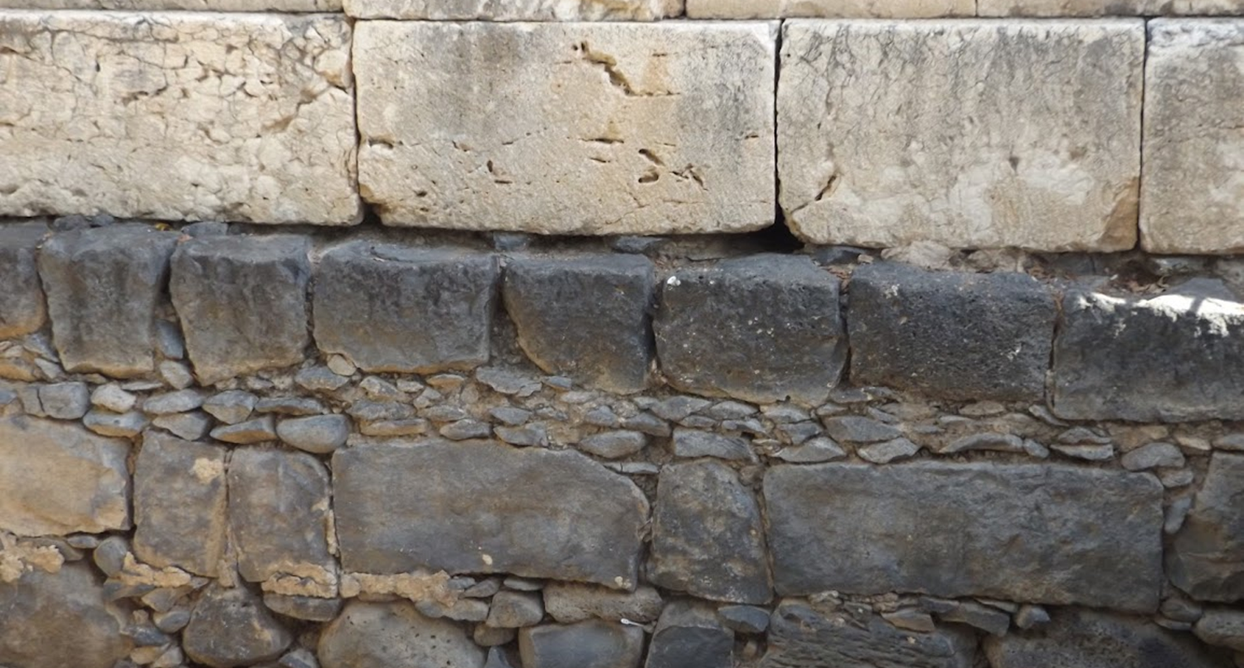

Studies in the Epistles
Foundations  Quarter 14
Lesson Five: Galatians Introduction & 1:1-10

Slide 2
Outline of Galatians
Section 1: Personal – Paul’s Authentic and Authoritative Apostleship
Chapter 1 – The Authority of Paul’s Gospel (1:11-12)
Chapter 2 – The Authenticity of Paul’s Apostleship (2:8)
Section 2: Doctrinal – The Law and the Faith
Chapter 3 – “The Law is not of faith” (3:12, 23-25)
Chapter 4 – Bondage versus Freedom: An Allegory (4:7, 31)
Section 3: Practical – Standing Fast in Liberty
Chapter 5 – Walk in the Spirit (5:16)
Chapter 6 – Walk by this Rule (6:16)

Slide 3
The Authority & Authenticity of Paul’s Gospel An Independent Revelation  Galatians 1:11—2:21
Paul’s Gospel is Independent of Human Sources
Paul’s gospel is not “after man”! (1:11)
Not only is it not “man’s gospel” (ESV), but it was not designed to elicit human approval or reflect human preferences.
Paul didn’t receive it from men, but through a revelation from Jesus Christ (1:12)
Paul’s earlier life had been devoted to Judaism.
He had persecuted the church, the body of Christ (1:13; cf. Acts 9:4).
He had advanced in Judaism (1:14; cf. Philippians 3:4-6; Acts 22:3).
But God had called him by His grace to preach the gospel to the Gentiles (1:15-16a; cf. Jeremiah 1:5).
Notes:
It is not “after man” (kata anthropon, in the accusative)*
“Revelation” is from ἀποκάλυψις (apokalupsis)
Acts 9:4 Then he fell to the ground, and heard a voice saying to him, "Saul, Saul, why are you persecuting Me?“
Philippians 3:4-6 though I also might have confidence in the flesh. If anyone else thinks he may have confidence in the flesh, I more so: 5 circumcised the eighth day, of the stock of Israel, of the tribe of Benjamin, a Hebrew of the Hebrews; concerning the law, a Pharisee; 6 concerning zeal, persecuting the church; concerning the righteousness which is in the law, blameless.
Acts 22:3 "I am indeed a Jew, born in Tarsus of Cilicia, but brought up in this city at the feet of Gamaliel, taught according to the strictness of our fathers' law, and was zealous toward God as you all are today.
Jeremiah 1:5 "Before I formed you in the womb I knew you; Before you were born I sanctified you; I ordained you a prophet to the nations.“
NOTE: Foreknowledge by God does not equal “no choice” by the one who is foreknown!

Slide 4
The Authority & Authenticity of Paul’s Gospel An Independent Revelation  Galatians 1:11—2:21
Paul’s Gospel is Independent of Human Sources
Immediately after being called to preach… (1:16a-24).
Paul had not conferred with flesh and blood!
He had not gone to Jerusalem to those who were apostles before him.
Eventually, after three years, he went to Jerusalem and spent 15 days with Peter and saw James the Lord’s brother.*
Paul assures us “before God” of the veracity of his narrative.
After that he went into the regions of Syria and Cilicia but was unknown by face Judean churches.
They had heard that he now preaches “the faith,” and they glorified God for that!
Notes:
“After three years” may coincide with “after many days” in Acts 9:22-23 But Saul increased all the more in strength, and confounded the Jews who dwelt in Damascus, proving that this Jesus is the Christ. 23 Now after many days were past, the Jews plotted to kill him.
Which James? The options are these: (1) Either James the physical brother of the Lord was in fact included among the twelve, or (2) the word "brother" is being used in some other sense (e.g. "relative") or (3) the word "apostle" is used in a more general sense (one "sent out" by the churches like Barnabas -- Acts 11:22; 13:2-3; 14:14), or (4) a better translation could be "I saw none other of the apostles, BUT [I did see] James the Lord's brother." This translation is awkward, but it is reasonable to translate the Greek "me" as "but" instead of "except."
* None of these options is especially satisfactory to me, but I think number 1 is the least likely because it would demand the appointment of an authorized apostle of Christ which is not recorded in Scripture; I lean toward 3 or 4 being probable.

Slide 5
The Authority & Authenticity of Paul’s Gospel An Independent Revelation  Galatians 1:11—2:21
Paul’s Gospel is Independent of Human Sources
“Pillars” received Paul’s gospel and apostleship (2:1-10).
After 14 years, Paul went up to Jerusalem with Barnabas and Titus (2:1-3; cf. Acts 11:27-30; 12:25; 15:1-2).
He communicated his gospel to those of reputation.
Not even Titus (a Greek) was compelled to be circumcised.
These events occurred because of “false brethren” who had come “by stealth” to “spy out or liberty” to “bring us into bondage” (2:4-5).
Paul did not give in to these false teachers (cf. Acts 15:1).
The “pillars” in Jerusalem “added nothing” to Paul (2:6-10).
They acknowledged his apostleship to the Gentiles and gave him the right hand of fellowship.
They also asked that he remember the poor, which he was eager to do.
Notes:
“

Slide 6
The Authority & Authenticity of Paul’s Gospel An Independent Revelation  Galatians 1:11—2:21
Paul’s Gospel is Independent of Human Sources
Paul corrected Peter’s hypocritical practice (2:11-14).
On a visit to Antioch, Peter had eaten with Gentile Christians, but when certain men came from James, he separated from them (2:11-13).
He feared those who were of the circumcision.
Even Barnabas was carried away with this hypocrisy.
NOTE the power of peer pressure to move us to treat unkindly those who are different from or outside of our group.
Paul confronted Peter because it was wrong from him to live as a Gentile but expect the Gentiles to live like Jews (2:14; cf. Rom. 2:1)!
Notes:
“

Slide 7
The Authority & Authenticity of Paul’s Gospel An Independent Revelation  Galatians 1:11—2:21
Jews and Gentiles are Justified by Faith
Paul and Peter (Jews) were justified by faith because “by the works of the Law shall no flesh be justified” (2:15-16)*.
Note the terms “sinners” and “Gentiles” being used interchangeably.
If being in Christ means one must keep the law, then being in Christ just makes Jews sinners like the Gentiles (2:17).
Rebuilding the obligation to the Law, merely makes one a transgressor! (2:18).
But through the Law Paul had come to the point where he died to the Law that he might live to God (2:19; Romans 7-8)
He is now living a life in which the Law, the flesh, sin, and the body of death have all been crucified (2:20; Romans 6-8).
“I do not set aside the grace of God; for if righteousness comes through the law, then Christ died in vain” (2:21)
Notes:
*This is true, despite the privileges of their race.
Psalms 143:2 Do not enter into judgment with Your servant, For in Your sight no one living is righteous.

Slide 8
Key concepts:
The gospel Paul preached did not come from or through men but by revelation from God.
The other apostles added nothing to what Paul preached, and they acknowledged his apostleship.
Peer pressure can cause us to act hypocritically, as Peter had in the way he treated Gentile Christians.
Jews and Gentiles are justified by faith in Christ.
When one is crucified with Christ, the Law, the flesh, and sin are put death, and life is lived in faith.

