Slide 1
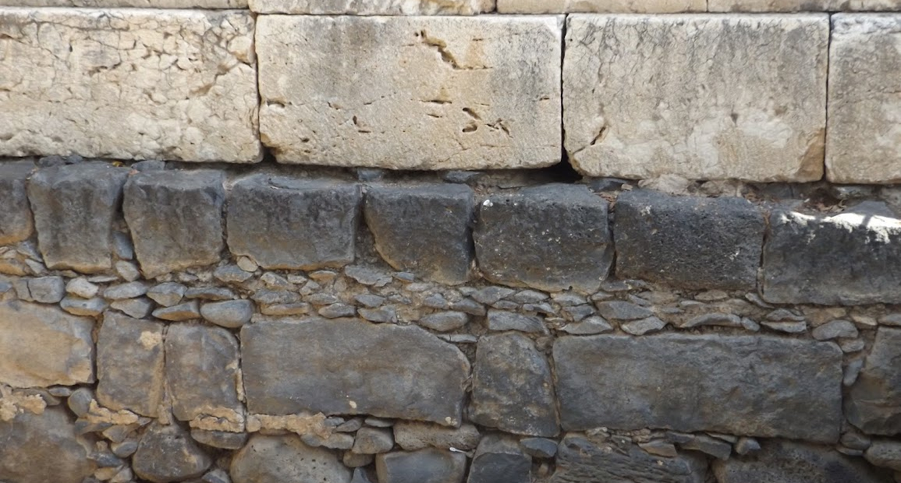

Studies in the Epistles
Foundations  Quarter 14
Lesson Nine: Galatians 5 & 6

Slide 2
Outline of Galatians
Section 1: Personal – Paul’s Authentic and Authoritative Apostleship
Chapter 1 – The Authority of Paul’s Gospel (1:11-12)
Chapter 2 – The Authenticity of Paul’s Apostleship (2:8)
Section 2: Doctrinal – The Law and the Faith
Chapter 3 – “The Law is not of faith” (3:12, 23-25)
Chapter 4 – Bondage versus Freedom: An Allegory (4:7, 31)
Section 3: Practical – Standing Fast in Liberty
Chapter 5 – Walk in the Spirit (5:16)
Chapter 6 – Walk by this Rule (6:16)

Slide 3
Stand Fast in Liberty Galatians 5 & 6
Circumcision is a Portal to the Bondage of the Law
Paul desires that the Galatians stand fast in the liberty that is in Christ and not become entangled again in a yoke of bondage (5:1).
Adherence to Circumcision voids Grace (5:2-4).
“If you become circumcised, Christ will profit you nothing.”
You must keep the whole Law if you bind yourself to any of it.
Attempting to be justified by the Law means that you have fallen from grace.
We must rely on faith (5:5-6).
We anticipate our hope by faith.
In Christ, circumcision does not avail anything, but faith working through love (cf. 1 Cor. 7:18-19).
Notes:
1 Corinthians 7:18-19 Was anyone called while circumcised? Let him not become uncircumcised. Was anyone called while uncircumcised? Let him not be circumcised. 19 Circumcision is nothing and uncircumcision is nothing, but keeping the commandments of God is what matters.

Slide 4
Stand Fast in Liberty Galatians 5 & 6
The Advocates of Circumcision are Leaven which must be Excised!
They have hindered the Galatians from obeying the truth (5:7-12).
Their “persuasion” is not from the Lord.
“A little leaven leavens the whole lump”
This troubler must bear his penalty (cf. 1 Cor. 5:4-7; 2 Cor. 2:6).
If what the troublers are saying is true, the offense of the cross has ceased (the very thing which brought both salvation and persecution).
Paul desires that such ones would “cut themselves off” from the body of true believers (cf. Mark 9:43; John 18:10; Acts 27:32).
Notes:
“Hindered” is a military term describing the bloking of roads, burning of bridges, etc., which one army might use to impede the progress of another” (see McGarvey & Pendleton, and RCH Lenski).
1 Corinthians 5:4-7 In the name of our Lord Jesus Christ, when you are gathered together, along with my spirit, with the power of our Lord Jesus Christ, 5 deliver such a one to Satan for the destruction of the flesh, that his spirit may be saved in the day of the Lord Jesus. 6 Your glorying is not good. Do you not know that a little leaven leavens the whole lump? 7 Therefore purge out the old leaven, that you may be a new lump, since you truly are unleavened. For indeed Christ, our Passover, was sacrificed for us.
2 Corinthians 2:6 This punishment which was inflicted by the majority is sufficient for such a man,
ἀποκόπτω, apokoptō, Thayer Definition: to cut off, amputate
Mark 9:43 (and v45 re: “foot”) If your hand causes you to sin, cut it off. It is better for you to enter into life maimed, rather than having two hands, to go to hell, into the fire that shall never be quenched—
John 18:10 Then Simon Peter, having a sword, drew it and struck the high priest's servant, and cut off his right ear. The servant's name was Malchus.
Acts 27:32 Then the soldiers cut away the ropes of the skiff and let it fall off.
* The translation of “emasculate themselves” is plausible but seems unlikely to me given the grammar of the sentence and the probably reference to some form of withdrawal (vs. 9-10). Some scholars suggest that Paul wishes sarcastically that the Judaizers would do as some of those in the pagan cults of Galatia did and emasculate themselves.

Slide 5
Stand Fast in Liberty Galatians 5 & 6
What are the Galatians freed to do?
“You were called to freedom” (5:13-15).
They are not free to sin (cf. Jude 4; Rom. 6:1-2, 14-15).
They are free to serve one another through love.
This is the fulfillment of the Law (cf. Romans 13:8-10).
But if they bite and devour each other like dogs or wild beasts, they may well be consumed by one another.
Notes:
Jude 4 For certain men have crept in unnoticed, who long ago were marked out for this condemnation, ungodly men, who turn the grace of our God into lewdness and deny the only Lord God and our Lord Jesus Christ.
Romans 6:1-2 What shall we say then? Shall we continue in sin that grace may abound? 2 Certainly not! How shall we who died to sin live any longer in it?
Romans 6:14-15 For sin shall not have dominion over you, for you are not under law but under grace. 15 What then? Shall we sin because we are not under law but under grace? Certainly not!
Romans 13:8-10 Owe no one anything except to love one another, for he who loves another has fulfilled the law. 9 For the commandments, "YOU SHALL NOT COMMIT ADULTERY," "YOU SHALL NOT MURDER," "YOU SHALL NOT STEAL," "YOU SHALL NOT BEAR FALSE WITNESS," "YOU SHALL NOT COVET," and if there is any other commandment, are all summed up in this saying, namely, "YOU SHALL LOVE YOUR NEIGHBOR AS YOURSELF." 10 Love does no harm to a neighbor; therefore love is the fulfillment of the law.

Slide 6
Stand Fast in Liberty Galatians 5 & 6
The Spirit-led walk.
Walk in the Spirit and you will not fulfill the lusts of the flesh (5:16-18).
Flesh and Spirit war with one another within us (cf. Rom. 7:18-23).
If we are led by the Spirit, we are not under the Law (cf. Rom. 8:1-14).
Those who are Christ’s have crucified the flesh; they live in the Spirit and are led by the Spirit (5:19-26).
Representative works of the flesh are adultery, fornication, uncleanness, lewdness, idolatry, sorcery, hatred, contentions, jealousies, outbursts of wrath, selfish ambitions, dissensions, heresies, envy, murders, drunkenness, revelries. These UNLAWFUL works prevent one from entering the Kingdom.
The fruit of the Spirit is love, joy, peace, longsuffering, kindness, goodness, faithfulness, gentleness, self-control.
Against such there is no law.
Notes:
The works of the flesh fall into four broad categories (1) Sensual passions/sexual sins, (2) False religion/false gods, (3) Violations of brotherly love, (4) Intemperent excesses.

Slide 7
Stand Fast in Liberty Galatians 5 & 6
Fulfilling the “law of Christ.”
Helping one another overcome the burden of sin (6:1-2).
Those who are spiritual restore those in sin in a spirit of gentleness and self-examination (cf. Matt. 7:1-5).
Bearing each other’s burdens fulfills the law of Christ (5:14; James 2:8).
Each must accurately assess himself and fulfill his duties (6:3-10).
Accurate self-examination will not lead to pride; however, doing one’s duty and bearing one’s own load is reason to rejoice (cf. Rom. 12:3-5).
Sharing with those who teach the word illustrates how individuals fulfill their own duties while supporting one another (cf. 1 Cor. 9:11-14)
We will reap what we sow, therefore let us not grow weary in doing good, especially to those of the household of faith.
Notes:
Romans 12:3-5 For I say, through the grace given to me, to everyone who is among you, not to think of himself more highly than he ought to think, but to think soberly, as God has dealt to each one a measure of faith. 4 For as we have many members in one body, but all the members do not have the same function, 5 so we, being many, are one body in Christ, and individually members of one another.
1 Corinthians 9:11-14 If we have sown spiritual things for you, is it a great thing if we reap your material things? 12 If others are partakers of this right over you, are we not even more? Nevertheless we have not used this right, but endure all things lest we hinder the gospel of Christ. 13 Do you not know that those who minister the holy things eat of the things of the temple, and those who serve at the altar partake of the offerings of the altar? 14 Even so the Lord has commanded that those who preach the gospel should live from the gospel.

Slide 8
Stand Fast in Liberty Galatians 5 & 6
Summation and Salutation
Paul writes in his own hand, authenticating his apostolic identity, authority, and personal concern (6:11; cf. 2 Thess. 3:17).
The Judaizing teachers stand in stark contrast to Paul (6:12-18).
The Judaizing teachers are seeking to make a show in the flesh, while avoiding persecution. They are feckless, faithless cowards!
They do not keep the Law themselves, but desire to boast of their superiority by forcing the Gentiles to conform to their ways.
Paul’s boast is that he has been crucified to the world.
The old fleshly self avails nothing in Christ; being a NEW CREATION is what counts!
This is the rule the Israel of God walks by to receive peace and mercy.
Paul had been crucified with Christ, and his body bore physical evidence of his willingness to suffer for Him (cf. 2 Cor. 11:23-25).
Notes:
2 Thessalonians 3:17 The salutation of Paul with my own hand, which is a sign in every epistle; so I write.
2 Corinthians 11:23-25 Are they ministers of Christ?—I speak as a fool—I am more: in labors more abundant, in stripes above measure, in prisons more frequently, in deaths often. 24 From the Jews five times I received forty stripes minus one. 25 Three times I was beaten with rods; once I was stoned; three times I was shipwrecked; a night and a day I have been in the deep;

Slide 9
Key concepts:
Requiring circumcision puts one under a yoke of bondage – the Law. Binding yourself to any part of the Law obligates you to keep all of it.
False teachers are like leaven which must be removed to prevent it from infecting everyone.
We are not freed to sin; we are freed to serve.
Love is the fulfillment of the law.
Flesh and spirit are at war; we must be led by the Spirit and produce its fruits.
We are all responsible to help one another bear burdens while at the same time doing our own individual duty.
We reap what we sow.
Pride in our fleshly selves will get us nowhere with God; we must become new creatures.

