Slide 1
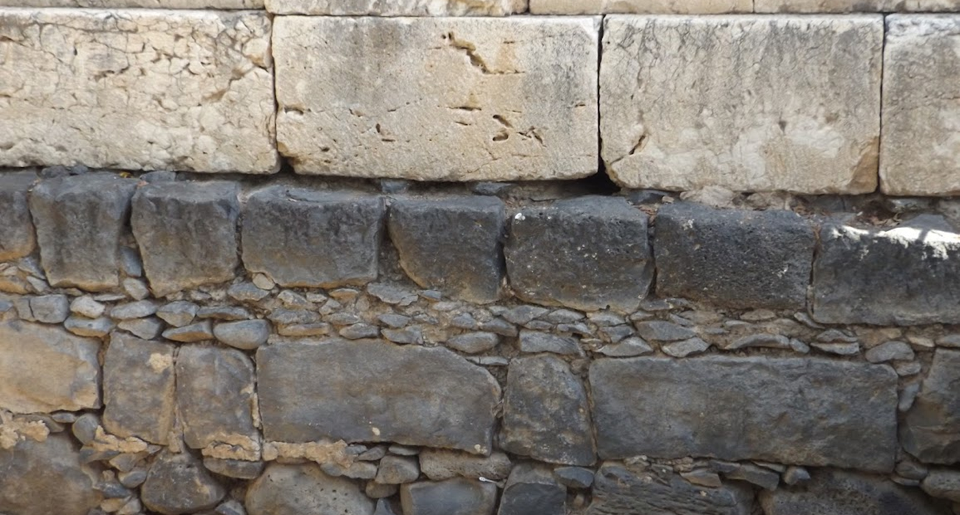

Studies in the Epistles
Foundations  Quarter 15
Lesson Eleven: Colossians 1:24—2:23

Slide 2
The Epistle To The Colossians
Theme: You are Complete in Christ !
Key Verse: “And you are complete in Him, who is the head of all principality and power” (Col. 2.10).
Purpose…
To assure the Colossians that Christ is all they need (1:1-29).
To warn them not to let anyone spoil what they have (2: 1-23).
To show them a picture of the true child of God (3:1-4:18).
Notes:
Paul had heard that the Colossian Christians, who had at one time been strong in their faith, were now vulnerable to deception about the faith (2:4, 8, 16, 18, 21–23).

Slide 3
Outline of Colossians
Introduction (Col. 1:1-14).
Salutation (1:1-2)
Thanksgiving and prayer (1:3-14)
The Preeminence Of Christ (Col. 1:15-23).
In creation (1:15-17)
In redemption (1:18-23)
II. The Apostle Of Christ (Col. 1:24—2:7)
Paul's service (1:24-29)
Paul’s concern for the Colossians (2:1-7)

Slide 4
Outline of Colossians
III. Warnings Against Colossian Heresy (Col. 2:8-23)
The faith of the Colossians was imperiled by philosophy, Judaism, angel worship, asceticism, and early Gnosticism.
IV. Living Life In Christ (Col. 3:1—4:6)
The mind must be set on things above (3:1-4)
Put off the old man, put on the new (3:5-17)
Relationship responsibilities (3:18-4:6)
V. Paul’s companions (4:7-14)
Commendations of his coworkers (4:7-9)
Greetings from his friends (4:10-14)
Conclusion (4:15-18)

Slide 5
The Epistle to the Colossians
Paul, the Apostle of Christ
Paul’s service (1:24-29)
Paul rejoices to suffer for and as a part of the church, the body of Christ (1 Thess. 1:4-5; Acts 14:22; 2 Cor. 1:6; Heb. 13:3).
The church is to suffer, and Paul is doing his part of the suffering.
Paul served the church as an appointed steward to make known God’s glorious will for the Gentiles: “Christ in you, the hope of glory” (cf. Ephesians 3:1-7).
In his preaching, Paul was striving with all the strength that God supplied to admonish and teach every man in order to present every man “perfect in Christ.”
Notes:
2 Thessalonians 1:4-5 so that we ourselves boast of you among the churches of God for your patience and faith in all your persecutions and tribulations that you endure, 5 which is manifest evidence of the righteous judgment of God, that you may be counted worthy of the kingdom of God, for which you also suffer;
Acts 14:22 strengthening the souls of the disciples, exhorting them to continue in the faith, and saying, "We must through many tribulations enter the kingdom of God.“
2 Corinthians 1:6 Now if we are afflicted, it is for your consolation and salvation, which is effective for enduring the same sufferings which we also suffer. Or if we are comforted, it is for your consolation and salvation.
Hebrews 13:3 Remember the prisoners as if chained with them—those who are mistreated—since you yourselves are in the body also.
“Perfect” (mature, ESV) is from τέλειος Thayer Definition:
1) brought to its end, finished
2) wanting nothing necessary to completeness
3) perfect

Slide 6
The Epistle to the Colossians
Paul, the Apostle of Christ
Paul’s concern for the Colossians (2:1-7)
Paul is concerned that the Colossians, Laodiceans, and all who had not seen him be knit together in love as they attain the full knowledge of the deep riches of God’s purpose for them (2:1-5).
All the treasures of wisdom and knowledge are in God!
Deceivers would try to convince them otherwise.
Paul rejoiced to see their ‘good order and steadfastness” in the faith.
Paul admonishes the saints to stick with what they had been taught in Christ – rooted in, established, and built up in it (2:6-7).
They must guard against becoming spiritual plunder through philosophy, empty deceit, human tradition, or worldly basics (2:8).
Notes:
“Order” is from τάξις (taxis) Thayer Definition: 1) an arranging, arrangement 2) order 2a) a fixed succession observing a fixed time 3) due or right order, orderly condition

Slide 7
The Epistle to the Colossians
Warnings Against Colossian Heresy (Col. 2:8-23)
The faith of the Colossians was imperiled by philosophy, Judaism, angel worship, asceticism, and early Gnosticism (2:8)
They must guard against becoming spiritual plunder through philosophy, empty deceit, human tradition, or worldly basics (2:8).
They are complete in Christ, who is the fullness of God (2:9-10).
They have been given new life through the death, burial, and resurrection of Christ (2:11-13)
They have been circumcised (sealed as God’s children) by being buried in baptism, raised through faith in the working of God, and made alive through the power of the resurrection (cf. Rom. 6:3-4).
Christ took away the Law that condemned us, nailing it to His cross and triumphing over the forces of evil (2:14-15).
Notes:
NOTE: Baptism is effective because of our faith AND the working of God!
In 2:14, some modern translations lean toward the idea of our sin record being canceled our wiped away at the cross (indicated also in v. 13). So the ESV translates Colossians 2:14 “by canceling the record of debt that stood against us with its legal demands. This he set aside, nailing it to the cross.”
But even here, the “legal demands” (i.e., the Law of Moses) is also under consideration.
The Law of Moses was nailed to the cross!!!!!!!!

Slide 8
The Epistle to the Colossians
Warnings Against Colossian Heresy (Col. 2:8-23)
Let no one judge you by a Law that has been nailed to the cross (2:16-17).
The Old Law contained shadows and copies of heavenly realities and the substance that is in Christ (Heb. 10:1; 9:23-24)
Let no one cheat you with fleshly thinking disguised as spirituality; hold fast as a united body to Christ as your Head (2:18-23).
Those living a new life in Christ have no business submitting to worldly, man-made regulations (1 Peter 1:18-19; Mark 7:8-9).
Self-made religion, asceticism, and outward displays of humility are of no value in the war against the flesh.
Notes:
Hebrews 10:1 For the law, having a shadow of the good things to come, and not the very image of the things, can never with these same sacrifices, which they offer continually year by year, make those who approach perfect.
Hebrews 9:23-24 Therefore it was necessary that the copies of the things in the heavens should be purified with these, but the heavenly things themselves with better sacrifices than these. 24 For Christ has not entered the holy places made with hands, which are copies of the true, but into heaven itself, now to appear in the presence of God for us;
1 Peter 1:18-19 knowing that you were not redeemed with corruptible things, like silver or gold, from your aimless conduct received by tradition from your fathers, 19 but with the precious blood of Christ, as of a lamb without blemish and without spot.
Mark 7:8-9 For laying aside the commandment of God, you hold the tradition of men—the washing of pitchers and cups, and many other such things you do." 9 He said to them, "All too well you reject the commandment of God, that you may keep your tradition.

Slide 9
Key concepts:
We rejoice to suffer as part of the body of Christ.
Preaching should be aimed at making people complete in Christ.
Christ is the fullness of God, and we are complete in Him!
We enter a new life in baptism through faith in the working of God.
Christ took away the Law that condemned us, triumphing over the forces of evil.
We must stay grounded in Christ and resist being drawn away by popular philosophy, spiritual adventurism, self-imposed religion, or worldly traditions.

