Slide 1
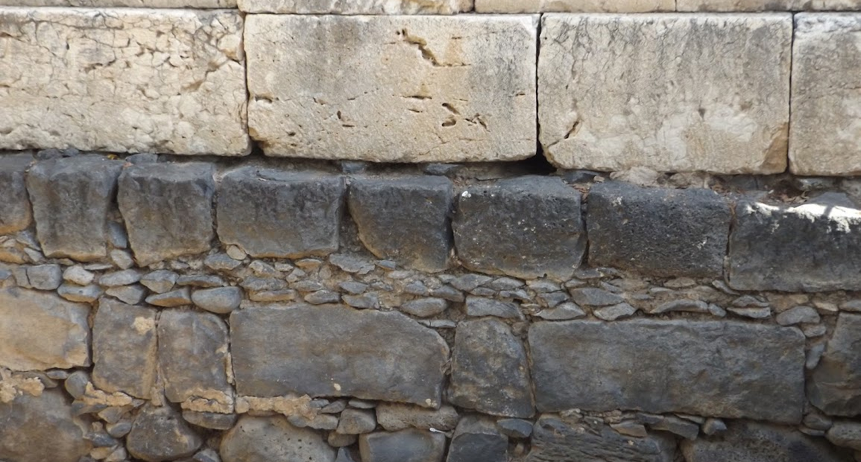

Studies in the Epistles
Foundations  Quarter 15
Lesson Thirteen: Philemon

Slide 2
The Epistle to Philemon
Theme: A Brotherly Appeal
Key Verse: “For love's sake I rather appeal to you—being such a one as Paul, the aged, and now also a prisoner of Jesus Christ— I appeal to you for my son Onesimus…” (Philemon 9-10).
Purpose…
  To encourage Philemon to continue in faith and love, in sharing his faith, and in being an encouragement to others.
  To appeal to Philemon out of love to receive his servant Onesimus back as a brother.
Notes:
Incarcerated in Rome, Paul apparently received a visitor named Onesimus. He was a runaway slave who had fled from his master, a man named Philemon, a friend of Paul’s who lived in Colossae. When Onesimus ran away, he evidently caused Philemon some financial loss, perhaps taking with him money or goods which belonged to his master. Eventually, Onesimus made his way to Rome. In Rome he somehow came to Paul and through Paul's teaching he became a Christian. A bond of friendship developed between Paul and Onesimus. Onesimus performed valuable services for Paul. He may have run errands for Paul, who being under arrest was not free to come and go as he pleased. Whatever Onesimus did, it greatly aided Paul's ministry.
Paul would have liked to keep Onesimus with him. However, he recognized that the duty Onesimus owed to Philemon, his master. Paul decided Onesimus should return to Philemon. Paul was about to send Tychicus, a co-worker, to Colosse with a letter Paul had written to the church there. Philemon was a member of that church. Tychicus' traveling to Colosse offered Paul the opportunity to send Onesimus with Tychicus to Philemon. Onesimus went willingly as a penitent Christian to seek his master's forgiveness and to return to his service in Philemon's household. Paul wrote his letter to Philemon and had Tychicus hand carry it to him. In Colossians 4:7-9 he writes, “Tychicus, a beloved brother, faithful minister, and fellow servant in the Lord, will tell you all the news about me. I am sending him to you for this very purpose, that he may know your circumstances and comfort your hearts, with Onesimus, a faithful and beloved brother, who is one of you. They will make known to you all things which are happening here.”

Slide 3
Outline of Philemon
Salutation (1-3).
  Paul’s prayer for Philemon (4-7)
  II. Paul’s appeal for Onesimus (8-22)
  III. Final Greetings (23-25)

Slide 4
The Epistle to Philemon
Salutation (1-3)
  Paul writes in the company of Timothy to Philemon and others:
    Apphia is a female, possibly Philemon’s wife.
    Archippus is likely also a member of Philemon’s household, (perhaps his son), and is “a fellow soldier” of Paul’s (Col. 4:17, cf. Phil. 2:25).
    The church in Philemon’s house (cf. Rom. 16:3-5; Col. 4:15).
  Greetings of “grace and peace.”
Notes:
Paul also writes to the Philippians and the Colossians in the company of Timothy while in prison. Php_1:1; Col_1:1;
Colossians 4:17 And say to Archippus, "Take heed to the ministry which you have received in the Lord, that you may fulfill it.“
Paul uses similar language to describe Epaphroditus. Philippians 2:25 Yet I considered it necessary to send to you Epaphroditus, my brother, fellow worker, and fellow soldier, but your messenger and the one who ministered to my need;
Aquilla and Priscilla, Nymphas (Laodicea) also hosted churches in their houses (Romans 16:3-5; Colossians 4:15)

Slide 5
The Epistle to Philemon
Paul’s prayer for Philemon (4-7)
  Paul thanks God continually for Philemon’s love and faith.
  Paul prays that Philemon might share is faith effectively as people see and hear all of the good that Jesus put in him.
  Paul is joyous and encouraged to see how Philemon’s love had refreshed the saints.

Slide 6
The Epistle to Philemon
Paul’s appeal for Onesimus (8-22)
  Although Paul could boldly command Philemon, for “love’s sake” he makes his appeal as an aged prisoner of Christ (8-9).
    Paul makes love the focus of this appeal because love is the very core of his relationship in Christ with Philemon.
  His appeal for Onesimus briefly explained (10-12).
    Paul had “begotten” Onesimus while in chains.
    Onesimus was once unprofitable to Philemon, but now is profitable.
      NOTE: The name Onesimus means “profitable” or “useful.”
    He is sending Onesimus back and asking Philemon to receive him.
      Sinners who repent and are forgiven need acceptance in God’s family.
      Paul’s own experience would have attested to this (cf. Acts 9:26-28).
Notes:
The word “receive” connotes receiving into friendship, fellowship, or one’s home. “To take as one’s companion” (Thayer).

Slide 7
The Epistle to Philemon
Paul’s appeal for Onesimus (8-22)
  Things for Philemon to consider:
    Paul wished to keep Onesimus to minister to him in his chains, but did not want to do so without the consent of Philemon (13-14)
      Good deeds are best done voluntarily, not by compulsion (2 Cor. 9:5).
    A plausible way to look at the turn of events (15-16).
      “Perhaps” this has all happened so that Paul and Philemon might have Onesimus as a beloved brother forever.
      Paul does not presume to KNOW how God works all things together for good, but he knows this could be an example (Rom. 8:28).
Notes:
2 Corinthians 9:5 Therefore I thought it necessary to exhort the brethren to go to you ahead of time, and prepare your generous gift beforehand, which you had previously promised, that it may be ready as a matter of generosity and not as a grudging obligation.
Romans 8:28 And we know that all things work together for good to those who love God, to those who are the called according to His purpose.

Slide 8
The Epistle to Philemon
Paul’s appeal for Onesimus (8-22)
  Things for Philemon to consider
    If Philemon counts Paul as a partner, Philemon should receive Onesimus as he would receive Paul (17-19).
      For his part, as a partner, Paul asks that any wrongs committed* by Onesimus, or any debts he had incurred, be put on his “account.”
      He reminds Philemon of his own debt to Paul.
    Paul asks Philemon to let him have joy in the Lord (20).
    He has confidence in Philemon and knows that Philemon will do even more than he is asking (21).
    Anticipating the best of outcomes, Paul asks Philemon to make preparations for him to be a guest in Philemon’s home (22).
Notes:
“But if he hath wronged thee at all” or “If he has wronged you or owes anything” (ei de ti ēdikēse se). Condition of the first class, assumed to be true.
1) Onesimus did wrong (ēdikēse, first aorist active indicative of adikēo, to wrong, without justice). (Robertson)
2) The same word is used in v. 17 If then thou countest me a partner (ei oun me echeis Koinéōnon). As I assume that you do, condition of the first class. (Robertson)
3) It’s like we might say in English, “If you are going to Walmart, pick up a loaf of bread and some milk.” The statement assumes that one is in fact going to Walmart.

Slide 9
Important Lessons:
Pray always for loved ones in Christ.
Share your faith effectively by exhibiting faith and love for all.
Make love the focus of your relationship with others.
Sinners who repent and are forgiven need acceptance in God’s family.
Good deeds are best done voluntarily.
All things work together for good for those who love God, although we do not always know how.
As partners in Christ, we are willing to bear each others’ burdens with mutual confidence, anticipating good outcomes, and growing closer in love.

