Slide 1
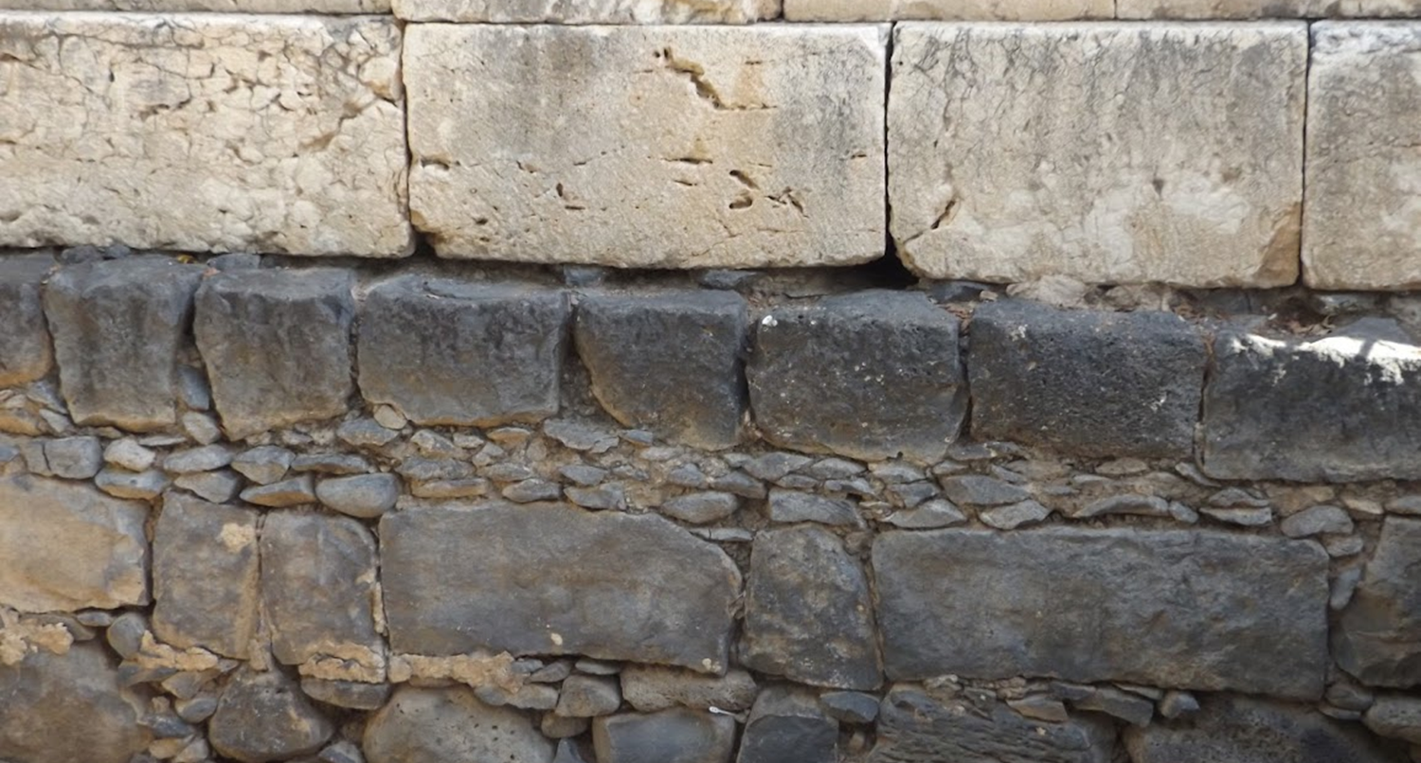

Studies in the Epistles
Foundations  Quarter 15
Lesson Sixteen: Hebrews 1-3

Slide 2
Introduction to Hebrews
Written to Hebrew Christians who were familiar with the Old Testament Scriptures.
Contains more than 30 O.T. quotations
Written to encourage Jewish Christians to hold fast their faith despite being persecuted and ostracized (3:6; 4:14; 10:23). They are encouraged to “run with endurance” (12:1).
“LET US” → This encouraging phrase of exhortation occurs 12 times in Hebrews (4:1, 11, 14, 16; 6:1; 10:22, 23, 24; 12:1, 28; 13:13, 15)

Slide 3
Theme: The Superiority of Christ
Jesus Christ is God’s Spokesman in these last days!
As God’s Son, He is superior to the angels and Moses (1:1 — 4:11)
As High Priest after the order of Melchizedek, He is superior to the Levitical Priesthood (4:12—7:28)
He is the Mediator of a better covenant (8:1— 10:29)
He is the Author & Finisher of our faith (11:1—13:25)

Slide 4
Theme: The Superiority of Christ
Everything that Christ has accomplished and established is “better” than what came before:
A better hope (7:19)
A better covenant (7:22)
Better promises (8:6)
Better sacrifices (9:23; 12:24)
A better [heavenly] country (10:34; 11:16)
God has “provided something better for us!” (Hebrews 11:40)

Slide 5
Author of Hebrews
The Lord may have used Paul as His instrument to write to the Hebrews (cf. 2 Timothy 3:16-17).
Early Christians such as Clement of Rome (A.D. 95) attribute the letter to Paul .
The writer was a companion and friend of Timothy (13:23).
The writer had been in chains; he hoped to “be restored to” the Hebrews soon (10:34; 13:19).
The epistle was written from Rome, where Paul was imprisoned at least once (13:24).
The writer was thoroughly familiar with the Law of Moses (Acts 22:2-3; Philippians 3:4-6).
Pauline authorship best explains the omission of his name to a Jewish audience.

Slide 6
God Has Spoken Through His Son (Hebrews 1:1-3)
God “at various times and in various ways* spoke in time past to the fathers by the prophets.”
In contrast to His previous methods, in these “last days,” God speaks to “us” through “His Son.”
THEN NOW
In Time Past “In these last days”
To the Fathers To us
By the prophets Through His Son
The prophets foretold that in the last days the Kingdom would be established, and God’s Spirit would be poured out (Dan. 2:28, 44; Isa. 2:2; Joel 2:28). We are now in the last days (Acts 2:16-17).
In these last days, we must heed Jesus as the prophet of God (Acts 3:22-24).
Notes:
The unity of the message despite the variety of methods of communication proves that the Bible is the product of One Mind – God’s!
Although God used 40 different men over a period of 1,500 years to convey His word in written form (and more to convey it orally). Yet the message is always consistent (2 Peter 1:20-21)

Slide 7
God Has Spoken Through His Son (Hebrews 1:1-3)
The Superiority of Christ
Heir of all things (Psalm 2:7-8; Philippians 2:5-11).
Through whom He made the Worlds (John 1:1-3; Col. 1:16).
The brightness of His glory and the express image of His person (John 1:18; 17:24-26; Colossians 1:15; 2:9; 1 Timothy 3:16).
Upholding all things (Col. 1:17; Acts 17:28).
Purged our sins (Ephesians 1:7; Heb. 9:24-28).
Sitting at God’s right hand (Hebrews 8:1; Ephesians 1:20-23).

Slide 8
Christ has a “More Excellent Name” than the Angels (Hebrews 1:4-14)
Angels are higher than men, but Jesus is better than the angels (1:4).
Angels do not rank as deity (Revelation 19:10, 22:8-9).
No angel was ever told by the Father… (1:5-6).
“You are my Son” (Psalm 2:7-8).
“I will be to Him a Father…” (Psalm 89:26).
“Let all the angels of God worship Him” (Psalm 97:7).

Slide 9
Christ has a “More Excellent Name” than the Angels (Hebrews 1:4-14)
No angel has been exalted to God’s throne (1:7-13).
Angels have their place as servants of God (1:7; Psalm 104:4)
Christ has been exalted to a much higher position (1:8-13)
Possesses an eternal throne (Psalm 45:6-7).
Exalted above companions.
Extolled as the everlasting Creator (Ps. 102:25-27).
Elevated to the Father’s right hand (Psalm 110:1; Acts 2:33-36; Ephesians 1:20-23; Hebrews 8:1).
This does not minimize the importance of Angels (1:14)
Angels are ministering spirits sent forth for our benefit.
They carry out at least a portion of the “providence of God” in the lives of His children (Matthew 18:10; Luke 16:22).
Notes:
Psalms 45:6-7 Your throne, O God, is forever and ever; A scepter of righteousness is the scepter of Your kingdom. 7 You love righteousness and hate wickedness; Therefore God, Your God, has anointed You With the oil of gladness more than Your companions.
Psalms 102:25-27 Of old You laid the foundation of the earth, And the heavens are the work of Your hands. 26 They will perish, but You will endure; Yes, they will all grow old like a garment; Like a cloak You will change them, And they will be changed. 27 But You are the same, And Your years will have no end.
Psalms 110:1 A Psalm of David. The LORD said to my Lord,"Sit at My right hand, Till I make Your enemies Your footstool.“
Matthew 18:10 "Take heed that you do not despise one of these little ones, for I say to you that in heaven their angels always see the face of My Father who is in heaven.
Luke 16:22 So it was that the beggar died, and was carried by the angels to Abraham's bosom. The rich man also died and was buried.

Slide 10
We must not Neglect so Great a Salvation (Hebrews 2:1-4)
“Therefore” we must “give the more earnest heed…”
Based on the position of Christ, we must give careful attention to His words (2 John 9).
“Lest we drift away” (3:12-14; 4:1, 11; 6:1-4).
The word spoken through angels proved steadfast.
Angels ordained the Old Law (Galatians 3:19; Acts 7:53).
The Lord demanded obedience and every disobedience was punished (Heb. 10:26-31).
How Shall We Escape If We Neglect So Great a Salvation?
This question is rhetorical.
The great salvation was first “spoken by the Lord”
It was confirmed by the apostles
God bore witness with miracles

Slide 11
Man Can Regain Through Christ What He Lost by Sin (Hebrews 2:5-8)
The world to come is in subjection to Christ (2:5; Eph. 1:20-23).
God originally put this world in subjection to man (2:6-8; Psalm 8:4-6; Gen. 1:26-28).
Man’s sin displaced him from this position (Genesis 3:16-19; cf. Romans 8:19-22).
Man needed help to fulfill the purpose for which God created him (2:8).

Slide 12
Christ Became Flesh That He Might Restore Man (Hebrews 2:9-16)
Christ became man…
To taste of death (2:9).
This is WHY He was made lower than the angels!
To bring many sons to glory (2:10).
He was perfected through suffering.
He became the perfect captain, author, prince and trailblazing pioneer of our salvation through suffering (12:2; 5:8-9; Acts 3:15; 5:31)
To qualify us as His brethren by sanctifying us (2:11-13).
This intimate relationship between Christ and His family was proclaimed long ago (2:12-13; cf. Psalm 22:22; Isaiah 8:18).
Notes:
This section of Hebrews anticipates the question, “If Christ is so superior, why did He become man?”

Slide 13
Christ Became Flesh That He Might Restore Man (Hebrews 2:9-16)
Christ became man…
To destroy the devil and release men from bondage (2:14-15).
Through Jesus’ death, man is freed from Satan’s grip (Romans 8:3-4; Revelation 12:10-11).
Through Jesus’ death, man is released from the fear of death (1 Corinthians 15:53-57)
This help was not provided to angels, but to the seed of Abraham (2:16; Galatians 3:29)
To be a merciful High Priest, able to aid those who are tempted (2:17-18).

Slide 14
An Inspired Comparison of Christ and Moses (Hebrews 3:1-6)
As “holy brethren” and “partakers of a heavenly calling” readers are asked to consider Christ, our Apostle and High Priest.
Jesus was sent into the world from heaven to come back to heaven into God’s presence on behalf of the world.
As a Builder, Christ is superior to Moses.
Both were faithful to Him who appointed them (3:2; 8:5)
Christ is worthy of “more honor” because He who built the house has more honor than the house (3:3-4; 1:3; Matthew 16:18).
Moses was God’s Servant. Jesus is His Son.
Moses was a servant in God’s house (3:5; Num. 12:7).
His work was merely a preface to the work of Christ (10:1; Gal. 3:23-25).
Jesus Christ is a Son over God’s house (3:6a; Eph. 1:22-23; cf. John 8:36).
We are His house “if we hold fast the confidence and the rejoicing of the hope firm to the end” (3:6).

Slide 15
Beware Lest You Depart from the Living God (Hebrews 3:7-19)
Heed the warning of the Old Testament (3:7-11; Ps. 95:7-11).
Do not harden your hearts like the Israelites in the rebellion in the wilderness (3:8; Exo. 17:1-7)
They “tested” and “tried” God (3:9)
God was angry with them because they always went astray in their hearts and did not know His ways (3:10)
The consequence was that God swore “they shall not enter my rest” (3:11; Deuteronomy 1:35; Numbers 14:23)
Notes:
Psalms 95:7-11 For He is our God, And we are the people of His pasture, And the sheep of His hand. Today, if you will hear His voice: 8 "Do not harden your hearts, as in the rebellion, As in the day of trial in the wilderness, 9 When your fathers tested Me; They tried Me, though they saw My work. 10 For forty years I was grieved with that generation, And said, 'It is a people who go astray in their hearts, And they do not know My ways.' 11 So I swore in My wrath, 'They shall not enter My rest.' "

Slide 16
Beware Lest You Depart from the Living God (Hebrews 3:7-19)
Beware of falling like the Israelites (3:12-15).
Those being warned are “brethren” (3:12)
We must exhort one another daily to prevent being hardened by the deceitfulness of sin (3:13)
Sin deceives → Hardens heart → Leads to Unbelief
DAILY mutual exhortation is the preventative.
We are partakers with Christ “if we hold fast” (3:14-15).
If we do not hold fast, we are neither part of His house nor partakers with Him of the inheritance.
We can so sin as to be lost (4:1, 11; 6:4-6; 10:26-31; 1 Cor. 9:27; 10:12; 1 Tim. 1:19)
We must not make the same mistake Israel made “in the rebellion.”
Notes:
Partakers of the heavenly calling (3:1)
Being warned about “departing from the living God” -- one cannot depart from a place he has never been!
The departure occurs if we have “an evil heart of unbelief” -- like the Israelites who “hardened their hearts” (cf. 3:8)

Slide 17
Beware Lest You Depart from the Living God (Hebrews 3:7-19)
Analysis of Israel’s apostasy (3:16-19)
Those who heard, rebelled (3:16)
They experienced God’s wrath due to their sin.
Their corpses fell in the wilderness.
They could not enter His rest because they “did not obey” (NKJV), “they believed not” (KJV, 3:18), and they “were disobedient” (ESV).
Ultimately, they could not enter in because of “unbelief” (3:19).
Notes:
The last words in verses 18 and 19 are defined in Thayer’s Greek Lexicon as follows.
Apeitheo: 1) not to allow one’s self to be persuaded 1a) to refuse or withhold belief 1b) to refuse belief and obedience 2) not to comply with
Apistia :1) unfaithfulness, faithless

Slide 18
Important Lessons:
Hebrews is about encouraging Christians to stay faithful and run the race to heaven with endurance.
As God’s Son, Jesus is the ultimate spokesman for God.
Jesus is superior to the angels and Moses, so we must pay extra attention to hear and do what He has said.
Jesus lowered Himself and became a man so that He could die for our sins, sanctify us, bring us into God’s family, and be our Great High Priest!
We must guard against drifting away into unbelief and disobedience like the Israelites did.

