Slide 1
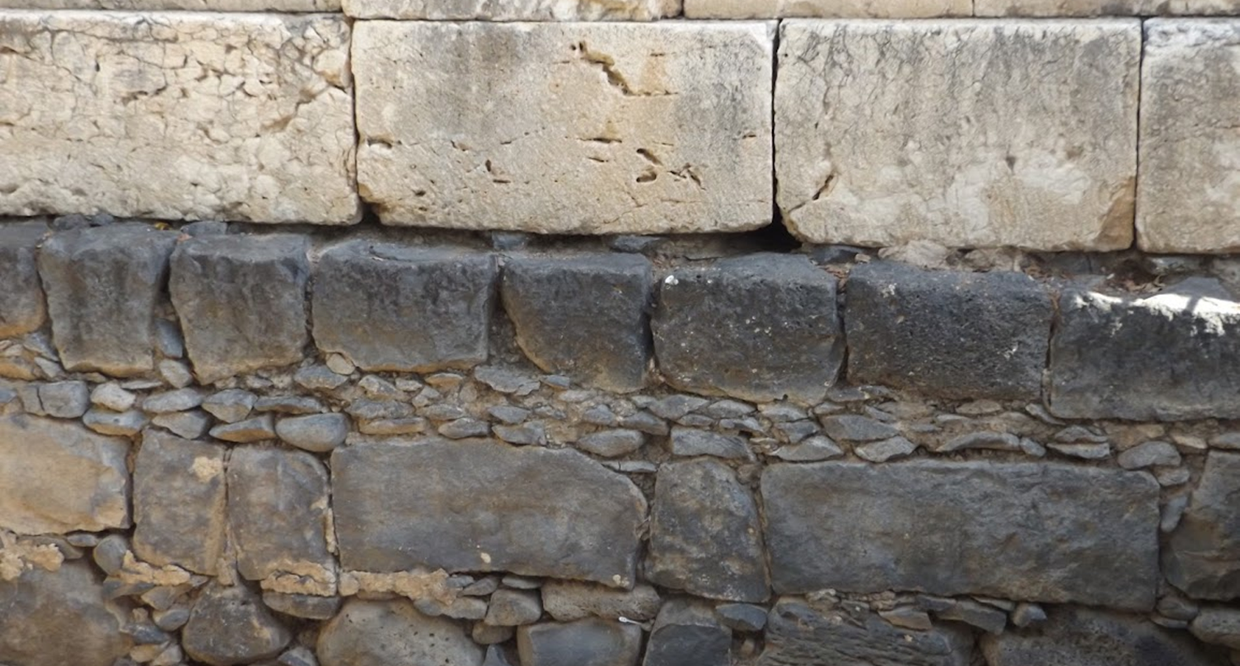

Studies in the Epistles
Foundations  Quarter 16
Lesson Eighteen: Hebrews 7-8

Slide 2
Theme: The Superiority of Christ
Everything that Christ has accomplished and established is “better” than what came before:
A better hope (7:19)
A better covenant (7:22)
Better promises (8:6)
Better sacrifices (9:23; 12:24)
A better [heavenly] country (10:34; 11:16)
God has “provided something better for us!” (Hebrews 11:40)

Slide 3
How can Christ be a High Priest?
Hebrew Christians would have understood the importance of the High Priest!
Hebrews has already asserted that Christ is our High Priest (2:17; 3:1; 4:14),
He has been described as a High Priest after the “order of Melchizedek.”
This “order” has not yet been explained (5:6, 10-11)
But it is now asserted again (6:20)
How could Christ be a High Priest, since priests were to come from the tribe of Levi and High Priests from the lineage of Aaron (Exo. 28-29; Lev. 8-10; Num. 16-18)?

Slide 4
Christ is a Priest after the Order of Melchizedek (Hebrews 7:1-10)
Melchizedek was both priest and king (7:1-2).
He is mentioned twice in the Old Testament (Gen. 14:1-20; Ps. 110:4).
His name means “king of righteousness.”
“Salem” means “peace.”
The Christ of prophecy was to be both a king and priest (Zech. 6:13).
Melchizedek is like the Son of God (7:3).
His priesthood was not determined by genealogy.
He had no recorded beginning or end -- He remains a priest continually.
Notes:
Zechariah 6:12-13 Then speak to him, saying, 'Thus says the LORD of hosts, saying: "Behold, the Man whose name is the BRANCH! From His place He shall branch out, And He shall build the temple of the LORD; 13 -- Yes, He shall build the temple of the LORD. He shall bear the glory, And shall sit and rule on His throne; So He shall be a priest on His throne, And the counsel of peace shall be between them both." '

Slide 5
Christ is a Priest after the Order of Melchizedek (Hebrews 7:1-10)
Consider the greatness of Melchizedek (7:4-10).
Abraham paid him tithes (7:4).
Levitical priests (descendants of Abraham), received tithes from their brethren but PAID tithes to Melchizedek through Abraham (7:5-6).
Melchizedek blessed Abraham – “the less is blessed by the better” (7:7).
Melchizedek received tithes as one who “lives” – not a mere mortal (7:8).
Even Levi paid tithes through Abraham (7:9-10).
The greatness of Abraham makes the above facts all the more significant (2 Chron. 20:7; Isa. 41:8; 51:2; Gen. 12:1-3)
Notes:
2 Chronicles 20:7 Are You not our God, who drove out the inhabitants of this land before Your people Israel, and gave it to the descendants of Abraham Your friend forever?
Isaiah 41:8 "But you, Israel, are My servant, Jacob whom I have chosen, The descendants of Abraham My friend.
Isaiah 51:1-2 "Listen to Me, you who follow after righteousness, You who seek the LORD: Look to the rock from which you were hewn, And to the hole of the pit from which you were dug. 2 -- Look to Abraham your father, And to Sarah who bore you; For I called him alone, And blessed him and increased him."

Slide 6
God Foretold of this Change of Priesthood (Hebrews 7:11-17)
Since the Levitical priesthood did not bring perfection, another priest after the order of Melchizedek was needed (7:11).
The change of the priesthood necessitated a change of the law (7:12-14)
Jesus came from Judah, a tribe of which the Law of Moses spoke nothing concerning priesthood.
SILENCE PROHIBITED! (i.e. Uzziah, 2 Chron. 26:19)
The Lord had promised to ordain another Priest according to the order of Melchizedek (7:15-17)
He did not come by the law of a fleshly commandment (the Old Law), but by the power of an endless life!
Notes:
2 Chronicles 26:18-19 And they withstood King Uzziah, and said to him, "It is not for you, Uzziah, to burn incense to the LORD, but for the priests, the sons of Aaron, who are consecrated to burn incense. Get out of the sanctuary, for you have trespassed! You shall have no honor from the LORD God." 19 -- Then Uzziah became furious; and he had a censer in his hand to burn incense. And while he was angry with the priests, leprosy broke out on his forehead, before the priests in the house of the LORD, beside the incense altar.

Slide 7
Important Applications (Hebrews 7:1-17)
Biblical silence does not authorize or give permission (Hebrews 7:14).
The Bible is complete. We must not ADD where it is silent (2 Timothy 3:16-17; 2 John 9; Proverbs 30:6)
Christ is our High Priest, and we are ALL priests
There is no special order of priests appointed by God or man to offer service on our behalf.
We are made kings and priests by the blood of Christ (Revelation 1:5-6; 5:9-10).
We offer spiritual sacrifices (1 Peter 2:5, 9; Heb. 13:15).
Notes:
Proverbs 30:6 Do not add to His words, Lest He rebuke you, and you be found a liar.
Revelation 1:5-6 and from Jesus Christ, the faithful witness, the firstborn from the dead, and the ruler over the kings of the earth. To Him who loved us and washed us from our sins in His own blood, 6 -- and has made us kings and priests to His God and Father, to Him be glory and dominion forever and ever. Amen.
Revelation 5:9-10 And they sang a new song, saying: "You are worthy to take the scroll, And to open its seals; For You were slain, And have redeemed us to God by Your blood Out of every tribe and tongue and people and nation, 10 -- And have made us kings and priests to our God; And we shall reign on the earth."
1 Peter 2:5 you also, as living stones, are being built up a spiritual house, a holy priesthood, to offer up spiritual sacrifices acceptable to God through Jesus Christ.
1 Peter 2:9 But you are a chosen generation, a royal priesthood, a holy nation, His own special people, that you may proclaim the praises of Him who called you out of darkness into His marvelous light;
Hebrews 13:15 Therefore by Him let us continually offer the sacrifice of praise to God, that is, the fruit of our lips, giving thanks to His name.

Slide 8
Better Things from a Better Priesthood (Overview of Hebrews 7:18-28)
A better hope (7:18-19)
A surety of a better covenant (7:20-22)
An unchangeable priesthood (7:23-24)
Salvation to the uttermost (7:25-26)
A sinless sacrifice sufficient for all men for all time (7:27-28)

Slide 9
The Better Priest Brings a Better Hope
There is “an annulling* of the former commandment” because it is weak (7:18; 8:13; 2 Cor. 3:7-11).
The Law was weak because of its inferior sacrifices (Heb. 10:1-4, 10-12), but in the present context its weakness relates more to its weaker priesthood.
Priests were not made by an oath of God (7:21).
Priests were prevented by death from continuing (7:23).
Priests needed to offer daily sacrifices (7:27).
The Law made nothing perfect! (7:19).
The bringing in of a “better hope” enables US to “draw near to God” (7:19).
Notes:
The word translated “annulling” means “cancelation” (Strong’s Dictionary)

Slide 10
The Better Priest Brings in a Better Covenant and a Better Priesthood
He was made a priest by God’s oath (7:20-21).
A law can be annulled, but an oath of God lasts forever (6:16-18).
“He has sworn and will not relent, ‘You are a priest forever’” (7:21).
The permanence of Christ’s priesthood guarantees the better, more enduring nature of the covenant (7:22).
The Law had “many priests” because each one was prevented by death* from continuing (7:23).
Because Christ “continues forever” He has an unchangeable priesthood (7:24-25, 7:16).
He continues as a priest forever by virtue of His everlasting life AND God’s everlasting oath.
Notes:
Old Testament priests might begin their service between the ages of 20 and 30, and their duties ceased when they turned 50, if they lived that long. (1 Chronicles 23:24, 27; 2 Chronicles 31:17; Numbers 8:23-26; 4:3, 23, 30, 35ff.)

Slide 11
The Better Priest is able to “Save to the Uttermost”
Christ is able to save to the uttermost both in terms of QUANTITY and QUALITY (7:25).
Salvation is for all men (Heb. 2:9; 1 Tim. 2:6). The gospel was to be carried to the “uttermost part of the earth” (Acts 1:8, KJV).
And every spiritual need is amply supplied (Eph. 1:3; Phil. 4:19).
Christ is so ABLE because He is perfectly qualified (7:26).
Holy, Harmless, Undefiled, Separated from sinners, Made higher than the heavens – exalted (1:3; 8:1).
Christ is able because He made the BEST sacrifice (7:27).
Christ did not need to offer a sacrifice for Himself, and the sacrifice that He did offer was offered “once for all”(7:27).
The effects of His sacrifice are permanent (9:26).
Notes:
Philippians 4:19 But my God shall supply all your need according to his riches in glory by Christ Jesus.

Slide 12
The Better Priest is Perfect Hebrews 7:28
Which Priest Would You Rather Have?
One appointed by the law or…
One appointed by an eternal oath?
One taken from men or…
One Who is God’s Son?
One who has weakness or…
One who has been perfected forever?

Slide 13
The Priesthood of Christ is “THE MAIN POINT”
Christ’s sovereign position at God’s right hand identifies Him as a High Priest after the order of Melchizedek; He is both King and Priest (8:1; 1:3, 13; 10:12:12:2).
The “true tabernacle” was erected by the Lord, not by man (8:2)
Notes:
He was elevated to this position upon His ascension (Ephesians 1:20-23; Acts 2:30-36)
He will remain there till every enemy is put under His feet (Hebrews 10:12-13; 1 Cor 10:25)
If we accept Him as our Priest we must acknowledge Him as our King! (Zech 6:12-13)
Premillennialists deny that He now reigns as King

Slide 14
Christ Serves as Priest in the “True Tabernacle”
Christ’s Priestly service requires Him to sacrifice (8:3).
His offering could not be the same as the priests on earth, or else His priesthood would be superfluous (8:4).
Levitical priests served a “copy and shadow of heavenly things” (8:5)
A Copy or a Shadow represents the true and original!
Moses was instructed to make the tabernacle “according to the pattern” precisely because it represented heavenly realities (8:5, Exodus 15:9, 40; 26:30; 27:8; Acts 7:44).
The principle of following God’s pattern applies to us as well (2 John 9; Rev. 22:18-19; Gal. 1:8-9).
Notes:
Moses and the children of Israel may not have fully understood why something had to be done a certain way.
Nor would they have comprehended the realities that their service in the tabernacle represented.
But Moses still had to follow the pattern.
So do we! (2 Timothy 1:13; Phil. 3:17; Rom. 6:17)

Slide 15
Christ is the Mediator of a Better Covenant
Christ obtained a more excellent ministry (8:6).
He serves in the true tabernacle (8:2; 9:11, 25).
He is the Mediator of a better covenant (8:6b).
The New Covenant has better promises.
The Old Covenant promised many earthly benefits (Deut. 28:1-14).
The New Covenant has enduring spiritual promises (Eph. 1:3, 7; Jn. 3:16).
The First Covenant accomplished the purpose God had for it.
Its law was “holy, just and good” (Romans 7:12).
It taught man the knowledge of sin (Rom 7:7, 13).
It brought us to Christ (Rom. 8:3; Gal. 3:23-25).
But the “fault” in the first covenant was that there was no remedy for man’s imperfection (8:7-8a; 7:18-19; 10:1; Gal. 3:21).
Notes:
Mediator is translated from μεσίτης (mesitēs)
“One who intervenes between two, either in order to make or restore peace and friendship, or form a compact, or for ratifying a covenant” (Thayer)
Christ is our One Mediator (1 Timothy 2:5)

Slide 16
The Prophetic Purpose of the New Covenant
The New Covenant was promised by God (Hebrews 8:8-12 → Jeremiah 31:31-34).
It would be made “with the house of Israel and with the house of Judah” (8:8).
Just as the promises to the seed of Abraham had spiritual fulfillment, (Heb. 2:16; Rom. 4:13-16; Gal, 3:29), these promises would be for spiritual Israel (Gal. 6:15-16).
The New is unlike the Old in key ways (8:9).
“They did not continue in my Covenant.”
“I disregarded them” (cf. Jeremiah 2:5-13).

Slide 17
The Better Blessings of The New Covenant”
God’s laws would be put in the minds and written on the hearts from the outset (8:10a).
The Lord and His people would be with one another (8:10b).
A holy God dwells among His holy people (2 Cor. 6:16-18).
Knowledge of God will be possessed by every participant in the covenant. (8:11).
Mercy and Forgiveness are full and free (8:12).
The Lord “will remember” our sins “no more.”
This stands in contrast to the Old Covenant in which there was a yearly reminder of sins (Hebrews 10:2-3).
Notes:
The First Covenant had been written on stones (Exodus 34:1, 28).
Reminders of it were written on doorposts, etc. (Deut. 6:7-9; Psalm 78:5-6).
While God expected obedience from the heart, children entered into the covenant by right of physical birth, and were taught the laws as they matured.
Those who enter the New Covenant are first taught, then enter the covenant of their own volition (John 1:12-13; 6:44-45)

Slide 18
The First Covenant is made Old, Obsolete and Vanishes Away
The New Covenant makes the First Covenant obsolete (8:13).
“New” here is translated from “kainos” (καινός) and refers to a thing’s substance – “a new kind, unprecedented, novel…unheard of” (Thayer).
In Hebrews 12:24, “new” is from “neos” (νέος) which refers to new with respect to freshness, “regenerate” (Strong) or “recently born” (Thayer).
“Obsolete” means “worn out” (Strong).
The Old is “ready to vanish away.”
Having been nailed to the cross (Col. 2:14).

Slide 19
Important Lessons:
Jesus Christ is our High Priest after the order of Melchizedek – a Kingly Priest, who is God’s eternal Son.
Biblical silence does not grant permission.
As our Great High Priest, Christ is perfectly suited to help us draw near to God; He brings a better hope by offering a better sacrifice.
Christ is the minister of the “true tabernacle” of which the Old Testament tabernacle was a mere copy.
Christ is the mediator of a better Covenant in which God’s people truly know Him and receive complete forgiveness of sins.

