Slide 1
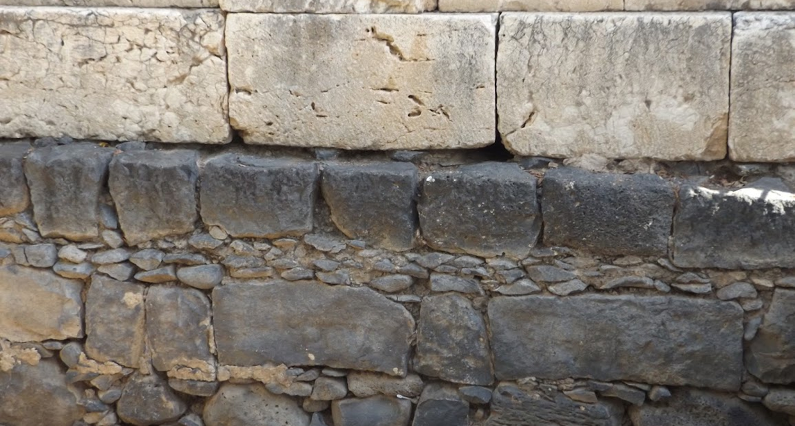

Studies in the Epistles
Foundations  Quarter 15
Lesson One: 1 Thessalonians 1:1—2:16

Slide 2
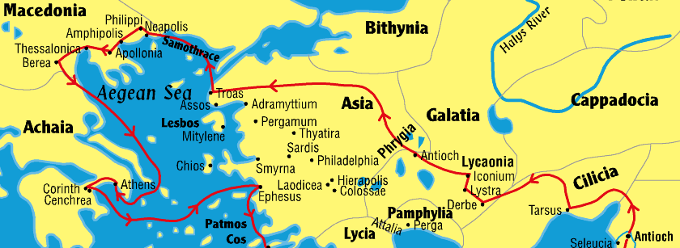
Paul’s 2nd Missionary Journey Paul and Silas (minus Luke) pass through Amphipolis and Appolonia and come to Thessalonica (17:1)

Slide 3
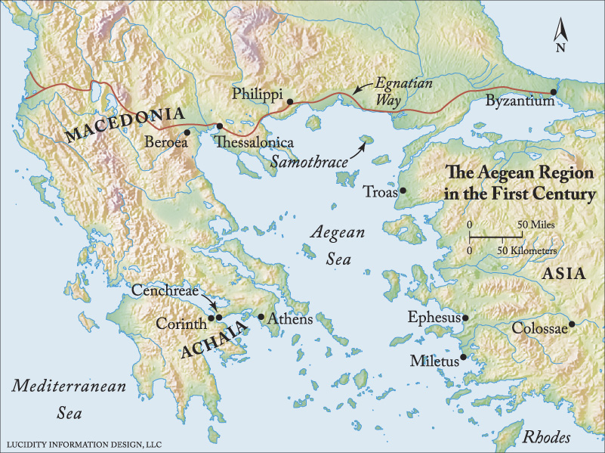

Slide 4
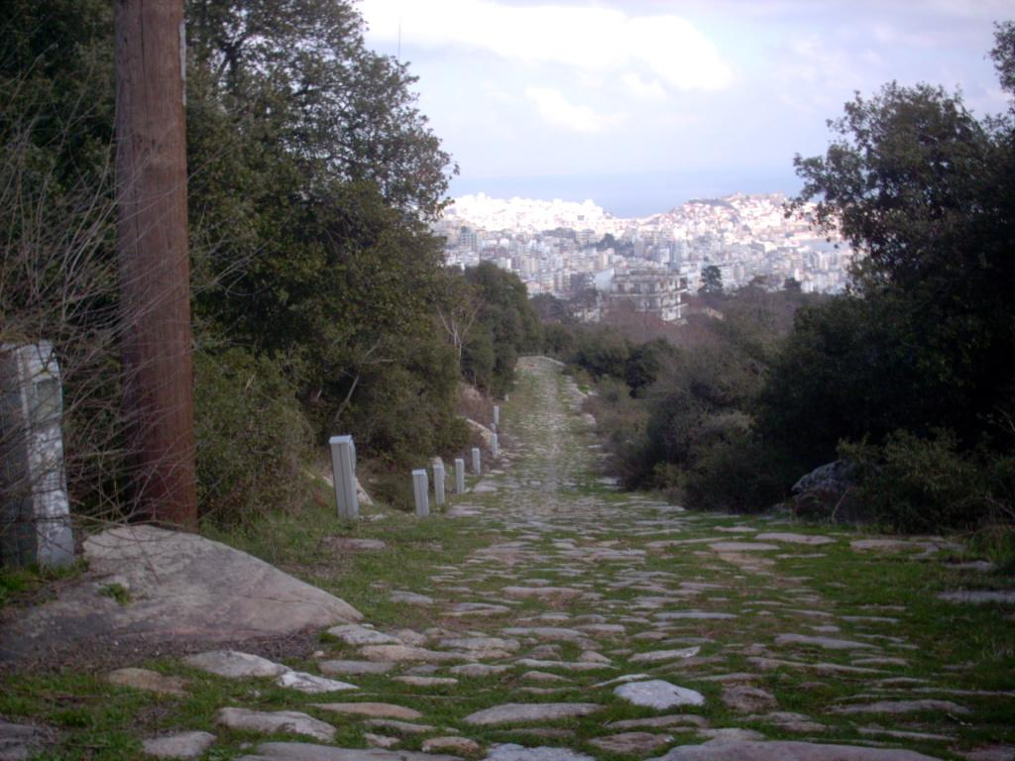
The Egnatian Way Looking back toward Philippi

Slide 5
Preaching in Thessalonica (Acts 17:2-10) Paul’s 2nd Journey
Arriving in Thessalonica, Paul preaches in the synagogue for three Sabbaths persuading many devout Greeks and leading women (17:2-4).
This may be when Paul receives support from Philippi (Phil. 4:15-16).
Envious Jews gather a mob and attack the house of Jason, seeking Paul and Silas (17:5-9).
Not finding them, they drag Jason before the city rulers, charging him with harboring men who had “turned the world upside down.” (17:6-8).
The rulers take security from Jason and release him (17:9).
The brethren send Paul and Silas to Berea by night (17:10-15).
When Jews from Thessalonica stir up trouble in Berea, Paul is taken to Athens, but Silas and Timothy remain. Timothy returns to Thessalonica to encourage the brethren (Acts 17:13-15; 1 Thess. 3).

Slide 6
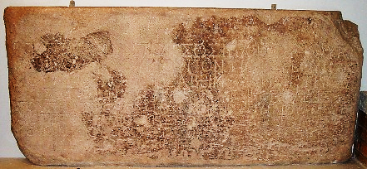
“Politarchs” in Thessalonica
In Acts 17:5-6…
The phrase “rulers of the city” (NKJV, ASV; “city authorities”—NASV) is translated from the Greek word politarchas and occurs only in Acts 17 verses 6 and 8. For many years, critics of the Bible accused Luke of a historical inaccuracy because he used the title politarchas to refer to the city officials of Thessalonica, rather than employing the more common terms, strateegoi (magistrates) or exousiais (authorities). -- Kyle Butt, Apologetics Press
This inscription from a first century Roman Arch at Thessalonica begins, “In the time of the politarchs…”

Slide 7
Thessalonica in the First Century
Politically significant as a provincial capitol
Major seaport and center for trade
Socially and ethnically diverse
Prominence started around 315 BC
Designated as Macedonian capitol in 146 BC
Became a free city in 42 BC
Paul visited in 51 AD
Strong “Christian” presence through the centuries
Modern day city of Thessaloniki
Second most important city in Greece behind Athens

Slide 8
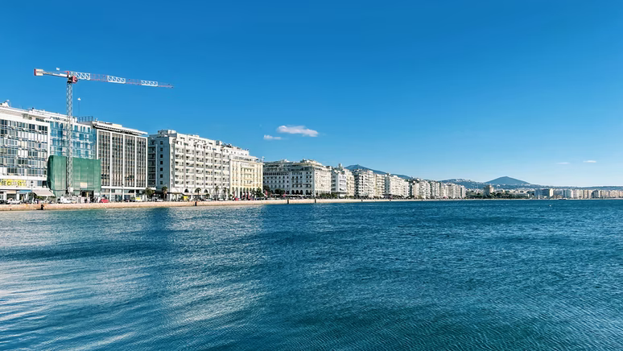
Current day Thessaloniki

Slide 9
Setting of the Epistle of 1 Thessalonians
Audience: Thessalonian Christians
Location of writing: Corinth
Date of letter: A.D. 51 or 52
Historical Setting: Second Missionary Journey
Purpose: Encourage newly converted Christians
Key doctrinal Theme: The Second Coming of Christ

Slide 10
Outline of First Thessalonians
Salutation (1:1)
I. The State of the Church (1:2-10)
Thanksgiving for the character of the church (1:2-3).
The election of the church (1:4-6).
The reputation of the church (1:7-10).
II. Paul’s Apostolic Relations with the Church (2:1—3:13)
Paul’s conduct toward the church (2:1-12).
Paul’s reception by the Thessalonians (2:13-16).
Paul’s concern for the church (2:17—3:10).
Paul’s prayer for the church (3:11-13).
III. The Problems of the Church (4:1—5:11)
Problems with sexual immorality and social conduct (4:1-12).
Understanding the state of the dead and the second coming (4:13-5:11).
IV. Concluding Exhortations (5:12-28)
Adapted from Merrill C. Tenney, New Testament Survey

Slide 11
The State of the Church in Thessalonica
Salutation (1:1)
Thanksgiving for the character of the church (1:2-3).
Paul remembers their “work of faith, labor of love, and patience of hope” (cf. 1 Cor. 13:13; 1 Thess. 5:8).
The election of the church (1:4-6).
The gospel came to them, they received it in much affliction and became followers of the Lord (NOTE: This is how election works, 2 Thes. 2:13-14).
The reputation of the church (1:7-10).
They were examples to believers throughout the region of spreading God’s word and sharing their faith.
Others were well aware of the huge change the gospel had worked in them – they’d turned from idols to serve God and wait for Jesus’ return!
Notes:
1 Corinthians 13:13 And now abide faith, hope, love, these three; but the greatest of these is love.

Slide 12
Paul’s Relationship with the Church in Thessalonica
Paul’s conduct toward the Thessalonians (2:1-12).
He spoken the gospel of God to them despite past and current affliction (2:1-2; cf. Acts 16:16-40).
His appeal was not out of error, impure motives, or deception (2:3).
He spoke to please God, not men (2:4; cf. Gal. 1:10).
He did not use flattery to gain favor or cloak covetousness (2:5; Prov. 29:5; Jude 16).
He did not seek glory from men, even though he could have made demands as an apostle of Christ (2:6).
He appealed to them as a loving parent to a child to “walk worthy of God who calls you into His kingdom” (2:7-12).
He labored diligently so as not to be a burden to them!
Notes:
Galatians 1:10 For do I now persuade men, or God? Or do I seek to please men? For if I still pleased men, I would not be a bondservant of Christ.
Proverbs 29:5 A man who flatters his neighbor Spreads a net for his feet.
Jude 16 These are grumblers, complainers, walking according to their own lusts; and they mouth great swelling words, flattering people to gain advantage.

Slide 13
Paul’s Relationship with the Church in Thessalonica
Paul’s reception by the Thessalonians (2:13-16).
They received God’s word as God’s word, not man’s (2:13).
They became like the churches of Judea who had suffered persecution at the hands of the Judeans (2:14-16, cf. Acts 8:1).
The Jews had killed the Christ and the prophets (Acts 7:52).
They were “contrary to all men” in that they hindered the saving gospel from being preached (2:15-16).
But “God’s wrath has come upon them to the uttermost” (2:16:b).
God had already revealed His intention to bring wrath upon the Jews for rejecting the Christ (Luke 19:33-34; Matthew 23:31-38; 24:1-35).
“The overthrow of Jerusalem and the temple, were but the outward expressions of the divine displeasure at their conduct. Paul, inspired to speak of the feelings of God, describes that wrath as already existing in the divine mind…” (Albert Barnes).
Notes:
Acts 8:1 Now Saul was consenting to his death. At that time a great persecution arose against the church which was at Jerusalem; and they were all scattered throughout the regions of Judea and Samaria, except the apostles.
Acts 7:52 Which of the prophets did your fathers not persecute? And they killed those who foretold the coming of the Just One, of whom you now have become the betrayers and murderers,
Luke 19:43-44 For days will come upon you when your enemies will build an embankment around you, surround you and close you in on every side, 44 and level you, and your children within you, to the ground; and they will not leave in you one stone upon another, because you did not know the time of your visitation.“
Matthew 23:31-32 "Therefore you are witnesses against yourselves that you are sons of those who murdered the prophets. 32 Fill up, then, the measure of your fathers' guilt.
Matthew 23:37-38 "O Jerusalem, Jerusalem, the one who kills the prophets and stones those who are sent to her! How often I wanted to gather your children together, as a hen gathers her chicks under her wings, but you were not willing! 38 See! Your house is left to you desolate;
In Matthew 24, Jesus then prophesies of the destruction of Jerusalem.

Slide 14
Key concepts:
Like the Thessalonians, we should spread the gospel and our faith everywhere.
We should accept the word of God spoken by the apostles as the word of God, and not merely the word of man.
We must not back down from speaking God’s word due to hardship or persecution.
The goal in sharing the gospel is to please God and save souls; it is not personal glory or gain.
We must not be influenced by persecution or pressure from others to reject God’s word.

