Slide 1
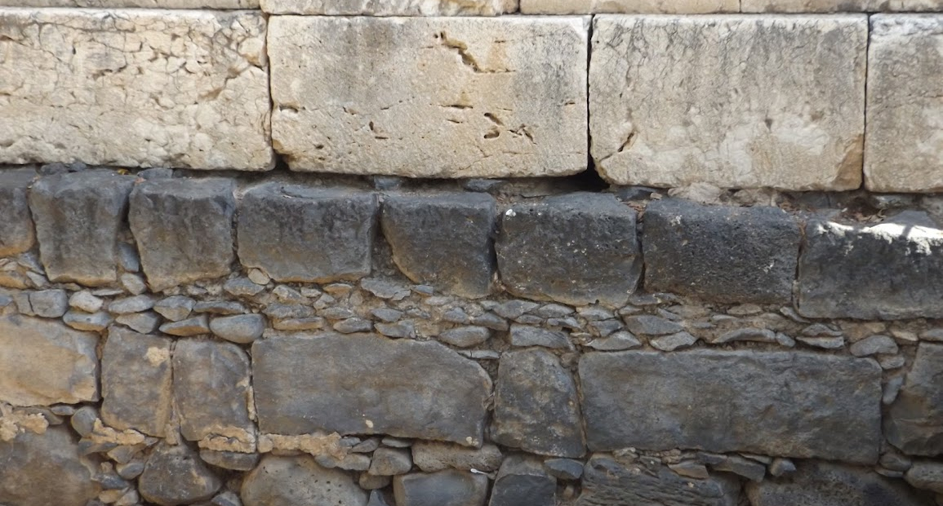

Studies in the Epistles
Foundations  Quarter 15
Lesson Three: 1 Thessalonians 4:13—5:28

Slide 2
Outline of First Thessalonians
Salutation (1:1)
I. The State of the Church (1:2-10)
Thanksgiving for the character of the church (1:2-3).
The election of the church (1:4-6).
The reputation of the church (1:7-10).
II. Paul’s Apostolic Relations with the Church (2:1—3:13)
Paul’s conduct toward the church (2:1-12).
Paul’s reception by the Thessalonians (2:13-16).
Paul’s concern for the church (2:17—3:10).
Paul’s prayer for the church (3:11-13).
III. The Problems of the Church (4:1—5:11)
Problems with sexual immorality and social conduct (4:1-12).
Understanding the state of the dead and the second coming (4:13-5:11).
IV. Concluding Exhortations (5:12-28)
Adapted from Merrill C. Tenney, New Testament Survey

Slide 3
The Problems of the Church
Understanding the Second Coming (4:13—5:11).
To keep them from needless sorrow, Paul wants the Thessalonians to understand the hope of those who have died in Christ (4:13-18).
Our belief in the second coming of Christ and the resurrection of the dead is based on our belief in Christ’s resurrection (4:14-15; 1 Cor. 15:14-20; 1 Peter 1:3-5).
Those who have died in Christ are “asleep” (cf. Lk. 8:52; Jn. 11:11).
The ORDER of events at the second coming is as follows (4:16-17):
The Lord will descend with the voice of the archangel and the trumpet of God (Acts 1:9-11; 1 Cor. 15:51-52; Rev. 1:7).
The dead in Christ will rise first (cf. John 5:28-29; cp. 2 Thess. 1:7-8).
Those who remain alive will be caught up to meet the Lord in the air.
We are to “comfort one another” with these words (4:18).
Notes:
1 Peter 1:3-5 Blessed be the God and Father of our Lord Jesus Christ, who according to His abundant mercy has begotten us again to a living hope through the resurrection of Jesus Christ from the dead, 4 to an inheritance incorruptible and undefiled and that does not fade away, reserved in heaven for you, 5 who are kept by the power of God through faith for salvation ready to be revealed in the last time.
“Asleep” or “sleep” is from the same Greek word in all three verses. Κοιμάω (koimaō). Thayer’s Definition: 1) to cause to sleep, put to sleep
2) Metaphorically 2a) to still, calm, quiet 2b) to fall asleep, to sleep2c) to die. The word may convey (1) the state of quiet repose in which they rest and/or (2) the ease with which they may awakened with God’s power (cf. Luke 8:52, Jairus’ daughter, John 11:11).
Michael is the only archangel named in Scripture (Jude 9; cf. Rev. 12:7), although there could be others.
1 Corinthians 15:51-52 Behold, I tell you a mystery: We shall not all sleep, but we shall all be changed— 52 in a moment, in the twinkling of an eye, at the last trumpet. For the trumpet will sound, and the dead will be raised incorruptible, and we shall be changed.
Revelation 1:7 Behold, He is coming with clouds, and every eye will see Him, even they who pierced Him. And all the tribes of the earth will mourn because of Him. Even so, Amen.
John 5:28-29 Do not marvel at this; for the hour is coming in which all who are in the graves will hear His voice 29 and come forth—those who have done good, to the resurrection of life, and those who have done evil, to the resurrection of condemnation.

Slide 4
The Problems of the Church
Understanding the Second Coming (4:13—5:11).
The day of the Lord comes as a thief in the night (5:1-11).
Like a thief in the night or a pregnant woman giving birth, though inevitable, many will be unprepared for the event (5:1-3; 2 Peter 3:4-10; Matt. 24:36-41).
Saints will be awake and vigilant (5:4-8; Matt. 24:42-51).
We are sons of light, not darkness (cf. Eph. 5:8).
We are sober, not drunken or in a stupor.
We are watchful soldiers, not spiritually asleep.
God did not appoint us to wrath but to obtain salvation (5:9-10).
“He died for us that “whether we wake or sleep we should live together with Him.”
Therefore, comfort each other and edify one another (5:11) .
Notes:
NOTE the comparison to the flood in both 2 Peter and Matthew: 2 Peter 3:4-6 and saying, "Where is the promise of His coming? For since the fathers fell asleep, all things continue as they were from the beginning of creation." 5 For this they willfully forget: that by the word of God the heavens were of old, and the earth standing out of water and in the water, 6 by which the world that then existed perished, being flooded with water.
2 Peter 3:10 But the day of the Lord will come as a thief in the night, in which the heavens will pass away with a great noise, and the elements will melt with fervent heat; both the earth and the works that are in it will be burned up.
Matthew 24:36-41
Matthew 24:42-44 Watch therefore, for you do not know what hour your Lord is coming. 43 But know this, that if the master of the house had known what hour the thief would come, he would have watched and not allowed his house to be broken into. 44 Therefore you also be ready, for the Son of Man is coming at an hour you do not expect.
Ephesians 5:8 For you were once darkness, but now you are light in the Lord. Walk as children of light
Soberness and drunkenness, darkness and light, contrast the clarity of ones spiritual mind.

Slide 5
Concluding Exhortations
Brief but vital admonitions (5:12—22).
Know, esteem, and love those who are rule over you in the Lord (5:12-13).
Those who “rule” over would include apostles and elders (cf. Heb. 13:17).
Being at peace among ourselves shows honors and aids those who watch over us in the Lord.
Exhort brethren who need help in appropriate ways (5:14; cf. Jude 22-23).
Warn those who are unruly or “admonish the idle” (ESV).
Comfort (encourage) the fainthearted,
Uphold the weak,
Be patient with all (2 Tim. 2:24-25).
Do not render evil for evil; pursue what is good for everyone (5:15; Rom. 12:17, 21).
Rejoice always (5:16; Phil. 4:4).
Notes:
This section is like Cliff Notes for Christian living – behaviors that characterize and cultivate a life of faith!!!
προΐ́στημι proistēmi Thayer Definition: 1) to set or place before 1a) to set over 1b) to be over, to superintend, preside over 1c) to be a protector or guardian 1c1) to give aid 1d) to care for, give attention to
Hebrews 13:17 Obey those who rule over you, and be submissive, for they watch out for your souls, as those who must give account. Let them do so with joy and not with grief, for that would be unprofitable for you.
Jude 22-23 And on some have compassion, making a distinction; 23 but others save with fear, pulling them out of the fire, hating even the garment defiled by the flesh.
The “unruly” or “idle” refer to those who are not doing what they are supposed to be doing!
2 Timothy 2:24-25 And a servant of the Lord must not quarrel but be gentle to all, able to teach, patient, 25 in humility correcting those who are in opposition, if God perhaps will grant them repentance, so that they may know the truth,
Romans 12:17 Repay no one evil for evil. Have regard for good things in the sight of all men.
Romans 12:21 Do not be overcome by evil, but overcome evil with good.
Philippians 4:4 Rejoice in the Lord always. Again I will say, rejoice!

Slide 6
Concluding Exhortations
Brief but vital admonitions (5:12—22).
Pray without ceasing (5:17; Eph. 6:18).
In everything give thanks (5:18; cf. Eph. 5:20).
Do not quench the Spirit (5:19; cf. Rom. 8:5, 13-14).
Do not despise prophecies (5:20).
Test all things; hold fast what is good (5:21).
Abstain from every form of evil (5:22; Heb. 5:12-14).
Greetings and well wishes
Paul reassures them of their hope; God will sanctify them and preserve their whole “spirit, soul, and body” at the coming of the Lord (5:23-24).
He requests prayers, encourages greetings of love, and the reading of this epistle by “all the holy brethren” (5:25-27).
He ends by expressing his desire that God’s grace be with them (5:28).
Notes:
Ephesians 6:18 praying always with all prayer and supplication in the Spirit, being watchful to this end with all perseverance and supplication for all the saints—
Eph 5:20 giving thanks always for all things to God the Father in the name of our Lord Jesus Christ,
Quench is to extinguish – to put the fire out. B.W. Johnson (notes) explains: Do not resist it, or counteract its influence by sensual lives. He does who disobeys the word of God, or refuses to follow the exhortations of those led by the Spirit, or who stifles his own conscience.
Romans 8:5 For those who live according to the flesh set their minds on the things of the flesh, but those who live according to the Spirit, the things of the Spirit.
Romans 8:13-14 For if you live according to the flesh you will die; but if by the Spirit you put to death the deeds of the body, you will live. 14 For as many as are led by the Spirit of God, these are sons of God.
“Prophecies” here is a noun – it is not the action of prophesying but the CONTENT of what is prophesied!!! “Prophesyings” (ASV, KJV) is somewhat misleading.
We test all things by God’s word – the content of what has been prophecies!!!
We then know to discern good and evil, and abstain from every form of evil. Hebrews 5:12-14 For though by this time you ought to be teachers, you need someone to teach you again the first principles of the oracles of God; and you have come to need milk and not solid food. 13 For everyone who partakes only of milk is unskilled in the word of righteousness, for he is a babe. 14 But solid food belongs to those who are of full age, that is, those who by reason of use have their senses exercised to discern both good and evil.

Slide 7
Key concepts:
When Christ returns, the dead in Christ will rise first, then those who remain alive will be caught up to meet the Lord in the air.
These truths are intended to provide us with great comfort!
The day of the Lord will come as a thief in the night; we do not know when it will be, so we must always be prepared.
Elders must be respected and loved.
The kind of encouragement we give to a fellow Christian depends on what is needed and appropriate for that person.
Do not render evil for evil; do good to everyone!
Our lives should be characterized by rejoicing, prayer, thanksgiving, and following what the Spirit has revealed in the Word.

