Slide 1
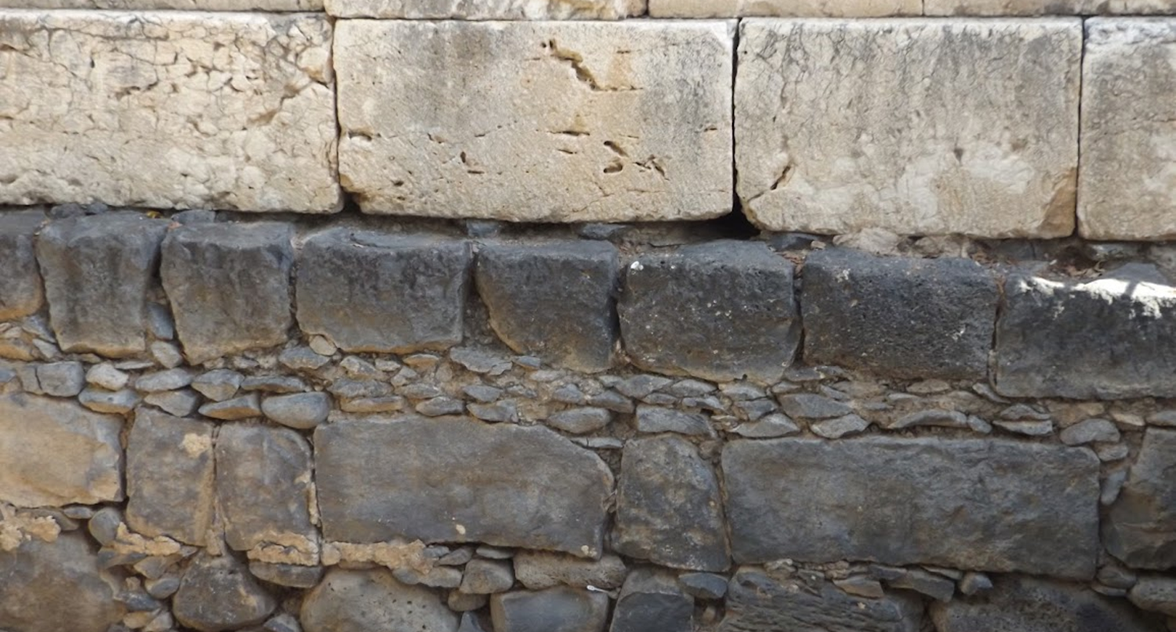

Studies in the Epistles
Foundations  Quarter 15
Lesson Five: 2 Thessalonians 2:13—3:18

Slide 2
Theme of Second Thessalonians
Expectations for faith and practice relative to the second coming of Christ:
Apostolic tradition must guide the way (2:15).
“Do not grow weary in doing good” (3:13).
NOTE: Like 1 Thessalonians, 2 Thessalonians also contains at least one reference to the second coming in every chapter (1:7-10; 2:1, 8; 3:5).

Slide 3
Outline of Second Thessalonians
Greeting (1:1-2)
I. Perseverance in Persecution (1:2-10)
Thanksgiving for the endurance of the Thessalonians (1:3-4).
Punishment of the persecutors (1:5-9).
Glorification of Christ by faithful saints (1:10-12).
II. Premature Expectation of Christ’s Coming (2:1-12)
Admonition against being shaken by error on the 2nd coming (2:1-3a).
The “man of sin” must be revealed before the 2nd coming (2:3a-12).
III. Stand fast in the Traditions (2:13—3:15)
The Lord’s expectation for the Thessalonians (2:13—3:5).
Discipline for those who do not hold to the traditions (3:6-15).
Closing prayer and salutation.

Slide 4
Stand Fast in the Traditions
The Lord’s Expectation for the Thessalonians (2:13—3:5).
Paul is thankful for the spiritual status of the Thessalonians (2:13-14).
The Lord had called the Thessalonians to belief through the gospel.
They were thus chosen and sanctified “for the obtaining of glory.”
Paul charges the Thessalonians to “stand fast and hold the traditions” (2:15-17).
Inspired traditions were handed down from God to man by the apostles. We must hold on to them (cf. 1 Cor. 11:2, 23; 15:3).
Paul prays that the Lord Himself will…
Comfort their hearts.
Establish them in every good work and word. (3:3; 1 Thess. 3:13).
Notes:
1 Corinthians 11:2 Now I praise you, brethren, that you remember me in all things and keep the traditions just as I delivered them to you.
1 Corinthians 11:23 For I received from the Lord that which I also delivered to you: that the Lord Jesus on the same night in which He was betrayed took bread;
1 Corinthians 15:3 For I delivered to you first of all that which I also received: that Christ died for our sins according to the Scriptures,
The word for “comfort” (παρακαλέω) can be translated exhort, encourage, and strengthen. It is found over 100 times in the NT, including 10 times in the Thessalonians epistles. The Thessalonians had need of comfort and encouragement.
Paul is very concern that they be Established --1 Thessalonians 3:13 so that He may establish your hearts blameless in holiness before our God and Father at the coming of our Lord Jesus Christ with all His saints.

Slide 5
Stand Fast in the Traditions
The Lord’s Expectation for the Thessalonians (2:13—3:5).
Paul requests prayers for himself and his work (3:1-2).
He wants them to pray that his current efforts to preach the word would have as much swift success as his preaching had with them.
Paul assures the Thessalonians that the Lord would indeed establish them and guard them from the evil one (3:3; cf. Matt. 6:13).
He has confidence that they would do what they were commanded to do (3:4).
He prays that the Lord would direct their hearts into divine love and patience (3:5).
Notes:
Matthew 6:13 And do not lead us into temptation, But deliver us from the evil one.
The ESV omits “one” from the translation in Matthew 6:13 but inserts it 2 Thess. 3:3.

Slide 6
Stand Fast in the Traditions
Discipline for those who do not hold to the traditions (3:6-15).
The Thessalonians are commanded to withdraw from every brother who walks disorderly and not according to the traditions (3:6).
The meaning of “withdraw” is detailed in 3:14-15 (cf. 1 Cor. 5:11).
The purpose of withdrawal is to encourage the repentance of a brother who is in sin and keep the church pure (cf. 1 Cor. 5:5-7).
Paul had taught and exemplified orderly living among them (3:7-10).
Working to support oneself and others is characteristic of the quiet and honorable life of a Christian (cf. Eph. 4:28).
The specific nature of their disorderly conduct involved being slothful busybodies (3:11-13; cf. 1 Peter 4:15-17).
Paul rather admonishes the Thessalonians: “Do not grow weary in doing good.”
Notes:
“Disorderly” is from ἀτάκτως and refers to “out of ranks (often so of soldiers)… deviating from the prescribed order or rule” (Thayer). In this case, the disorderly are not in step with the “traditions” which Paul had delivered (not just in this letter).
1 Corinthians 5:11 But now I have written to you not to keep company with anyone named a brother, who is sexually immoral, or covetous, or an idolater, or a reviler, or a drunkard, or an extortioner—not even to eat with such a person.
The purpose(s) of withdrawal are to make one feel proper shame for their sin so they might repent (3:14b; 1 Cor. 5:5), and to maintain purity within the church (1 Corinthians 5:6-7 Your glorying is not good. Do you not know that a little leaven leavens the whole lump? 7 Therefore purge out the old leaven, that you may be a new lump, since you truly are unleavened. For indeed Christ, our Passover, was sacrificed for us.).
Ephesians 4:28 Let him who stole steal no longer, but rather let him labor, working with his hands what is good, that he may have something to give him who has need.
1 Peter 4:15-17 But let none of you suffer as a murderer, a thief, an evildoer, or as a busybody in other people's matters. 16 Yet if anyone suffers as a Christian, let him not be ashamed, but let him glorify God in this matter. 17 For the time has come for judgment to begin at the house of God; and if it begins with us first, what will be the end of those who do not obey the gospel of God?

Slide 7
Closing Prayer and Salutation
Paul prays for the peace and presence of the Lord to be with the Thessalonians (3:16).
He signs the letter to verify its authenticity (3:17; cf. 1 Cor. 16:21; Col. 4:18; Gal. 6:11; Rom. 16:22-23).
He ends with a salutation of grace (3:18).
Notes:
1 Corinthians 16:21 The salutation with my own hand—Paul’s..
Colossians 4:18 This salutation by my own hand—Paul. Remember my chains. Grace be with you. Amen.
Galatians 6:11 See with what large letters I have written to you with my own hand!
Romans 16:22-23 I, Tertius, who wrote this epistle, greet you in the Lord. 23 Gaius, my host and the host of the whole church, greets you. Erastus, the treasurer of the city, greets you, and Quartus, a brother.

Slide 8
Key concepts:
We must hold fast to the traditions of the apostles, handed down from God.
Like the Thessalonians, let us strive to be examples of endurance! Do not be weary in doing good!
Unruly and disorderly Christians need to be disciplined.
The Lord expects his people to work to provide for themselves and others.
We are to focus and taking care of our business and not sticking our noses into other people’s business.

