Slide 1
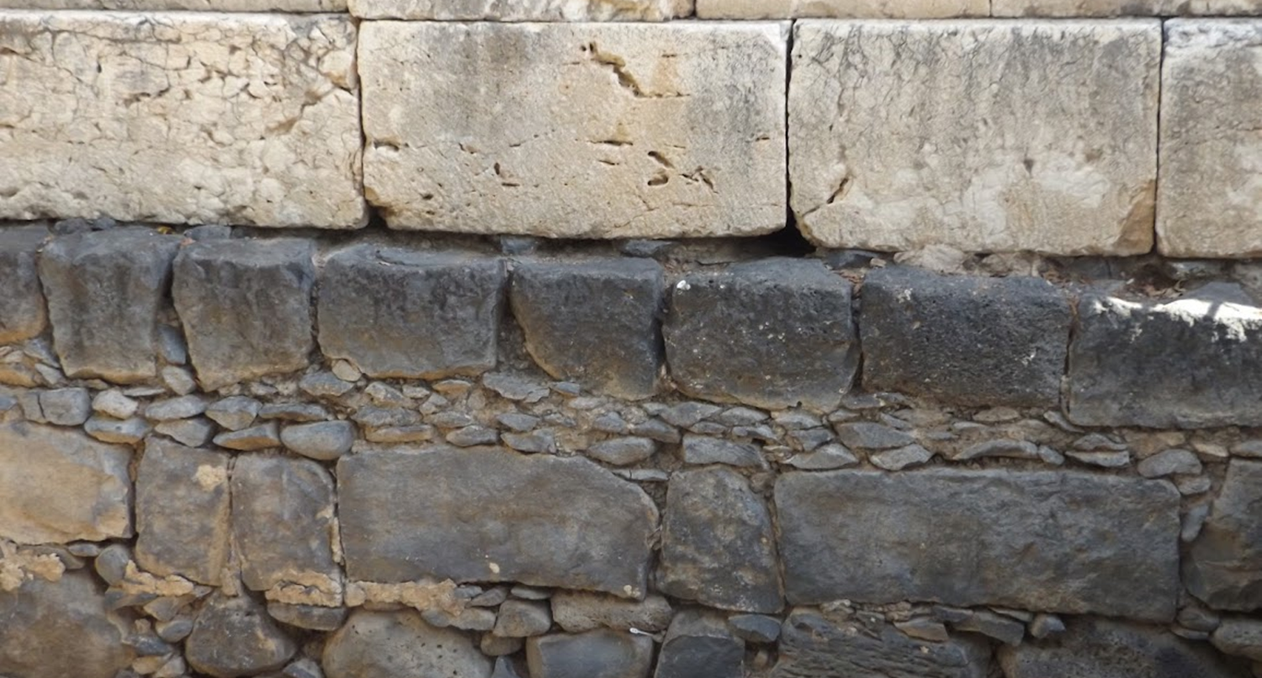

Studies in the Epistles
Foundations  Quarter 15
Lesson Six: Ephesians Introduction and 1:1-14
Notes:
Ephesus is mentioned by name 21 times in the NT:
Acts 18:19, 21, 24; 19:1, 17, 26, 28, 34, 35 (twice); 20:16, 17; 21:29
1 Corinthians 15:32; 16:8
Ephesians 1:1
1 Timothy 1:3 As I urged you when I went into Macedonia—remain in Ephesus that you may charge some that they teach no other doctrine,
2 Timothy 1:18; 4:12
Revelation 1:11; 2:1,4

Slide 2
The Epistle to the Ephesians
Author: Paul (Eph. 1:1).
Location of writing: Roman Prison (Eph. 3:1; 4:1; 6:20).
Date: 61-63 A.D.
Theme: God’s Rich Blessings Bring Responsibilities.
Purpose: To Remind the Ephesian Christians of…
Their Spiritual Wealth in Christ (Eph. 1-3)
Their Spiritual Walk in Christ (Eph. 4-6).
In Ephesians, we see the Church revealed as the fullness of Christ and the eternal purpose of God (Eph. 1:21-22; 3:8-11).

Slide 3
Outline of Ephesians
The Christian’s Wealth in Christ (1:1-3:21)
Salutation (1:1-2)
Wealth of Redemption (1:3-14)
Wealth of Resources (1:15-23)
Wealth of Regeneration (2:1-10)
Wealth of Reconciliation (2:11-22)
Wealth of Revelation (3:1-13)
Wealth of Revitalization (3:14-21)

Slide 4
Outline of Ephesians
The Christian’s Walk in Christ (4:1-6:24)
Walk in Unity (4:1-16)
Walk in Newness (4:17-32)
Walk in Love (5:1-2)
Walk in Light (5:3-14)
Walk in Wisdom (5:15-17)
Walk in the Spirit (5:18-21)
Walk in Subjection and Love (5:22-33)
Walk in Obedience (6:1-9)
Walk in Warfare (6:10-20)
Closing Remarks (6:21-24)
Outline via Jeff Smith

Slide 5
The Epistle to the Ephesians
The City of Ephesus:
The ancient city was in the “upper country” (Acts 19:1) on the southwest coast of the Roman province of Asia.
As the “gateway to Asia,” it was located on the coast of the Aegean Sea at the mouth of the Cayster River and at the crossroads of two major highways running through western Asia.
Paul’s connection to Ephesus:
After visiting Ephesus briefly on his 2nd journey (Acts 18:19-21), Paul worked with the church there for at least two years on his 3rd journey.
The strategic location of Ephesus enabled Paul to evangelize “all who dwelt in Asia” (Acts 19:10).
Paul later visited the Ephesian elders at Miletus (Acts 20:16-17).

Slide 6
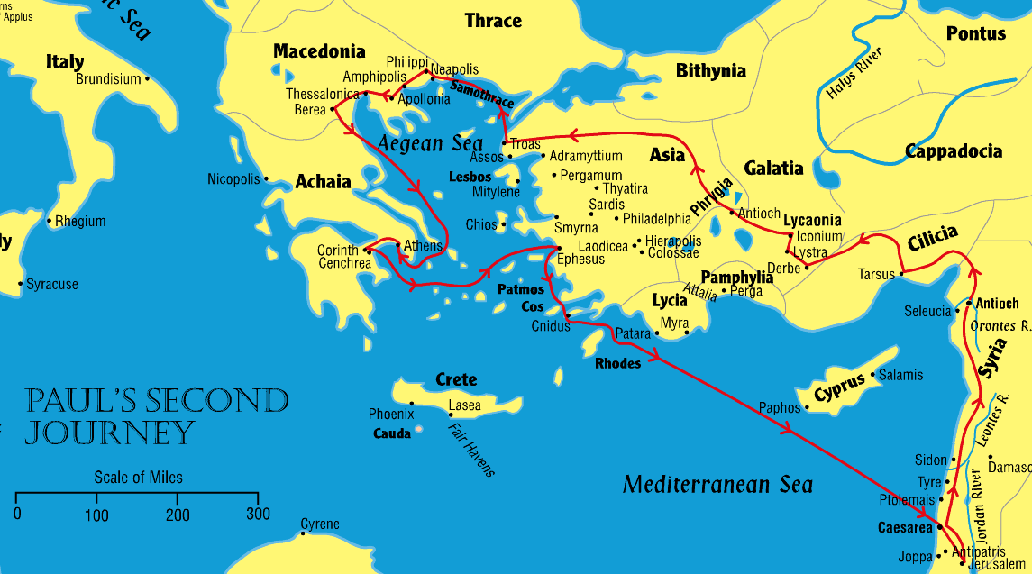
Ephesus
Where was Ephesus?

Slide 7
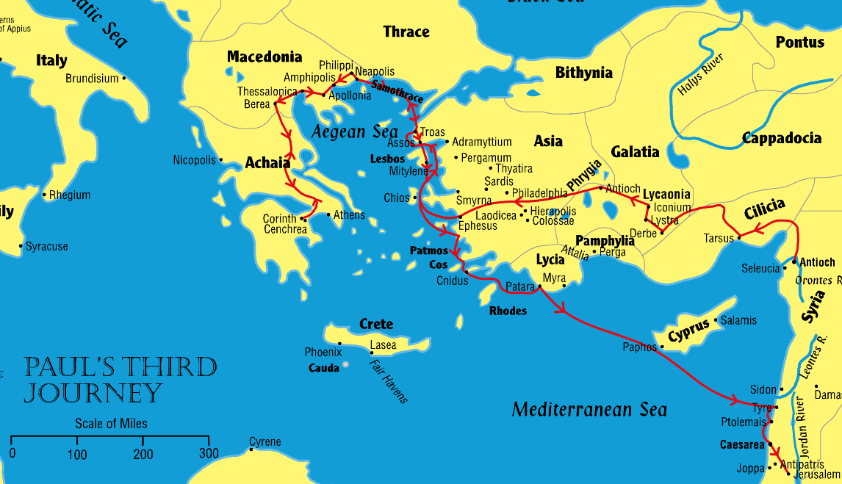
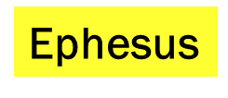

Slide 8
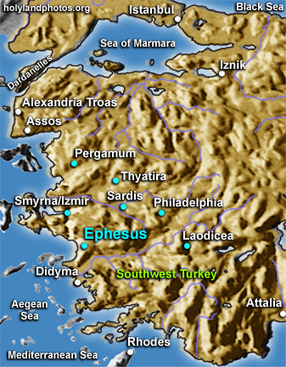
The City of Ephesus
Ephesus was an economic stronghold in Asia Minor and justified the title “supreme metropolis” of Asia. Scholars estimate the number of people living at Ephesus when Paul visited in 54 A.D. to have exceeded 250,000. There is good historical evidence that John lived and taught in Ephesus in his later years.
Notes:
The population of Huntsville is about 210,000 in 2022.

Slide 9
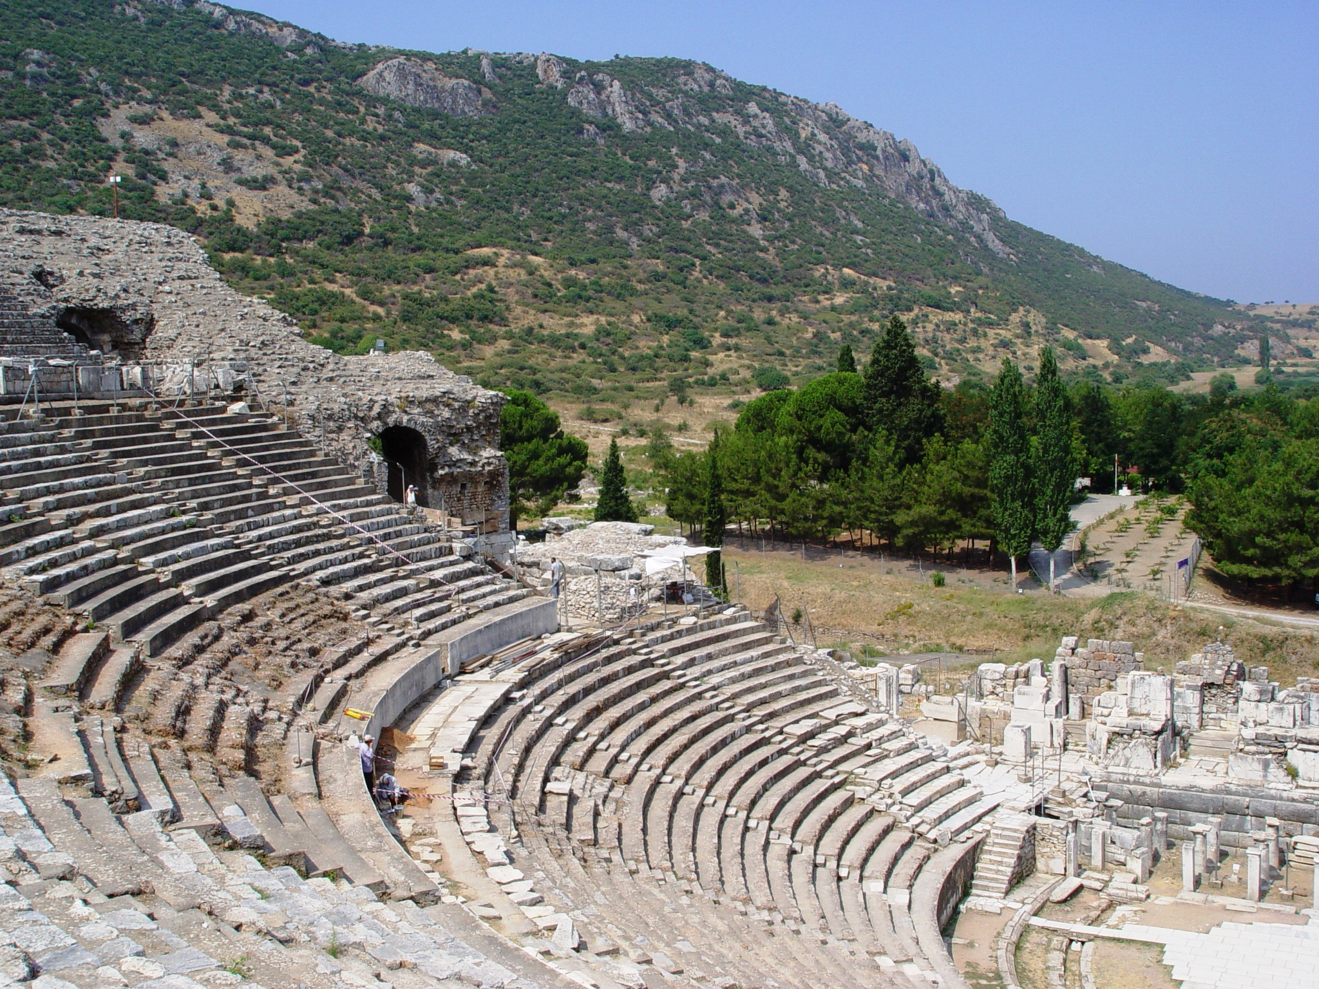
The Theater at Ephesus seats 25,000 people.

Slide 10
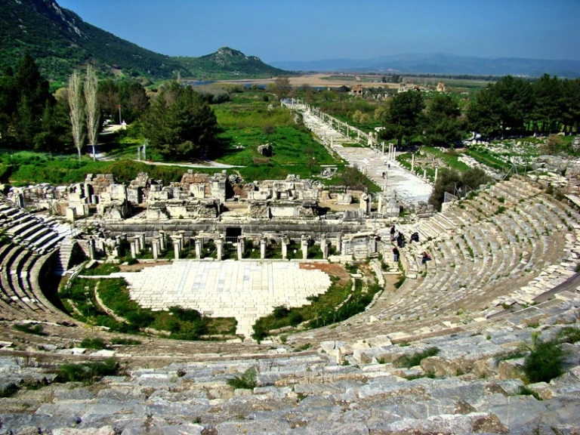
Ephesus Theater. View toward ancient harbor. Photo by Leon Mauldin

Slide 11
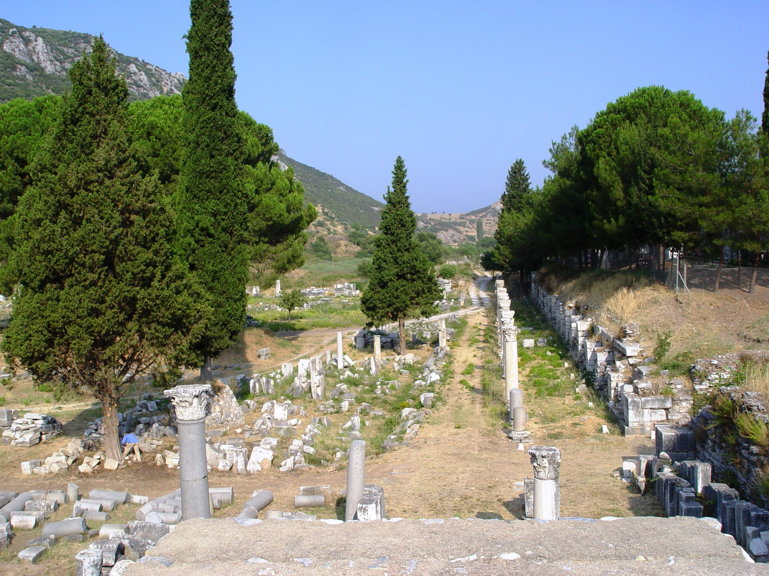
The Agora or Marketplace at Ephesus
Notes:
Commercial Agora. Todd Bolen: The commercial agora at Ephesus was first constructed in Hellenistic times. The Romans, especially under Augustus, Nero, and Caracalla, remodeled and changed it. Different types of columns were used when it was restored a second time (4th century A.D.), after an earthquake greatly damaged it. The agora measured 110 meters square (340 feet) and had a sundial/water clock in the center, the foundations of which are still visible. Inscriptions found here reveal that it was once decorated with numerous statues. There were also many shops selling food and other goods.

Slide 12
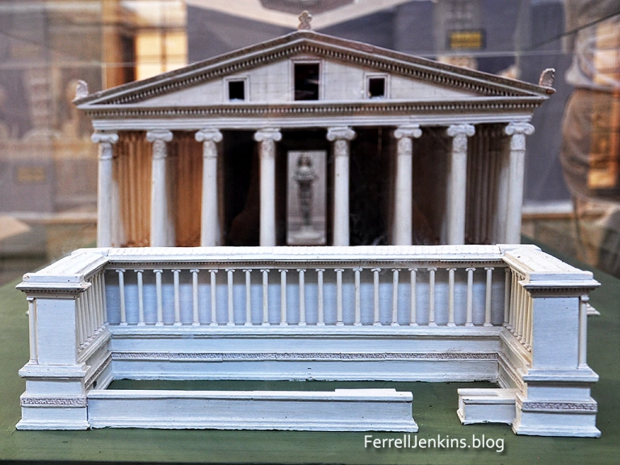
The Epistle to the Ephesians
Cultural aspects of Ephesus alluded to in Scripture.
Jewish Synagogue (Acts 18:19)
School of Tyrannus (Acts 19:9-10)
The Occult/magic (Acts 19:13-19)
The Theater (Acts 19:29)
The Assembly (Acts 19:39)
Worship of Diana (Acts 19:27,35)
Model of the Temple of Artemis/Diana. Located in the Ephesus Museum. Photo by Ferrell Jenkins.
Notes:
Diana
The temple of Diana was considered one of seven wonders of ancient world
117 columns each 60 feet tall and 6 feet in diameter supported the roof, 360 feet long by 180 feet wide
Diana’s image believed to have fallen from heaven
The Assembly
Ephesus was a free-city under Roman control
The civil assembly sometimes met in the theatre with Roman officials presiding and/or the town-clerk
We see multiple uses of the Greek word “ekklesia” from which we get our word “church” that describes an assembly of people.

Slide 13
The Christian’s Wealth in Christ
Salutation (1;1-2).
Paul greets the saints in Ephesus and all the faithful as an apostle of Christ.
He sends greetings of Grace and Peace.
The Wealth of Redemption: The blessings of God’s eternal purpose (1:3-14),
God is to be blessed for blessing us with “every spiritual blessing in the heavenly places in Christ” (1:3)
NOTE the use of the phrase the “heavenly places” in Ephesians. It refers to the realm of spiritual things (cf. 1:20; 2:6; 3:10; 6:12).
Many of the “spiritual blessings” alluded to are named in the long sentence from verses 3 to 14.
Notes:
Blessed and blessing are from εὐλογητός and εὐλογία respectively. Of the latter, Thayer says:
Thayer Definition:
1) praise, laudation, panegyric: of Christ or God…5) a (concrete) blessing, benefit
Heavenly (places) ἐπουράνιος epouranios
Thayer Definition: 1) existing in heaven 1a) things that take place in heaven 1b) the heavenly regions
Eph_1:20 which He worked in Christ when He raised Him from the dead and seated Him at His right hand in the heavenly places,
Eph_2:6 and raised us up together, and made us sit together in the heavenly places in Christ Jesus,
Eph_3:10 to the intent that now the manifold wisdom of God might be made known by the church to the principalities and powers in the heavenly places,
Eph_6:12 For we do not wrestle against flesh and blood, but against principalities, against powers, against the rulers of the darkness of this age, against spiritual hosts of wickedness in the heavenly places.
A few other similar usages of “heavenly” are as follows:
Matthew 18:35 "So My heavenly Father also will do to you if each of you, from his heart, does not forgive his brother his trespasses.“
John 3:12 If I have told you earthly things and you do not believe, how will you believe if I tell you heavenly things?
Hebrews 3:1 Therefore, holy brethren, partakers of the heavenly calling, consider the Apostle and High Priest of our confession, Christ Jesus,
Hebrews 8:5 who serve the copy and shadow of the heavenly things, as Moses was divinely instructed when he was about to make the tabernacle. For He said, "SEE THAT YOU MAKE ALL THINGS ACCORDING TO THE PATTERN SHOWN YOU ON THE MOUNTAIN."

Slide 14
The Christian’s Wealth in Christ
The blessings of God’s eternal purpose (1:3-14),
Chosen before the foundation of the world to be HOLY and WITHOUT BLAME before Him in LOVE (1:4).
Predestined to ADOPTION AS SONS (1:5).
Made to be ACCEPTED in the “Beloved” (i.e. His beloved Son) (1:6).
REDEMPTION and FORGIVENESS through His blood (1:7).
GRACE abounding in wisdom and prudence (1:8).
KNOWLEDGE of the MYSTERY of His eternal purpose – that Christ is the unifying reason for all things (1:9-10; Colossians 1:15-20).
In Christ we have obtained an eternal INHERITANCE according to God’s great purpose; we exist for His Glory!!! (1:11-12).
SEALED with the Holy Spirit as a GAURANTEE of our inheritance (1:13-14; cf. 4:30; 2 Cor. 1:22)
Notes:
Redemption: Thayer defines the term as “liberation procured by the payment of a ransom.”
Albert Barnes comments, “Its root (λύτρον, lutron) properly denotes the price which is paid for a prisoner of war; the ransom, or stipulated purchase-money, which being paid, the captive is set free. The word used here is then employed to denote liberation from bondage, captivity, or evil of any kind, usually keeping up the idea of a price, or a ransom paid, in consequence of which the delivery is effected.” NOTE: The blood would be the price paid.
The word redeem(ed) is found 146 times in the Bible, often of rescue or liberation of God’s people as individuals or the collective group in the O.T.
SEALED by the Holy Spirit as a GUARANTEE.
Barnes comments on the use of the word “sealed” here: “The word used here (from σφραγίζω sphragizō) means to seal up; to close and make fast with a seal, or signet; as, e. g., books, letters, etc. that they may not be read. It is also used in the sense of setting a mark on anything, or a seal, to denote that it is genuine, authentic, confirmed, or approved, as when a deed, compact, or agreement is sealed. it is thus made sure; and is confirmed or established.”
Ephesians 4:30 And do not grieve the Holy Spirit of God, by whom you were sealed for the day of redemption.
2 Corinthians 1:22 who also has sealed us and given us the Spirit in our hearts as a guarantee.
2 Corinthians 5:5 Now He who has prepared us for this very thing is God, who also has given us the Spirit as a guarantee.
Guarantee (“earnest,” KJV, ASV) is from ἀῤῥαβών (arrhabōn) and refers to “money which in purchases is given as a pledge or downpayment that the full amount will subsequently be paid” (Thayer).

Slide 15
Key concepts:
Paul’s extensive work in this large, pagan city resulted in the salvation of many souls.
Praise the Lord for blessing us with every spiritual blessing in the heavenly places in Christ!
We have been made blameless and holy through Christ.
We have been adopted and accepted by God through Christ.
We have received redemption and forgiveness through the blood of Christ.
Saving grace has been extended to us through Christ.
We have been given the knowledge of God’s eternal plan and purpose for heaven and earth in Christ.
We have obtained an eternal inheritance in Christ.
We are sealed with the Holy Spirit as a guarantee of our inheritance.

