Slide 1
In the Days When Judges Ruled
Ruth 1-2

Slide 2

Timing
Ruth
Ruth 4:18-22
  Matthew 1:4-5
Micah
Judges 18:30
  Who is Manasseh?
Levite and His Concubine
Judges 20:27-28
So why are these stories told at the end of the book?

Slide 3

Evil Bookends the Book of Judges
Judges 2:10
Judges 2:12-13
Judges 2:17
Judges 17:6
Judges 21:25

Slide 4
In the Same Context We Have Ruth
There is good among the evil
Sound Familiar?

Slide 5
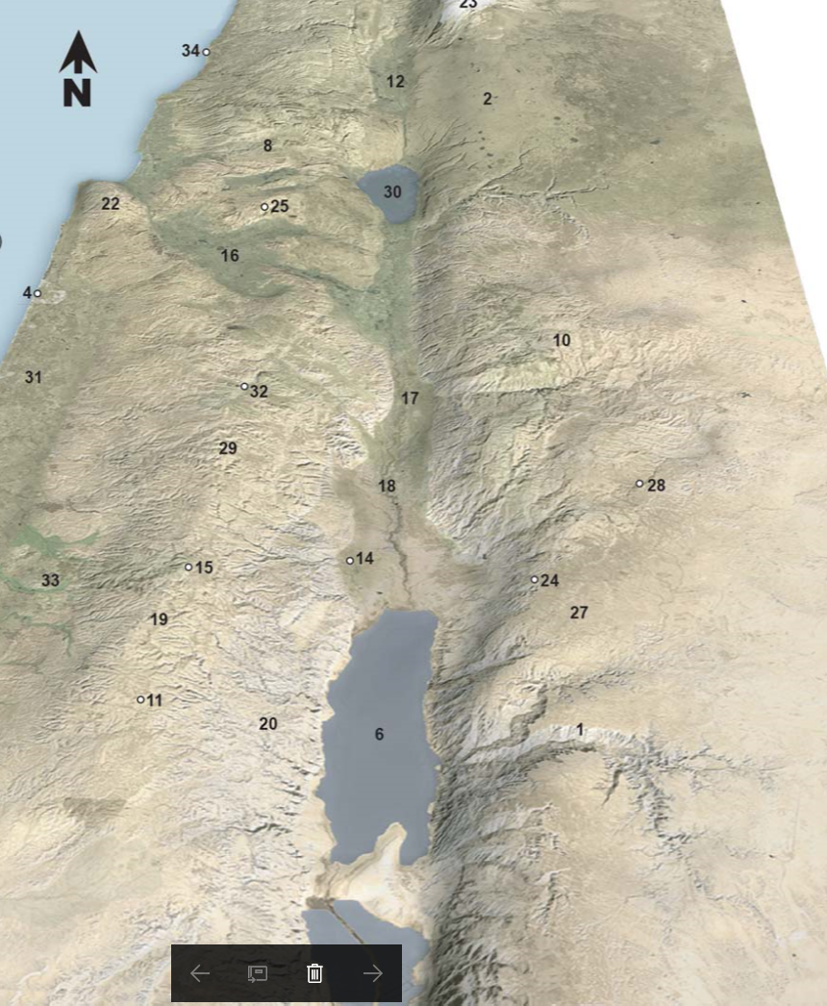
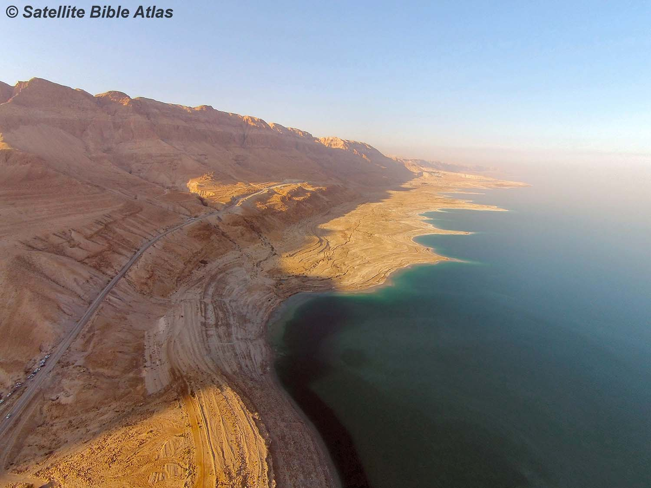
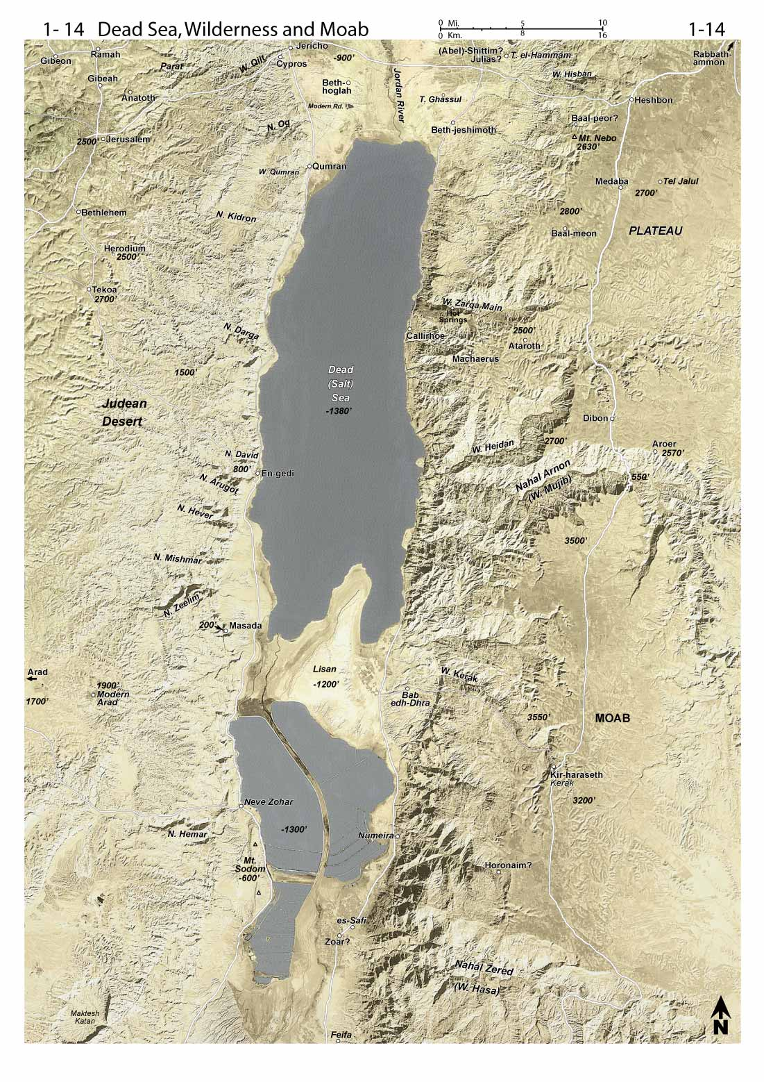
Jerusalem
Bethlehem

Slide 6
Ruth
Character of the Characters
What do we know about Noami’s Character? (1:6, 8,9,13,20-21)
What do we know about Ruth’s Character? (1:9-10,12-14,16-17, 2:2)
What do we know about Boaz’s character? (2:4,8-9,11-12,14,15)

Slide 7
Lessons from Ruth
There are lessons for men and women, young and old
There are lessons for each of us to consider as well as the Jews.
There are lessons that will help us through life spiritually and secularly, as they did Ruth.

Slide 8
Faith and Commitment In a Foreign God and People
But Ruth said, “Do not urge me to leave you or to return from following you. For where you go I will go, and where you lodge I will lodge. Your people shall be my people, and your God my God. Where you die I will die, and there will I be buried. May the Lord do so to me and more also if anything but death parts me from you.” Ruth 1:16-17

Slide 9
Faith and Commitment
Naomi had no husband or children but she did have land (4:3)
Traveling alone could be dangerous.
She had no means of support.
Ruth purposed to go with her; to stay with her; and to care for her.
Even together, life held many obstacles for two widowed women. (Ruth 2:22)

Slide 10
Responsibility And Loyality To Work
And Ruth the Moabite said to Naomi, “Let me go to the field and glean among the ears of grain after him in whose sight I shall find favor.” And she said to her, “Go, my daughter.” Ruth 2:2
She said, ‘Please let me glean and gather among the sheaves after the reapers.’ So she came, and she has continued from early morning until now, except for a short rest.” Ruth 2:7

Slide 11
How to Give Help
Then Boaz said to Ruth, “You will listen, my daughter, will you not? Do not go to glean in another field, nor go from here, but stay close by my young women. Let your eyes be on the field which they reap, and go after them. Have I not commanded the young men not to touch you? And when you are thirsty, go to the vessels and drink from what the young men have drawn.” Ruth 2:8-9
And Boaz answered and said to her, “It has been fully reported to me, all that you have done for your mother-in-law since the death of your husband, and how you have left your father and your mother and the land of your birth, and have come to a people whom you did not know before. (v. 11)

Slide 12
How to Accept Help
Then she fell on her face, bowing to the ground, and said to him, “Why have I found favor in your eyes, that you should take notice of me, since I am a foreigner?” Ruth 2:10
Then she said, “I have found favor in your eyes, my lord, for you have comforted me and spoken kindly to your servant, though I am not one of your servants.” Ruth 2:13
So she gleaned in the field until evening. Then she beat out what she had gleaned, and it was about an ephah of barley. Ruth 2:17

Slide 13
Kindness and Faithfulness Noticed
Naomi noticed the kindness shown to Ruth and inquired as to what field she was in.
Boaz noticed the kindness shown by Ruth to Naomi

