Slide 1
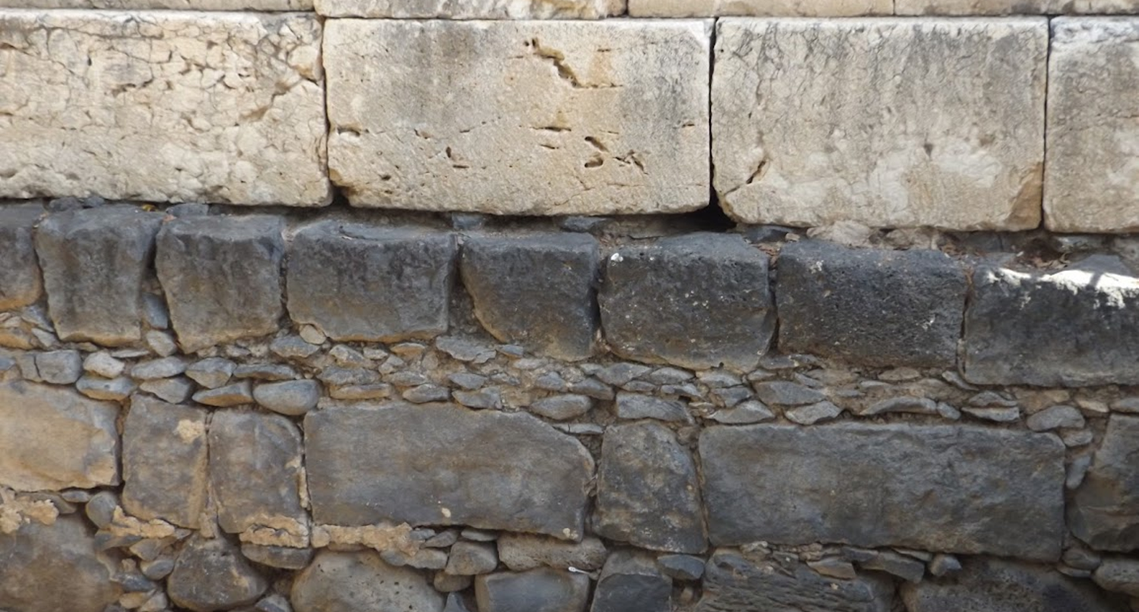

Studies in the Epistles
Foundations  Quarter 15
Lesson Eight: Ephesians 4:1---5:21

Slide 2
The Epistle to the Ephesians
Purpose: To Remind the Ephesian Christians of…
Their Spiritual Wealth in Christ (Eph. 1-3)
Their Spiritual Walk in Christ (Eph. 4-6).
In Ephesians, we see the Church revealed as the fullness of Christ and the eternal purpose of God (Eph. 1:21-22; 3:8-11).

Slide 3
Outline of Ephesians
The Christian’s Wealth in Christ (1:1-3:21)
Salutation (1:1-2)
Wealth of Redemption (1:3-14)
Wealth of Resources (1:15-23)
Wealth of Regeneration (2:1-10)
Wealth of Reconciliation (2:11-22)
Wealth of Revelation (3:1-13)
Wealth of Revitalization (3:14-21)

Slide 4
Outline of Ephesians
The Christian’s Walk in Christ (4:1-6:24)
Walk in Unity (4:1-16)
Walk in Newness (4:17-32)
Walk in Love (5:1-2)
Walk in Light (5:3-14)
Walk in Wisdom (5:15-17)
Walk in the Spirit (5:18-21)
Walk in Subjection and Love (5:22-33)
Walk in Obedience (6:1-9)
Walk in Warfare (6:10-20)
Closing Remarks (6:21-24)
Outline via James Bullington/Jeff Smith

Slide 5
The Christian’s Walk in Christ
Walk in Unity (4:1-16).
Paul’s plea is that our walk be unified -- “worthy of the calling” (4:1-3).
Unity is to be maintained by walking in lowliness, gentleness, longsuffering, and bearing with one another in love
It involves endeavoring to keep the unity of the Spirit.
Unity is based on the inherent oneness of the body, the Spirit, the Lord, hope, faith, baptism, and God (4:4-6).*
The Lord has given the church what is needed to maintain unity (4:7-12).
Christ’s ascension enabled Him to give gifts to men (cf. Ps. 68:18).
He gave apostles, prophets, evangelists, pastors, and teachers “to equip the saints for the work of ministry, for building up the body of Christ” (ESV).
The intended outcome is unity of the faith, becoming a body proportional to our head, with every member of the body doing its part – thus causing the body to grow and edify itself in love (cf. 1 Cor. 12:12-27).
Notes:
*Each of these is ONE, so those who share in them are ONE!
Psalms 68:18 You have ascended on high, You have led captivity captive; You have received gifts among men, Even from the rebellious, That the LORD God might dwell there.

Slide 6
The Christian’s Walk in Christ
Walk in Newness (4:17-32).
The old walk was ignorant and blind (4:17-19).
In Christ we have learned to walk anew (4:20-24).
We put off the old man and put on the new, being renewed in the spirit of our minds.
We are God’s new creation (cf. 2 Cor. 5:17).
Old behaviors are displaced with new (4:25-32).
Lying is replaced with truth.
Anger is replaced with guarded self control.
Stealing is replaced with honest labor and charity.
Corrupt language is replaced with words of grace that build up.
Bitterness, wrath, anger, clamor, evil speaking, and malice are replaced with being kind, tenderhearted, and forgiving .
Notes:
2 Corinthians 5:17 Therefore, if anyone is in Christ, he is a new creation; old things have passed away; behold, all things have become new.

Slide 7
The Christian’s Walk in Christ
Walk in Love (5:1-2).
We are to imitate God as dear children and walk in love (cf. Mt. 5:43-44)
Just as Christ loved us and gave Himself for us (1 John 3:16).
Walk in Light (5:3-14).
Completely avoid the deeds of darkness that bring God’s wrath (5:3-7)
Fornication, uncleanness, covetousness, filthiness, foolish talking, and coarse jesting are behaviors that are not fit for Christians to engage in, and they should not even be named among Christians.
God’s wrath will come on those who do such things. Be not deceived!
We must walk as children of light, having no fellowship with the unfruitful works of darkness; we expose the works of darkness for what they are (5:8-14).
Notes:
Matthew 5:43-45 "You have heard that it was said, 'YOU SHALL LOVE YOUR NEIGHBOR and hate your enemy.' 44 But I say to you, love your enemies, bless those who curse you, do good to those who hate you, and pray for those who spitefully use you and persecute you, 45 that you may be sons of your Father in heaven; for He makes His sun rise on the evil and on the good, and sends rain on the just and on the unjust.
1 John 3:16 By this we know love, because He laid down His life for us. And we also ought to lay down our lives for the brethren.

Slide 8
The Christian’s Walk in Christ
Walk in Wisdom (5:15-17).
We must walk circumspectly or carefully.*
Those who are “fools” or “unwise” care careless and aimless in their walk (cf. Prov. 17:24; 1:32).
The wise make to most of their time and apply God’s will to their lives.
Walk in the Spirit (5:18-21).
Drinking wine is the opposite of being filled with the Spirit (cf. Prov. 20:1).
The songs of one filled with the Spirit stand in contrast to the songs of drunkards (cf. Ps. 69:12).
They are psalms, hymns, and spiritual songs offered to the Lord!
We give thanks to God “always for all things.”
We submit to one another in the fear of God.
Proper submission is always a reflection of our respect for God!
Notes:
*Circumspectly or carefully (ESV) translate ἀκριβῶς akribōs which Thayer says means “exactly, accurately, diligently”
Those who are “fools” or “unwise” care careless and aimless in their walk.
Proverbs 17:24 Wisdom is in the sight of him who has understanding, But the eyes of a fool are on the ends of the earth.
Proverbs 1:32 For the turning away of the simple will slay them, And the complacency of fools will destroy them;
Proverbs 20:1 Wine is a mocker, Strong drink is a brawler, And whoever is led astray by it is not wise.

Slide 9
Key concepts:
We must endeavor to the keep unity that God provided through the Spirit.
Every member must do their part to build up the body.
We are to walk in newness of life – renewed minds will result in new behaviors!
As God’s children, we are to imitate His self-sacrificial love.
We must walk in the light, having nothing to do with the works of darkness, but rather expose them for what they are.
We must walk carefully in God’s wisdom and will.
We are to walk in the Spirit, singing God’s praises, thanking God for everything, and submitting to one another.

