Slide 1
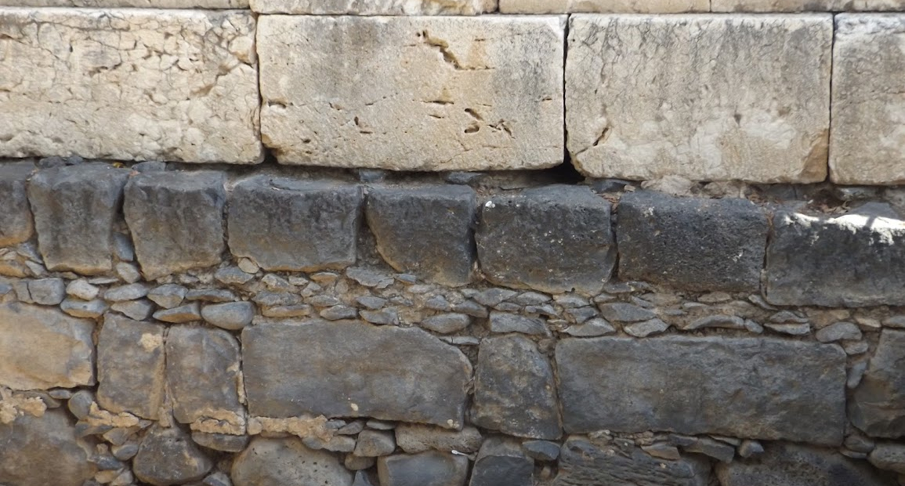

Studies in the Epistles
Foundations  Quarter 17
Lesson 11: Second Peter 1

Slide 2
Background to 2 Peter
The Writer and those to Whom He Wrote:
Simon Peter identifies himself as the writer and as a servant and apostle of Jesus Christ.
Most scholars believe that this second epistle was written sometime between 64 – 68 A.D.
Peter states that it was his second letter (2 Peter 3:1).
He states that his death was imminent (2 Peter 1:14-15).
Secular history indicates he died between A.D. 64-68.
Peter writes “to those who have obtained a like precious faith,” and he deals with the challenges of growing, maintaining faith, and resisting false teachers.

Slide 3
Theme & Purpose
“Make Your Calling and Election Sure” (2 Peter 1:10)
Grow in grace and knowledge (1:5-11; 3:18)
Guard against false teachers (2:1-22; 3:3-5)
Look back and remember what has been learned (1:12-15; 3:1-2, 8)
Look forward to the day of Judgment (2:1-9; 3:9-14)
Peter concludes the epistle by emphasizing these themes (3:12, 17-18)

Slide 4
Benefits of the Knowledge of God (2 Peter 1:1-4)
Grace and Peace are multiplied in the knowledge of God (1:2)
Through the knowledge of God…
Who called us “by” or “to” His glory and virtue (cf. 1 Peter 1:15; 2:9; 3:9; 5:10)
His divine power has given us ALL THINGS* that pertain to LIFE and GODLINESS (cf. 2 Tim. 3:16-17).
We have been given great and precious promises – forgiveness, help in trials, a home in heaven.
We may become partakers of the divine nature – love and holiness (1 Jn. 4:17; Heb. 12:10).
We have escaped the corruption in the world.
Notes:
Knowledge from God helps us grow in the qualities that will keep us faithful. (2 Peter 1:1-11)
1 Peter 1:15 but as He who called you is holy, you also be holy in all your conduct,
1 Peter 2:9 who called you out of darkness into His marvelous light;
1 Peter 3:9 you were called to this, that you may inherit a blessing.
1 Peter 5:10 But may the God of all grace, who called us to His eternal glory by Christ Jesus, after you have suffered a while, perfect, establish, strengthen, and settle you.
Robertson notes: “By his own glory and virtue (dia doxēs kai aretēs). So B K L, but Aleph A C P read idiāi doxēi kai aretēi (either instrumental case “by” or dative “to”). Peter is fond of idios (own, 1Pe_3:1, 1Pe_3:5; 2Pe_2:16, 2Pe_2:22, etc.).” [Word Pictures of the NT].
ALL THINGS: What does this passage do to those who claim “latter revelations” such as Joseph Smith (Latter Day Saints), Charles Russell (Jehovah’s Witnesses) and Ellen White (Seventh Day Adventists) and Pentecostals (2 Timothy 3:16.17,Galatians 1:8, 2 John 9)
Great and precious promises: Pardon from sin, help in trials, a glorious resurrection, eternity in heaven. [All of which were discussed in Peter’s first epistle].
1 John 4:17 Love has been perfected among us in this: that we may have boldness in the day of judgment; because as He is, so are we in this world.
Hebrews 12:10 [God chastens us for our profit] “that we may be partakers of His holiness.” 1 Peter 1:15 but as He who called you is holy, you also be holy in all your conduct,

Slide 5
The Need for Diligent Growth (2 Peter 1:5-11)
We gain hold of the promises and become more attuned to the Divine Nature by Giving all Diligence to add to our faith…
Virtue: Moral excellence or goodness.
Knowledge: “Of spiritual truth”, “seeking to know”. (Vine). “Of deeper more perfect and enlarged knowledge” (Thayer).
Self-Control: Temperance in KJV.
Self-discipline. The will exercising control over conduct to achieve good and productive ends.
Following knowledge in this list may suggest that we should put what we learn into practice.
Notes:
Gnosis as opposed to epignosis used in verses 2 & 3 which seems to reflect to precise and correct knowledge.
SELF CONTROL: Acts 24:25 Now as he reasoned about righteousness, self-control, and the judgment to come, Felix was afraid and answered, "Go away for now; when I have a convenient time I will call for you.“

Slide 6
The Need for Diligent Growth (2 Peter 1:5-11)
Giving all Diligence to add to our faith…
Perseverance: “Patience” [KJV] or “Steadfastness” [ESV]. Endurance in faithful service.
Godliness: To be devout. It is characterized by a Godward attitude, and it does what is pleasing to God.
Brotherly Kindness*: Mutual affection or brotherly love.
Love: The love God had for His Son and for the whole world (John 3:16; Romans 5:8).
It can be known by the action it prompts (1 Cor. 13:4-8).
Not based merely on feeling. It is a decision to do what is best for another.
Notes:
GR. “Philadelphia”
1 Corinthians 13:4-8 Love suffers long and is kind; love does not envy; love does not parade itself, is not puffed up; (5) does not behave rudely, does not seek its own, is not provoked, thinks no evil; (6) does not rejoice in iniquity, but rejoices in the truth; (7) bears all things, believes all things, hopes all things, endures all things. (8) Love never fails. But whether there are prophecies, they will fail; whether there are tongues, they will cease; whether there is knowledge, it will vanish away.

Slide 7
The Need for Diligent Growth (2 Peter 1:5-11)
Growth in these qualities secures our salvation.
They will keep us from being barren and unfruitful (1:2-3; Matthew 7:19; John 15:2-5).
One who lacks these qualities is so nearsighted that he is blind – failing to remember the precious forgiveness of his old sins.
They will secure our salvation.
They will prevent us from stumbling.
They will provide an entrance “abundantly into the everlasting kingdom of our Lord and Savior Jesus Christ. ”
Confirm Your Election and Calling!
Notes:
You can bear fruit and still be unfruitful because the fruit is no good!!!
Matthew 7:19 Every tree that does not bear good fruit is cut down and thrown into the fire.
John 15:2 Every branch in Me that does not bear fruit He takes away; and every branch that bears fruit He prunes, that it may bear more fruit.
John 15:4-5 Abide in Me, and I in you. As the branch cannot bear fruit of itself, unless it abides in the vine, neither can you, unless you abide in Me. (5) "I am the vine, you are the branches. He who abides in Me, and I in him, bears much fruit; for without Me you can do nothing.

Slide 8
The Need to be Reminded of Truth (2 Peter 1:12-15)
Peter has a duty to remind his readers of truths they already know (1:12-13).
They were established in the truth.
But as long as Peter was “in this tent,” he felt the need to “stir” them up (cf. 2 Cor. 5:1-10).
Peter’s death was imminent (1:14-15).
Jesus had previously told Peter how he would die (John 21:18-19).
Secular sources of history indicate Peter died near the end of Nero’s reign (between 64-68 A.D.).
Peter wanted those of like precious faith to “always have a reminder” of these important truths.
Notes:
The need to be reminded of known truths – “present truth” is the truth that is present with you, “the truth that you have.”
Paul’s contemplation of his time “in this tent” made him very aware of the need to always please the Lord! (2 Corinthians 5:1-10)
John 21:18-19 Most assuredly, I say to you, when you were younger, you girded yourself and walked where you wished; but when you are old, you will stretch out your hands, and another will gird you and carry you where you do not wish." (19) This He spoke, signifying by what death he would glorify God. And when He had spoken this, He said to him, "Follow Me.“
Nero’s full reign was from 37-68 AD

Slide 9
The Reliability of our Source of Truth (2 Peter 1:16-21)
The Reliability of the Apostles
Peter declares, “We did not follow cunningly devised fables” (1:16-18)
We were eyewitnesses of His majesty!
Peter, James and John saw Jesus transfigured and heard the voice from heaven (Matthew 17:1-9; cf. Mark 9:2-7; Luke 9:28-36).
They were also witnesses of Jesus’ resurrection (John 20:1-7, 19-31; 21:1-2; Acts 1:1-3).
Notes:
Matthew 17:1-9 Now after six days Jesus took Peter, James, and John his brother, led them up on a high mountain by themselves; (2) and He was transfigured before them. His face shone like the sun, and His clothes became as white as the light. (3) And behold, Moses and Elijah appeared to them, talking with Him. (4) Then Peter answered and said to Jesus, "Lord, it is good for us to be here; if You wish, let us make here three tabernacles: one for You, one for Moses, and one for Elijah." (5) While he was still speaking, behold, a bright cloud overshadowed them; and suddenly a voice came out of the cloud, saying, "This is My beloved Son, in whom I am well pleased. Hear Him!" (6) And when the disciples heard it, they fell on their faces and were greatly afraid. (7) But Jesus came and touched them and said, "Arise, and do not be afraid." (8) When they had lifted up their eyes, they saw no one but Jesus only. (9) Now as they came down from the mountain, Jesus commanded them, saying, "Tell the vision to no one until the Son of Man is risen from the dead."

Slide 10
The Reliability of our Source of Truth (2 Peter 1:16-21)
The Reliability of the Old Testament Prophets
Confirmed prophecies verify the reliability of Scripture as well as Peter’s testimony (1:19-21)
Pay attention to prophecy like it’s a lamp in a dark room; continue to look into Scripture until fully illuminated.
Scripture is not of private interpretation because it is not of human origination – the Holy Spirit moved men!
The gospel of Christ is verified in prophecy (John 5:39; Luke 24:44).
The Ethiopian could see Christ in Isaiah 53 (Acts 8:30-35).
The Bereans could discern the truth by examining Scripture (Acts 17:11).
Herod Agrippa could believe in Christ if he believed the prophets (Acts 26:22-27, cf. 28:23).
Notes:
Jesus and His apostles pointed to the Bible prophecies as proof that Jesus is the Christ.
John 5:39 You search the Scriptures, for in them you think you have eternal life; and these are they which testify of Me.
Luke 24:44 Then He said to them, "These are the words which I spoke to you while I was still with you, that all things must be fulfilled which were written in the Law of Moses and the Prophets and the Psalms concerning Me."
Acts 3:18 But those things which God foretold by the mouth of all His prophets, that the Christ would suffer, He has thus fulfilled.
Acts 8:30-35
Acts 26:22-23 Therefore, having obtained help from God, to this day I stand, witnessing both to small and great, saying no other things than those which the prophets and Moses said would come— (23) that the Christ would suffer, that He would be the first to rise from the dead, and would proclaim light to the Jewish people and to the Gentiles."
Acts 26:27 King Agrippa, do you believe the prophets? I know that you do believe.“
Acts 28:23 So when they had appointed him a day, many came to him at his lodging, to whom he explained and solemnly testified of the kingdom of God, persuading them concerning Jesus from both the Law of Moses and the Prophets, from morning till evening.

Slide 11
The Danger of False Prophets (2 Peter 2:1-3)
False Teachers are Inevitable!
Just as there were false prophets among God’s people of old, there will be false teachers among us (Jeremiah 4:14; Matthew 7:15).
Their well-worn motives and methodology:
Secretly introduce destructive heresies (Gal 2:4).
Deny the Master (Titus 1:16; 2 Cor. 11:13-15).
Many will follow them.
Characterized by sensuality.
Way of truth maligned because of them.
Motivated by greed and covetousness, they will exploit you with false words.
Notes:
Jeremiah 14:14 And the LORD said to me, "The prophets prophesy lies in My name. I have not sent them, commanded them, nor spoken to them; they prophesy to you a false vision, divination, a worthless thing, and the deceit of their heart.
Matthew 7:15 "Beware of false prophets, who come to you in sheep's clothing, but inwardly they are ravenous wolves.
Galatians 2:4 And this occurred because of false brethren secretly brought in (who came in by stealth to spy out our liberty which we have in Christ Jesus, that they might bring us into bondage),
Titus 1:16 They profess to know God, but in works they deny Him, being abominable, disobedient, and disqualified for every good work.
2 Corinthians 11:13-15 For such men are false apostles, deceitful workmen, disguising themselves as apostles of Christ. (14) And no wonder, for even Satan disguises himself as an angel of light. (15) So it is no surprise if his servants, also, disguise themselves as servants of righteousness. Their end will correspond to their deeds.

Slide 12
The Danger of False Prophets (2 Peter 2:4-9)
The Doom of False Prophets
God’s judgment awaits false teachers!
The Lord has repeatedly shown His willingness to punish sinners and spare the righteous:
The angels who sinned (2:4).
Punishing the ungodly of Noah’s day while sparing Noah and his family (2:5; Gen. 6:5-8; 7:20-22).
Making an example of Sodom and Gomorrah by destroying them while sparing Lot (2:6-7; Gen. 13:12; 18:20; 19:24-25).
“The Lord knows how to deliver the godly out of temptations and to reserve the unjust under punishment for the day of judgment.”
Notes:
Genesis 6:5-8 Then the LORD saw that the wickedness of man was great in the earth, and that every intent of the thoughts of his heart was only evil continually. (6) And the LORD was sorry that He had made man on the earth, and He was grieved in His heart. (7) So the LORD said, "I will destroy man whom I have created from the face of the earth, both man and beast, creeping thing and birds of the air, for I am sorry that I have made them." (8) But Noah found grace in the eyes of the LORD.
Genesis 7:20-22 The waters prevailed fifteen cubits upward, and the mountains were covered. (21) And all flesh died that moved on the earth: birds and cattle and beasts and every creeping thing that creeps on the earth, and every man. (22) All in whose nostrils was the breath of the spirit of life, all that was on the dry land, died.
Genesis 13:13 But the men of Sodom were exceedingly wicked and sinful against the LORD.
Genesis 18:20 And the LORD said, "Because the outcry against Sodom and Gomorrah is great, and because their sin is very grave,
Genesis 19:24-25 Then the LORD rained brimstone and fire on Sodom and Gomorrah, from the LORD out of the heavens. (25) So He overthrew those cities, all the plain, all the inhabitants of the cities, and what grew on the ground.

Slide 13
Important Lessons:
To make certain of our salvation, we must grow in grace and knowledge, guard against false teachers, remember what we have learned, and look forward to the Judgment Day.
We must add to our faith virtue, knowledge, self-control, perseverance, godliness, brotherly kindness, and love.
We need to be reminded of things we already know.
God’s word is 100% reliable.
The gospel of Christ was delivered by qualified witnesses -- the apostles.
The Scriptures are verified by fulfilled prophecy.
False teachers will cause many to be lost, but God will punish them.

