Slide 1
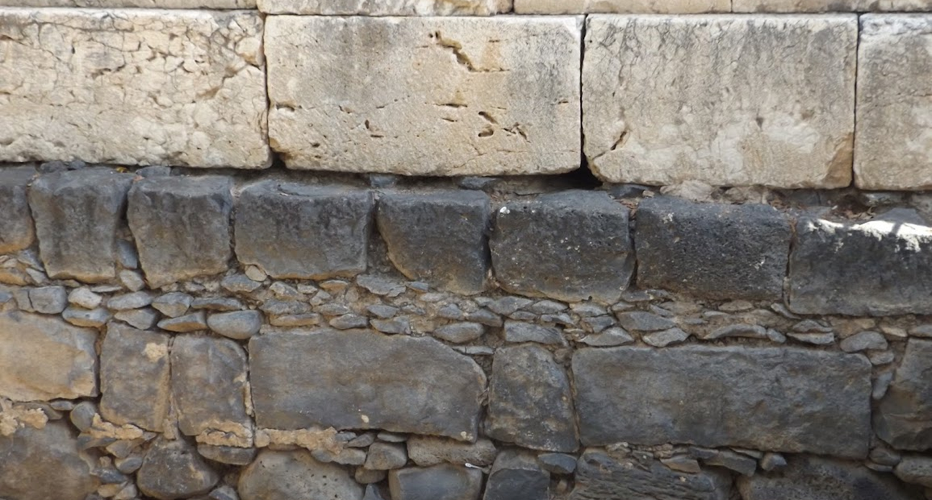

Studies in the Epistles
Foundations  Quarter 17
Lesson 11: Second Peter 2 & 3 AND Jude

Slide 2
Theme & Purpose of 2nd Peter
“Make Your Calling and Election Sure” (2 Peter 1:10)
Grow in grace and knowledge (1:5-11; 3:18)
Guard against false teachers (2:1-22; 3:3-5)
Look back and remember what has been learned (1:12-15; 3:1-2, 8)
Look forward to the day of Judgment (2:1-9; 3:9-14)
Peter concludes the epistle by emphasizing these themes (3:12, 17-18)

Slide 3
The Danger of False Prophets
(2 Peter 2:1-3)
False Teachers are Inevitable!
Just as there were false prophets among God’s people of old, there will be false teachers among us (Jeremiah 4:14; Matthew 7:15).
Their motives, methodology, character, and fruit:
  Secretly introduce destructive heresies (Gal 2:4).
  Deny the Master (Titus 1:16; 2 Cor. 11:13-15).
  Many will follow them.
  Characterized by sensuality.
  The way of truth will be maligned because of them.
  They are motivated by greed and covetousness; they will exploit you with false words.
Notes:
Jeremiah 14:14 And the LORD said to me, "The prophets prophesy lies in My name. I have not sent them, commanded them, nor spoken to them; they prophesy to you a false vision, divination, a worthless thing, and the deceit of their heart.
Matthew 7:15 "Beware of false prophets, who come to you in sheep's clothing, but inwardly they are ravenous wolves.
Galatians 2:4 And this occurred because of false brethren secretly brought in (who came in by stealth to spy out our liberty which we have in Christ Jesus, that they might bring us into bondage),
Titus 1:16 They profess to know God, but in works they deny Him, being abominable, disobedient, and disqualified for every good work.
2 Corinthians 11:13-15 For such men are false apostles, deceitful workmen, disguising themselves as apostles of Christ. (14) And no wonder, for even Satan disguises himself as an angel of light. (15) So it is no surprise if his servants, also, disguise themselves as servants of righteousness. Their end will correspond to their deeds.

Slide 4
The Danger of False Prophets
(2 Peter 2:4-9)
The Punishment of False Prophets
God’s judgment awaits false teachers!
The Lord has repeatedly shown His willingness to punish sinners and spare the righteous (3 examples):
  The angels who sinned (2:4).
  Punishing the ungodly by the flood of Noah’s day while sparing Noah and his family (2:5; Gen. 6:5-8; 7:20-22).
  Making an example of Sodom and Gomorrah by destroying them while sparing Lot (2:6-8; Gen. 13:12; 18:20; 19:24-25).
“The Lord knows how to deliver the godly out of temptations and to reserve the unjust under punishment for the day of judgment (2:9)
Notes:
Genesis 6:5-8 Then the LORD saw that the wickedness of man was great in the earth, and that every intent of the thoughts of his heart was only evil continually. (6) And the LORD was sorry that He had made man on the earth, and He was grieved in His heart. (7) So the LORD said, "I will destroy man whom I have created from the face of the earth, both man and beast, creeping thing and birds of the air, for I am sorry that I have made them." (8) But Noah found grace in the eyes of the LORD.
Genesis 7:20-22 The waters prevailed fifteen cubits upward, and the mountains were covered. (21) And all flesh died that moved on the earth: birds and cattle and beasts and every creeping thing that creeps on the earth, and every man. (22) All in whose nostrils was the breath of the spirit of life, all that was on the dry land, died.
Genesis 13:13 But the men of Sodom were exceedingly wicked and sinful against the LORD.
Genesis 18:20 And the LORD said, "Because the outcry against Sodom and Gomorrah is great, and because their sin is very grave,
Genesis 19:24-25 Then the LORD rained brimstone and fire on Sodom and Gomorrah, from the LORD out of the heavens. (25) So He overthrew those cities, all the plain, all the inhabitants of the cities, and what grew on the ground.

Slide 5
The Epistle of Jude
Introduction and Overview
Authorship
The author is “Jude, a bondservant of Jesus Christ, and brother of James”
  Jude the apostle OR Jude the brother of Jesus* could fit this description (Matt. 13:55; Luke 6:16; Acts 1:13)
  Jude 17-18 appears to rule out Jude the apostle.
Date
Probably written AFTER Second Peter.
  2nd Peter warns of false teachers in the future tense (2:1-3, 3:3), but Jude says they’ve arrived (4, 12).
  Many scholars believe that Jude was written between 70-90 AD.*

Slide 6
The Epistle of Jude
Introduction and Overview
Theme: “Contend earnestly for the faith which was once for all delivered to the saints.”
The threat to the faith is that “certain ungodly men have crept in unnoticed” and imperil us.
  Much like 2nd Peter, Jude warns of false teachers and promises their destruction.
  Jude also tells his readers to guard their faith and themselves by remembering things they already know (Jude 5, 17).

Slide 7
The Epistle of Jude
Contend Earnestly for the Faith!
The Reason we must contend : “Ungodly men have crept in”
Their Destruction is Certain (5-7)
They Disrespect Authority (8-10)
Their Direction follows Cain, Balaam, and Korah (11)
Their Depravity (12-13)
Their Destiny is Determined (14-15)
They Deceive with Flattery (16)
The Way we must contend: Remember, Renovate, Rescue!
Remember the words of the apostles (17-19)
Renovate & preserve ourselves spiritually (20-21)
Rescue the perishing (22-23)

Slide 8
The Epistle of Jude
Contend Earnestly for the Faith!
False Teachers – the reason we must contend (v. 4)
Certain men crept in unnoticed (2 Peter 2:1; Gal. 2:4).
  They were marked out for destruction long ago.
  They turn the grace of God into lewdness (2 Peter 2:18-19; Romans 6:1).
  They “deny the only Lord God and our Lord Jesus Christ.”
  They may profess to know God, but they reject the Lordship of the Father and the Son (Titus 1:16; Luke 6:46).
Notes:
2 Peter 2:1 But there were also false prophets among the people, even as there will be false teachers among you, who will secretly bring in destructive heresies, even denying the Lord who bought them, and bring on themselves swift destruction.
Galatians 2:4 And this occurred because of false brethren secretly brought in (who came in by stealth to spy out our liberty which we have in Christ Jesus, that they might bring us into bondage),
Romans 6:1 What shall we say then? Shall we continue in sin that grace may abound?
Titus 1:16 They profess to know God, but in works they deny Him, being abominable, disobedient, and disqualified for every good work.
Luke 6:46 "But why do you call Me 'Lord, Lord,' and not do the things which I say?

Slide 9
The Epistle of Jude
Contend Earnestly for the Faith!
The Punishment of the Ungodly (vs. 5-7, 3 examples*)
The Lord, having saved Israel from Egypt, destroyed those who refused to believe (v. 5; 1 Cor. 10:1-10).
The Lord chained angels who did not keep their domain to hold them for the judgment day ( v. 6; 2 Peter 2:4).
The Lord destroyed Sodom and Gomorrah because of their sexual immorality (v.7; 2 Peter 2:6).
The lesson from these examples is that the Lord punishes the unbelieving, the disobedient, and the wicked, AND He will surely punish the false teachers Jude describes.
Notes:
*Compare 2 Peter 3:4-9

Slide 10
The Character of False Teachers
(2 Peter 2:10-22)
The Character of False Teachers
They are motivated by lasciviousness, greed, corrupt desires, and disrespect for authority. (2:10-11).
They are characterized as unreasoning beasts, revilers without knowledge, pleasure seekers, carousers, adulterers, and habitual sinners (2:12-16).
They are full of empty promise; they cause people to be worse off than they were to begin with – like a dog returning to its vomit or a sow that had washed to wallowing in the mire (2:17-22).

Slide 11
The Epistle of Jude
Contend Earnestly for the Faith!
The Character of the Ungodly (vs. 8-11)
They disrespect authority (vs. 8-10)
  The false teachers who have “crept in” (v. 4) are now characterized as “dreamers” who “defile the flesh, reject authority, and speak evil of dignitaries.”
  They brazenly walk where angels fear to tread!
Their character is compared to…
  Cain, who offered an inferior sacrifice and hated the one whose worship God respected (Genesis 4; Hebrews 11:4; 1 John 3:12).
  Balaam, who was motivated by money (Numbers 22).
  Korah, who despised God-appointed authority (Numbers 16).
Notes:
Compare 2 Peter 2:10-12
“Dreamers” is applied to these persons as holding doctrines and opinions which sustained the same relation to truth which dreams do to good sense. Their doctrines were the fruits of mere imagination, foolish vagaries and fancies.” (Barnes)
Hebrews 11:4 By faith Abel offered to God a more excellent sacrifice than Cain, through which he obtained witness that he was righteous, God testifying of his gifts; and through it he being dead still speaks.
1 John 3:12 not as Cain who was of the wicked one and murdered his brother. And why did he murder him? Because his works were evil and his brother's righteous.
Compare Balaam here with 2 Peter 2:15-16 They have forsaken the right way and gone astray, following the way of Balaam the son of Beor, who loved the wages of unrighteousness; (16) but he was rebuked for his iniquity: a dumb donkey speaking with a man's voice restrained the madness of the prophet

Slide 12
The Epistle of Jude
Contend Earnestly for the Faith!
The Depravity of the Ungodly (vs. 12-13)
They are spots or “hidden reefs,” participating in feasts of love, while posing danger to all around.
They serve themselves!
They are full of empty promise! They are like…
  Clouds without water.
  Clouds…carried about by the winds.
  Late autumn trees without fruit, twice dead, pulled up by the roots.
  Raging waves of the sea, foaming up their own shame.
  Wandering stars.

Slide 13
The Epistle of Jude
Contend Earnestly for the Faith!
The Destiny of the Ungodly (vs. 14-16)
Enoch prophesied of their judgment.
  The Lord will come with myriads of His holy ones (i.e. “angels,” Matt. 25:31; Mark 8:38; 2 Thess. 1:7-8).
  The Lord will execute judgment on the ungodly for what they DID, the WAY they did it, and THE THINGS THAT THEY HAVE SPOKEN against Him!
Jude sums up their godless ways:
  “These are grumblers, complainers, walking according to their own lusts; and they mouth great swelling words, flattering people to gain advantage.”

Slide 14
Judgment is Coming!
(2 Peter 3:1-13)
Remember the words of the apostles and prophets (3:1-2).
In the last days, scoffers will deny the second coming (3:3-7).
Walking according to their own lusts.
Denying the coming of the Lord based on a false narrative.
They WILLFULLY FORGET historical truth! God’s word created the world but destroyed it in the days of Noah (Gen. 1; Ps. 33:9; Gen. 6-7).
    That same word preserves the world now and reserves it for future destruction.
    Note that Peter and Jesus both considered the flood to be an historical event and used it to illustrate truth (2:5; 1 Peter 3:20; Matt. 24:38-39).
The passing of time shows God’s patience and his desire that all would repent. It is not proof that judgment will not come (3:8-9).
Notes:
When we use our own desires to determine what is right, we will always be wrong! (Deuteronomy 12:8; Proverbs 12:15; 21:2)
Psalms 33:8-9 Let all the earth fear the LORD; Let all the inhabitants of the world stand in awe of Him. (9) For He spoke, and it was done; He commanded, and it stood fast.
Matthew 24:38-39 For as in the days before the flood, they were eating and drinking, marrying and giving in marriage, until the day that Noah entered the ark, (39) and did not know until the flood came and took them all away, so also will the coming of the Son of Man be.

Slide 15
Judgment is Coming!
(2 Peter 3:1-13)
Since judgment is coming, we must be holy (3:10-13).
  The day of the Lord is surely coming like a thief in the night.
  We “ought” to be the manner of people whose conduct is holy and godly.
  Heaven’s citizens long for the coming of the day of the Lord, looking forward to the new heavens and a new earth (Phil. 3:20).
  The new heavens and earth are the new eternal abode or dwelling for the righteous (Rev. 21:1, 5, 27).
Notes:
One of the more literal definitions of the phrase “what manner” is “from what country” The word is ποταπός which Thayer Defines as 1) from what country, nation or tribe 2) of what sort or quality (what manner of)
Philippians 3:20 For our citizenship is in heaven, from which we also eagerly wait for the Savior, the Lord Jesus Christ,
New is καινός Thayer Definition: 1) new as respects form recently made, fresh, recent, unused, unworn
1b) as respects substance of a new kind, unprecedented, novel, uncommon, unheard of

Slide 16
Looking forward to These Things
(2 Peter 3:14-18)
Be diligent to “be found by Him in peace, without spot and blameless” (cf. Phil. 2:15).
Understand that the purpose of God’s longsuffering is salvation.
  Don’t twist Paul’s writings or other Scriptures to justify procrastination or any error (cf. Rom. 2:4-5).
“Beware” of falling “from your own steadfastness” by being “led” into the error of the wicked (1:10, 12; 2:1).
GROW in the grace and knowledge of Jesus!
To Him be the glory forever.*
Notes:
Romans 2:4-5 Or do you despise the riches of His goodness, forbearance, and longsuffering, not knowing that the goodness of God leads you to repentance? (5) But in accordance with your hardness and your impenitent heart you are treasuring up for yourself wrath in the day of wrath and revelation of the righteous judgment of God,
“forever” is Literally “The day of eternity”

Slide 17
The Epistle of Jude
Contend Earnestly for the Faith!
Contending for the Faith (vs. 17-23)
By Remembering the apostles’ words and heeding their warnings about the dangers of false teachers (vs. 17-19)
By Renovating and preserving ourselves spiritually (vs. 20-21)
By Rescuing the perishing (vs. 22-23)

Slide 18
Important Lessons:
False teachers are sure to come, and when they do, they will sneak in.
False teachers can be identified by their character, their motives, their teaching, and their fruit.
The Day of Judgment will surely come for false teachers, the ungodly, and the righteous – the righteous can look forward to it!
To avoid being led astray by false teachers, we must hold fast to God’s word as revealed by His apostles and prophets. We must “contend earnestly for the faith which was once for all delivered to the saints.”

