Slide 1
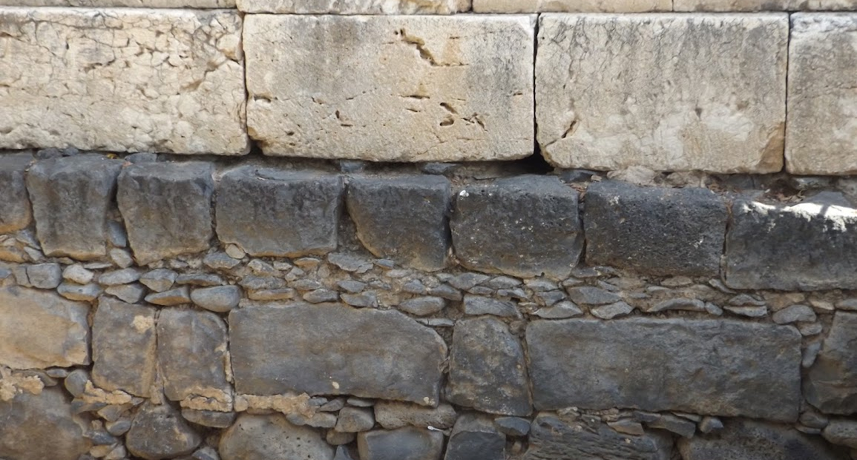

Studies in the Epistles
Foundations  Quarter 17
Lesson 12: First John 1 & 2

Slide 2
The Relationship Between First John & The Gospel Of John
First John builds on the groundwork of belief that was laid in the Gospel of John.
The Gospel of John presents evidence to lead us to believe. “These are written that you may believe that Jesus is the Christ, the Son of God, and that believing you may have life in His name” (Jn. 20:30-31).
In 1 John, belief transitions to practical applications and greater confidence in our hope. We can “know that we have eternal life.” “These things I have written to you who believe in the name of the Son of God, that you may know that you have eternal life…” (1 Jn 5:13).

Slide 3
The Relationship Between First John & The Gospel Of John
Other areas of similarity between 1 John & the Gospel of John:
Both present testimony that Jesus is the “Word” of God who came in the flesh (Jn. 1:1, 14; 19:35; 1 Jn. 1:1-2).
Both reveal that life is in God’s Son (John 1:4; 5:21-26; 6:47-48; 11:25; 1 John 5:11-12).
Both speak of the relationship between love and keeping commandments (John 14:15, 21, 23-24; 15:10; 1 John 2:5; 5:2-3).
Both emphasize that those who receive God’s love must love one another (John 13:34; 15:9-12; 1 John 3:16-18; 4:7-12).
Notes:
John 19:35 And he who has seen has testified, and his testimony is true; and he knows that he is telling the truth, so that you may believe.
John 5:21 For as the Father raises the dead and gives life to them, even so the Son gives life to whom He will.
John 6:47-48 Most assuredly, I say to you, he who believes in Me has everlasting life. (48) I am the bread of life.
John 11:25 Jesus said to her, "I am the resurrection and the life. He who believes in Me, though he may die, he shall live.
John 14:15 "If you love Me, keep My commandments.
John 14:21 He who has My commandments and keeps them, it is he who loves Me. And he who loves Me will be loved by My Father, and I will love him and manifest Myself to him.“
John 14:23 Jesus answered and said to him, "If anyone loves Me, he will keep My word; and My Father will love him, and We will come to him and make Our home with him.
John 15:10 If you keep My commandments, you will abide in My love, just as I have kept My Father's commandments and abide in His love.
John 13:34 A new commandment I give to you, that you love one another; as I have loved you, that you also love one another.
John 15:12 This is My commandment, that you love one another as I have loved you.

Slide 4
Theme of First John: “That You may Know…”
Some form of the word “know” is found 41 times in 1st John.
The word “confidence” is used 3 times.
First John is written for the following reasons:
“…that your joy may be full” (1 John 1:4)
“…so that you may not sin” (1 John 2:1)
“… because you know [the truth]” (1 John 2:21)
“…concerning those who try to deceive you” (1 John 2:26)
“…that you may know that you have eternal life” (1 John 5:13).
Each of these truths gives us Confidence!

Slide 5
“Concerning those who are trying to deceive you…”
John was writing to combat the effects of particular false teaching.
He plainly says that he has written “concerning those who try to deceive you” (2:26)
False prophets had gone out into the world and the spirit of the Antichrist was at work (4:1-3; 2:18-19).
The nature of the false teaching:
Denied that God’s Son came in the flesh (4:2).
Claimed that one could know God without keeping commandments (2:4), and that one could be righteous without practicing righteousness (3:7).
Called into question the spiritual “knowledge” of true believers (2:21-22).
These things were taught by early heretics
known to history as the Gnostics.

Slide 6
Fellowship with God and with One Another (1 John 1:1-10)
The Word of life brings us into fellowship with God (1:1-4; 1 Cor. 1:9; 2 Thess. 2:13-14).
The Word was “from the beginning” (2:7, 24; Jn. 1:1; 17:5; Col. 1:17).
The apostles are witnesses of the Word -- they heard, saw, looked upon, and handled the Word of life (Jn. 1:14; Acts 1:2-3, 8; Lk. 24:39).
These witnesses proclaimed the Word so that we all might have fellowship with the Father and the Son.
Fellowship is “association, community, communion, joint participation” (Thayer). “Sharing in common” (Vine).
The result is that our “joy may be full” (Jn. 15:11).
Notes:
The PARALLEL between the introductions of John and 1 John are intentional and instructive. John seems to be emphasizing the Word as the person of Christ whereas 1 John is focusing on the life-giving, life changing message of Christ, and the beginning of that message being declared (1 John 2:7, 24).
1 Corinthians 1:9 God is faithful, by whom you were called into the fellowship of His Son, Jesus Christ our Lord.
2 Thessalonians 2:13-14 But we are bound to give thanks to God always for you, brethren beloved by the Lord, because God from the beginning chose you for salvation through sanctification by the Spirit and belief in the truth, (14) to which He called you by our gospel, for the obtaining of the glory of our Lord Jesus Christ.
John 17:5 And now, O Father, glorify Me together with Yourself, with the glory which I had with You before the world was.
Colossians 1:17 And He is before all things, and in Him all things consist.
“Seen” is from ὁράω 1) to see with the eyes 2) to see with the mind, to perceive, know 3) to see, i.e. become acquainted with by experience, to experience (Thayer)
“Looked upon” is from θεάομαι 1) to behold, look upon, view attentively, contemplate (often used of public shows) 1a) of important persons that are looked on with admiration
2) to view, take a view of 2a) in the sense of visiting, meeting with a person (Thayer)
Handled is the same word Luke uses (psēlaphaō) in Luke 24:39 Behold My hands and My feet, that it is I Myself. Handle Me and see, for a spirit does not have flesh and bones as you see I have.“
John 15:11 "These things I have spoken to you, that My joy may remain in you, and that your joy may be full.
:

Slide 7
Fellowship with God and with One Another (1 John 1:1-10)
Maintaining fellowship (1:5-10).
There is no darkness in God.
To maintain fellowship with God we must walk in the light with Him.
If we claim to have fellowship with God but walk in darkness, we lie!
If we walk in the light, Jesus’ blood cleanses us from all sin.
Sin is an impediment to fellowship. It must be removed!!!
We must admit that we have sin (1:8).
If we confess our sins, God is faithful to forgive us and cleanse us (1:9).
Complete forgiveness is ours when we meet God’s conditions (James 5:16; Acts 8:22; Psalm 103:12).
If we claim that we have not sinned, we make God out to be a liar because He says we have (1:10; Rom. 3:23).
Notes:
James 5:16 Confess your trespasses to one another, and pray for one another, that you may be healed. The effective, fervent prayer of a righteous man avails much.
Acts 8:22 Repent therefore of this your wickedness, and pray God if perhaps the thought of your heart may be forgiven you.
What is the difference between confessing sins, confessing that we have sins, and confessing that we are sinful?
Psalms 103:12 As far as the east is from the west, So far has He removed our transgressions from us.

Slide 8
God’s Provision for Overcoming Sin and Maintaining Fellowship with Him (1 John 2:1-6)
Jesus Christ our Advocate and the Propitiation for our Sins (2:1-2).
John has shown us the motivation and method for overcoming sin.
God has provided for us an advocate, a propitiation, and a path.
We have an Advocate who stands beside us to help (Job 9:32-33)
Jesus is also the Propitiation for our sins (2:2)
A propitiation is a sacrifice or price paid that serves as atonement and makes reconciliation possible.
It turns away wrath by appeasement AND it removes the blot of the offense, thus enabling fellowship (cf. Lev. 17:11; Ps. 65:3; 79:9; Ezek. 16:62-63; Rom. 5:25-26).
Jesus Christ is our example and His commandments our path (2:3-6).
If we keep His commandments, we know Him and are in Him.
If we walk as Jesus walked, we are abiding in Him.
Notes:
Job 9:32-33 "For He is not a man, as I am, That I may answer Him, And that we should go to court together. (33) Nor is there any mediator between us, Who may lay his hand on us both.
PROPITIATION: “The proper meaning of the word is that of reconciling, appeasing, turning away anger, rendering propitious or favorable. The idea is, that there is anger or wrath, or that something has been done to offend, and that it is needful to turn away that wrath, or to appease.” – Albert Barnes
Leviticus 17:11 For the life of the flesh is in the blood, and I have given it to you upon the altar to make atonement for your souls; for it is the blood that makes atonement for the soul.'
Psalms 65:3 Iniquities prevail against me; As for our transgressions, You will provide atonement for them.
Psalms 79:9 Help us, O God of our salvation, For the glory of Your name; And deliver us, and provide atonement for our sins, For Your name's sake!
Ezekiel 16:62-63 And I will establish My covenant with you. Then you shall know that I am the LORD, (63) that you may remember and be ashamed, and never open your mouth anymore because of your shame, when I provide you an atonement for all you have done," says the Lord GOD.' "
Romans 3:25-26 whom God set forth as a propitiation by His blood, through faith, to demonstrate His righteousness, because in His forbearance God had passed over the sins that were previously committed, (26) to demonstrate at the present time His righteousness, that He might be just and the justifier of the one who has faith in Jesus.

Slide 9
Love will Keep us in the Light (1 John 2:7-17)
The Old Commandment to love your brother is New in Christ (2:7-11).
Whoever loves his brother is in the light (and in fellowship with God).
“And there is no cause for stumbling in him.”
If you love your brother, you won’t cause him to sin!!!
Appreciating what has already happened in their lives in Christ will help those of every level of maturity to be confident (2:12-14).
The children’s sins are forgiven, and they have known the Father.
The fathers had known the Lord from the beginning.
The young men are strong, the word of God abides in them, and they have overcome the wicked one.

Slide 10
Love will Keep us in the Light (1 John 2:7-17)
Love the Father, not the World (2:15).
Loving the world and loving the Father are mutually exclusive.
Whoever keeps God’s word loves God (2:5).
Whoever loves the world will not keep God’s word.
The “world” refers to realm of spiritual darkness – this present evil world over which Satan holds sway (compare 1 John 3:1, 13; 4:4-5; 5:4-5, 19 with 2:2; 4:9).
All that is in the world is not of the Father – the lust of the flesh, the lust of the eyes, and pride (2:16-17).
Loving the things of the world leads to sin (James 1:14; Genesis 3:6; Matthew 4:1-11).
The world and its lusts pass away, but the one who does the will of God abides forever (Matthew 24:35; 1 Peter 1:23, 25).
Notes:
James 1:14 But each one is tempted when he is drawn away by his own desires and enticed.
Genesis 3:6 So when the woman saw that the tree was good for food, that it was pleasant to the eyes, and a tree desirable to make one wise, she took of its fruit and ate. She also gave to her husband with her, and he ate.
Matthew 24:35 Heaven and earth will pass away, but My words will by no means pass away.
1 Peter 1:23 having been born again, not of corruptible seed but incorruptible, through the word of God which lives and abides forever,
1 Peter 1:25 BUT THE WORD OF THE LORD ENDURES FOREVER." Now this is the word which by the gospel was preached to you.

Slide 11
Abide in the Father by Abiding in Truth (1 John 2:18-29)
Antichrists have come (2:18-19).
By this we may know that we are in the last epoch of time (cf. 2 Timothy 3:1-7; 2 Thess. 2:1-12).
The antichrists had left the fellowship of those who held true faith and doctrine; apparently, they were never truly committed (Acts 20:30).
Due to God’s provision, John’s readers knew the truth and could recognize the lies of the antichrist (2:20-23).
They had “an anointing” that enabled them to know all things (2:20-21; Jn. 17:8, 17-18; 16:13; 1 Cor. 2:12-13).
Notes:
Barnes notes: “It is the last time - The closing period or dispensation; that dispensation in which the affairs of the world are ultimately to be wound up. The apostle does not, however, say that the end of the world would soon occur, nor does he intimate how long this dispensation would be. That period might continue through many ages or centuries, and still be the last dispensation, or that in which the affairs of the world would be finally closed. See the Isa_2:2 note; Act_2:17 note; Heb_1:2… Some have supposed that the “last time” here refers to the destruction of Jerusalem, and the end of the Jewish economy; but the more natural interpretation is to refer it to the last dispensation of the world, and to suppose that the apostle meant to say that there were clear evidences that that period had arrived.”
In 2 Timothy 3:1-7, esp. note “last days” and “always learning but never able to come to the knowledge of the truth.”
Acts 20:29-30 For I know this, that after my departure savage wolves will come in among you, not sparing the flock. (30) Also from among yourselves men will rise up, speaking perverse things, to draw away the disciples after themselves.
John 17:8 For I have given to them the words which You have given Me; and they have received them, and have known surely that I came forth from You; and they have believed that You sent Me.
John 17:17-18 Sanctify them by Your truth. Your word is truth. (18) As You sent Me into the world, I also have sent them into the world.
John 16:13 However, when He, the Spirit of truth, has come, He will guide you into all truth; for He will not speak on His own authority, but whatever He hears He will speak; and He will tell you things to come.
1 Corinthians 2:12-13 Now we have received, not the spirit of the world, but the Spirit who is from God, that we might know the things that have been freely given to us by God. (13) These things we also speak, not in words which man's wisdom teaches but which the Holy Spirit teaches, comparing spiritual things with spiritual.

Slide 12
Abide in the Father by Abiding in Truth (1 John 2:18-29)
Abiding in the Father and the Son requires that the original message of truth abides in us (2:24-27; John 6:45; Heb. 8:10-11).
By “abiding in Him” we can have confidence before Him when He comes (2:28-29).
The judgment will occur at His coming (Matt. 25:31-46).
Doing right shows that we are God’s children (Matt. 12:48-50).
Notes:
John 6:45 It is written in the prophets, 'AND THEY SHALL ALL BE TAUGHT BY GOD.' Therefore everyone who has heard and learned from the Father comes to Me.
Hebrews 8:10-11 For this is the covenant that I will make with the house of Israel after those days, says the Lord: i will put my laws in their mind and write them on their hearts; and i will be their Tod, and they shall be my people. (11) none of them shall teach his neighbor, and none his brother, saying, 'know the Lord,' for all shall know me, from the least of them to the greatest of them.
Matthew 12:48-50 But He answered and said to the one who told Him, "Who is My mother and who are My brothers?" (49) And He stretched out His hand toward His disciples and said, "Here are My mother and My brothers! (50) For whoever does the will of My Father in heaven is My brother and sister and mother."

Slide 13
Important Lessons:
First John assures us of things we can “know” based upon what we “believe.”
We can have fellowship with God if we walk in the light.
God will forgive our sins when we admit our problem and confess our sins.
God has provided the help we need to overcome sin by sending His Son as our advocate, propitiation, and perfect example.
Our love must be directed toward God and others, not toward the world.
False teachers will try to convince us that we don’t know things that we do know; we can know that we know because we have received and believed God’s word.

