Slide 1
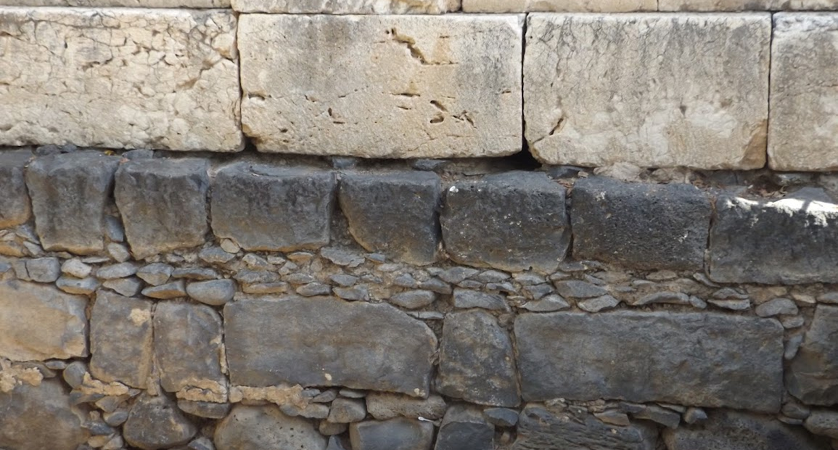

Studies in the Epistles
Foundations  Quarter 17
Lesson 19: Revelation 4-9

Slide 2
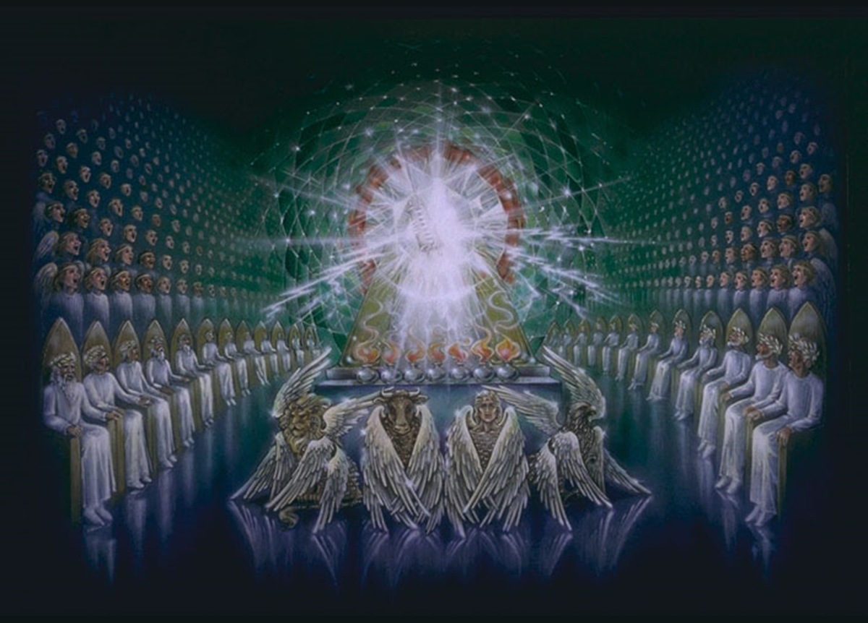
The Throne Scene (Revelation 4:1-11)
Overview:
The vivid visions of John’s Revelation begin in earnest in this chapter.
The throne scene depicts the sovereignty and majesty of God! He reigns in majesty!
John saw “a door standing open in heaven” and heard a voice “like a trumpet… saying, ‘Come up here, and I will show you things which must take place after this.’” (4:1)

Slide 3
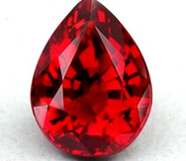
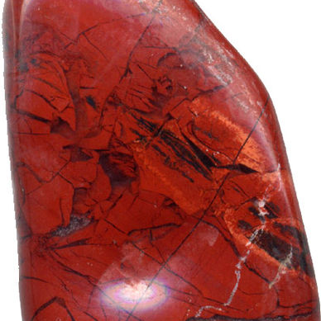
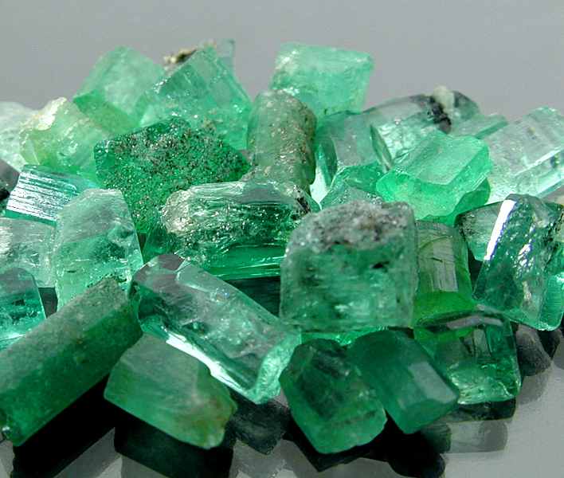
The Throne Scene (Revelation 4:1-11)
He who sat on the throne was like a jasper and sardius stone (21:11; Ps. 89:14).
A rainbow around the throne like an emerald.
24 thrones with 24 elders in white robes with gold crowns on their heads.
Lightning, thundering and voices (Ex. 19:16).
Seven lamps of fire.
A sea of glass like crystal before the throne (21:1; 15:2).
Four living creatures around the throne – with eyes and wings.
Notes:
Psa 89:14 Righteousness and justice are the foundation of Your throne; Mercy and truth go before Your face.

Slide 4
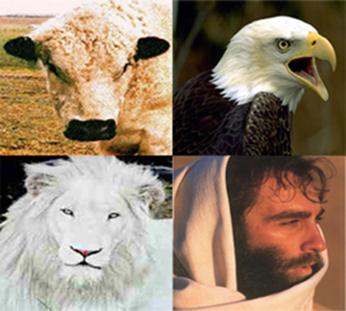
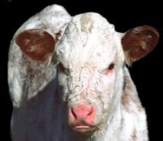

The Four Living Creatures (Ezekiel 1 AND Revelation 4)
In Revelation, the creatures have but one visage each – the first like a lion, the second like a calf, the third like a man and the fourth like and eagle.
The creatures in Ezekiel each have four faces like a man, a lion, an ox and an eagle.

Slide 5
The Significance of the Four Living Creatures
Identified as Cherubim (Ezekiel 1; 10:20)
In Scripture, Cherubim are consistently the guardians to the presence of God.
In Eden (Genesis 3:24).
Over the Mercy Seat (Exodus 25:18-20).
Their wings and eyes relate to God’s omniscience and omnipresence.
In Revelation 4, they continuously proclaim God’s holiness, sovereignty, and everlasting being.
Notes:
Ezekiel 10:20 This is the living creature I saw under the God of Israel by the River Chebar, and I knew they were cherubim.
Genesis 3:24 So He drove out the man; and He placed cherubim at the east of the garden of Eden, and a flaming sword which turned every way, to guard the way to the tree of life.
Exodus 25:18-20 And you shall make two cherubim of gold; of hammered work you shall make them at the two ends of the mercy seat. 19 Make one cherub at one end, and the other cherub at the other end; you shall make the cherubim at the two ends of it of one piece with the mercy seat. 20 And the cherubim shall stretch out their wings above, covering the mercy seat with their wings, and they shall face one another; the faces of the cherubim shall be toward the mercy seat.

Slide 6
The Significance of the Twenty-Four Elders
The number 12 represents God’s people (12 tribes, 12 apostles).
Elders are respected leaders – representative of the those who rule over God’s people.
Casting their crowns before God’s throne symbolizes that they are completely subject to the rule of God – their crowns are under His crown.
Notes:
Ezekiel 10:20 This is the living creature I saw under the God of Israel by the River Chebar, and I knew they were cherubim.
Genesis 3:24 So He drove out the man; and He placed cherubim at the east of the garden of Eden, and a flaming sword which turned every way, to guard the way to the tree of life.
Exodus 25:18-20 And you shall make two cherubim of gold; of hammered work you shall make them at the two ends of the mercy seat. 19 Make one cherub at one end, and the other cherub at the other end; you shall make the cherubim at the two ends of it of one piece with the mercy seat. 20 And the cherubim shall stretch out their wings above, covering the mercy seat with their wings, and they shall face one another; the faces of the cherubim shall be toward the mercy seat.

Slide 7
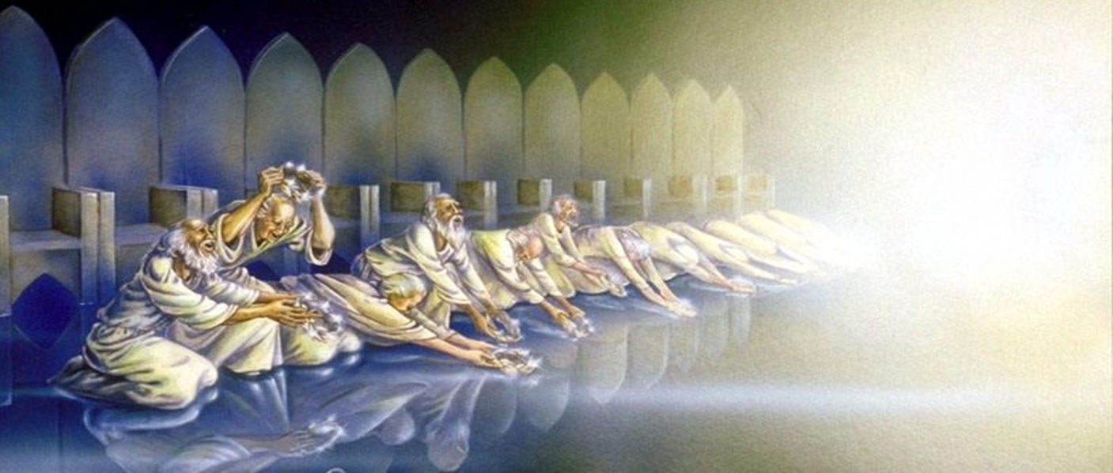
The Significance of the Twenty-Four Elders

Slide 8
The Lamb & the Scroll (Revelation 5:1-14)
John sees a scroll sealed with 7 seals in the right hand of the One on the throne (5:1).
An angel asks, “Who is worthy to open the scroll?” (5:2-4)
John weeps because no one is found worthy.
One of the elders informs John of One who has prevailed to open the scroll (5:5).
The Lion of Judah (Genesis 49:9-10).
The Root of David (2 Sam. 7:12-16; Jer. 23:5-6; Acts 2:30).
Notes:
Genesis 49:9-10 Judah is a lion's whelp; From the prey, my son, you have gone up. He bows down, he lies down as a lion; And as a lion, who shall rouse him? 10 The scepter shall not depart from Judah, Nor a lawgiver from between his feet, Until Shiloh comes; And to Him shall be the obedience of the people.
2 Samuel 7:12-13 "When your days are fulfilled and you rest with your fathers, I will set up your seed after you, who will come from your body, and I will establish his kingdom. 13 He shall build a house for My name, and I will establish the throne of his kingdom forever.
Jeremiah 23:5-6 "Behold, the days are coming," says the LORD, "That I will raise to David a Branch of righteousness; A King shall reign and prosper, And execute judgment and righteousness in the earth. 6 In His days Judah will be saved, And Israel will dwell safely; Now this is His name by which He will be called: THE LORD OUR RIGHTEOUSNESS.

Slide 9
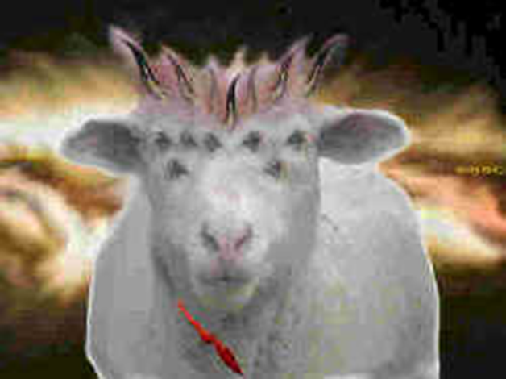
The Lamb & the Scroll (Revelation 5:1-14)
John looks and sees a Lamb in the middle of the throne scene (5:6).
The Lamb looked as if it had been slain (13:8).
He had seven horns and seven eyes.
The horns represent the power of Jesus (1 Sam 2:10; Matt. 28:18).
The eyes represent the omniscience of the Spirit of God (Ps. 139:7).
Notes:
1 Samuel 2:10 The adversaries of the LORD shall be broken in pieces; From heaven He will thunder against them. The LORD will judge the ends of the earth. "He will give strength to His king, And exalt the horn of His anointed.“
Psalms 139:7 Where can I go from Your Spirit? Or where can I flee from Your presence?

Slide 10
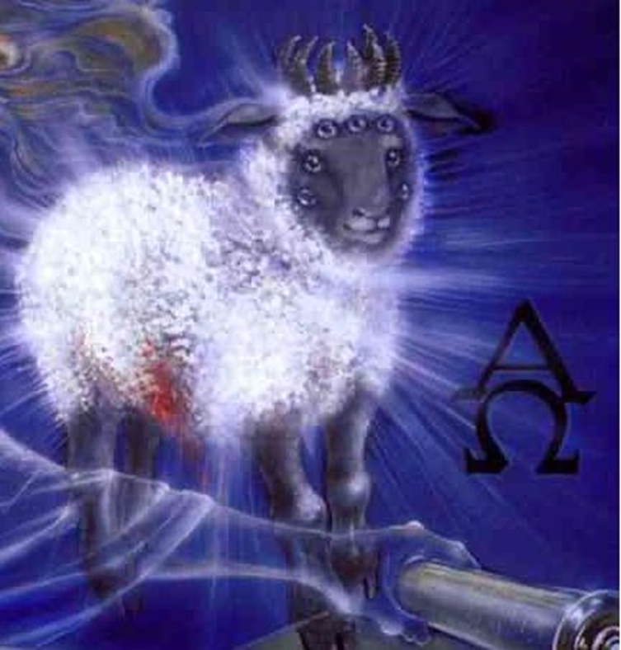
The Lamb & the Scroll (Revelation 5:1-14)
The Lamb “took the scroll out of the right hand of Him who sat on the throne” (5:7).
The four living creatures and the 24 elders fall down before the Lamb (5:8).
Each elder has a harp (for praise) and golden bowls of incense (the prayers of the saints).
They praise the Lamb with a new song (5:9-10).
For being worthy to open the scroll, for being slain for man’s redemption, and for making us kings & priests.
All the host around the throne praise the “worthy” Lamb and the One who sits on the throne (5:11-13).
Notes:
?

Slide 11
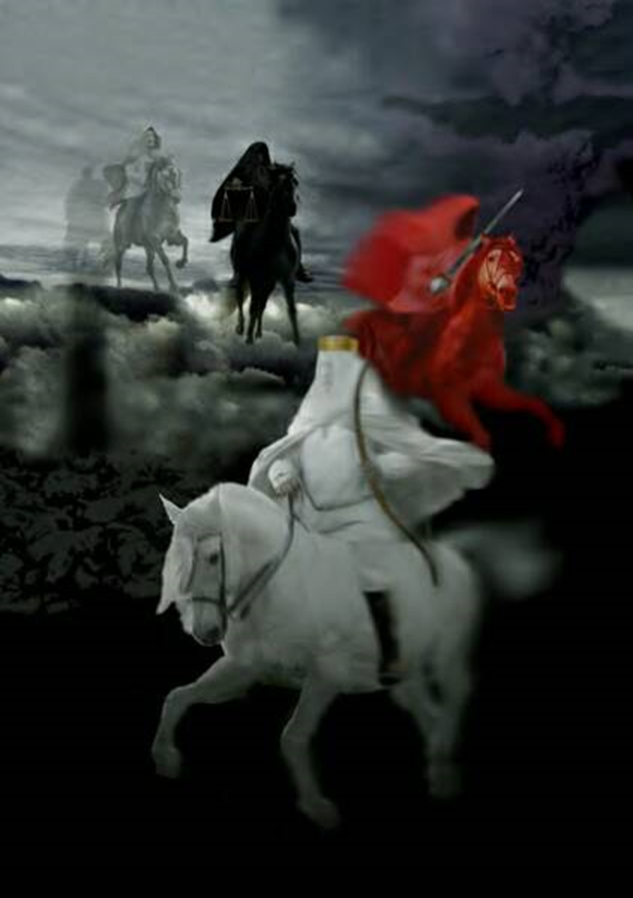
The First Six Seals are Opened (Revelation 6:1-17)
First Four Seals -> Four Horsemen (6:1-8).
THE FIRST SEAL reveals a rider with a bow and a crown on a white horse (6:1-2).
Similar to a description of Christ (19:11-16).
He goes forth with a bow “conquering and to conquer” (Psalm 45:1-7).
May represent the cause of Christ (gospel).
THE SECOND SEAL reveals a rider on a fiery red horse with a great sword (6:3-4).
He is to “take peace from the earth.”
Wherever the gospel goes, persecution and violence follow (2 Timothy 3:12; Matthew 10:34).
Notes:
Note that the unveiling of each seal is preceded by an invitation to “come and see.” (6:1, 2, 5, 7)
Matthew 10:34 "Do not think that I came to bring peace on earth. I did not come to bring peace but a sword.
Note that the sword of this rider is one used to slay sacrificial animals (Gr. Machaira; Rom.8:36)

Slide 12
The First Six Seals are Opened (Revelation 6:1-17)
First Four Seals -> Four Horsemen (6:1-8).
THE THIRD SEAL reveals a rider on a black horse carrying scales (6:5-6).
A voice in the midst of the four creatures declares that a quart of wheat or 3 quarts of barley will cost a full day’s wages.
Christians experience economic hardships
THE FOURTH SEAL reveals a rider named “Death” on a pale horse (6:7-8).
“Hades” followed with him.
He kills ¼ of the earth with the sword, hunger, natural death, and by beasts.
Christians are martyred (Ez. 5:16-17; 14:21)
Notes:
Ezekiel 5:16-17 When I send against them the terrible arrows of famine which shall be for destruction, which I will send to destroy you, I will increase the famine upon you and cut off your supply of bread. 17 So I will send against you famine and wild beasts, and they will bereave you. Pestilence and blood shall pass through you, and I will bring the sword against you. I, the LORD, have spoken.’”
Ezekiel 14:21 For thus says the Lord GOD: "How much more it shall be when I send My four severe judgments on Jerusalem—the sword and famine and wild beasts and pestilence—to cut off man and beast from it?

Slide 13
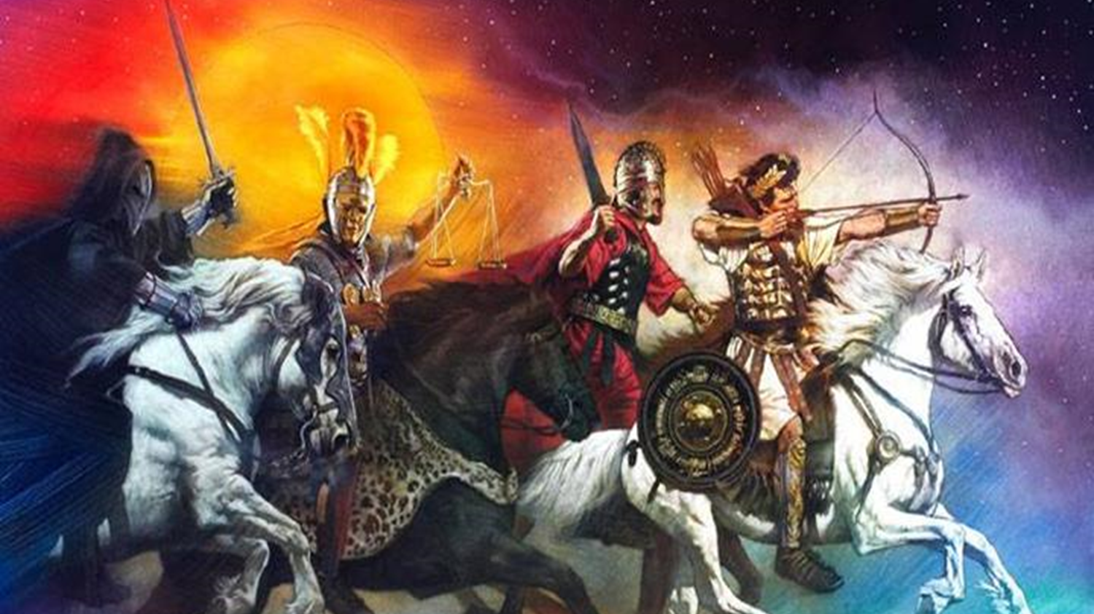

Slide 14
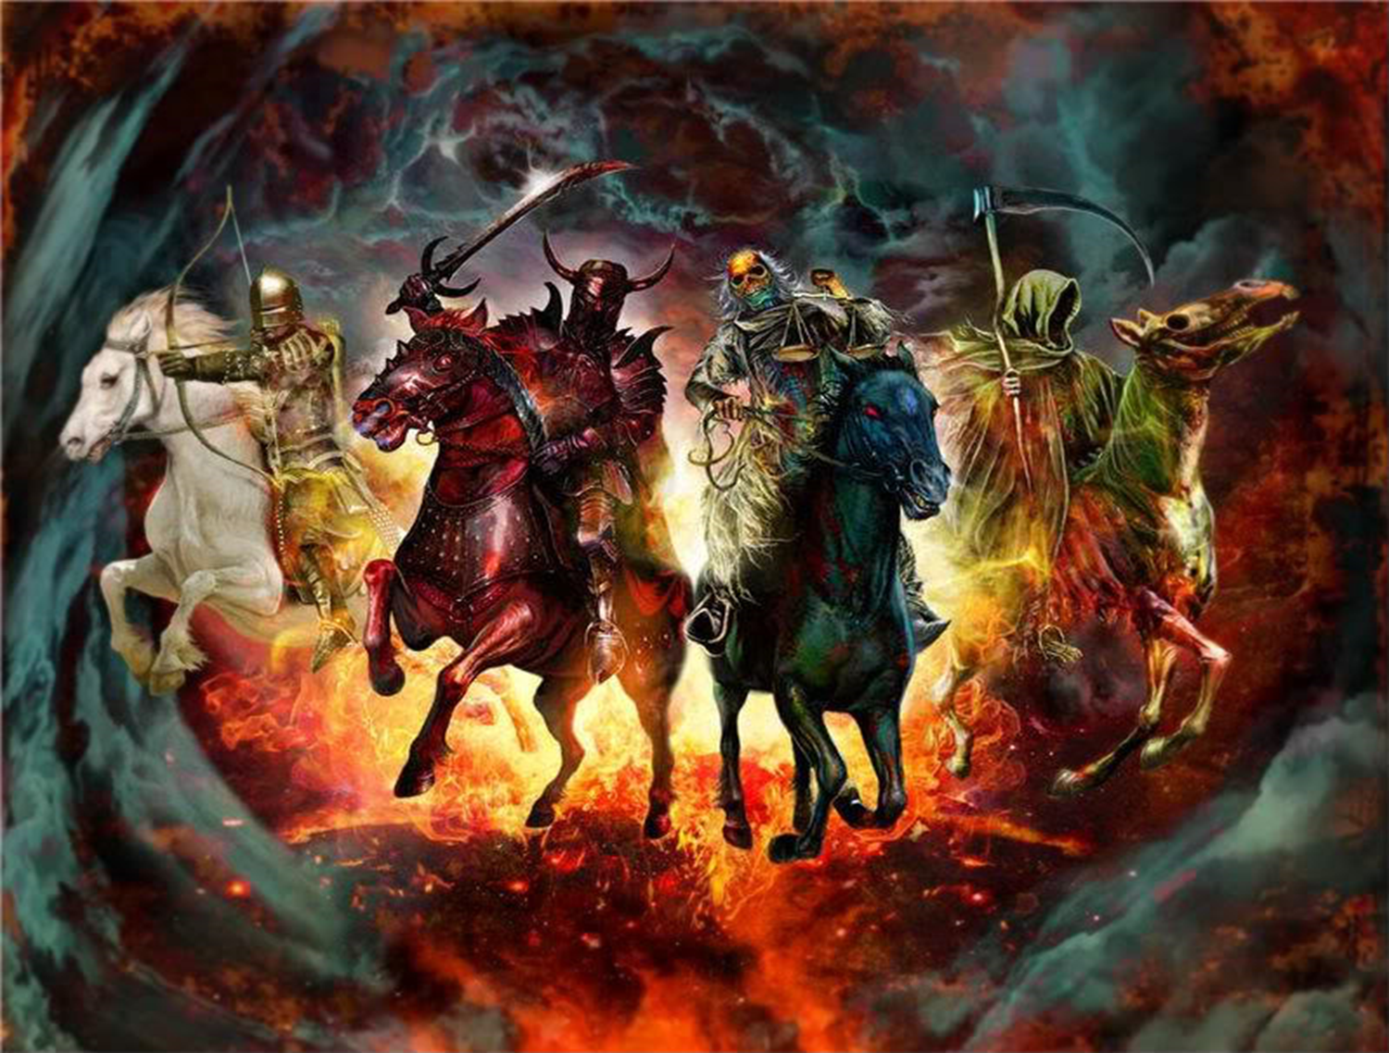

Slide 15
The First Six Seals are Opened (Revelation 6:1-17)
THE FIFTH SEAL: The Souls Under the Altar (Revelation 6:9-11).
When the Lamb opens the fifth seal, John sees under the altar souls that had been slain for the word of God and their testimony.
These have given their lives for the gospel.
They cry to the Lord, “How long…until You avenge our blood?”
In response, each is given a white robe and told to rest “a little while longer” until the number of those who would be killed as they were was completed.
In a sense, the entire Book of Revelation is an answer to the questions asked and implied by the souls under the altar:
How can God allow good people to be oppressed and slain by evil people?
Will good be overcome by evil forever?
How long will God put up with this?

Slide 16
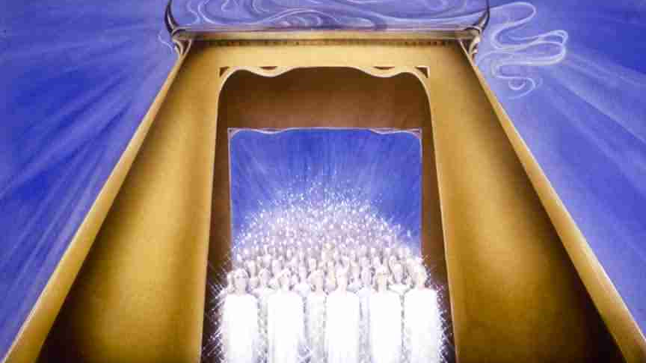

Slide 17
The First Six Seals are Opened (Revelation 6:1-17)
THE SIXTH SEAL: Preview of Punishment (Revelation 6:12-17).
God will avenge His people:
The sun will be darkened, the moon turned to blood, stars will fall, the sky will recede, and mountains will be moved..
Men will plead to be crushed by rocks rather than face God’s wrath..
Similar symbols are used elsewhere to denote God’s judgments against the wicked
Similar symbols of judgment (Joel 2:10; Isaiah 13:10)
These are not literal occurrences, but changes in geo-political world order.
Seemingly stable governments and institutions are swept away by God’s power.
Similar symbols of the reaction of the wicked (Isa. 2:19; Hos.10:8; Lk. 23:30)
Notes:
Joel 2:10 The earth quakes before them, The heavens tremble; The sun and moon grow dark, And the stars diminish their brightness.
Isaiah 13:10 For the stars of heaven and their constellations Will not give their light; The sun will be darkened in its going forth, And the moon will not cause its light to shine.
Isaiah 2:19 They shall go into the holes of the rocks, And into the caves of the earth, From the terror of the LORD And the glory of His majesty, When He arises to shake the earth mightily.
Hosea 10:8 Also the high places of Aven, the sin of Israel, Shall be destroyed. The thorn and thistle shall grow on their altars; They shall say to the mountains, "Cover us!" And to the hills, "Fall on us!“
Luke 23:30 Then they will begin 'TO SAY TO THE MOUNTAINS, "FALL ON US!" AND TO THE HILLS, "COVER US!" '

Slide 18
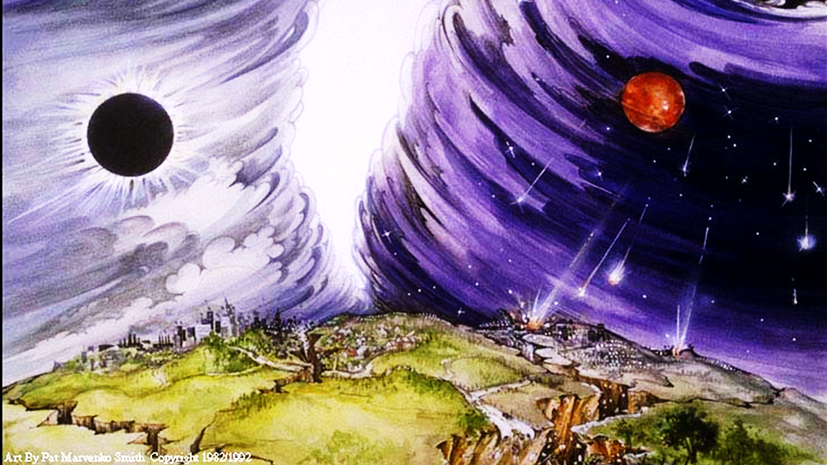

Slide 19
An Interlude: 144,000 Sealed and a Multitude Saved (Revelation 7:1-17)
144,000 Sealed on the Earth
Before the Lord sends His retribution to evil men on the earth, His chosen people are sealed – identified and protected (cf. Ezek. 9:1-11).
144,000 are sealed of the tribes of Israel.
These represent “the servants of our God” (7:3).
144,000 is the sum of 12,000 taken from each of the twelve tribes. It is also a multiple of 12 x 12 (tribes, apostles) and 1,000 (a large number)
If meant literally, then only Israelites on the earth are sealed.
NOTE: Dan & Ephraim are omitted.

Slide 20
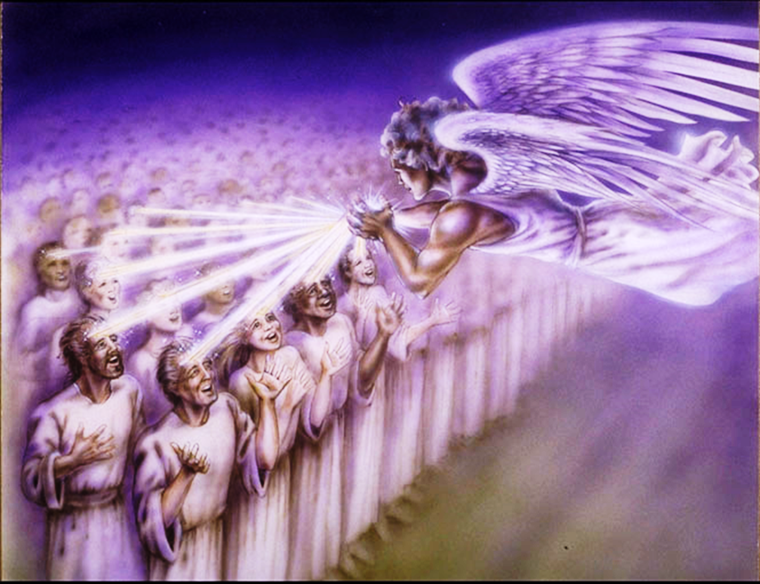

Slide 21
An Interlude: 144,000 Sealed and Multitude Saved (Revelation 7:1-17)
An Innumerable Multitude Redeemed in Heaven
John then sees an innumerable multitude before the throne of God with white robes and palm branches praising God with the heavenly host (7:9-12)
One of the elders identifies the multitude as those who come out of the great tribulation having washed their robes white in the blood of the Lamb. (7:13-17)
Their future is glorious!
Their needs are fulfilled, and they no longer suffer pain or grief.

Slide 22
The 7th Seal Open, The 7 Trumpets Introduced (Revelation 8:1-13)
The Seventh Seal introduces the Seven Trumpets (8:1-5)
The opening of the seventh seal produces a dramatic silence (8:1; Zeph. 1:7; Zech. 2:13)
John sees 7 angels given 7 trumpets (8:2; Joel 2)
He sees an angel offer incense on the golden altar before God’s throne – the incense with the prayers of the saints rise before God (8:3-4)
The angel takes fire from the altar and throws it to the earth with dramatic results – noises, thunder, lightning, earthquake) (8:5).
GOD IS ABOUT TO ANSWER THE PRAYERS OF THE SAINTS WITH TROUBLE ON THE EARTH (Luke 18:7).

Slide 23
The 7th Seal Open, The 7 Trumpets are Introduced (Revelation 8:1-13)
The First Four Trumpets Sound (8:6-13)
The angels prepare to sound their trumpets (8:6)
THE FIRST TRUMPET brings hail & fire mingled with blood to the earth. 1/3 of the vegetation is burned (8:7)
THE SECOND TRUMPET reveals a burning mountain thrown into the sea. 1/3 of the sea turns to blood, and 1/3 of sea creatures and ships are destroyed. (8:8-9)
THE THIRD TRUMPET reveals a star named Wormwood falling on the rivers, making them bitter and resulting in the death of many men (8:10-11)
THE FOURTH TRUMPET darkens 1/3 of the sun, moon & stars (8:12-13)
An angel pronounces 3 woes on the inhabitants of the earth because of the 3 remaining trumpets that are about to sound.

Slide 24
The 7th Seal Open, The 7 Trumpets are Introduced (Revelation 8:1-13)
Symbolism in the First Four Trumpets
These apparent calamities of nature SYMBOLIZE measured punishments of God upon evil men in order to motivate repentance (see 9:20-21).
The “earth” is the dwelling place of evil men.
“A third” symbolizes that these punishments are partial.
Trees and green grass may symbolize things which support human life and make it pleasurable.
A mountain represents a kingdom, the sea is human society, and the ships represent commerce.
A “great star” is a world leader (Num. 24:17). His fall embitters life and results in spiritual death for many.
World powers (sun, moon and stars, Isa. 13:10) do not shine as brightly as they otherwise might.

Slide 25
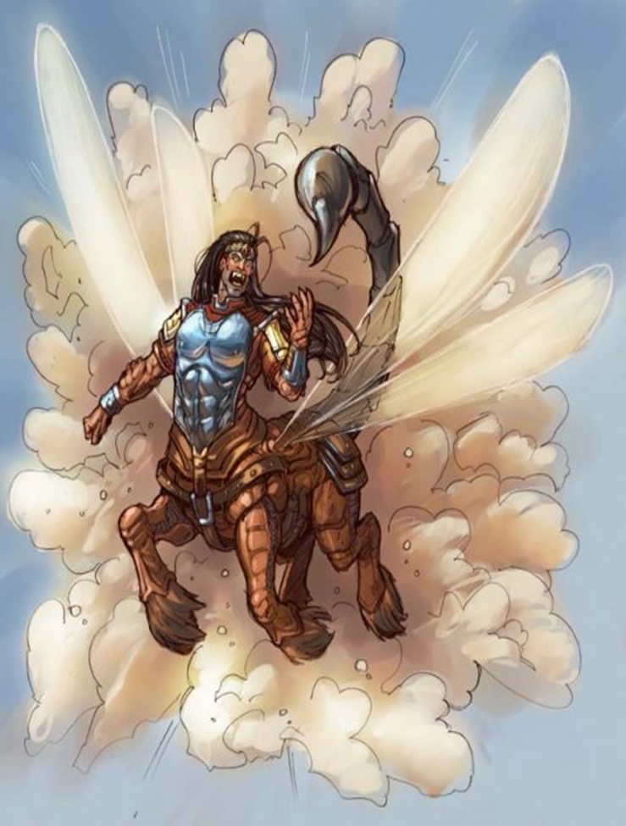
The Final 3 Trumpets bring Woes upon the Wicked (Revelation 9:1-21)
THE FIFTH TRUMPET – 1st Woe (9:1-12)
A star falls from heaven with the key to the bottomless pit (9:1; cf. 11:7; 17:8).
When he opens the pit, smoke ascends and darkens the sun and the air, and out of the smoke come locusts (9:2-3).
The locust (9:3-6).
Were given power as scorpions (9:3).
They were only to harm those who did not have the seal of God (9:4; 7:3).
Torment men 5 months (9:5-6).

Slide 26
The Final 3 Trumpets bring Woes upon the Wicked (Revelation 9:1-21)
THE SIXTH TRUMPET – 2ND Woe (Rev. 9:13-19)
A voice from the altar commands “release the 4 angels who are bound at the…river Euphrates”
The 4 prepared angels are released, unleashing an army of 200 million to kill 1/3 of mankind.
The riders had breastplates of bright colors and heads like lions.
Fire smoke and brimstone out of their mouths; plagues which killed 1/3 of mankind. Tails like serpents with heads to do harm
Reaction of the Wicked to the Plagues of the Sixth Trumpet (9:20-21)
They did not repent!
They continued to worship demons and idols
They continued to engage in murder, sorcery, sexual immorality and theft.

Slide 27
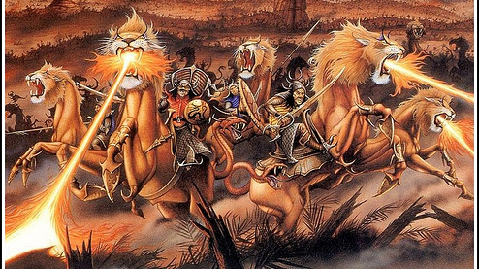

Slide 28
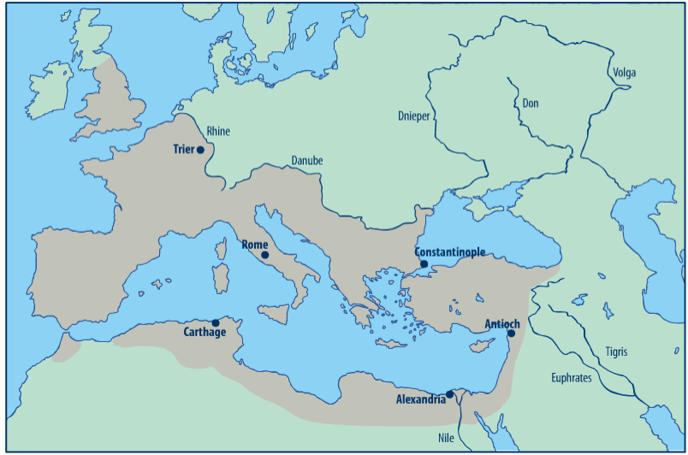
Roman Empire (circa 125 AD)
Media
Parthia

Slide 29
The Final 3 Trumpets bring Woes upon the Wicked (Revelation 9:1-21)
Symbolism of the 5th and 6th trumpets
Because it persecuted God’s people, the Roman Empire is to be plagued with problems from within and without.
These problems bring considerable suffering and misery to those who are not God’s people.
Many of these things are likely Divinely established consequences of sins which were institutionalized in the Roman Empire – sins such as idolatry, immorality, dishonesty, oppression, and gross political corruption have grave and harmful consequences.

Slide 30
Important Lessons:
The throne room of God is majestic, glorious, and awe-inspiring. God reigns in Majesty!!!
The One who sits on the throne, and the Lamb, are worthy of all worship, praise, glory, honor, and dominion.
The gospel brings hardship, persecution, and even death to those who believe and obey it, but God will give them justice in the end.
The Lord protects His people from punishments intended for their persecutors, and He cleanses His people that they might live eternally in His presence.
God brings evil times upon evil men to encourage them to repent before it is too late.

