Slide 1
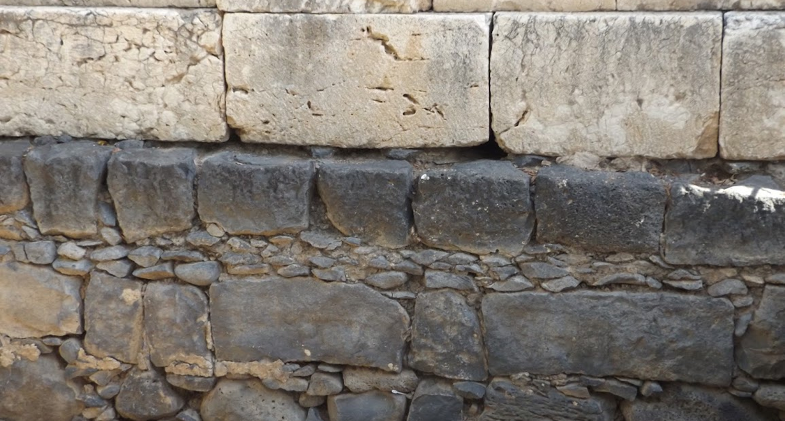

Studies in the Epistles
Foundations  Quarter 17
Lesson 20: Revelation 10-13

Slide 2
The 7th Seal Opened – Seven Trumpets Introduced
(Revelation 8:1-13)
The Seventh Seal introduces the Seven Trumpets (8:1-5)
    The opening of the seventh seal produces a dramatic silence (8:1; Zeph. 1:7; Zech. 2:13)
    John sees 7 angels given 7 trumpets (8:2; Joel 2)
    He sees an angel offer incense on the golden altar before God’s throne – the incense with the prayers of the saints rise before God (8:3-4)
  The angel takes fire from the altar and throws it to the earth with dramatic results – noises, thunder, lightning, earthquake) (8:5).
  GOD IS ABOUT TO ANSWER THE PRAYERS OF THE SAINTS WITH TROUBLE ON THE EARTH (Luke 18:7).

Slide 3
The 7th Seal Opened – Seven Trumpets Introduced
(Revelation 8:1-13)
The First Four Trumpets Sound (8:6-13)
    The angels prepare to sound their trumpets (8:6)
    THE FIRST TRUMPET brings hail & fire mingled with blood to the earth. 1/3 of the vegetation is burned (8:7)
    THE SECOND TRUMPET reveals a burning mountain thrown into the sea. 1/3 of the sea turns to blood, and 1/3 of sea creatures and ships are destroyed. (8:8-9)
    THE THIRD TRUMPET reveals a star named Wormwood falling on the rivers, making them bitter and resulting in the death of many men (8:10-11)
    THE FOURTH TRUMPET darkens 1/3 of the sun, moon & stars (8:12-13)
    An angel pronounces 3 woes on the inhabitants of the earth because of the 3 remaining trumpets that are about to sound.

Slide 4
The 7th Seal Opened – Seven Trumpets Introduced
(Revelation 8:1-13)
Symbolism in the First Four Trumpets
These apparent calamities of nature SYMBOLIZE measured punishments of God upon evil men in order to motivate repentance (see 9:20-21).
  The “earth” is the dwelling place of evil men.
  “A third” symbolizes that these punishments are partial.
  Trees and green grass may symbolize things which support human life and make it pleasurable.
  A mountain represents a kingdom, the sea is human society, and the ships represent commerce.
  A “great star” is a world leader (Num. 24:17). His fall embitters life and results in spiritual death for many.
  World powers (sun, moon and stars, Isa. 13:10) do not shine as brightly as they otherwise might.

Slide 5
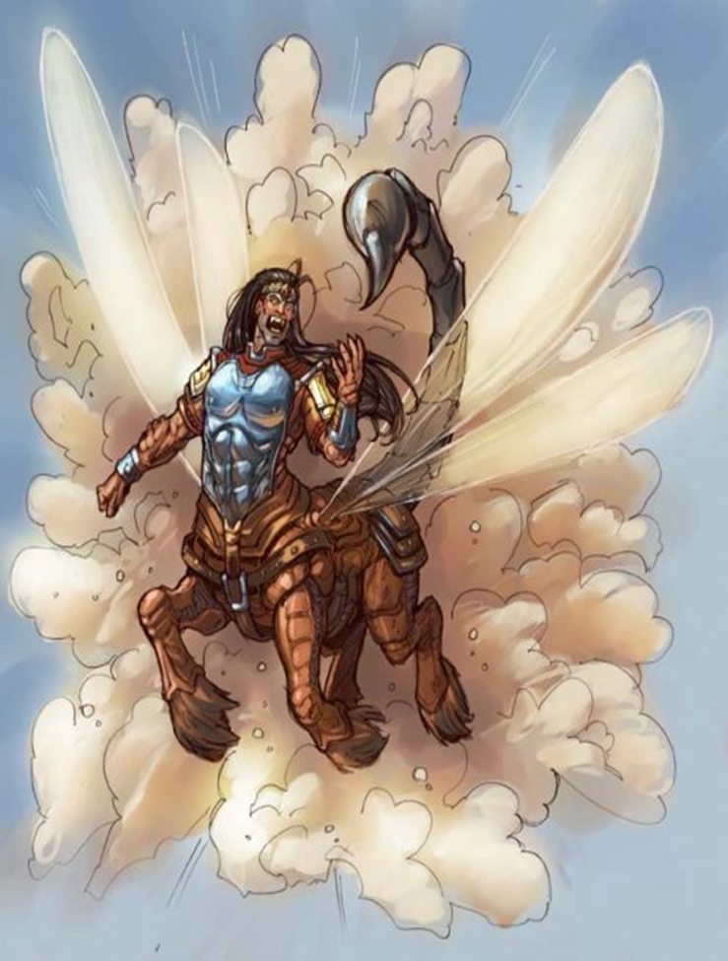
The Final 3 Trumpets bring Woes upon the Wicked
(Revelation 9:1-21)
THE FIFTH TRUMPET – 1st Woe (9:1-12)
A star falls from heaven with the key to the bottomless pit (9:1; cf. 11:7; 17:8).
When he opens the pit, smoke ascends and darkens the sun and the air, and out of the smoke come locusts (9:2-3).
The locust (9:3-6).
  Were given power as scorpions (9:3).
  They were only to harm those who did not have the seal of God (9:4; 7:3).
  Torment men 5 months (9:5-6).

Slide 6
The Final 3 Trumpets bring Woes upon the Wicked
(Revelation 9:1-21)
THE SIXTH TRUMPET – 2nd Woe (Rev. 9:13-19)
A voice from the altar commands “release the 4 angels who are bound at the…river Euphrates”
The 4 prepared angels are released, unleashing an army of 200 million to kill 1/3 of mankind.
  The riders had breastplates of bright colors and heads like lions.
  Fire smoke and brimstone out of their mouths; plagues which killed 1/3 of mankind. Tails like serpents with heads to do harm
Reaction of the Wicked to the Plagues of the Sixth Trumpet (9:20-21)
  They did not repent!
  They continued to worship demons and idols
  They continued to engage in murder, sorcery, sexual immorality and theft.

Slide 7
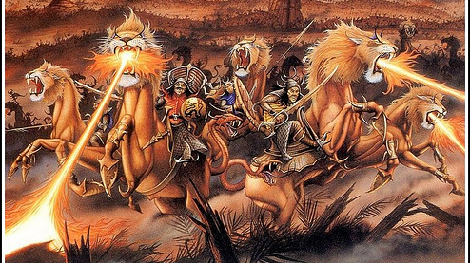

Slide 8
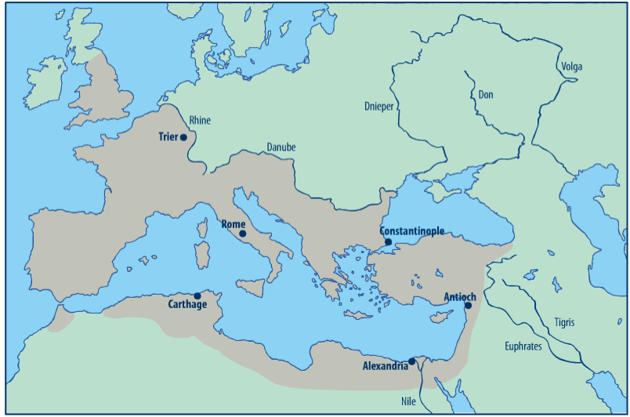
Roman Empire (circa 125 AD)
Media
Parthia

Slide 9
The Final 3 Trumpets bring Woes upon the Wicked
(Revelation 9:1-21)
Symbolism of the 5th and 6th trumpets
Because it persecuted God’s people, the Roman Empire is to be plagued with problems from within and without.
These problems bring considerable suffering and misery to those who are not God’s people.
Many of these things are likely Divinely established consequences of sins which were institutionalized in the Roman Empire – sins such as idolatry, immorality, dishonesty, oppression, and gross political corruption have grave and harmful consequences.

Slide 10
Important Lessons:
The throne room of God is majestic, glorious, and awe-inspiring. God reigns in Majesty!!!
The One who sits on the throne, and the Lamb, are worthy of all worship, praise, glory, honor, and dominion.
The gospel brings hardship, persecution, and even death to those who believe and obey it, but God will give them justice in the end.
The Lord protects His people from punishments intended for their persecutors, and He cleanses His people that they might live eternally in His presence.
God brings evil times upon evil men to encourage them to repent before it is too late.

Slide 11
Second Interlude: A Mighty Angel and a Little Book
Revelation 10:1-11
Revelation 10:1 – 11:14 presents a second interlude prior to the sounding of the 7th trumpet in Revelation 11:15.
This interlude gives assurance…
that God has even more planned to vindicate His saints.
that He does not reveal to men everything that He is doing or will do.
and that He will not allow His testimony to be stamped out by the forces of evil.

Slide 12
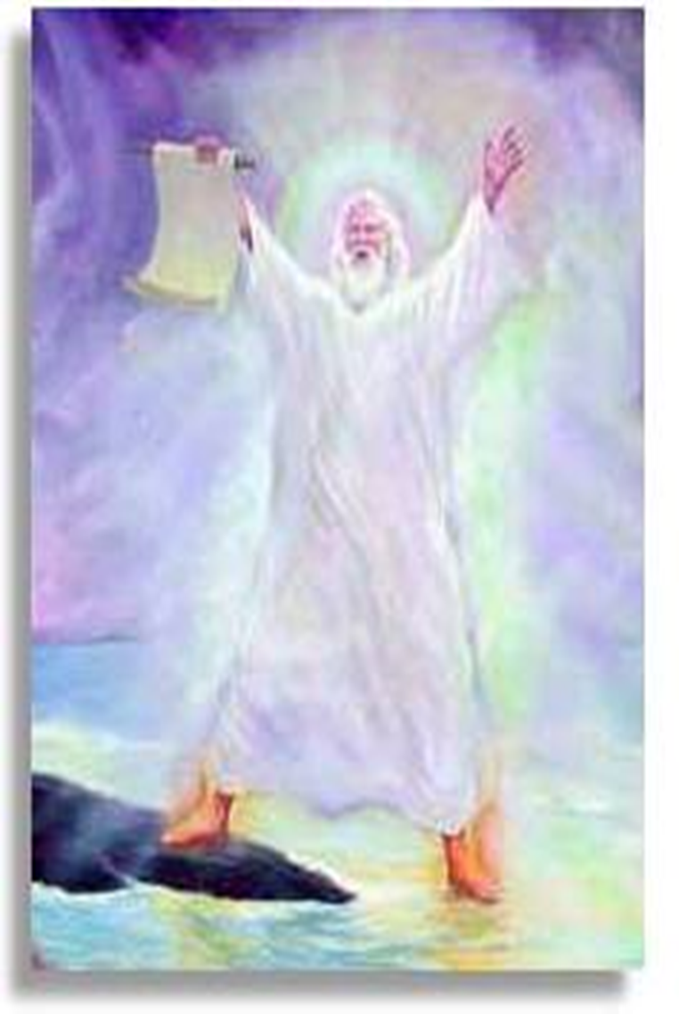
Second Interlude: A Mighty Angel and a Little Book
Revelation 10:1-11
The Mighty Angel (10:1-3).
John sees another mighty angel (cf. 5:2)
  The angel is clothed in a cloud, has a rainbow on his head, a face like the sun, and feet like pillars of fire.
  A little book is open in his right hand.
  He has one foot on the sea and one on the land.
When he cries out with a loud voice, 7 thunders utter their voices.
SYMBOLIC MEANING
  The angel’s appearance reflects the Divine power and majesty of that which he is announcing.
  The placement of his feet suggests that his announcement will affect both earth and sea (i.e., man’s dwelling place and societal interactions).

Slide 13
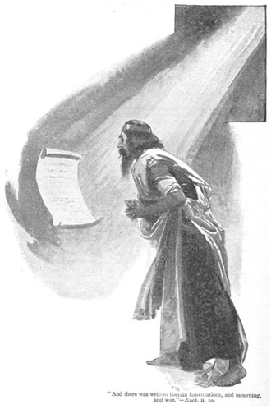
Second Interlude: A Mighty Angel and a Little Book
Revelation 10:1-11
Seven Thunders & John eats the Book (10:4-11).
John is told not to write what the seven thunders uttered (10:4).
  The Lord has plans that He does not reveal to man.
Then the angel swears that the mystery of God would be finished in the days of the sounding of the 7th trumpet (10:5-7, cf. Matthew 5:34-35).
John eats the book in the angel’s hand (10:8-11).
  The angel tells John to eat the book; it would be sweet in his mouth but bitter in his stomach (10:9-10; cf. Ps. 119:103; Ezek. 2:8-10; 3:1-3).
  He is then told that he must “prophesy again, about many peoples, nations, tongues and kings” (10:11).

Slide 14
Second Interlude: The Measured Temple & 2 Witnesses
Revelation 11:1-14
John measures the temple, the altar, and the worshipers (11:1-2).
Our relationship with God has precise dimensions (Ezek. 40-43; 43:10-11).
  The temple may represent the church (Eph. 2:21-22).
  The altar may represent the worship/prayers of the saints (Rev. 6:9-11).
  Worshipers are the saints (1 Peter 2:5).
The outer court remains unmeasured; it is given to the Gentiles who will trample the holy city 42 months.

Slide 15
Second Interlude: The Measured Temple & 2 Witnesses
Revelation 11:1-14
The Two Witnesses (11:3-14).
Power is given to God’s two witnesses to prophesy 1,260 days clothed in sackcloth (11:3).
  This time is equal to 42 months, 3½ years or times, time and a half time. IT IS ½ OF SEVEN.
These are two olive trees (11:4; Zechariah 4).
They have Divine power and protection (11:5-6).
When they finish testifying, they are killed by the beast (11:7).
  People of the earth will rejoice over the death of the witnesses for 3 ½ days (11:8-10).
  After 3 ½ days, the two witnesses come back to life and ascend up to heaven (11:11-13).

Slide 16
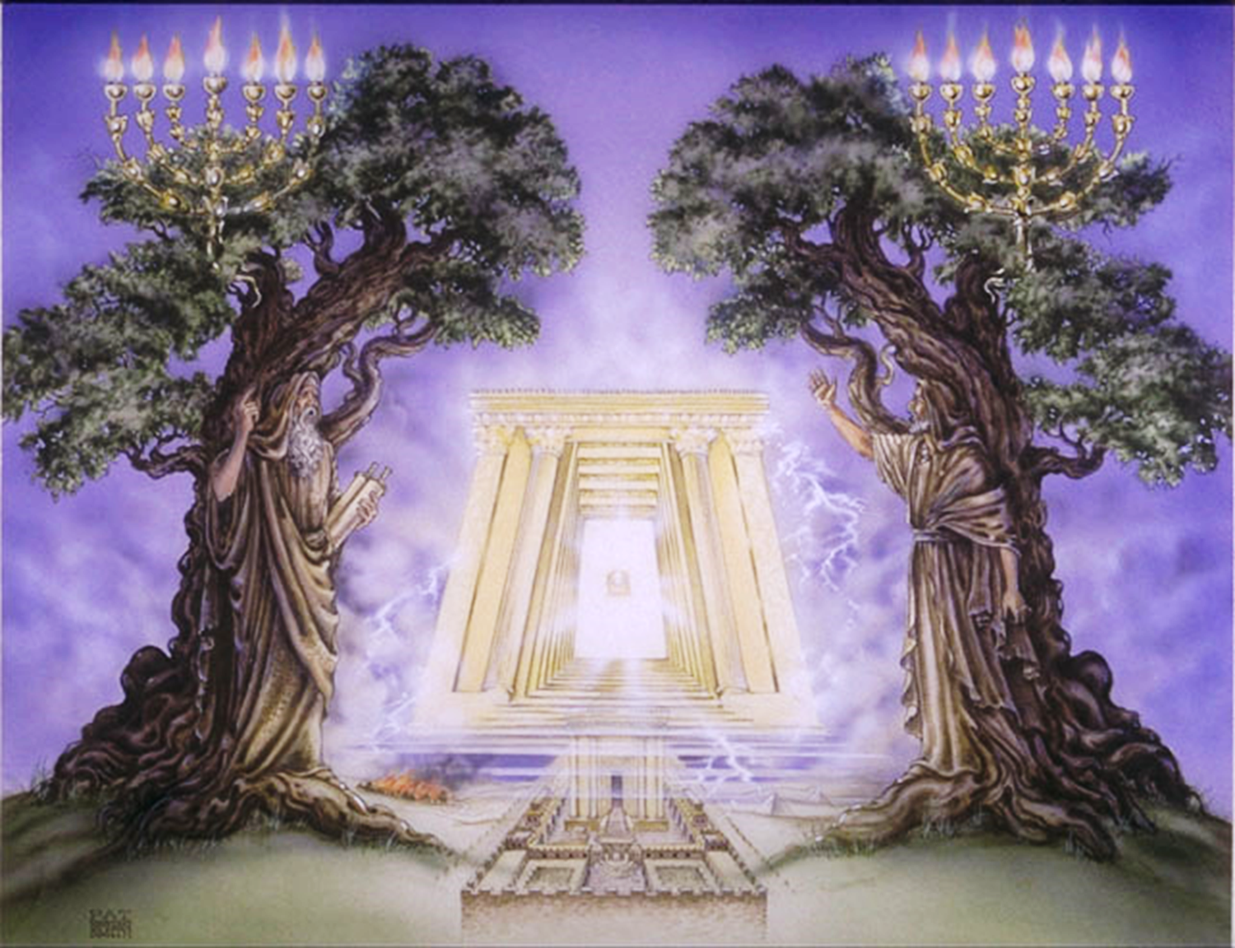
The Two Witnesses Prophesy

Slide 17
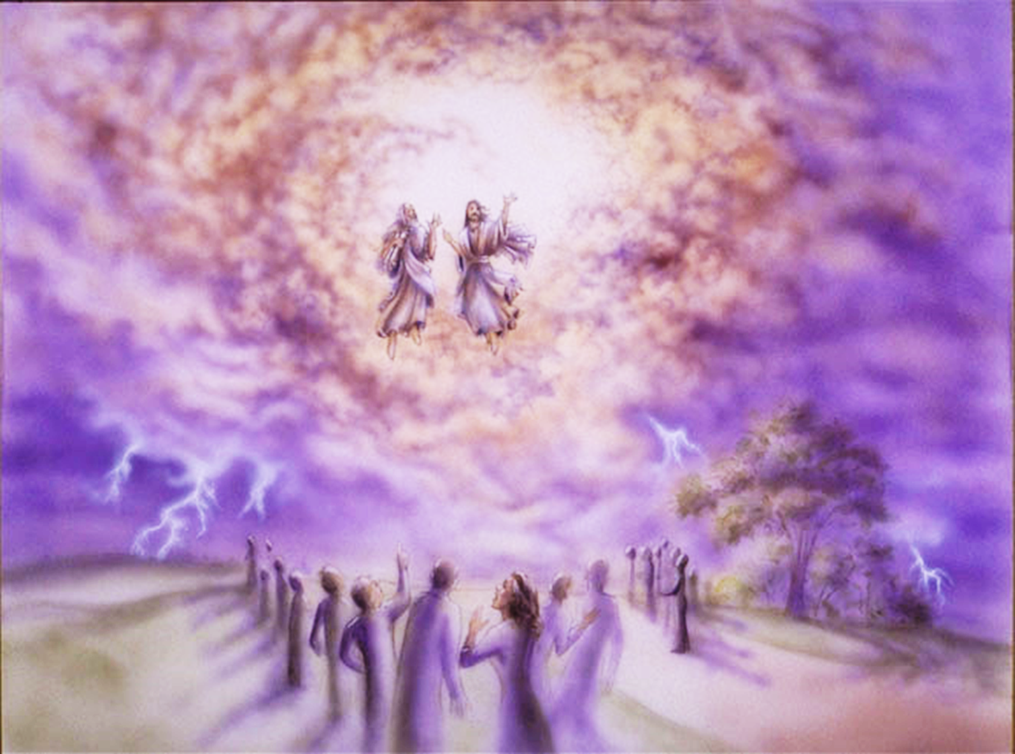
The Two Witnesses Ascend

Slide 18
The Seventh Trumpet (3rd Woe)
Revelation 11:15-19
The Seventh Trumpet Sounds (11:15-19).
At the sounding of the seventh trumpet, we see that Christ has gained ultimate victory.
  He has taken His power and reigned (11:17).
  His wrath has come, and final judgment is impending (11:18).
In a powerful conclusion, we see the temple opened in heaven and the ark of the covenant in the temple (11:19).
  This symbolizes the place where man dwells with God eternally in a covenant relationship.
Analysis: The seventh trumpet reveals ultimate victory, but not in detail. Revelation 12-20 will retell this story of triumph from a heavenly perspective using different symbols and greater detail at the end.

Slide 19
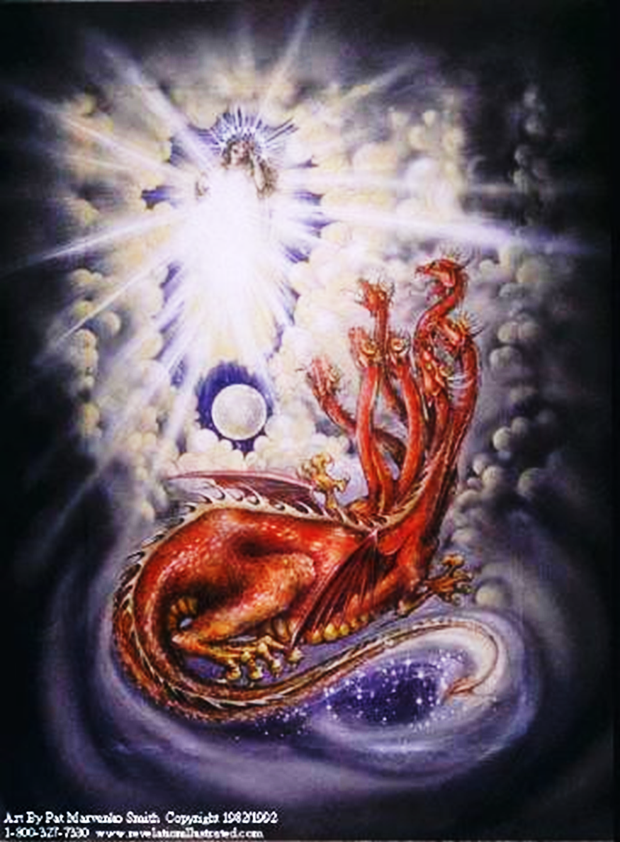
ACT TWO: The Woman and the Dragon
Revelation 12:1-6
The Woman (12:1-2).
  John sees a “sign” in heaven (12:1, 3)
  A woman clothed in the sun, the moon under her feet, and wearing a garland of 12 stars.
  She is about to give birth (12:2)
  Her child will be the Christ (12:5; 19:15)
The Dragon (12:3-6)
  The dragon is fiery red; he has 7 heads, 10 horns and 7 crowns on its heads.
  With his tail he threw 1/3 of the stars to earth.
  He stands ready to devour the woman’s child, but the child is caught up to God,
  The woman flees to the wilderness to be nourished 1,260 days.

Slide 20
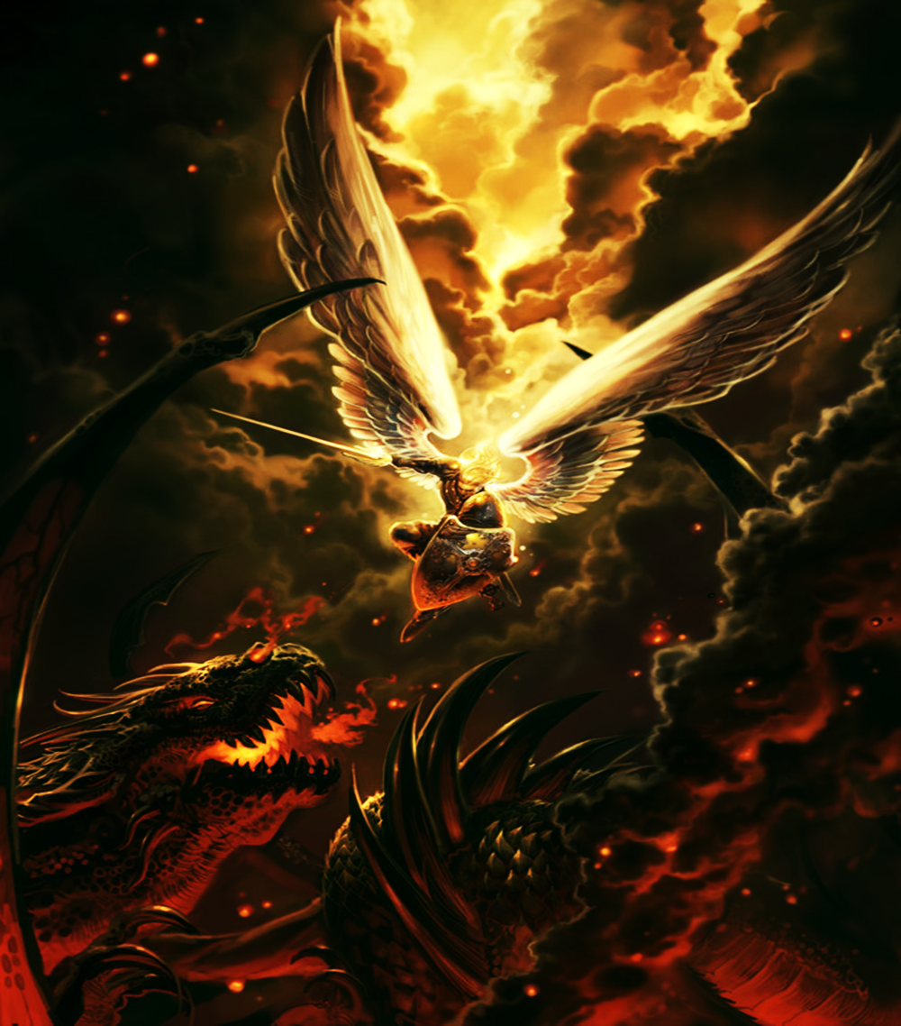
ACT TWO: War in Heaven
Revelation 12:7-12
War breaks out in heaven between Michael and his angels and the Devil and his angels. (12:7).
Satan and his forces are cast down to the earth (12:8-9).
By virtue of this victory, salvation, strength, the Kingdom of God, and the power of Christ have come (12:10-11).
  Their victory was empowered by the blood of the Lamb, the word of His testimony, and the willingness of His followers to give their lives.
Woe is pronounced on the inhabitants of the earth and sea because the devil has come down (12:12).

Slide 21
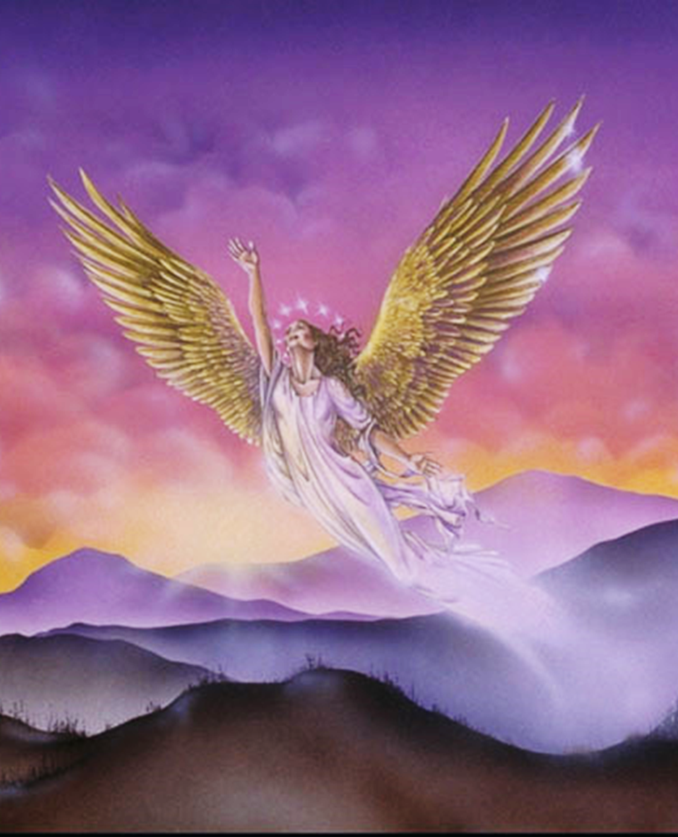
ACT TWO: The Dragon & the Woman on Earth
Revelation 12:13-17
When the dragon sees that he is cast down, in “great wrath” he seeks to persecute the woman (12:12-13).
But the woman is given help to flee into the wilderness where she is protected time, times and a ½ time [or 3 and ½ , or 1,260 days or 42 months] (12:14, see 12:6; 11:2-3).

Slide 22
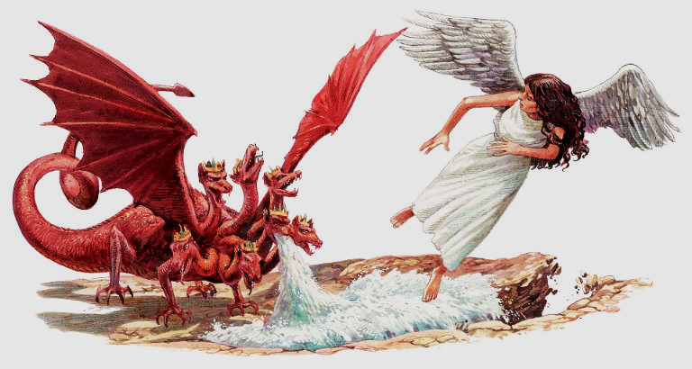
ACT TWO: The Dragon & the Woman on Earth
Revelation 12:13-17
The serpent spews water out of his mouth to cause the woman to be carried away in a flood, but the earth swallows up the flood (12:15-16).
  Satan’s first attempts to harm the church were thwarted by the world.
The enraged dragon goes off to make war with the woman’s offspring (12:17).

Slide 23
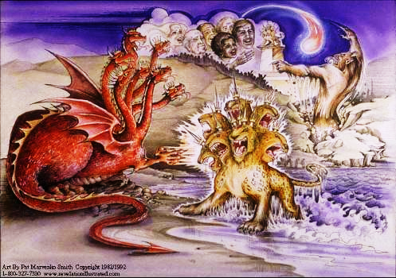
Satan’s New Strategy: The Sea Beast & the Land Beast
Revelation 13
Unable to destroy the woman on his first attempts, Satan brings up two horrible beasts to accomplish the task.
The Sea Beast and the Land Beast represent the Roman Empire and the False Religion that fueled its persecution of the church.

Slide 24
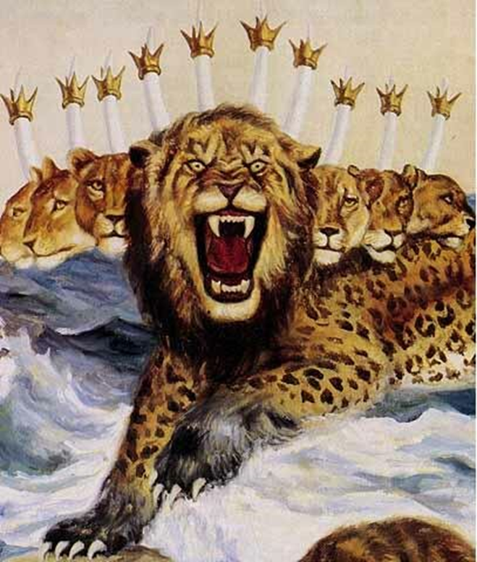
Satan’s New Strategy: The Sea Beast & the Land Beast
Revelation 13
The Sea Beast (Rev. 13:1-10)
He arises out of the Sea (society).
He has, 10 horns, 7 heads, 10 crowns, and blasphemous names.
His parts are like ferocious animals.
His power comes from the Dragon.
He represents the Roman Empire (Daniel 7).
“All the world” adores the Beast and is held under his sway.
His blasphemous tyranny lasts 42 months (Daniel 7:25, Rev. 11:2).
The saints patiently trust God; though all the world follow the Beast and he appears invincible, he will be slain.

Slide 25
Satan’s New Strategy: The Sea Beast & the Land Beast
Revelation 13
The Land Beast or “False Prophet” (Rev. 13:11-18)
The Land Beast comes out of the earth. He has two horns like a Lamb but speaks like a Dragon (13:11).
He causes those on the earth to worship the Sea Beast (13:12-15).
  He is later called the “False Prophet” (16:13; 19:20; 20:10)
He compels all to receive a mark on their hand or forehead in order to buy or sell (13:16-17).
The number of the Beast is 666 (imperfect deity).

Slide 26
Important Lessons:
God does not reveal to man all of his plans or power.
God determines the dimensions of our relationship with Him.
God will ensure that His word is established on the earth.
Satan seeks to destroy God’s people and God’s plans, but the forces of heaven are too powerful for him.
Satan empowers great forces of this world to harm God’s people.
We can overcome through God’s word, the blood of the Lamb, and a willingness to sacrifice our lives.

