Slide 1
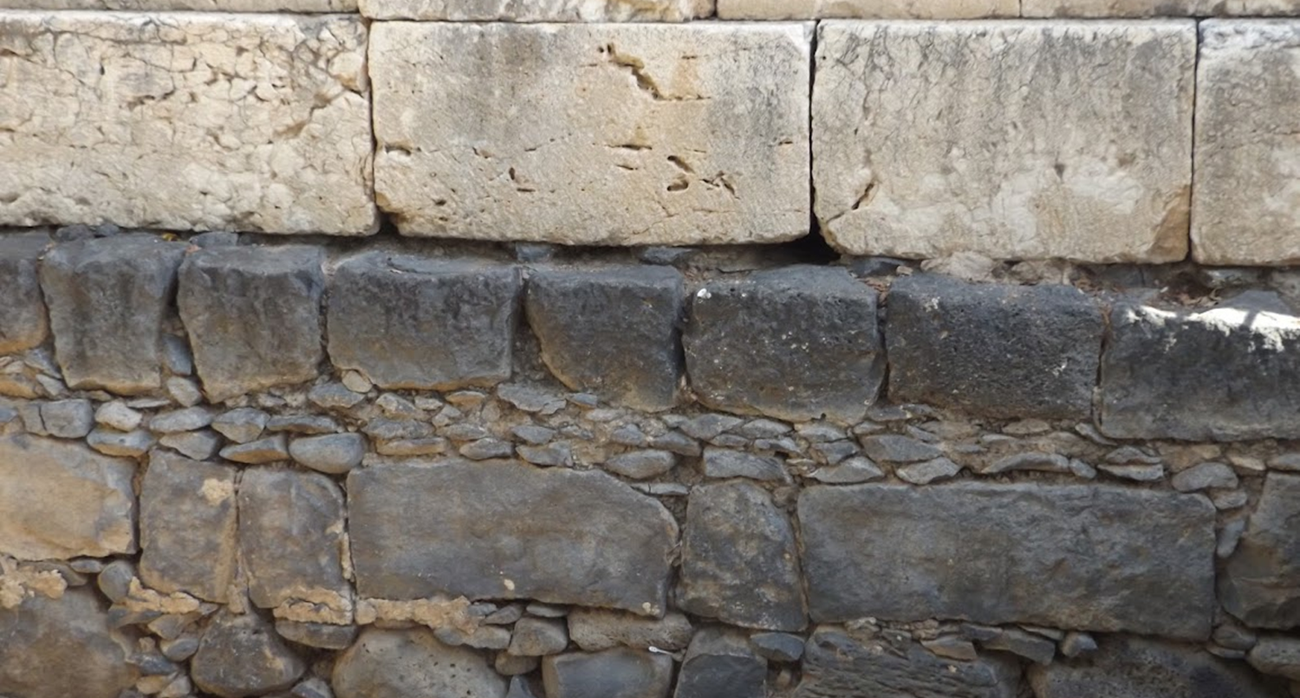

Studies in the Epistles
Foundations  Quarter 17
Lesson 23: Revelation 20-22 & Review

Slide 2
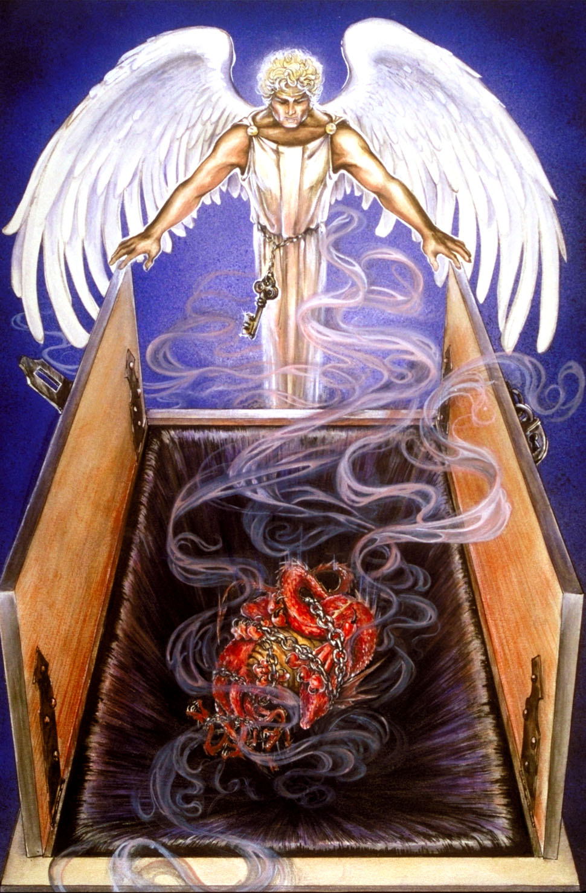
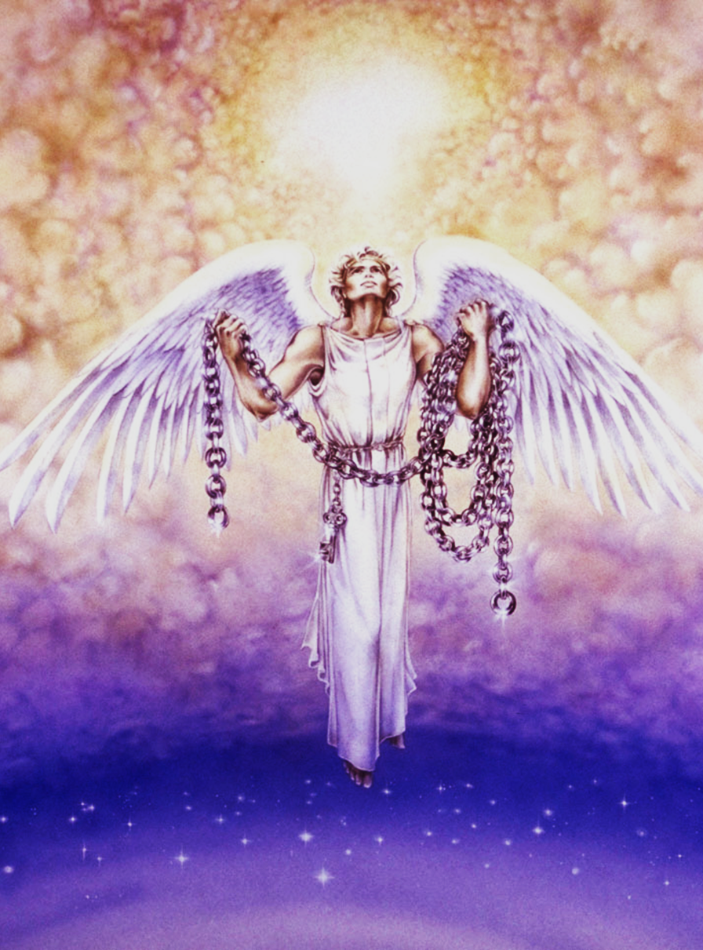
Binding of Satan, 1000 Year Reign & Judgment (Revelation 20)
The Binding of Satan (20:1-6)
Satan’s power to manipulate nations through a world empire to systematically persecute Christians was taken away when Rome fell (Daniel 7:18-28).
Satan is bound and prevented from deceiving the nations in this way for 1,000 years (a long period of time).
The first resurrection represents the “emergence of the cause of Christ out of apparent defeat” (cf. Ezekiel 37:10-14).

Slide 3
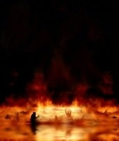
Binding of Satan, 1000 Year Reign & Judgment (Revelation 20)
The Loosing of Satan (20:7-10)
The loosing of Satan occurs at the end of the 1,000-year reign.
Evil may once again control powerful institutions (cf. Matthew 24:36-39).
Ancient enemies of God’s people (Gog & Magog, Ezekiel 38-39) will again begin to move against God’s people.
God then destroys the enemies of His people and casts Satan into the lake that burns with fire and brimstone.

Slide 4
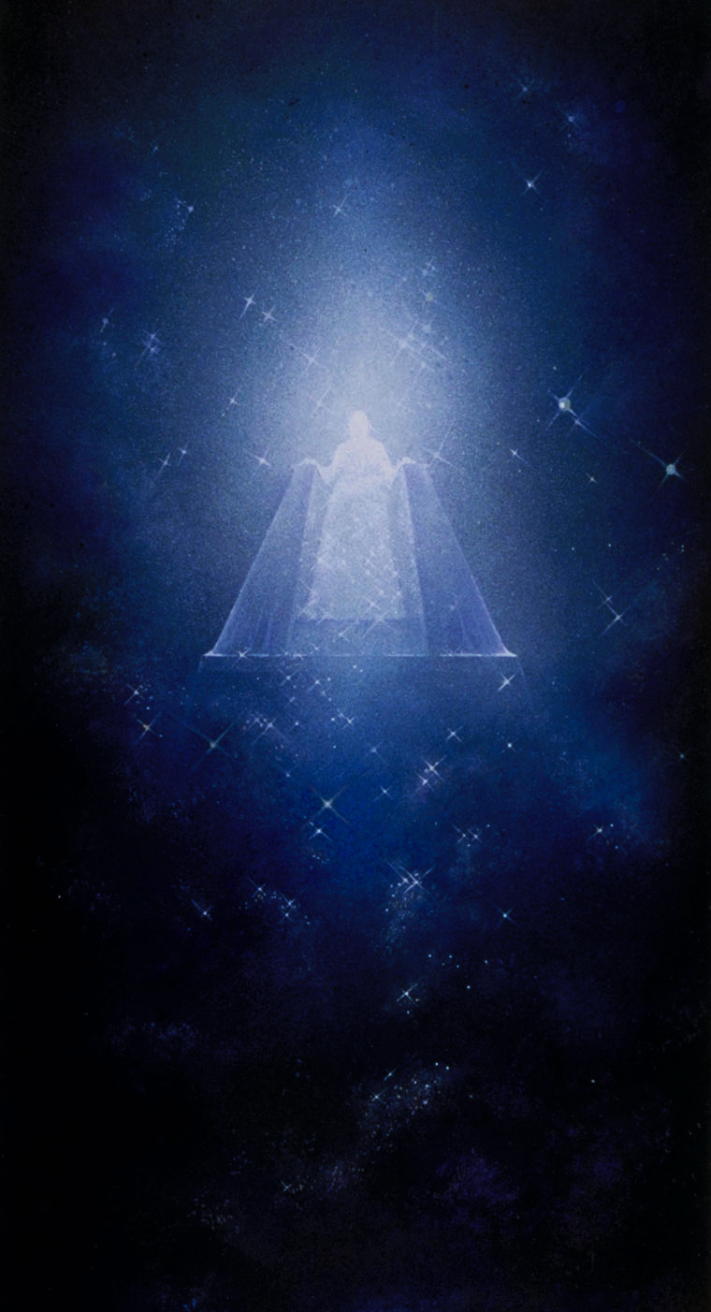
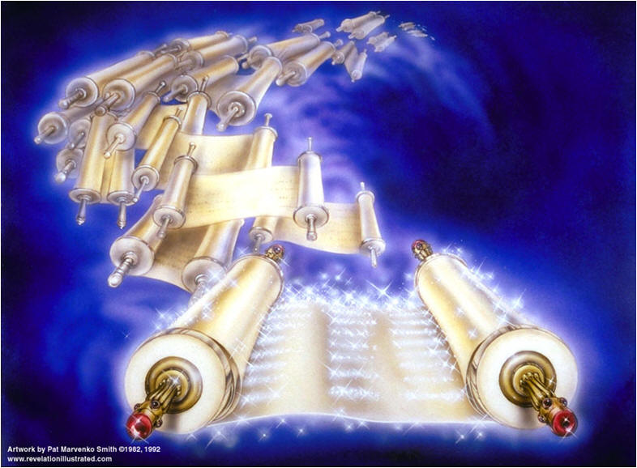
Binding of Satan, 1000 Year Reign & Judgment (Revelation 20)
The Great White Throne (20:11-15)
John sees a great white throne.
Heaven & earth flee away (2 Peter 3:10-13).
Everyone is gathered for judgment (Acts 17:30-31; Romans 14:12).
Books were opened (Romans 2:12-16).
The Book of Life was also opened (cf. Exodus 32:32-33; Malachi 3:16-17; Philippians 4:3).
The dead were judged from the books according to their works (Romans 2:6-11; 2 Corinthians 5:10; John 12:48).

Slide 5
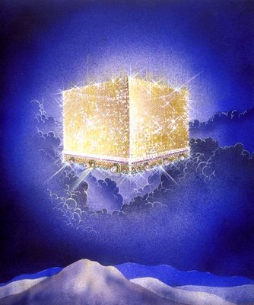
The Destiny of the Redeemed(Revelation 21-22)
Fellowship With God (21:1-8)
A new heaven and a new earth – an entirely new realm of existence characterized by righteousness (cf. 21:5; 2 Peter 3:13).
No more sea – not referring to the sea of glass, but the sea of corrupt human society (Revelation 8:8-9; 12:12; 16:3; 18:17-21).
The New Jerusalem – the perfect dwelling for God’s people (Heb. 11:10; 12:22-23; 13:14).
The Tabernacle of God is with men (Heb 9:11).
He who OVERCOMES inherits these things!
In stark contrast, the wicked have their part in the lake that burns with fire & brimstone.

Slide 6
The Destiny of the Redeemed(Revelation 21-22)
The Perfect City for the Saints (21:9-27)
The city is illuminated with light like a jasper stone, clear as crystal (cf. 4:3).
The number 12 figures prominently in the design & construction of the city.
There are 12 gates, 12 angels, names of 12 tribes written on each gate made of a pearl.
The 12 foundations have on them the names of 12 apostles and are adorned with 12 precious stones.
The dimensions are 12,000 furlongs square; the wall is 144 cubits wide.
The saved walk in God’s glorious light and bring their glory and honor to the city.
Nothing can enter that doesn’t belong.

Slide 7
The Destiny of the Redeemed(Revelation 21-22)
The Provisions of Paradise (22:1-5, cf. 2:7)
A pure river of “water of life” proceeding from the throne (John 4:14; Rev. 21:6).
The tree of life, with 12 fruits for the healing of the nations (Gen. 2:9; 3:22-24; Rev. 2:7).
God’s servants…
Shall serve Him.
Shall see His face (1 John 3:2).
Will have His name on their foreheads .
Shall reign forever and ever (2 Timothy 2:12).

Slide 8
The Destiny of the Redeemed(Revelation 21-22)
Assurance and Final Warnings (22:6-21)
The message is from God, who alone is worthy of worship (22:6-9, 16).
“Behold I come quickly” (22:7, 12, 20).
These statements appear to refer to the speed & surety of the Lord’s coming; not nearness in time (compare 1:1; 22:6; 1:3; 22:10).
Fulfillment will begin so soon and is so certain that there will be little opportunity for men to alter their lives -- the dye is cast (22:11).
An invitation: Whoever desires may take of the water of life freely (22:17).

Slide 9
The Destiny of the Redeemed(Revelation 21-22)
Assurance and Final Warnings (22:6-21)
Warnings:
Whoever adds to the words of this book will have the plagues of the book added to him (22:18).
Whoever takes away from the book will have his name taken away from the book of life and from the holy city (22:19).
The same principle applies to all Scripture (Galatians 1:6-8; 1 Corinthians 4:6; Proverbs 30:6; Deuteronomy 4:2)
A Promise – “Surely I come quickly” (22:20-21)
Anticipation: “…even so, come Lord Jesus” (cf. 2 Peter 3:11-14)

Slide 10
REVELATION Visual Review

Slide 11
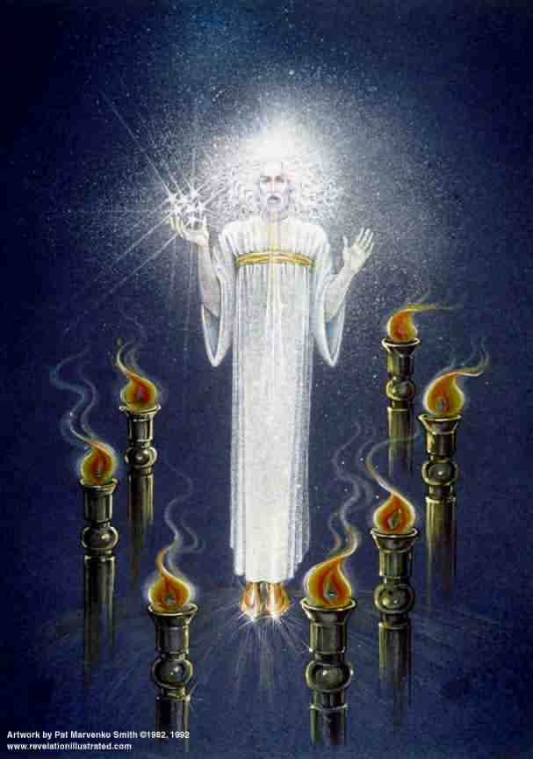
Chapter 1 Christ Among the Lampstands

Slide 12
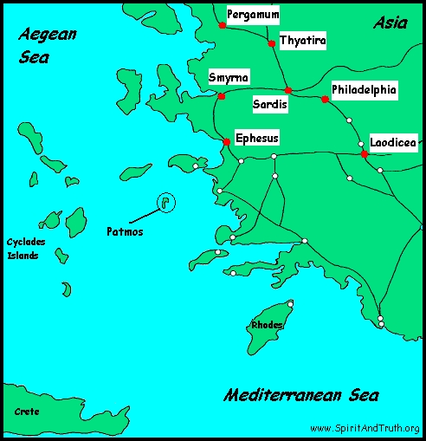
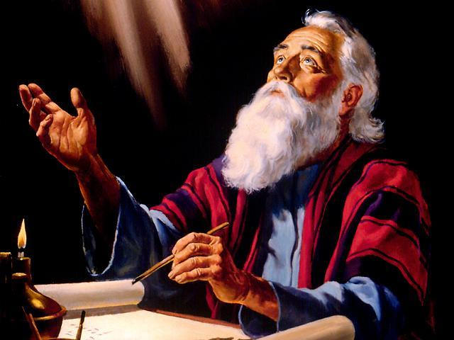
Chapters 2 & 3 Letters to Seven Churches

Slide 13
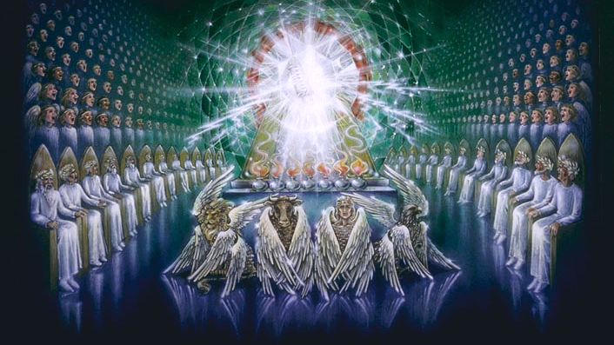
Chapter 4 -- The Throne Scene

Slide 14
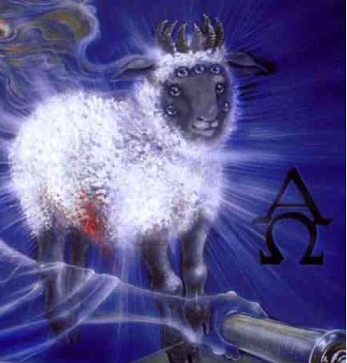
Chapter 5 The Lamb and the Book with Seven Seals

Slide 15
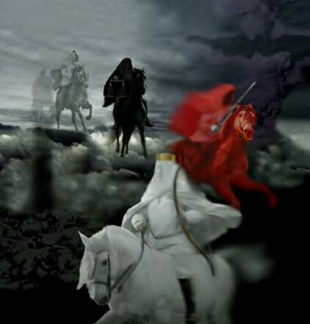
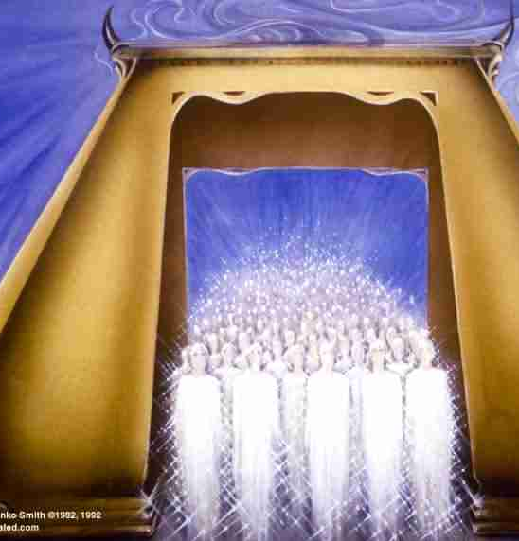
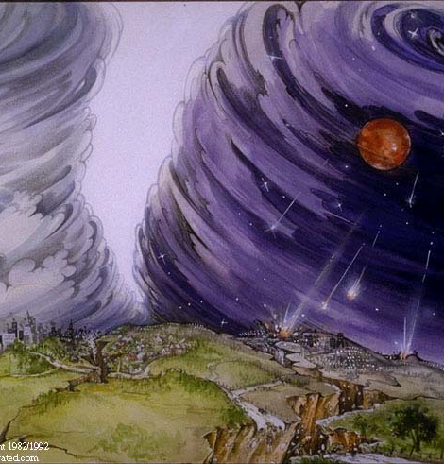
Chapter 6 -- The First Six Seals are Opened

Slide 16
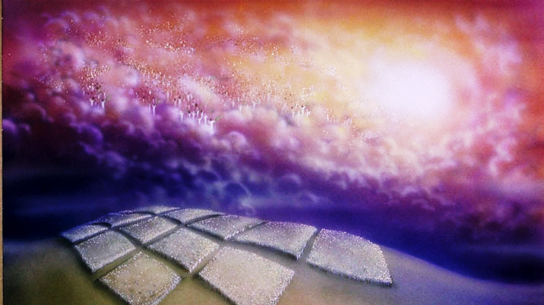
Chapter 7 An Interlude: 144,000 Sealed on Earth and a Great Multitude Saved in Heaven

Slide 17
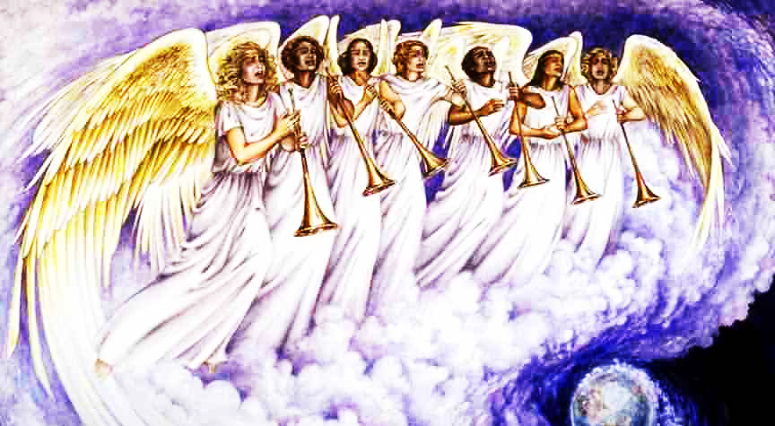
Chapter 8
The 7th Seal Introduces the Seven Trumpets (Four Trumpets Sound)

Slide 18
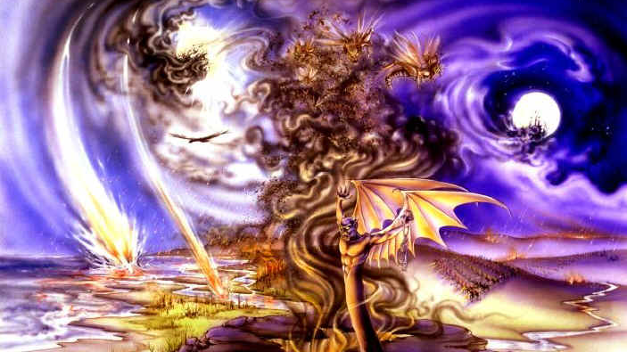
Chapter 9
The 5th & 6th Trumpets Sound (Three Woes)

Slide 19
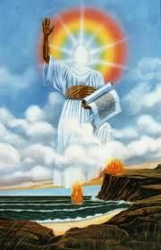
Chapter 10
An Interlude: A Mighty Angel, Seven Thunders and a Little Book

Slide 20
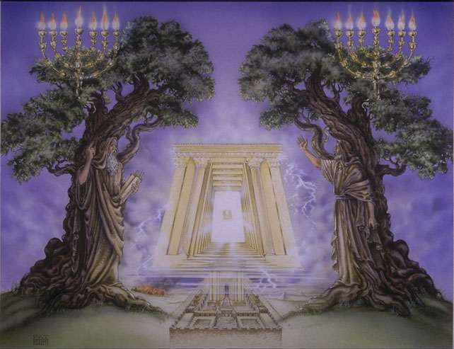
Chapter 11 The Measured Temple, 2 Witnesses & the Seventh Trumpet

Slide 21
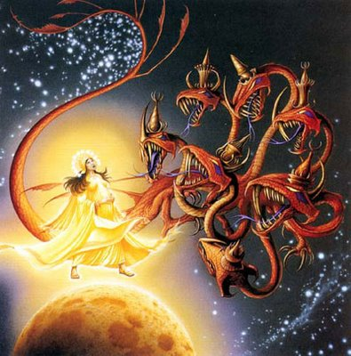
Chapter 12 The Woman and the Dragon

Slide 22
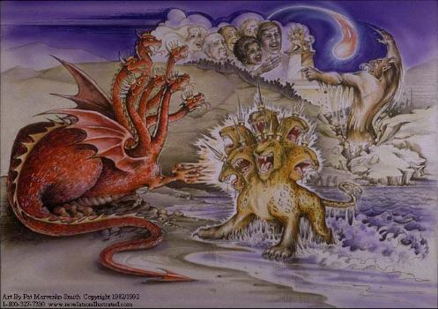
Chapter 13 The Sea Beast & Land Beast

Slide 23
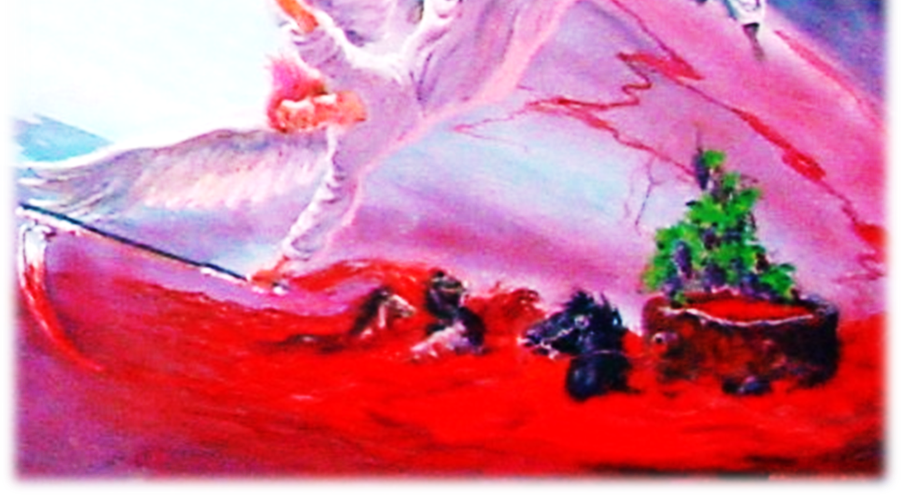
Chapter 14
The blessed 144,00, the earth is reaped, and the wrath of God is pressed out.

Slide 24
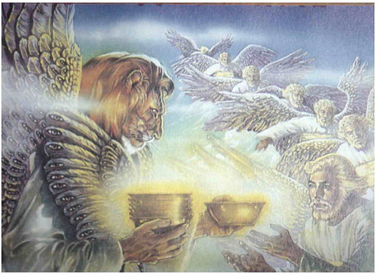
Chapter 15 Seven Angels are given Seven Bowls filled with God’s Wrath

Slide 25
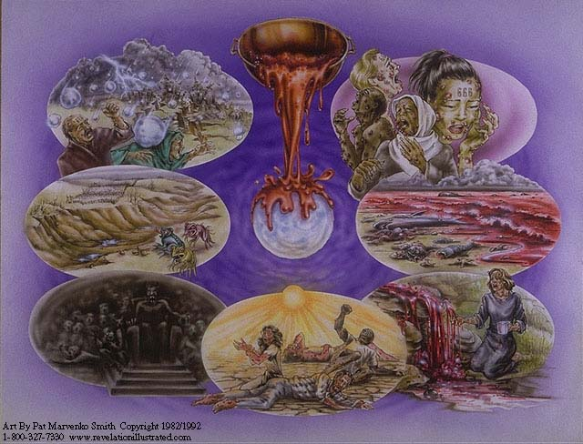
Chapter 16 The Seven Bowls of Wrath are Poured out on the Earth

Slide 26
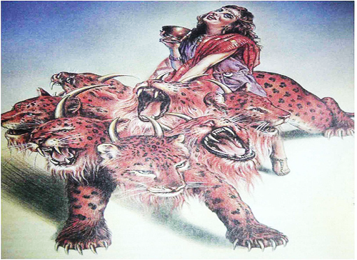
Chapter 17 Description of “Babylon: The Mother of All Harlots”

Slide 27
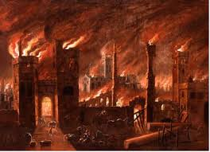
Chapter 18 The Fall of the Harlot Babylon – contrasting reactions from earth and heaven

Slide 28
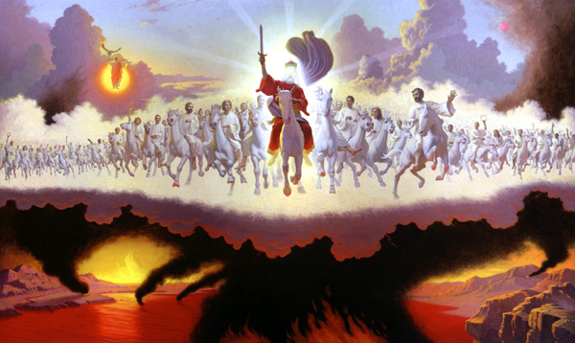
Chapter 19 Praises to God for Judging the Harlot & the Victory of the King of Kings

Slide 29
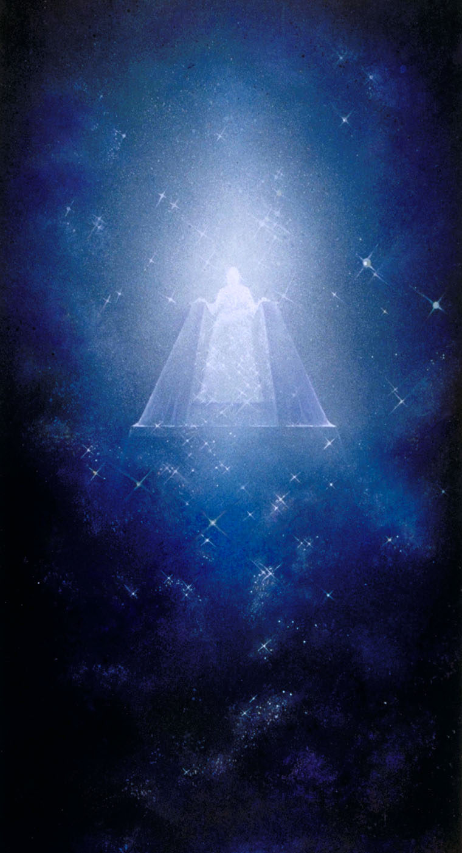
Chapter 20 – The Binding of Satan, the 1,000 Year Reign & the Final Judgment

Slide 30
Chapters 21 & 22 The New Jerusalem

