Slide 1
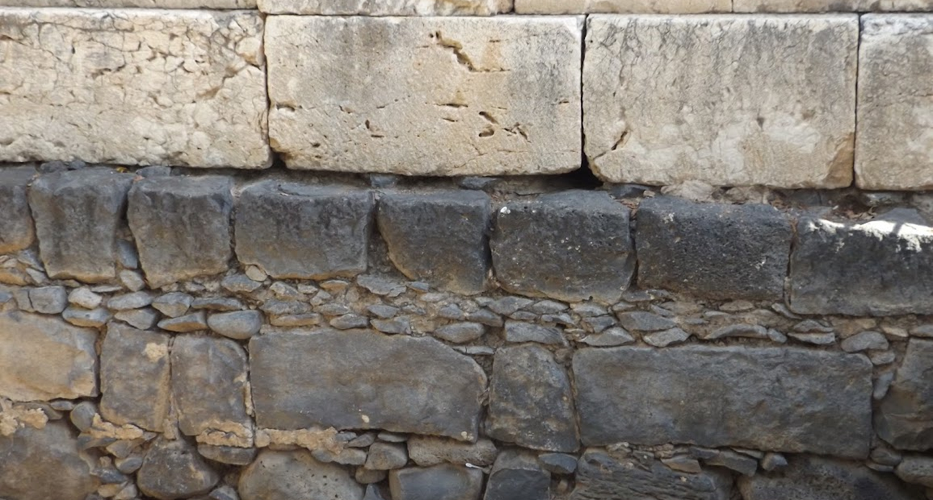

Studies in the Epistles
Foundations  Quarter 17
Lesson 8: First Peter 2-3

Slide 2
Theme & Purpose: “Rejoice to the extent that you partake of Christ’s sufferings”
A central theme of 1 Peter is that suffering for Christ is a privilege and blessing (1:11; 2:18-23; 3:14-18; 4:1,12-16, 19; 5:9-10).
Our pilgrimage is full of hardship, but it will lead to stronger faith, holier lives, fuller submission, and a greater longing for our home in heaven.
The theme of suffering as a pilgrim connects to 3 sub-themes:
Sanctification: The appropriate condition for those who are not at home in this World.
Submission: A needed characteristic of every pilgrim.
Salvation: The comfort and hope of every Pilgrim.

Slide 3
Selection for Sanctification (1 Peter 2:11-12)
Our special status compels honorable behavior as we journey (2:11-12)
Abstaining from fleshly lusts that war against the soul (1:14; 4:2-3; Eph. 4:22)
Having our conduct honorable among the Gentiles.
To the end that our good works will cause them to “glorify God” (Matthew 5:16)
“In the day of visitation” refers to a time when God would bless men with the opportunity for salvation (Psalm 106:4; 8:4; Luke 7:16; 19:44; Jer. 29:10; 1 Samuel 2:21)
Notes:
Ephesians 4:22 that you put off, concerning your former conduct, the old man which grows corrupt according to the deceitful lusts,
Psalms 106:4 Remember me, O LORD, with the favor You have toward Your people. Oh, visit me with Your salvation,
Psalms 8:4 What is man that You are mindful of him, And the son of man that You visit him?
Jeremiah 29:10 For thus says the LORD: After seventy years are completed at Babylon, I will visit you and perform My good word toward you, and cause you to return to this place.
1 Samuel 2:21 And the LORD visited Hannah, so that she conceived and bore three sons and two daughters. Meanwhile the child Samuel grew before the LORD.
Luke 7:16 [After raising widow’s son] Then fear came upon all, and they glorified God, saying, "A great prophet has risen up among us"; and, "God has visited His people.“
Luke 19:44 [Jesus to Jerusalem] they will not leave in you one stone upon another, because you did not know the time of your visitation."

Slide 4
Submission to Government (1 Peter 2:13-17)
Pilgrims submit to “every ordinance of man for the Lord’s sake.”
If human laws conflict with God’s laws, we obey God (Acts 5:29).
Submission to government is for the Lord’s sake who ordained government to protect good people from bad people (Rom. 13:1-4).
Submission to government reflects godly character.
Doing good silences worldly critics (Titus 2:8)
Our freedom is not a cover to do evil, but an opportunity do live up to God’s higher standard for His people (Gal. 5:13-14).
The pilgrim’s life is ever characterized by respect, love, and honor.
Honor and respect for all people.
Love for the brotherhood (1:22).
Fear of God (Eccl. 12:13).
Honor and respect for rulers (Rom. 13:7).
Notes:
Acts 5:29 But Peter and the other apostles answered and said: "We ought to obey God rather than men.
Titus 2:8 sound speech that cannot be condemned, that one who is an opponent may be ashamed, having nothing evil to say of you.
Galatians 5:13-14 For you, brethren, have been called to liberty; only do not use liberty as an opportunity for the flesh, but through love serve one another.(14) For all the law is fulfilled in one word, even in this: "YOU SHALL LOVE YOUR NEIGHBOR AS YOURSELF."
Ecclesiastes 12:13 Let us hear the conclusion of the whole matter: Fear God and keep His commandments, For this is man's all.
Romans 13:7 Render therefore to all their due: taxes to whom taxes are due, customs to whom customs, fear to whom fear, honor to whom honor.

Slide 5
Submission to Masters (even in suffering) (1 Peter 2:18-25)
Servants are to submit to their masters irrespective of their masters’ character or how their masters treat them.
Submission when suffering undeservedly is good in God’s eyes.
This applies in other relationships too.
To submit when suffering unjustly is to follow Christ’s example.
We are called to follow His example of suffering.
He did not retaliate, although He suffered unjustly.
He trusted God!
Submission in suffering acknowledges our trust in…
God’s Justice.
Christ’s sacrifice.
God’s guidance and care as our Shepherd and Overseer (Isa. 53:5-11).

Slide 6
Submission Trusts God and Influences Others (1 Peter 3:1-7)
Wives are to submit to their husbands (3:1-2).
This same command was given to citizens and servants (2:13, 18).
A wife’s submission may lead to a husband’s salvation as she exemplifies chaste and respectful behavior (1 Cor. 7:16; Eph. 5:33).
The adornment of the wife (3:3-6).
Should not be merely outward; but focused on the inward “hidden person” and the incorruptible beauty of a gentle and quiet spirit (1 Tim. 2:9-10).
This inner adornment is seen in wives being submissive to their own husbands like Sarah, who called Abraham Lord (Gen. 18:12).
Daughters of Sarah do good, not in fear, but because they trust God.
Notes:
Submit means to subordinate themselves AND obey
Chaste behavior is clean, pure from carnality & modest
1 Corinthians 7:16 For how do you know, O wife, whether you will save your husband? Or how do you know, O husband, whether you will save your wife?
Ephesians 5:33 Nevertheless let each one of you in particular so love his own wife as himself, and let the wife see that she respects her husband.
1 Timothy 2:9-10 in like manner also, that the women adorn themselves in modest apparel, with propriety and moderation, not with braided hair or gold or pearls or costly clothing, (10) but, which is proper for women professing godliness, with good works.
John 6:27 Do not labor for the food which perishes, but for the food which endures to everlasting life, which the Son of Man will give you, because God the Father has set His seal on Him.“
Genesis 18:12 Therefore Sarah laughed within herself, saying, "After I have grown old, shall I have pleasure, my lord being old also?"
STRONG’s Dictionary: From an unused root (meaning to rule); sovereign, that is, controller (human or divine): - lord, master, owner. Compare also names beginning with “Adoni-”.

Slide 7
Submission Trusts God and Influences Others (1 Peter 3:1-7)
Husbands are to… (3:7).
Dwell with their wives with understanding.
Give honor to the wife as to the weaker vessel and as being heirs together of the grace of life (Eph. 5:25; Gal. 3:28-29).
So that prayers are not hindered.
Prayer can be hindered by many things (3:12), such as bitterness, an unforgiving spirit, bickering, jealousy, irritability, uncontrolled temper, and unkind words.
These things hinder all spirituality, because they are not done in love (see 1 Cor. 13:1-8).
Notes:
The submissive person must not be regarded as weak, unimportant, or of lesser value.
Specifically, the submissive wife is treasured and honored, and treated as a joint heir!!!
Colossians 3:19 Husbands, love your wives and do not be bitter toward them.
Ephesians 5:25 Husbands, love your wives, just as Christ also loved the church and gave Himself for her,
Galatians 3:28-29 There is neither Jew nor Greek, there is neither slave nor free, there is neither male nor female; for you are all one in Christ Jesus. (29) And if you are Christ's, then you are Abraham's seed, and heirs according to the promise.

Slide 8
The Quality of a Submissive Life (1 Peter 3:8-12)
Qualities of a godly submissive life (3:8-9a).
Unity: “All of you be of one mind” (Rom. 12:16; Phil. 2:2-4)
Compassion/sympathy for one another (Rom 12:15; 1 Cor. 12:26)
Brotherly love
Being Tenderhearted
Courtesy
Returning good for evil (Rom. 12:17-21)
Those who exhibit these qualities will inherit a blessing (3:9b-12).
Peter quotes Psalm 34:12-16 to support this claim.
Those who want to see good days should refrain from evil speaking and deceit, turn away from evil and do good, and seek peace and pursue it.
The Lord hears and blesses such righteous people, but He does not heed the prayers of those who do evil (Prov. 28:9).
Notes:
Romans 12:16 Be of the same mind toward one another. Do not set your mind on high things, but associate with the humble. Do not be wise in your own opinion.
Philippians 2:2-4 fulfill my joy by being like-minded, having the same love, being of one accord, of one mind. (3) Let nothing be done through selfish ambition or conceit, but in lowliness of mind let each esteem others better than himself. (4) Let each of you look out not only for his own interests, but also for the interests of others.
1 Corinthians 12:26 And if one member suffers, all the members suffer with it; or if one member is honored, all the members rejoice with it.
Romans 12:15 Rejoice with those who rejoice, and weep with those who weep.
Romans 12:17-21 (17) Repay no one evil for evil. Have regard for good things in the sight of all men. (18) If it is possible, as much as depends on you, live peaceably with all men. (19) Beloved, do not avenge yourselves, but rather give place to wrath; for it is written, "VENGEANCE IS MINE, I WILL REPAY," says the Lord. (20) Therefore "IF YOUR ENEMY IS HUNGRY, FEED HIM; IF HE IS THIRSTY, GIVE HIM A DRINK; FOR IN SO DOING YOU WILL HEAP COALS OF FIRE ON HIS HEAD." (21) Do not be overcome by evil, but overcome evil with good.
Proverbs 28:9 One who turns away his ear from hearing the law, Even his prayer is an abomination.

Slide 9
Suffering for Righteousness’ Sake (1 Peter 3:13-17)
Doing good makes it less likely that you will be harmed (3:13).
Fellow citizens and law enforcement have no cause to harm you (Rom. 13:3-4).
If you do suffer for righteousness’ sake, you are blessed (3:14-17).
Don’t be afraid.
Be ready to take advantage of the opportunity to defend your hope with meekness and fear.
Live true to your conscience, and those who mistreat you will be ashamed.
Remember: It is better to suffer for doing good!
Notes:
Romans 13:3-4 For rulers are not a terror to good works, but to evil. Do you want to be unafraid of the authority? Do what is good, and you will have praise from the same. (4) For he is God's minister to you for good. But if you do evil, be afraid; for he does not bear the sword in vain; for he is God's minister, an avenger to execute wrath on him who practices evil.

Slide 10
Christ’s Example of Suffering (1 Peter 3:18-20a)
Christ also suffered unjustly.
He suffered for our sins, not His (1 Pet. 2:24).
He suffered for the unjust (Romans 5:8).
He suffered to bring us to God.
He was “put to death in the flesh but made alive by the Spirit” (cf. Rom. 8:11).
He preached to “spirits in prison” who had been disobedient in Noah’s day.
Jesus’ words to these spirits are not revealed; their mention here serves to introduce Noah’s salvation.
Notes:
Romans 5:8 But God demonstrates His own love toward us, in that while we were still sinners, Christ died for us.
Romans 8:11 But if the Spirit of Him who raised Jesus from the dead dwells in you, He who raised Christ from the dead will also give life to your mortal bodies through His Spirit who dwells in you.
2 Peter 2:5 and did not spare the ancient world, but saved Noah, one of eight people, a preacher of righteousness, bringing in the flood on the world of the ungodly;
2 Peter 2:9 then the Lord knows how to deliver the godly out of temptations and to reserve the unjust under punishment for the day of judgment,

Slide 11
Noah’s Salvation Symbolizes our Salvation (1 Peter 3:20b-22)
God showed His divine longsuffering in Noah’s day while the ark was being prepared.
Noah was a “preacher of righteousness.”
God’s longsuffering gives men the chance to repent (Romans 2:4).
But only eight souls were saved in the ark through water.
Noah’s salvation is a type or symbol of how we are saved. Baptism now saves us:
An antitype is “something that is represented by a symbol” (Oxford Languages Dictionary).
Noah’s salvation is symbolic of our salvation, not the other way around!
Notes:
Romans 2:4 Or do you despise the riches of His goodness, forbearance, and longsuffering, not knowing that the goodness of God leads you to repentance?
An antitype is a real or actual thing, represented by a type or symbol

Slide 12
Noah’s Salvation Symbolizes our Salvation (1 Peter 3:20b-22)
Baptism effectively saves us…
As the answer of a good conscience toward God, not by removing the dirt from our bodies.
Because of the power of the resurrection of Christ (Romans 6:4; Colossians 2:12).
The resurrection of Christ also enabled His exaltation at God’s right hand (cf. Ephesians 1:19-21).
Notes:
Romans 6:4 Therefore we were buried with Him through baptism into death, that just as Christ was raised from the dead by the glory of the Father, even so we also should walk in newness of life.
Colossians 2:12 buried with Him in baptism, in which you also were raised with Him through faith in the working of God, who raised Him from the dead

Slide 13
Important Lessons:
As pilgrims, we live sanctified lives – different from those in the world.
We are to submit to human authorities while maintaining godly character.
We are never more Christ-like than when we are suffering undeservedly for the sake of righteousness.
It is better to suffer for doing good than for doing evil!
Noah’s salvation symbolizes our salvation. As Noah was saved through water, baptism also now saves us.

