Slide 1

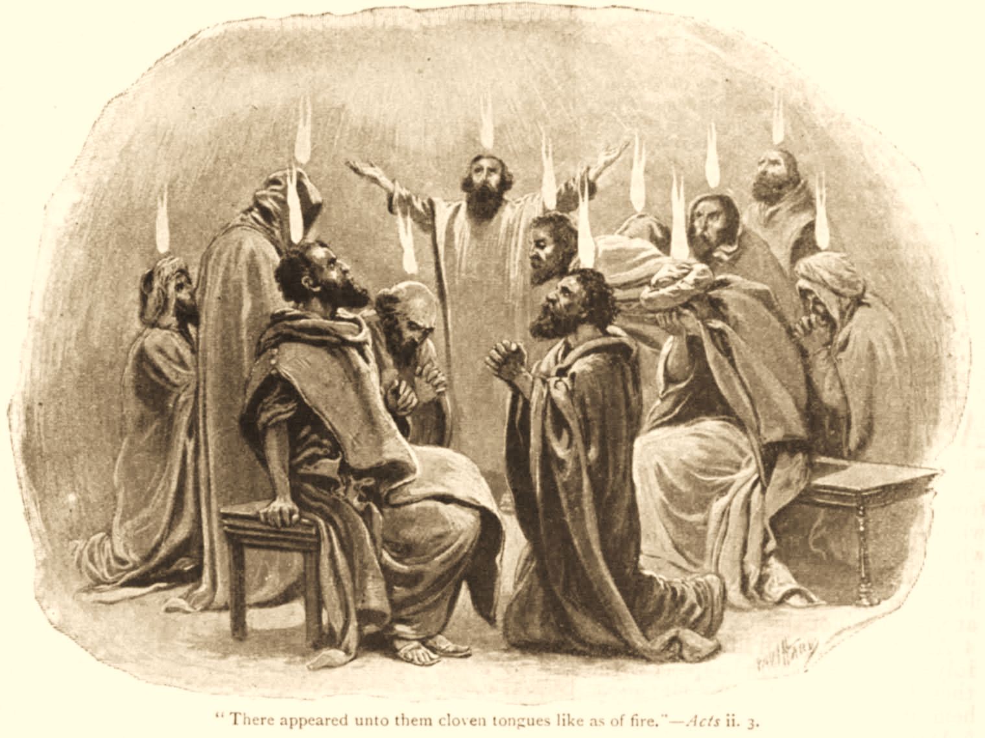
A C T S
Go Tell
the Good
News!

Slide 2
Introduction to Acts
The Book of Acts, also known as Acts of the Apostles, details the early church’s establishment, growth, and spread after Jesus' ascension. It focuses on the ministry of key figures like Peter and Paul, the outpouring of the Holy Spirit, and the transition of the gospel message from a Jewish context to a Gentile one.
Acts chronicles the early church's expansion from Jerusalem to Judea, Samaria, and eventually to the ends of the earth, highlighting the power of the Holy Spirit in confirming the testimony of the apostles of Christ.
It is the bridge that joins the gospels to the rest of the New Testament.

Slide 3
Introduction to Acts
Acts can be outlined or divided as follows:
  Chapters 1-12 Mostly Peter's work
  Chapters 13-28. Mostly Paul's work
This quarter we will cover…
The message of the apostles to the Jews: (Acts 2:23-24, 32; 3:15; 5:30-32; 13:27-32)
  You killed Him.
  God raised Him up
  We are witnesses
The gospel is preached to Gentiles with resistance from the Jewish community.

Slide 4
Planned Since The Beginning
Purposed and promised before the world began (Titus 1:2-3; Ephesians 3:8-11)
All the plans are realized in Acts
  Promises of Christ. (Genesis 3:15; 12:1-3,7; 49:10; 2 Samel 7:12-13).
  Promises of the Church (Danel 2:44; 7:13-14; Isaiah 2:2-4).
God planned for the church to be the vehicle for the gospel (1 Corinthians 2:6-10; Colossians 1:26-27; Ephesians 3:21)
Notes:
Titus 1:2-3 in hope of eternal life which God, who cannot lie, promised before time began, (3) but has in due time manifested His word through preaching, which was committed to me according to the commandment of God our Savior;
Ephesians 3:8-11 To me, who am less than the least of all the saints, this grace was given, that I should preach among the Gentiles the unsearchable riches of Christ, (9) and to make all see what is the fellowship of the mystery, which from the beginning of the ages has been hidden in God who created all things through Jesus Christ; (10) to the intent that now the manifold wisdom of God might be made known by the church to the principalities and powers in the heavenly places, (11) according to the eternal purpose which He accomplished in Christ Jesus our Lord,
Daniel 2:44 And in the days of these kings the God of heaven will set up a kingdom which shall never be destroyed; and the kingdom shall not be left to other people; it shall break in pieces and consume all these kingdoms, and it shall stand forever.
Daniel 7:13-14 "I was watching in the night visions, And behold, One like the Son of Man, Coming with the clouds of heaven! He came to the Ancient of Days, And they brought Him near before Him. (14) Then to Him was given dominion and glory and a kingdom, That all peoples, nations, and languages should serve Him. His dominion is an everlasting dominion, Which shall not pass away, And His kingdom the one Which shall not be destroyed.
Isaiah 2:2-4 Now it shall come to pass in the latter days That the mountain of the LORD's house Shall be established on the top of the mountains, And shall be exalted above the hills; And all nations shall flow to it. (3) Many people shall come and say, "Come, and let us go up to the mountain of the LORD, To the house of the God of Jacob; He will teach us His ways, And we shall walk in His paths." For out of Zion shall go forth the law, And the word of the LORD from Jerusalem. (4) He shall judge between the nations, And rebuke many people; They shall beat their swords into plowshares, And their spears into pruning hooks; Nation shall not lift up sword against nation, Neither shall they learn war anymore.
Ephesians 3:21 to Him be glory in the church by Christ Jesus to all generations, forever and ever. Amen.

Slide 5
Progression of the Gospel
(Acts 1:8)
Jerusalem Acts 1 – 8:4
  Because of persecution disciples were scattered
  Went everywhere preaching the gospel
Judea and Samaria Acts 8:5 – 11:18
  Phillip went down to Samaria
All the world Acts 11:19 – 28:31
  Those scattered went to Phoenicia, Cyprus and Antioch.
  Includes Paul's 3 missionary journeys throughout Asia Minor and to Rome

Slide 6
Key Events in the Book of Acts
Ascension of Jesus (Acts 1:6-11)
Establishment of the church (Acts 2:1-47)
Baptism of the Holy Spirit (Acts 2:1-4; 10:44-48; 11:15)
  Fulfillment of the promise of the Holy Spirit in the revelation and the confirmation of the Gospel!
    Languages
    Miracles
    Other gifts

Slide 7
Notable Conversions in Acts
3000 Acts 2:41
Samaritans Acts 8:12
Simon Acts 8:13
Ethiopian Acts 8:35
Saul of Tarsus Acts 9:1-18; 22:6-16
Cornelius Acts 10
Sergius Paulus Acts 13:12
Lydia Acts 16:15
Jailer Acts 16:33
Corinthians Acts 18:8

Slide 8
Persecution in Acts
Mocking (Acts 2:13)
Apostles (Acts 4:2; 4:21; 5:18, 40; 12:1-3)
Stephen (Acts 7:58)
Paul (Acts 9:23; 13:45, 50; 14:5,19; 17:13; 23:12)
Judaizers (Acts 15)

Slide 9
Organization & Work of Church
Elders (Acts 14:23; 11:30; 15:2-23; 20:17-38)
Worship (Acts 2:42; 20:6-7; 21:4; 28:13-14)

