Slide 1


Slide 2
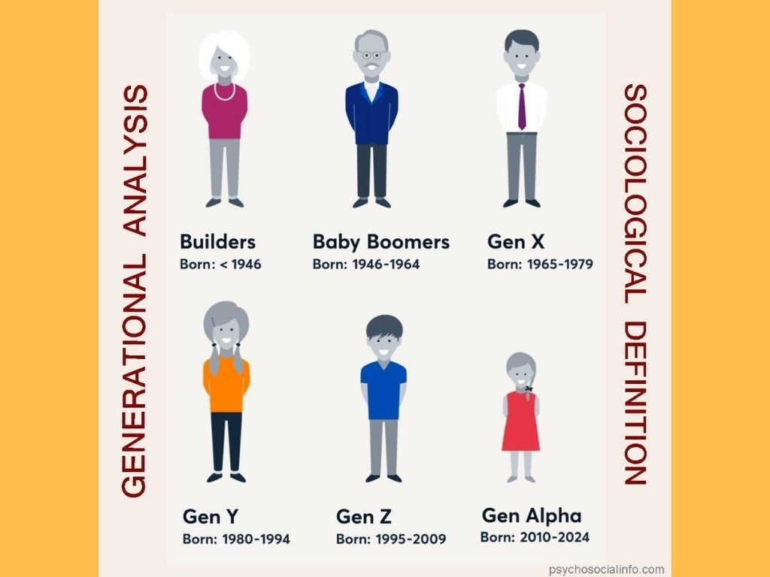
Notes:
Introduction: How many Gen Alpha’s do we have here today (this means you were born between 2010-2024)? Fortune magazine shared the results of a survey conducted in 2024 among 12-14 year-old’s from Gen Alpha in the United States. The question was asked, “what do you aspire to be when you grow up?” Can you guess what the top career aspiration was on the list?

Slide 3


Slide 4
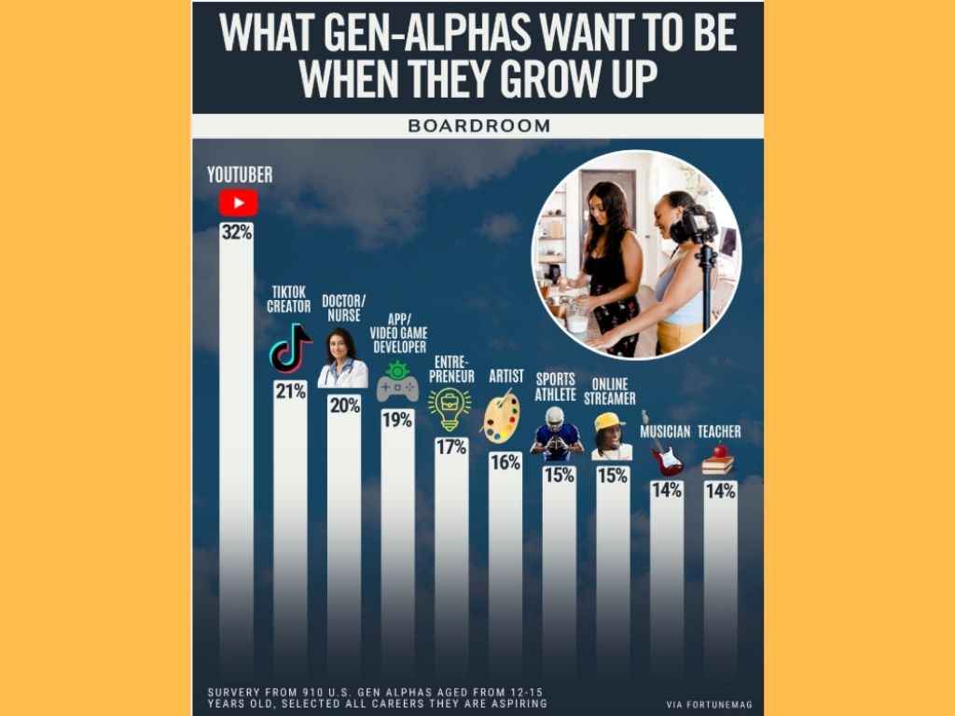
Notes:
A whopping 32% said they wanted to be a YouTuber, 21% wanted to be a TikTok creator, and 15% wanted to be an online streamer. These three different career options are all part of one broad category: influencer.

Slide 5
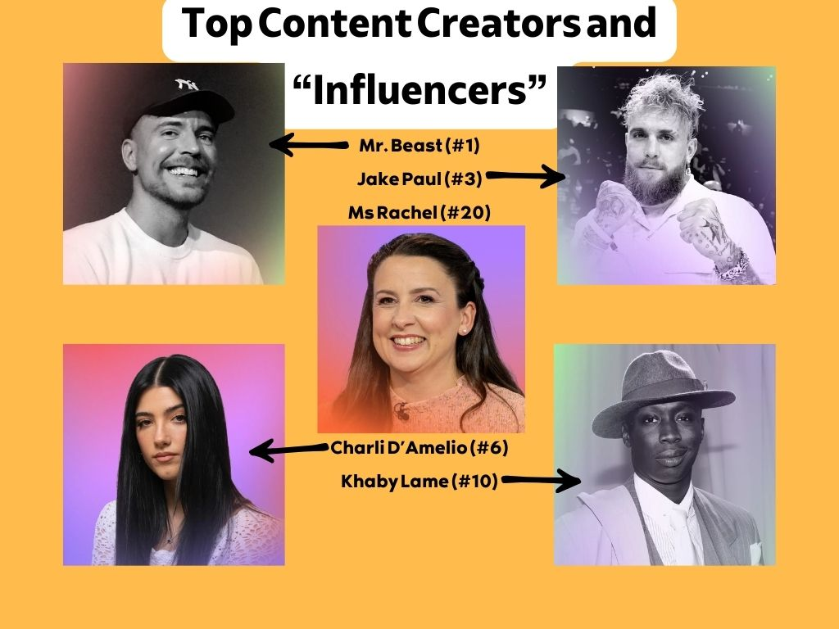
Notes:
What is an influencer? In the social media world, an influencer is someone who uses various social media platforms to influence or steer others. These people post content that gets liked, shared, and followed more than others indicating their “influence.” Of course, the larger your platform, the more value you bring to the platform and other companies, products, and causes you might promote. With the top “influencers” making money in the millions it is no surprise young kids want to be the next Mr. Beast, or Jake Paul, or even Ms. Rachel.
Yet, unfortunately, if you were to walk through the list of some of the top “influencers” we begin to quickly see how some of them are seeking to gain influence. Some go viral because of their over-the-top pranks, some are comedians, some get attention because they dress and act provocatively, some rage-bait and light the fires of controversy, some talk sensually. Not every social media “influencer” needs to be villainized. There’s some legitimately clean and productive content out there. However, as Christians, we need to think deeply about first of all, the importance of influence, and how Jesus Christ has called us to exert that influence.

Slide 6
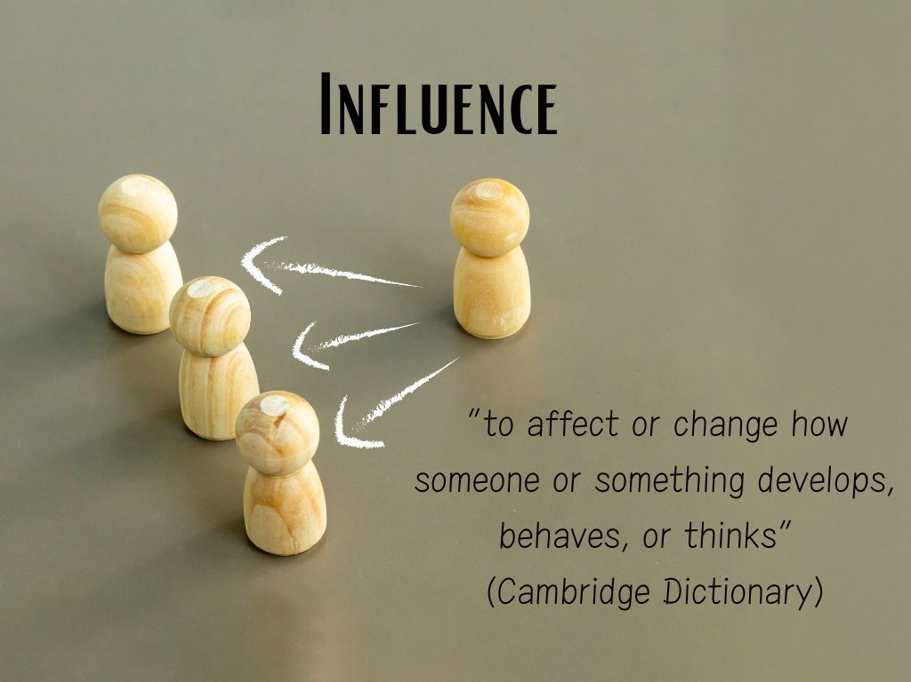
Notes:
The word “influence” in its broader sphere is defined by Oxford as, “to affect or change how someone or something develops, behaves, or thinks” (Cambridge Dictionary). Essentially, “influence” is a leadership word. Yet, you don’t have to be the appointed leader to “influence” others.

Slide 7
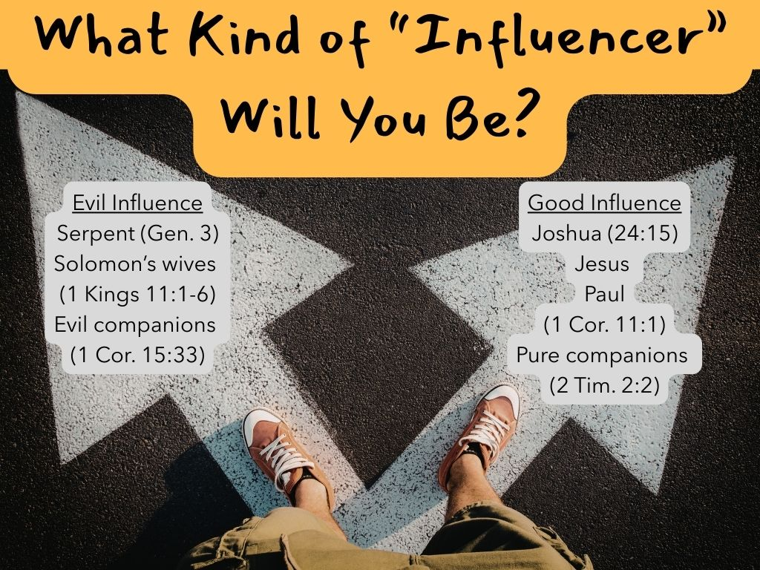
Notes:
Kings are expected to have “influence” but this does not mean an everyday “cupbearer” like Nehemiah is incapable of exerting influence upon the king. Husbands are to be the head of the home but that does not mean a godly wife cannot exert influence by her conduct (just see Esther or 1 Peter 3 for an example). Elders are to be the “shepherds” of the local church but this does not mean others do not and cannot exert influence for good or ill. So, right away, I want you to see you can have an effect on the character, development, or behavior of someone or something (the church).
Romans 14:7 says, “For not one of us lives for himself, and not one dies for himself…” (NASB1995). There’s no doubt about this: your life influences others either positively or negatively, to be more godly or to be more worldly. Many Bible characters show us this dual possibility of influence. Some, like the serpent, Solomon’s wives, or “evil companions” influence us in a negative direction. Yet, others like Daniel, Esther, Jesus, or the apostle Paul exerted a positive impact. So, what kind of “influencer” will you be to the world around you? How will you accomplish it?
We need to be careful not to get our ideas from the world (1 John 2:15-17). Instead, we need to go to God’s Word for the answers. This is such a broad topic and the inspired Scriptures have so much to say about both positive and negative influence. Indeed, nearly every Bible character is a template for one or the other. We can use the heroes of the Bible to learn about how to be an influence for good. We can use the villains of the Scriptures to learn about the dangers of negative influence.

Slide 8
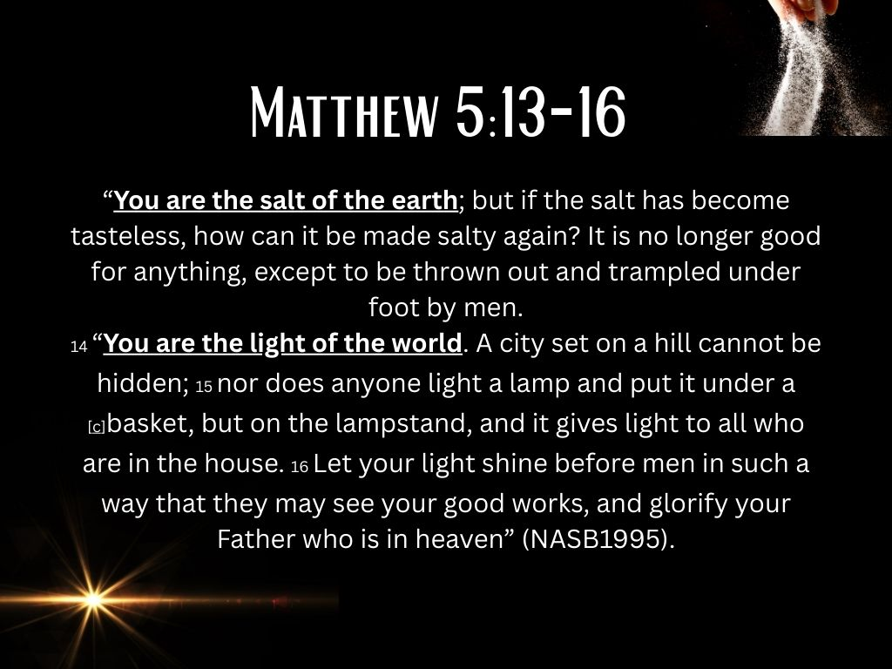
Notes:
Yet, perhaps one of the best texts comes from an illustration Jesus Himself uses in his Sermon on the Mount as he speaks of being “salt and light.”
Let’s read Matthew 5:13-16,
“You are the salt of the earth; but if the salt has become tasteless, how can it be made salty again? It is no longer good for anything, except to be thrown out and trampled under foot by men. 14 “You are the light of the world. A city set on a hill cannot be hidden; 15 nor does anyone light a lamp and put it under a basket, but on the lampstand, and it gives light to all who are in the house. 16 Let your light shine before men in such a way that they may see your good works, and glorify your Father who is in heaven” (NASB1995).

Slide 9
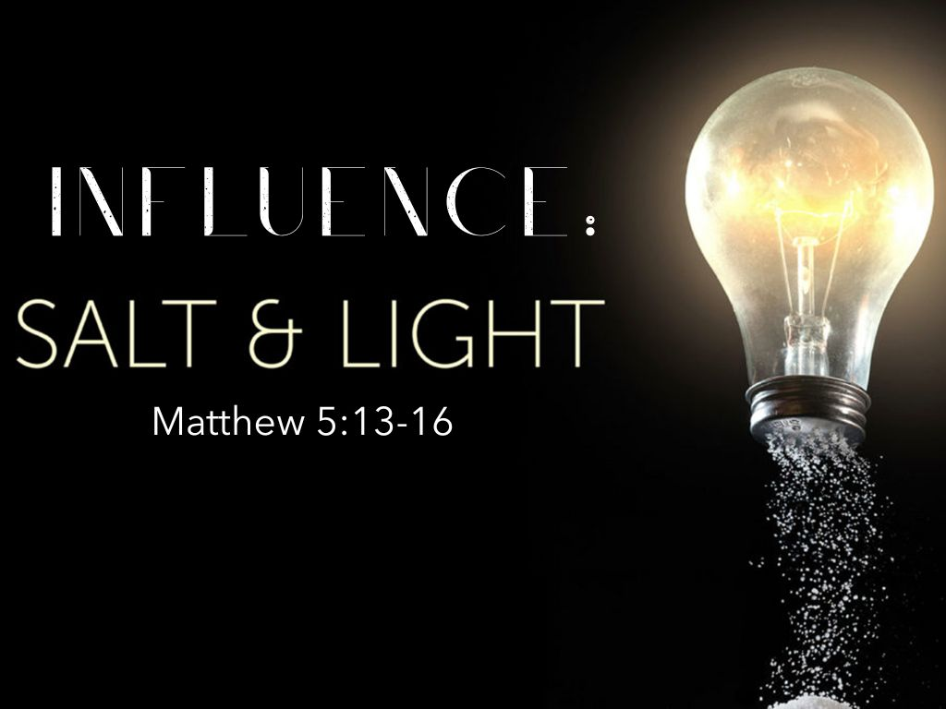
Notes:
After the Beatitudes, Jesus shares two similitudes to help us understand our role as “influencers” in His kingdom. Pliny the elder once said, “There is nothing useful than sun and salt.” Jesus takes this idea and teaches a spiritual lesson. Consider what it means to be “salt” and “light.”

Slide 10
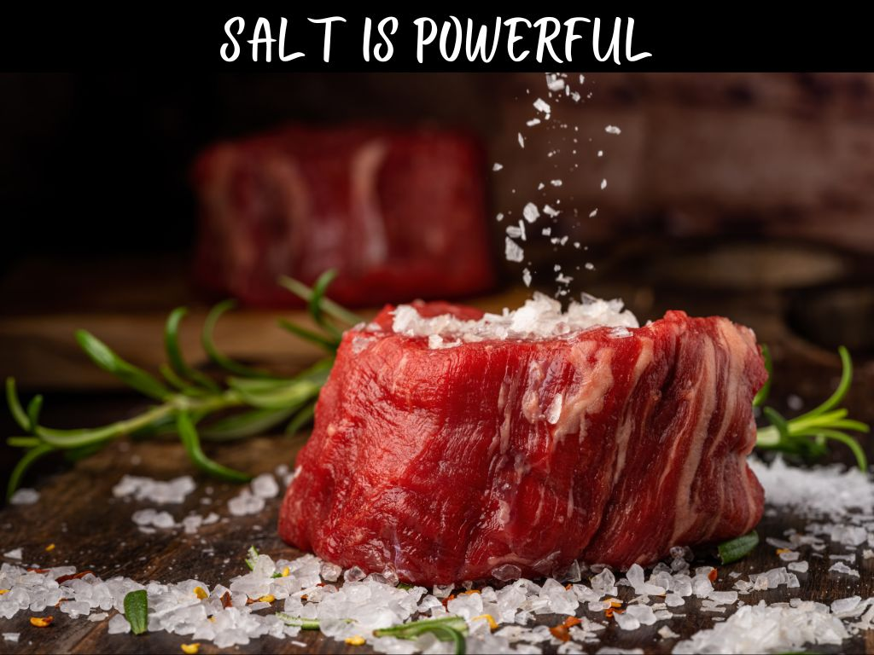
Notes:
I. Salt--“You are the salt of the earth, but if salt has lost its taste, how shall its saltiness be restored? It is no longer good for anything except to be thrown out and trampled under people’s feet” (Matthew 5:13, ESV).
A. “Salt” is powerful.
1. Just a teaspoon of salt rubbed into a 16 oz. Porterhouse steak can have a big tenderizing and flavor impact.
2. Likewise, when Jesus says “you are the salt of the earth” it sounds like a big task—“little ol’ me, just the few of us, are going to impact the whole earth?!”
3. There’s an old African proverb that says, “If you think you are too small to make a difference, try spending the night in a closed room with a mosquito!”
4. Now, maybe you won’t impact the whole planet! But, you can have impact!
i. Joseph’s wisdom had a profound impact upon the Egyptian nation.
ii. Gideon and his band of 300 soldiers, by God’s strength, were able to save conquer the Midianite oppressors.
iii. Josiah’s reforms had a purifying effect upon the Israelite nation.
iv. Esther’s request helped reverse the plot of Haman and the Persian nation.
v. Jesus died to save the entire world.
vi. Then, he sends out a band of 12 mostly uneducated fishermen to tell the world and they take the gospel from coast to coast.
vii. Do not underestimate what God can do with just a little bit of “salt!” (1 Corinthians 7:14; Romans 1:16).
5. “A little leaven leavens the whole lump” (1 Corinthians 5:6) is true in both a positive and negative sense.
6. Your decisions now can affect the future of your family, your church, and this nation for generations to come (see Exodus 20:5; Joshua 24:31)!

Slide 11
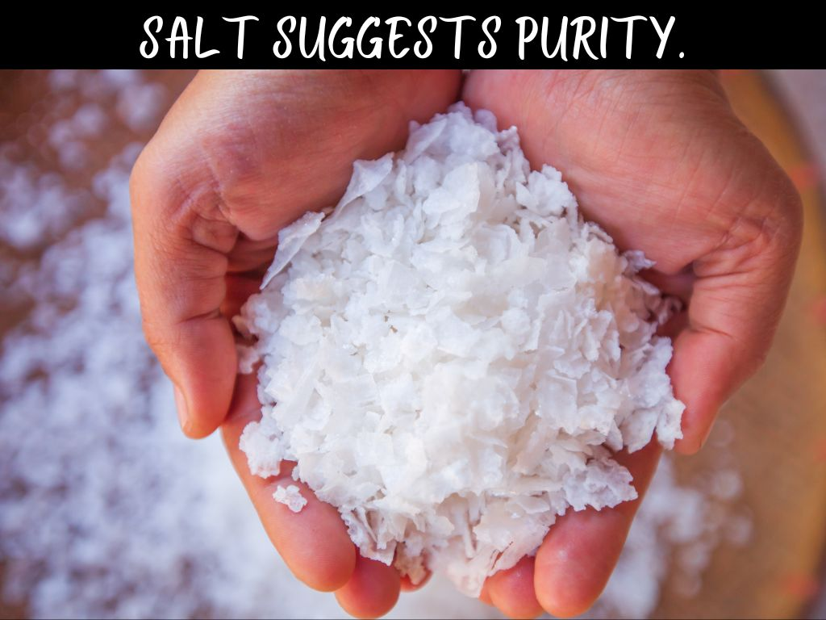
Notes:
B. Being “salt” implies purity.
1. Salt, because it is white and because of its origins (without preservatives or additives), is often associated with purity.
i. Often, when you are buying salt some labels emphasize the “pure sea salt” in contrast to the synthetic lab-created salt.
ii. Of course, in the time of Jesus all “salt” was pure and an essential to have on hand in every household.
2. Jesus, just a few moments earlier had emphasized the necessity of being “pure in heart” (Matthew 5:8).
i. If you want to ruin your influence live in hypocrisy. Be two-faced. Double-tongued. Live two lives.
ii. Yet, if you want to impact the lost world they need to see purity of heart in our motives, our speech, and our actions.
3. As Paul wrote Timothy he encouraged him to “be an example...in purity” if he hoped to have a positive reputation (4:12; cp. 5:1).
4. Timothy was also told to “flee youthful lusts; but pursue righteousness, faith, love, peace with those who call on the Lord out of a pure heart” (2 Timothy 2:22, NKJV).
5. The basic idea here is…if you want to stay pure “run from sin” and put yourself around people with “a pure heart.” This may not mean they’re perfect. But, are they growing? Are they humble in correction? Do they long for spiritual growth?
6. “Evil companions corrupt good morals” (1 Corinthians 15:33)—so be very careful of your influences. Some versions say “communication” (I like that better) because “communication” may include the music you are listening to, the social media “influencers” you are following, the television shows you are watching…if you want to stay “pure” you might need to hit the delete or “unfollow” button and be more discerning about what you are putting into your heart and mind.

Slide 12

Notes:
C. Salt was used for preservation.
1. Salt is commonly used as a preservative for foods.
i. Especially prior to modern refrigeration, salt was the primary means of preserving food for longer periods of time and slowing decay.
ii. To preserve meat, it was salted with a granular salt and often buried in the cool depths of an underground meat locker.
iii. A saltwater brine was also used to preserve fish or vegetables—the little boy who brought his “five loaves and two fishes” probably had salted fish.
iv. Even in ancient Egypt, salt was used in the embalming process to preserve bodies for longer periods of time.
v. Salt is used in these ways because it kills bacteria and slows decay.
2. The Christian is the world’s preservative.
i. We, by the grace of God, keep the world from spoiling and rotting.
ii. We can either contribute to the decay of the world or hold it at bay.
iii. It might sound cliché, but Jesus wants us to be the type of people who make this world a better place.
iv. People, when around Christians, ought to be improved by our influence upon them.
v. Have you ever been around someone who made you want to be better or think twice about being bad?
a. Ex. Y basketball—a bunch of religious guys played together and when a newcomer came they kept the cursing in check.
b. Are you the type of person who makes people better by your presence and influence? Do you instigate trouble or keep your friends out of trouble?
vi. Take the influence of Christianity off a team, out of a home, a community or a nation and you will eventually find a deteriorating people.

Slide 13

Notes:
D. Salt makes some foods palatable--gives them some additional flavor and taste that pleases the palate.
1. Without Christ, the world can be a cruel and ruthless place. People can be just plain mean and it can make life depressing.
2. Yet, when Christians walk by “the fruit of the Spirit” they fill the world with “love, joy, peace, longsuffering, kindness, goodness, faithfulness, gentleness, self-control” (Galatians 5:22).
3. These qualities truly make the world a more pleasant place.
4. When the opposite of these qualities begin to rule the day then life becomes a sickening experience.

Slide 14

Notes:
E. Salt produces a thirst.
1. Eat a salty ham and you will want water later.
2. Christians ought to live in such a way that it produces a thirst from others.
3. How wonderful when we can live in such a way that it produces a “hunger and thirst for righteousness” in the lives of observers.

Slide 15
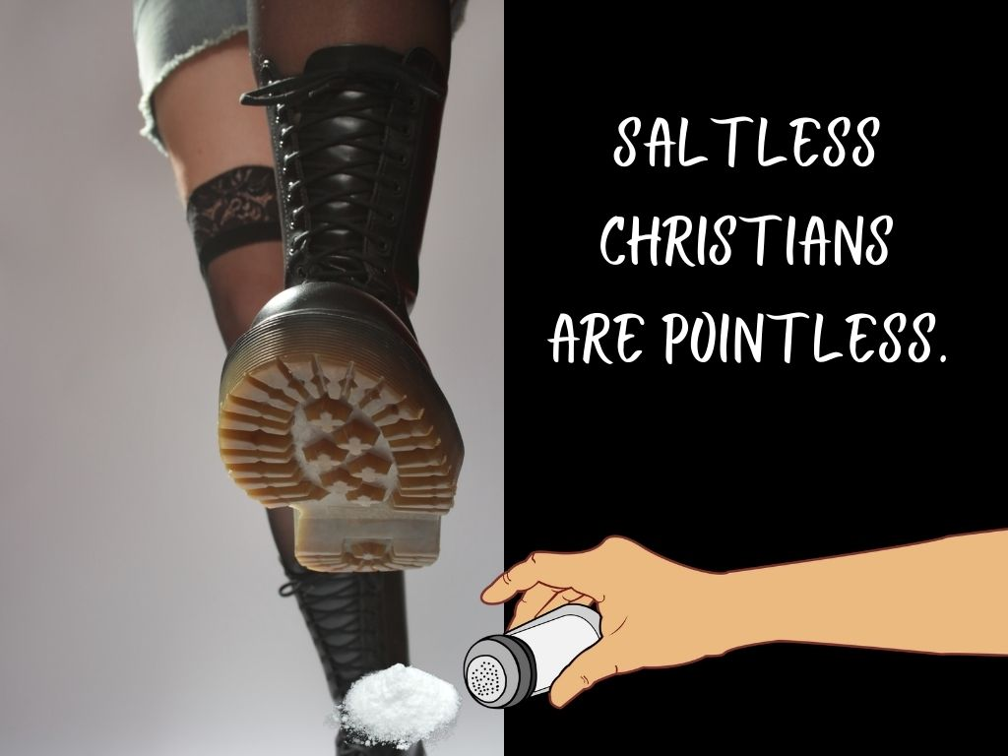
Notes:
E. What are we if we are not “salt?” Jesus, essentially, calls us pointless! The text says we are “good for nothing.” Do you know one of the reasons some Christians are having very little impact upon the world? Because so many Christians are acting just like the world! What would make someone want to be a Christian when your lifestyle and morals are nearly identical to their current lifestyle and morals? There’s got to be something compelling and persuasive about our lives that encourages change. Be salt!

Slide 16


Slide 17
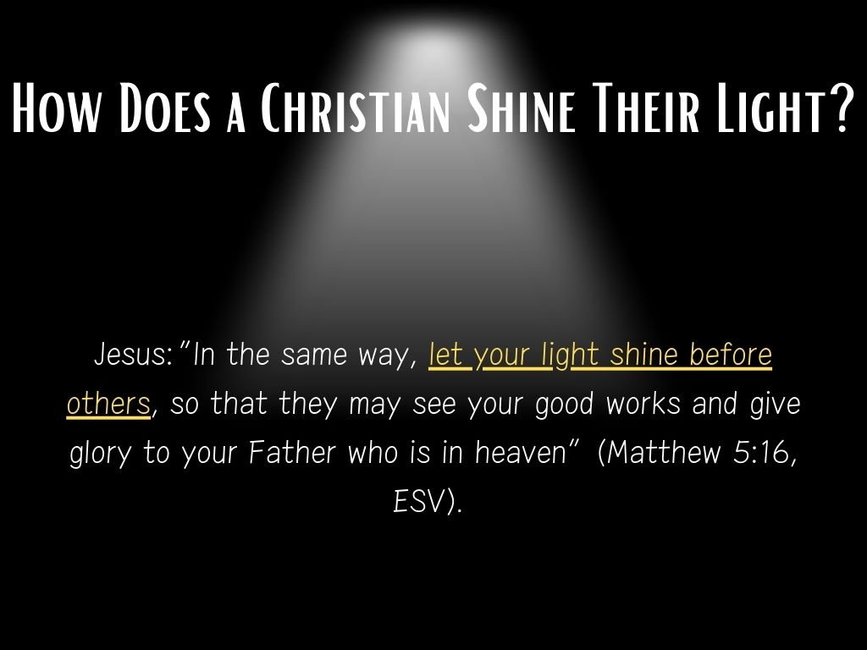
Notes:
II. Light--“You are the light of the world. A city set on a hill cannot be hidden. 15 Nor do people light a lamp and put it under a basket, but on a stand, and it gives light to all in the house. 16 In the same way, let your light shine before others, so that they may see your good works and give glory to your Father who is in heaven.” (Matthew 5:16, ESV). How does a Christian shine this light?

Slide 18

Notes:
A. Light reflects.
1. Light reflects off of water and mirrors.
2. Jesus is, Himself, the “light of the world” (John 8:12).
3. Christians are to be a reflection of Jesus to touch people where Jesus Himself may not directly reach (Acts 13:47).
i. There is a difference in “being the light” and reflecting “the light.”
ii. If we will influence others, we must learn from and imitate Jesus!
iii. This type of language shows up often in Scripture (Ephesians 5:7-8; Philippians 2:14-15

Slide 19
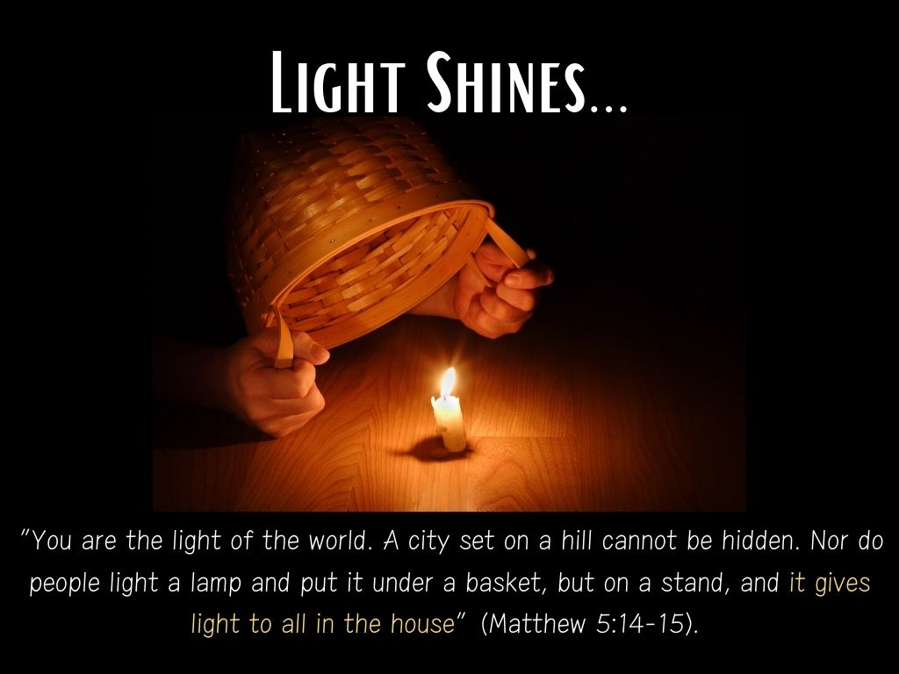
Notes:
B. Light shines.
1. To make this point, Jesus says earlier, “You are the light of the world. A city set on a hill cannot be hidden. Nor do people light a lamp and put it under a basket, but on a stand, and it gives light to all in the house” (Matthew 5:14-15).
2. Followers of Jesus shine and stand out.
i. A secret disciple is akin to a lamp covered up by a basket—it has little value.
ii. Do people outside of the church building even know you are a Christian?
iii. A Sunday-only, church-building only Christian isn’t much of a light to a dark world.
iv. Jesus did not say, “You are the light of the church.”
v. He said, “you are the light of the world”—meaning we’ve got to act like Christ calls us to act outside of our Christian circle.
3. When the rest of the world is living in darkness, Christ-followers dare to be different, we do not sway from the standards, we shine in darkness!
i. Perhaps the context of the Sermon on the Mount is a great demonstration of how we can do just that!
ii. When the rest of the world is full of anger and hate, we act with kindness.
iii. When the rest of the world is pursuing porn and saturated in sinful lust, we behave with self-control.
iv. When the rest of the world treats marriage like an option, we still value it as a covenant between God and man.
v. When the rest of the world is willing to be dishonest for personal gain, we are people trusted at our words.
vi. When the rest of the world vengefully attacks or cuts off our enemies, we extend love.
vii. While the rest of the world is consumed with money and things, we keep our focus on our good God who provides all things.
viii. In a world that values uniqueness, there will be nothing more different and unique than a Christian who operates by these standards (Rom 12:1-2).
4. Barclay writes this: ““A Christianity whose effects stop at the church door is not much use to anyone. It should be even more visible in the ordinary activities of the world. Our Christianity should be visible in the way we treat a shop assistant across the counter, in the way we order a meal at a restaurant, in the way we treat our employees or serve our employer, in the way we play a game or drive or park a car, in the daily language we use, in the daily literature we read. A Christian should be just as much a Christian in the factory, the workshop, the shipyard, the mine, the schoolroom, the surgery, the kitchen, the golf course, the playing field as he is in church. Jesus did not say, “You are the light of the Church”; he said, ‘You are the light of the world,’ and in a man’s life in the world his Christianity should be evident to all.” (Barclay, William. The Gospel of Matthew, Vol. 1, p. 123).

Slide 20

Notes:
C. Light exposes.
1. We turn on the light in a dark room so we can see the lurking dangers and avoid stubbing our toes and knocking over furniture.
i. We want to see the problems which may trip us. We want to see the bad guys in the corner.
ii. Christians have a duty to expose sin not to act as hurtful judges, but as helpful protectors of people’s souls.
iii. C.S. Lewis once wrote in Mere Christianity, “Jesus Christ didn’t say go into all the world and tell the world that it is quite right.”
2. Those who love sin and ignore its consequences will hate the light because self-willed people hate to be exposed (Ephesians 5:11-13).
3. Those who love to be careful in their walk with God will love the light of God’s Word being shone upon their lives (John 3:20-21).
4. Our world looks down upon the “exposure” aspect of Christianity as judgmental—but how wicked would it be to know someone was in danger and to refuse to give them warning? Do you call the doctor evil when he alerts you to health dangers? Do you call the tornado siren evil when it warns you of impending weather? Is the airport X-ray scanner evil when it reveals the hidden weapon?
5. Love warns of the danger ahead.

Slide 21

Notes:
D. Light guides.
1. Why do airports line the runways with lights? Why do we light walkways with lights? What was the original purpose of placing a lighthouse near a seaport?
2. In these settings, the purpose of light is to guide our path. Show us the way.
i. This is what being a role model is all about…
ii. Ex. Eric Davis, Cincinnati Reds…when I was a kid growing up in the 90’s I wanted to do everything like him.
iii. At some point, it clicks in that there are higher and nobler role models to imitate than athletes and celebrities though.
iv. Jesus shows us the way to eternity…not just better health, a better physique, or better momentary joys. He is a guide to the Father (John 14:6).
3. A Christian is a person worthy of being followed—because they set the standard and help us see the goal (see 1 Timothy 4:12-13).
i. The world erodes and lowers standards.
ii. Yet, the Christian upholds the standards in our words, our conduct, in love, in spirit, in faith, in purity!
iii. The world can respect a person who stands on his convictions.
iv. Other Christians can follow a Christian, even a young Christian, who holds firm to godly standards.
4. God needs His people to set the standard and be the guide for others who have lost their way and are wandering in darkness (Luke 1:79).
5. Some people do not have the moral strength and courage to take a stand—but if someone will step up and lead they will follow. Are you willing to be a guide?

Slide 22

Notes:
E. Light impresses.
1. Like a solar eclipse, light can also be impressive.
2. One of my famous painters is Thomas Kincade--the “painter of lights.”
3. Like a chandelier in a drab room, or a fireworks show in the night sky, light can be a lovely thing—Christians, by being who God calls them to be, can be lovely.
4. Whatever light people see in us, is not intended to impress them with us personally—but with Jesus who “is the radiance of the glory of God and the exact imprint of his nature” (Hebrews 1:3; cp. Philippians 2:14-16).
5. Are people impressed as they see you shining the light of God by your good works? Are you living a life of beauty worthy of admiration?

Slide 23
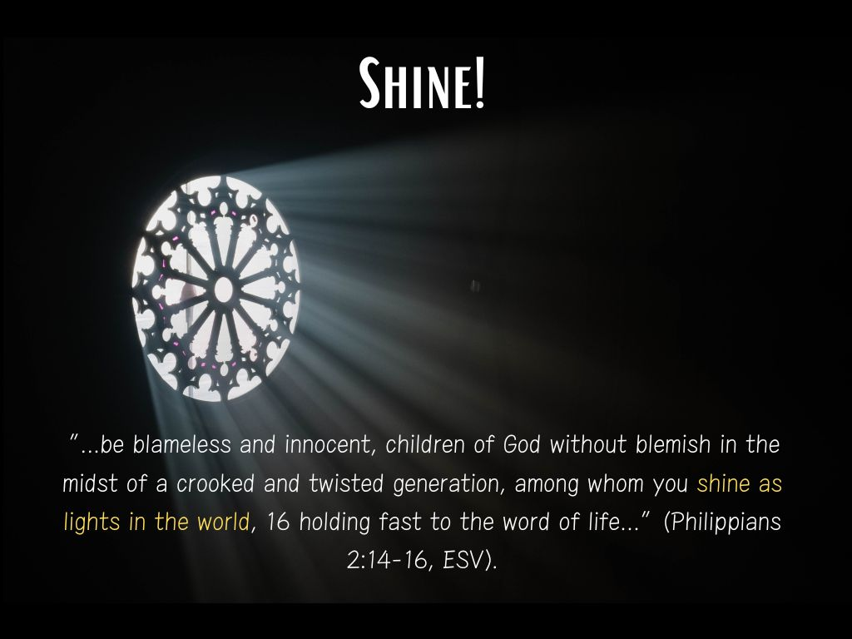

Slide 24
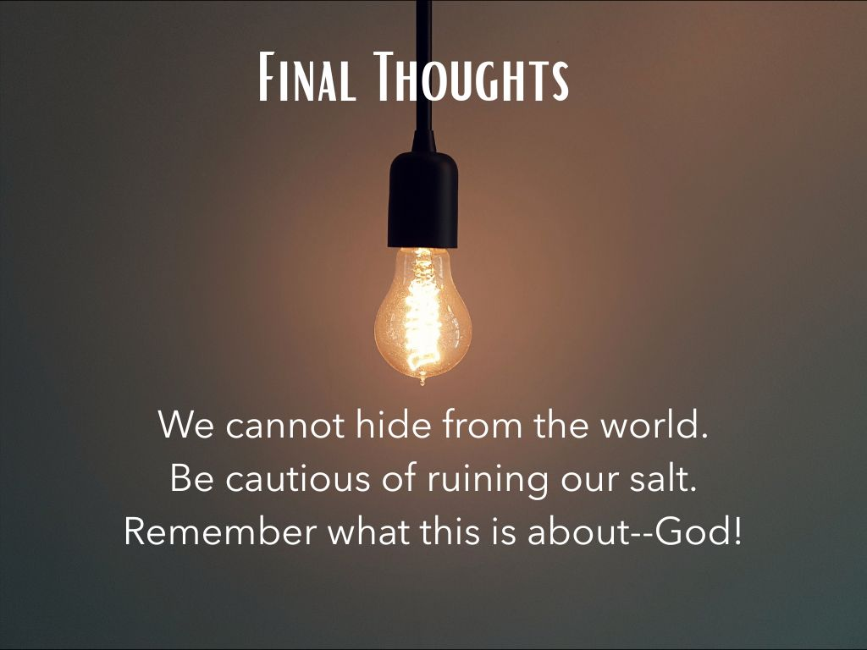
Notes:
III. Final Conclusions About Salt and Light
A. Christians must be careful not to encourage avoiding contact with the world if salt and light is to do what it is intended to do.
1. The salt needs to get out of the shaker to preserve the meat.
2. A light must be placed in a dark room to do its job (cp. John 17:14-15).
3. Christians must not be so afraid of being around the world if God’s going to do what He intends to do with us!
B. We must be extremely cautious of ruining our valuable salt.
1. Mix salt too much with other dangerous minerals and chemicals it can become toxic instead of helpful.
2. When Christians have so much of the world in them their hypocrisy, lukewarmness, or compromise becomes repulsive.
3. James said we must be “unstained from the world” (James 1:27).
C. We need to remember what this is all about—not ourselves, but God!
1. We are not trying to be a good example to promote ourselves, like a social media influencer looking for popularity or monetary gain.
2. Our job is to simply be vessels that help people see the power Jesus has in our lives and that He can have in their lives too.
3. We want others to “glorify God in heaven!”

Slide 25
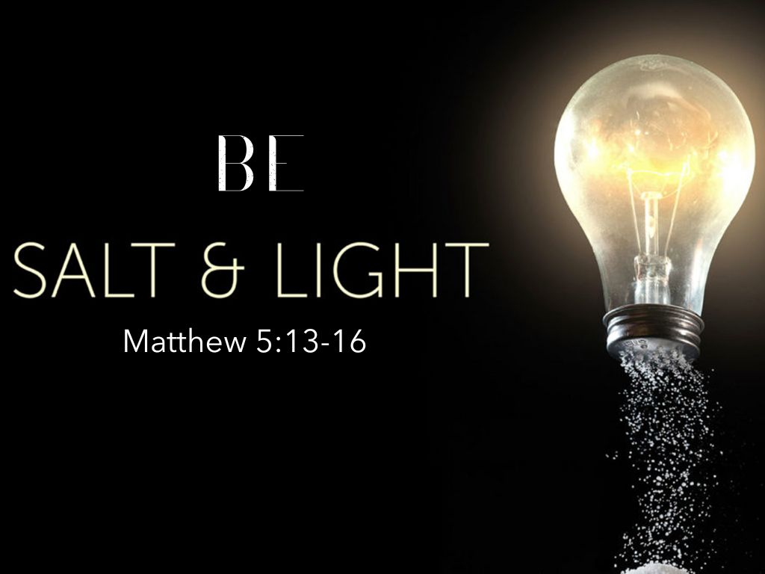
Notes:
Conclusion: Christians, the lost world needs you. Someone out there is depending on you to be a light that shines through the darkness and clutter of their hearts, the decay of their souls, and shows them there is a higher purpose, a bigger meaning, and a greater hope than they are living for currently.
We are signposts to the world. If we were to change the sin posts out on SR 72 or I-65 we would confuse a lot of people and cause a lot of chaos. Let’s make sure we are pointing people in the right direction by our words and deeds. The world needs you to be an influencer….may you courageously be the positive influence God has called you to be in this world.

