Slide 1

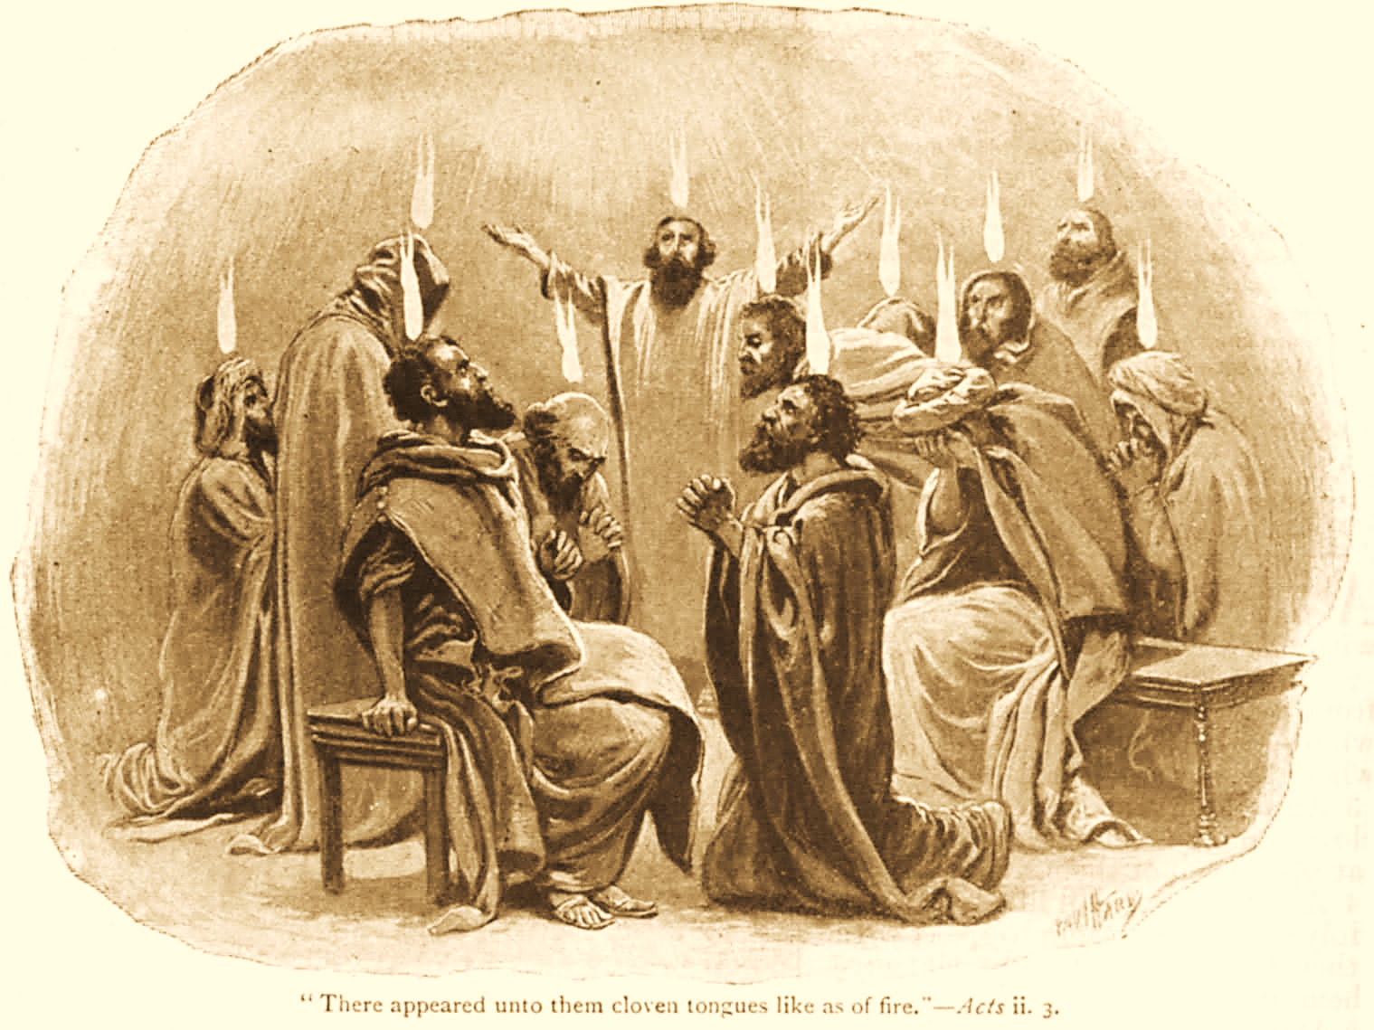
A C T S
Go Tell
the Good
News!
The Growth and
Development of the Early Church

Slide 2
A C T S
Lesson 10
Acts 7
Stephen’s Speech
Stephen’s Martyrdom

Slide 3
Stephen’s preaching brings him into conflict with the Jews (Acts 6:8-15)
Those from the Synagogue of the Freedmen dispute with him.
  Unable to answer Stephen’s wisdom and inspired words, they induce false witnesses to accuse him of blasphemy.
  For the first time in Acts, opposition comes from a source other than the leading Jewish officials.
Stephen is seized and brought before the council who see his face as that of an angel.
Notes:
Angels are messengers of God. They can appear in many forms, including as men or in a flame of fire. Their appearance often causes those who see them to fear and respectfully heed the message of the angel.
Revelation 18:1 After these things I saw another angel coming down from heaven, having great authority, and the earth was illuminated with his glory.
Num_22:31 Then the LORD opened Balaam's eyes, and he saw the Angel of the LORD standing in the way with His drawn sword in His hand; and he bowed his head and fell flat on his face.
Revelation 10:1 I saw still another mighty angel coming down from heaven, clothed with a cloud. And a rainbow was on his head, his face was like the sun, and his feet like pillars of fire.

Slide 4
Overview of Stephen’s Speech
Most of Acts 7 is Stephen’s defense of himself and the gospel before the Sanhedrin.
His defense takes the form of an historical synopsis of Old Testament Israel (Acts 7:2-50).
  He chronicles the faithfulness of selected servants of God, and how they kept pointing toward the coming of the Messiah.
  He also highlights Israel’s repeated unfaithfulness and how they continually rejected the leaders God sent to them.
He concludes that his accusers were no different than the previous disobedient generations among God’s people (Acts 7:51-53).
Notes:
Abraham FAITHFUL in receiving & passing on God’s promises as well as obeying His commands 7:2-8 (Heb 11:8-10)
Joseph FAITHFUL in trusting God as well as preserving the nation in Egypt 7:9-16
Moses FAITHFUL in delivering the nation from bondage, leading them through the hard wilderness years, and in prophesying 7:17-44 [longest section]
Joshua FAITHFUL in conquering the promised land 7:45
David FAITHFUL in ruling God’s kingdom as well as desiring to build God a dwelling place v. 46
Solomon FAITHFUL in building God’s dwelling place, although God cannot be so confined vv. 47-50
Israel Repeatedly UNFAITHFUL in disobeying God and the rulers He chose for them – Joseph v. 9

Slide 5
Overview of Stephen’s Speech
This is not a “sermon” designed to persuade hearers to believe and repent; it is more of an indictment.
Stephen directly quotes 17 O.T. passages.
He also cites numerous other O.T. references and stories his audience would be very familiar with.

Slide 6
Stephen’s Inspired Synopsis of Jewish History (Acts 7)
God called faithful Abraham and promised to bless his descendants by giving them “this land” (7:2-7)
  Although Abraham’s descendants would first have to spend 400 years in bondage to another nation.
God sealed His promise to Abraham by giving him the sign of circumcision (7:8, Gen. 17:10-14)
God worked His providence to move Abraham’s descendants to the land of bondage (7:8b-19)
Notes:
Genesis 17:10-14 This is My covenant which you shall keep, between Me and you and your descendants after you: Every male child among you shall be circumcised; 11 and you shall be circumcised in the flesh of your foreskins, and it shall be a sign of the covenant between Me and you. 12 He who is eight days old among you shall be circumcised, every male child in your generations, he who is born in your house or bought with money from any foreigner who is not your descendant. 13 He who is born in your house and he who is bought with your money must be circumcised, and My covenant shall be in your flesh for an everlasting covenant. 14 And the uncircumcised male child, who is not circumcised in the flesh of his foreskin, that person shall be cut off from his people; he has broken My covenant."

Slide 7
Stephen’s inspired synopsis of Jewish History (Acts 7)
God raised up faithful Moses to deliver Israel (7:20-35).
  Protecting him as a child.
  Leading him to Midian.
  Calling him at the burning bush.
  First Rejection: "This Moses whom they rejected, saying, 'WHO MADE YOU A RULER AND A JUDGE?' is the one God sent to be a ruler and a deliverer by the hand of the Angel who appeared to him in the bush (7:35).
God delivered Israel through Moses, who promised a future Prophet like himself (7:36-37).

Slide 8
Stephen’s Inspired Synopsis of Jewish History (Acts 7)
God gave Israel His word through Moses (7:38-41).
  Second rejection: “Whom our fathers would not obey, but rejected” (7:39).
Israel rejected tabernacle worship given them by God in favor of idolatry (7:42-45).
  Third rejection: “You also took up the tabernacle of Moloch…”
  But God kept His promise to give them the Land!
At David’s request, God allowed Solomon to build Him a dwelling, although no place on earth could contain Him (7:46-50).

Slide 9
Stephen’s charges and the Council’s Reaction (Acts 7)
Stephen charges the Jewish leaders (7:51-53)
  They are stiff-necked! Like their fathers, they always resist the Holy Spirit.
  They persecuted the prophets, killed those who prophesied of the coming Christ, and then killed the Christ Himself!
  They had received the Law but had not kept it!

Slide 10
Stephen’s charges and the Council’s Reaction (Acts 7)
The council’s reaction (7:54-60)
  They are cut to the heart!
  They “ground their teeth” at Stephen.
  When Stephen testifies of seeing Jesus standing at God’s right hand, they cry out and stop their ears.
    Stephen is filled with the Holy Spirit.
    As he gazes into heaven, he is privileged to see “the glory of God” and Jesus standing at God’s right hand.
  They gang rush Stephen, cast him out of the city and stone him!
  They lay their clothes at Saul’s feet.

Slide 11
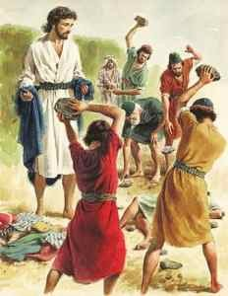
And they stoned Stephen as he was calling on God and saying, “Lord Jesus, receive my spirit.” Then he knelt down and cried out with a loud voice, “Lord, do not charge them with this sin.” And when he had said this, he fell asleep. (Acts 7:59-60)

