Slide 1

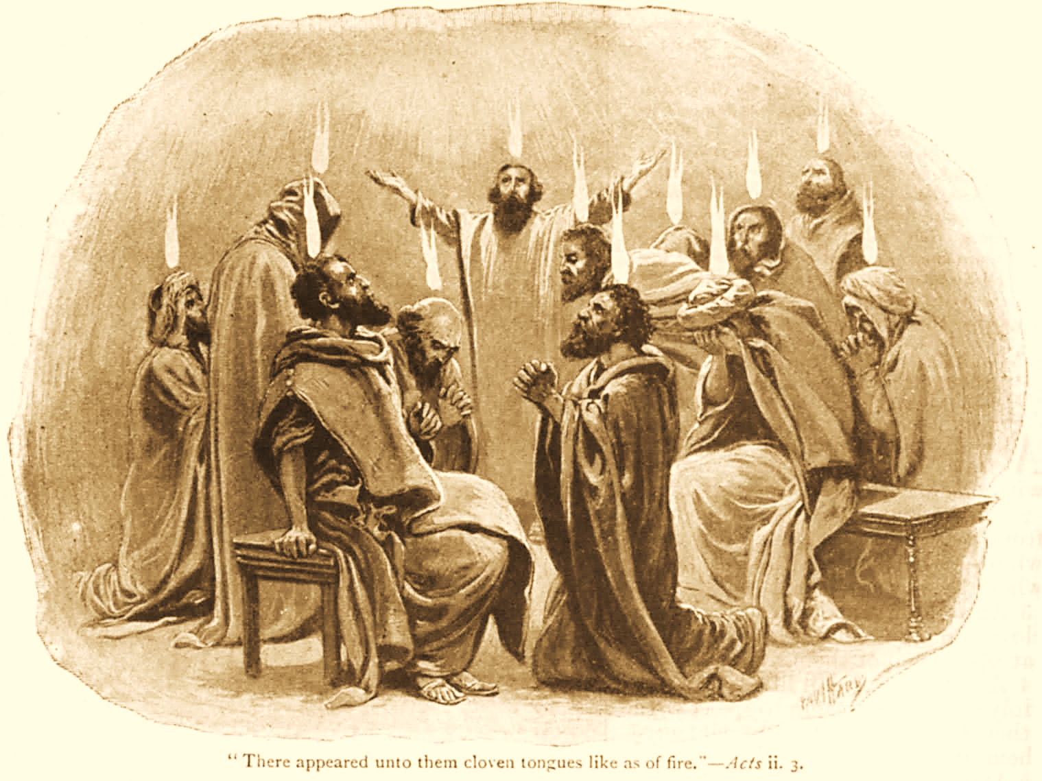
A C T S
Go Tell
the Good
News!
The Growth and
Development of the Early Church

Slide 2
A C T S
Lesson 11
Acts 8:1-25
Saul Persecutes the Church
Philip Labors In Samaria

Slide 3
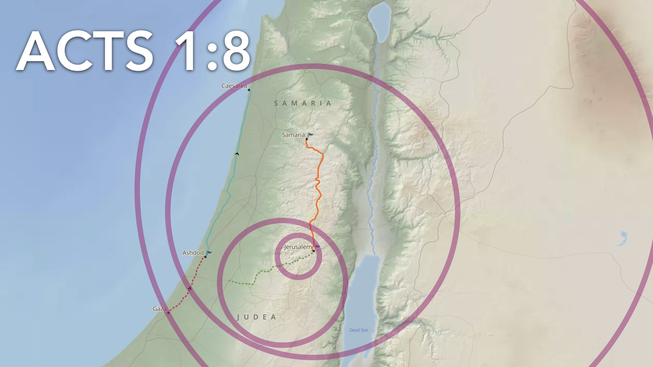
“But you shall receive power when the Holy Spirit has come upon you; and you shall be witnesses to Me in Jerusalem, and in all Judea and Samaria, and to the end of the earth.”
Notes:
Apostolic witnessing efforts to this point (Acts 1-7)
Two gospel sermons re: the resurrected Christ (2:22-36; 3:12-26)
Opportunities to work signs & wonders…this drew audiences to hear the gospel (2:6-12; 3:11; 4:33; 5:15-16)
Two major defenses before opposing religious leaders to display faith and commitment to Christ (4:3-21; 5:17-40)

Slide 4
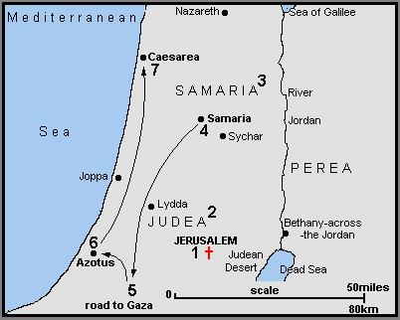
Philip & Simon the Sorcerer (8:5-25)
Philip and the Ethiopian Eunuch (8:26-40)
To Gaza

Slide 5
Severe Persecution Arises (Acts 8:1-4)
Acts 26:9-11 “…many of the saints I shut up in prison, having received authority from the chief priests; and when they were put to death, I cast my vote against them. And I punished them often in every synagogue and compelled them to blaspheme; and being exceedingly enraged against them, I persecuted them even to foreign cities.”
Saul consents to Stephen’s death.
A great persecution arises against the church, and disciples are scattered throughout Judea and Samaria, except the apostles.*
Devout men bury Stephen, and great lamentation is made for him. (8:2, 1 Thess. 4:13)
Saul makes havoc of the church…
  Entering EVERY HOUSE
  Dragging off MEN and WOMEN
  Committing them to PRISON
Notes:
His actions related to Stephen’s murder v. 1a
Hearty agreement, full consent (glad it happened): “Consenting” is from συνευδοκέω 1) to be pleased together with, to approve together (with others)
2) to be pleased at the same time with, consent, agree to 2a) to applaud (Thayer)
*The “bridge” from gospel activity in Jerusalem (Acts 1-7) to Judea and Samaria (Acts 8-12) the persecution of followers of Jesus Christ
Jesus’ command specified the WHERE…no mention of HOW. Like Joseph & Esther, Acts 8:1-3 is another good Bible story on how God’s providence makes a way for His will to be accomplished even in the face of wicked human actions
Brethren greatly mourned & lamented Stephen’s death but not Saul…he had no remorse or sadness at all
He began “ravaging” or “making havoc of” the church (cf. 9:1-2).

Slide 6
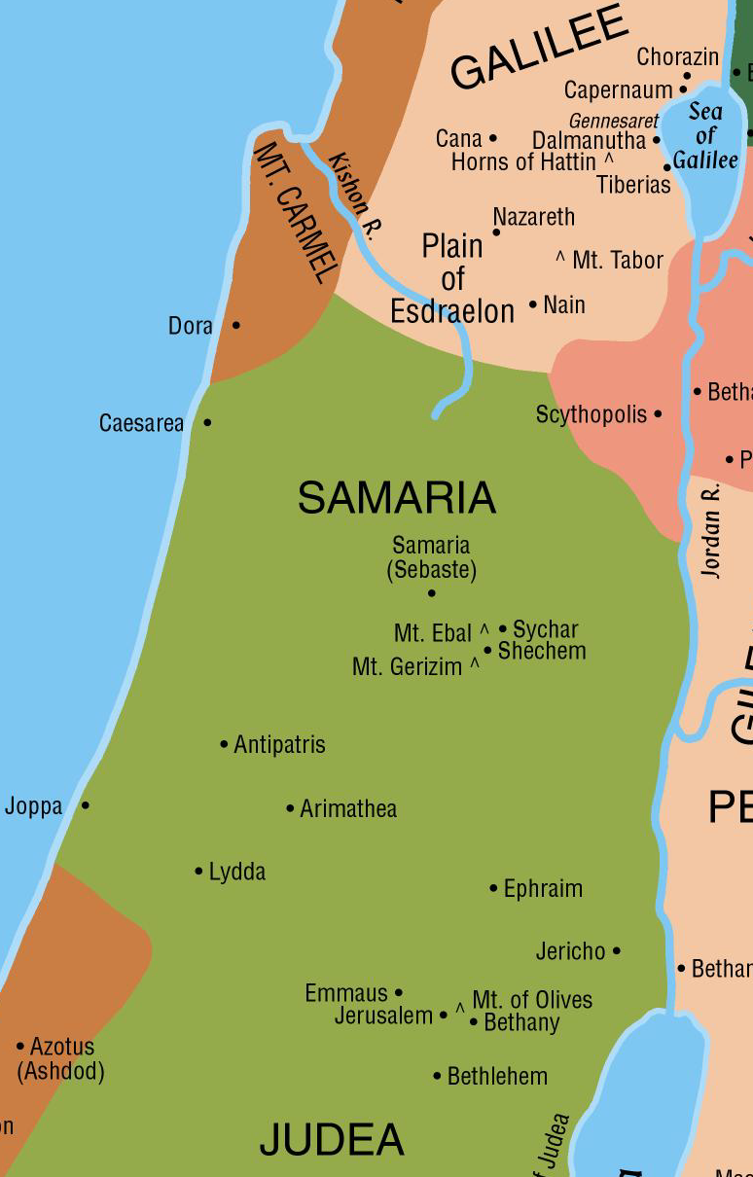
Philip preaches in Samaria (Acts 8:4-8)
Those who were scattered went everywhere preaching the word!
Philip preaches Christ in Samaria.
  Philip’s ability to perform miracles would have come through the apostles.*
  His miracles led multitudes to believe his preaching.
  There was “great joy” in Samaria.
Notes:
* Of the men appointed for service on whom the apostles laid their hands in Acts 6, the only two we are told more about (Stephen and Philip) performed miracles.
Acts 6:6 whom they set before the apostles; and when they had prayed, they laid hands on them.
In Acts 8:18, Simon saw that through the laying on of the apostles' hands the Holy Spirit was given,
Romans 1:11 For I long to see you, that I may impart to you some spiritual gift, so that you may be established—
2 Timothy 1:6 Therefore I remind you to stir up the gift of God which is in you through (dia) the laying on of my hands.
1 Timothy 4:14 Do not neglect the gift that is in you, which was given to you by (dia) prophecy with (meta) the laying on of the hands of the eldership.

Slide 7
Simon the Sorcerer Believes (Acts 8:9-17)
Simon had a great following among the people because of his sorcery.
But the people believed Philip’s preaching about Jesus and the kingdom, and they had been baptized.
Simon also believed and was baptized.
He was amazed at the signs and miracles done by Philip.
When Peter and John came to Samaria, they imparted the miraculous measure of the Holy Spirit to believers.
Notes:
A “sorcerer” an ancient, oriental astrologer; a wizard or magician [original word = magos; plural = magi (Matt 2:1)]
A fraud, trickster who apparently used drugs to seduce people; often associated with idolatry [“sorcery” = pharmakeia (Gal 5:20)] This is how he gained much acclaim from the people vv. 9-11

Slide 8
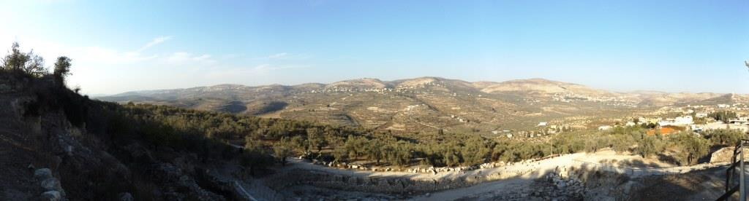
Simon’s Sin (Acts 8:18-25)
Simon tries to buy the power to impart the Holy Spirit.
Peter informs Simon that his thinking and his heart are not right in the sight of God.
  Peter instructs Simon to repent and pray.
  Simon had been poisoned with bitterness (Heb. 12:15).
  He was bound by iniquity (Prov. 5:22; John 8:34).
  He requests that Peter pray for him (James 5:16).
Returning to Jerusalem, the apostles evangelize the villages of Samaria.
Notes:
Hebrews 12:15 looking carefully lest anyone fall short of the grace of God; lest any root of bitterness springing up cause trouble, and by this many become defiled;
Proverbs 5:22 His own iniquities entrap the wicked man, And he is caught in the cords of his sin.
John 8:34 Jesus answered them, "Most assuredly, I say to you, whoever commits sin is a slave of sin.
James 5:16 Confess your trespasses to one another, and pray for one another, that you may be healed. The effective, fervent prayer of a righteous man avails much.

Slide 9
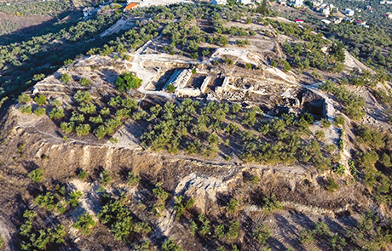
Notes:
BILL SCHLEGEL / BIBLEPLACES.COM via BAR

Slide 10
Lessons for Us
Erring believers have steps to take to be forgiven, reconciled to God.
It is possible for one to be saved and become lost again (Acts 8:13, 20-24; Mark 16:16).
Notes:
According to Jesus, Simon was saved Acts 8:13 Mk 16:16
According to the apostle Peter, Simon became lost again Acts 8:20-24
The Calvinistic doctrine of the “Impossibility of Apostasy” is widespread and found in many/most denominational churches
This doctrine is false and contrary to the Scripture
One can lose his salvation after gaining it
Galatians 5:4 You have become estranged from Christ, you who attempt to be justified by law; you have fallen from grace.
2 Peter 2:20-21 For if, after they have escaped the pollutions of the world through the knowledge of the Lord and Savior Jesus Christ, they are again entangled in them and overcome, the latter end is worse for them than the beginning. 21 For it would have been better for them not to have known the way of righteousness, than having known it, to turn from the holy commandment delivered to them.e, fervent prayer of a righteous man avails much.

