Slide 1

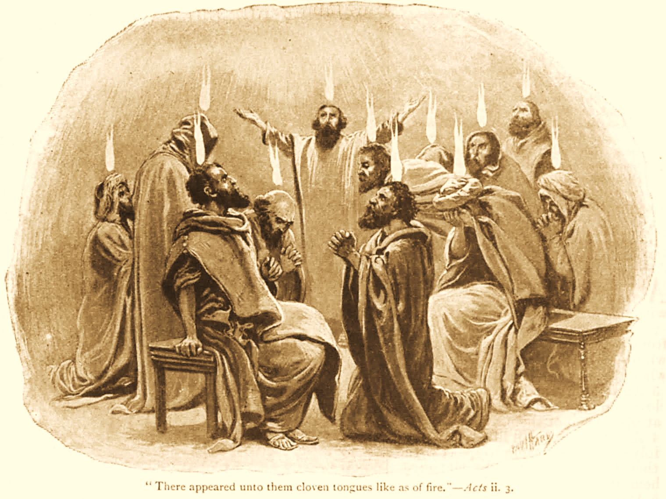
A C T S
Go Tell
the Good
News!
The Growth and
Development of the Early Church

Slide 2
A C T S
Lesson 12
Acts 8:26-40
Philip preaches to the Ethiopian Eunuch

Slide 3
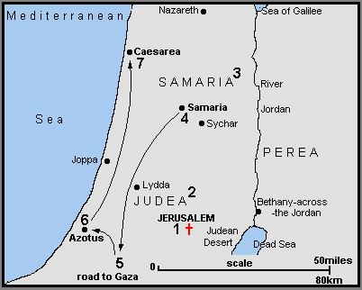
Philip & Simon the Sorcerer (8:5-25)
Philip and the Ethiopian Eunuch (8:26-40)
To Gaza

Slide 4
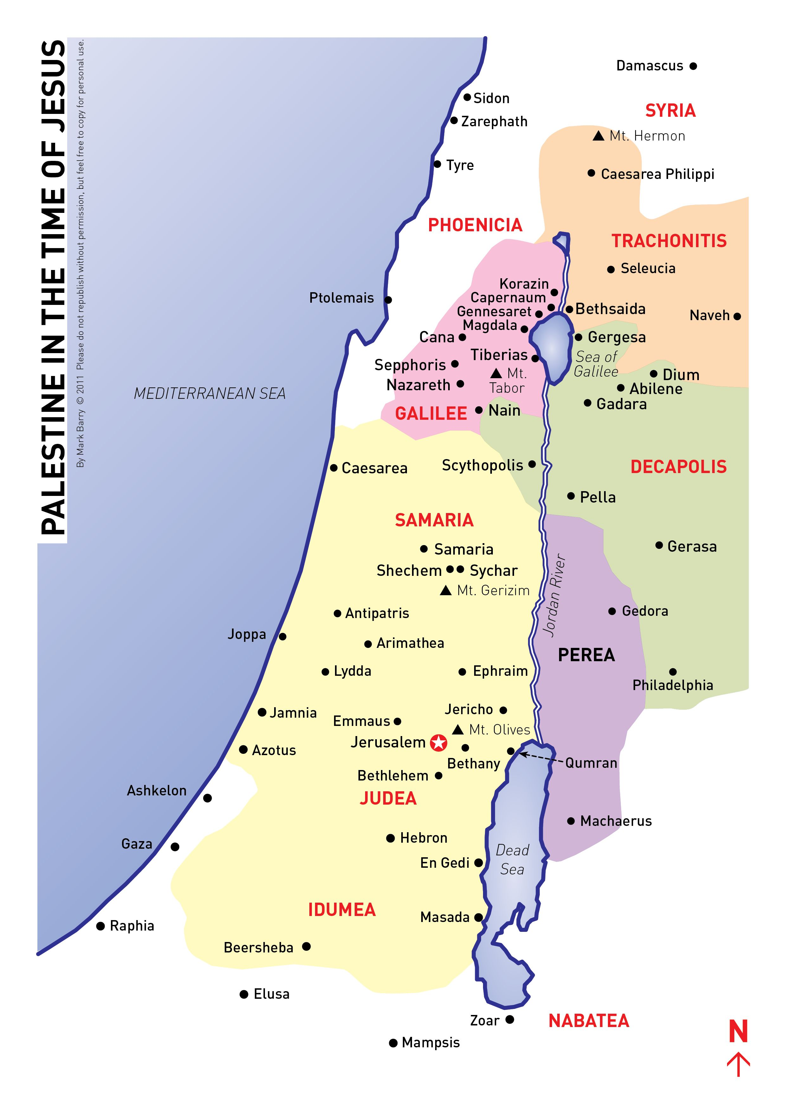
Philip Travels South
When last we saw Philip, he was in the city of Samaria (8:5)
Now an angel of the Lord tells Philip to "Arise and go toward the south along the road which goes down from Jerusalem to Gaza." This is desert.
So he arose and went (8:26-27a).
Notes:
As far as Luke’s record goes, he left Samaria to go to the road leading to Gaza
How long did it take him to get there? Where exactly on this road was he to go?
Did he have any Divine help getting there? (cp. 8:39)
All we know is he went (8:27a)

Slide 5
An Ethiopian is Travelling
home from Jerusalem (8:27-28)
Nothing is known about his name or age.
He was an Ethiopian.
  Referring either to race or nationality or both.
  History indicates there was a sizeable Jewish population in Ethiopia at this time.
  He was a man of prominence and wealth.
    Treasurer to the Queen (Candace).
    Riding in a chariot.
    Reading a scroll.
He was a eunuch.*
  This would have limited his worship opportunities in the Jewish temple (Deut. 23:1).
He was probably a proselyte, and he had come a long way to worship.
Notes:
Google AI: In the Bible, "Ethiopian" (or the related term "Cushite") primarily refers to people of black African ancestry, encompassing a racial group rather than just one specific nationality or modern country. This term described people of Kush (Nubia), a powerful kingdom along the Nile River south of Egypt.
Jeremiah 13:23 Can the Ethiopian change his skin or the leopard its spots?
Pronunciation of Candace: Kan-DAH-keh
While the Latinized version "Candace" is pronounced similarly to the English name "Candice" (KAN-dis), the original Meroitic and Greek term Kandake has the stress on the second syllable.
*A eunuch is an emasculated male, often made so in ancient courts to ensure his loyalty to the crown.
Deuteronomy 23:1 "He who is emasculated by crushing or mutilation shall not enter the assembly of the LORD.

Slide 6
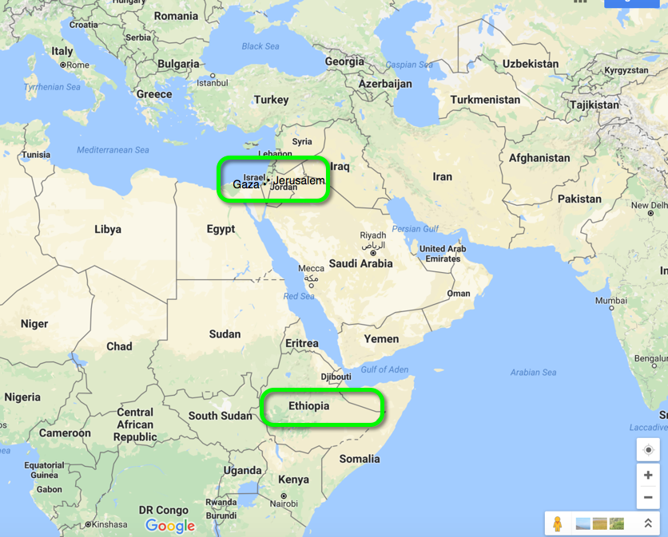
Notes:
The distance was approximately 1,500 miles between Ethiopia and Jerusalem.
What might this suggest about his character?
The eunuch was a high-ranking official under "Candace," the queen of the Ethiopians. This kingdom was ancient Kush, with its capital at Meroë, located in modern-day Sudan. "Ethiopia" in ancient texts referred to this region, south of Egypt, not the modern country.

Slide 7
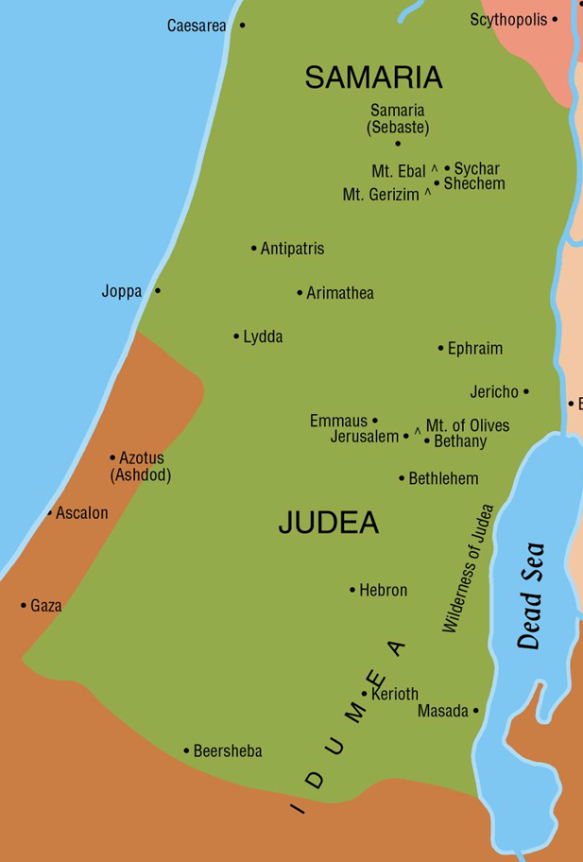
Philip Preaches to the Ethiopian Eunuch (Acts 8:26-40)
The angel had instructed Philip to go toward the south along the road from Jerusalem to Gaza.
An Ethiopian who had come to Jerusalem to worship was returning home.

Slide 8
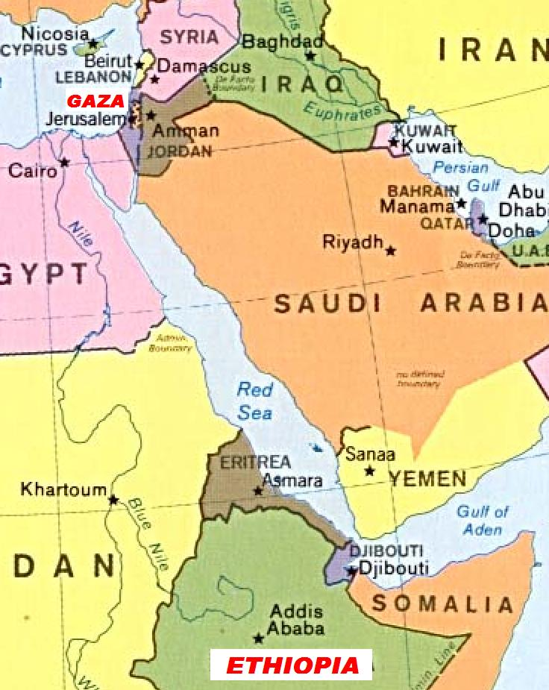
Philip Preaches to the Ethiopian (Acts 8:26-40)
The Spirit instructs Philip to overtake the chariot.
The Ethiopian is reading from Isaiah (Isa. 53:7-8)
When Philip asks if he understands what he is reading, the Ethiopian says he needs guidance.
Philip starts in Isaiah 53 and preaches Jesus!

Slide 9
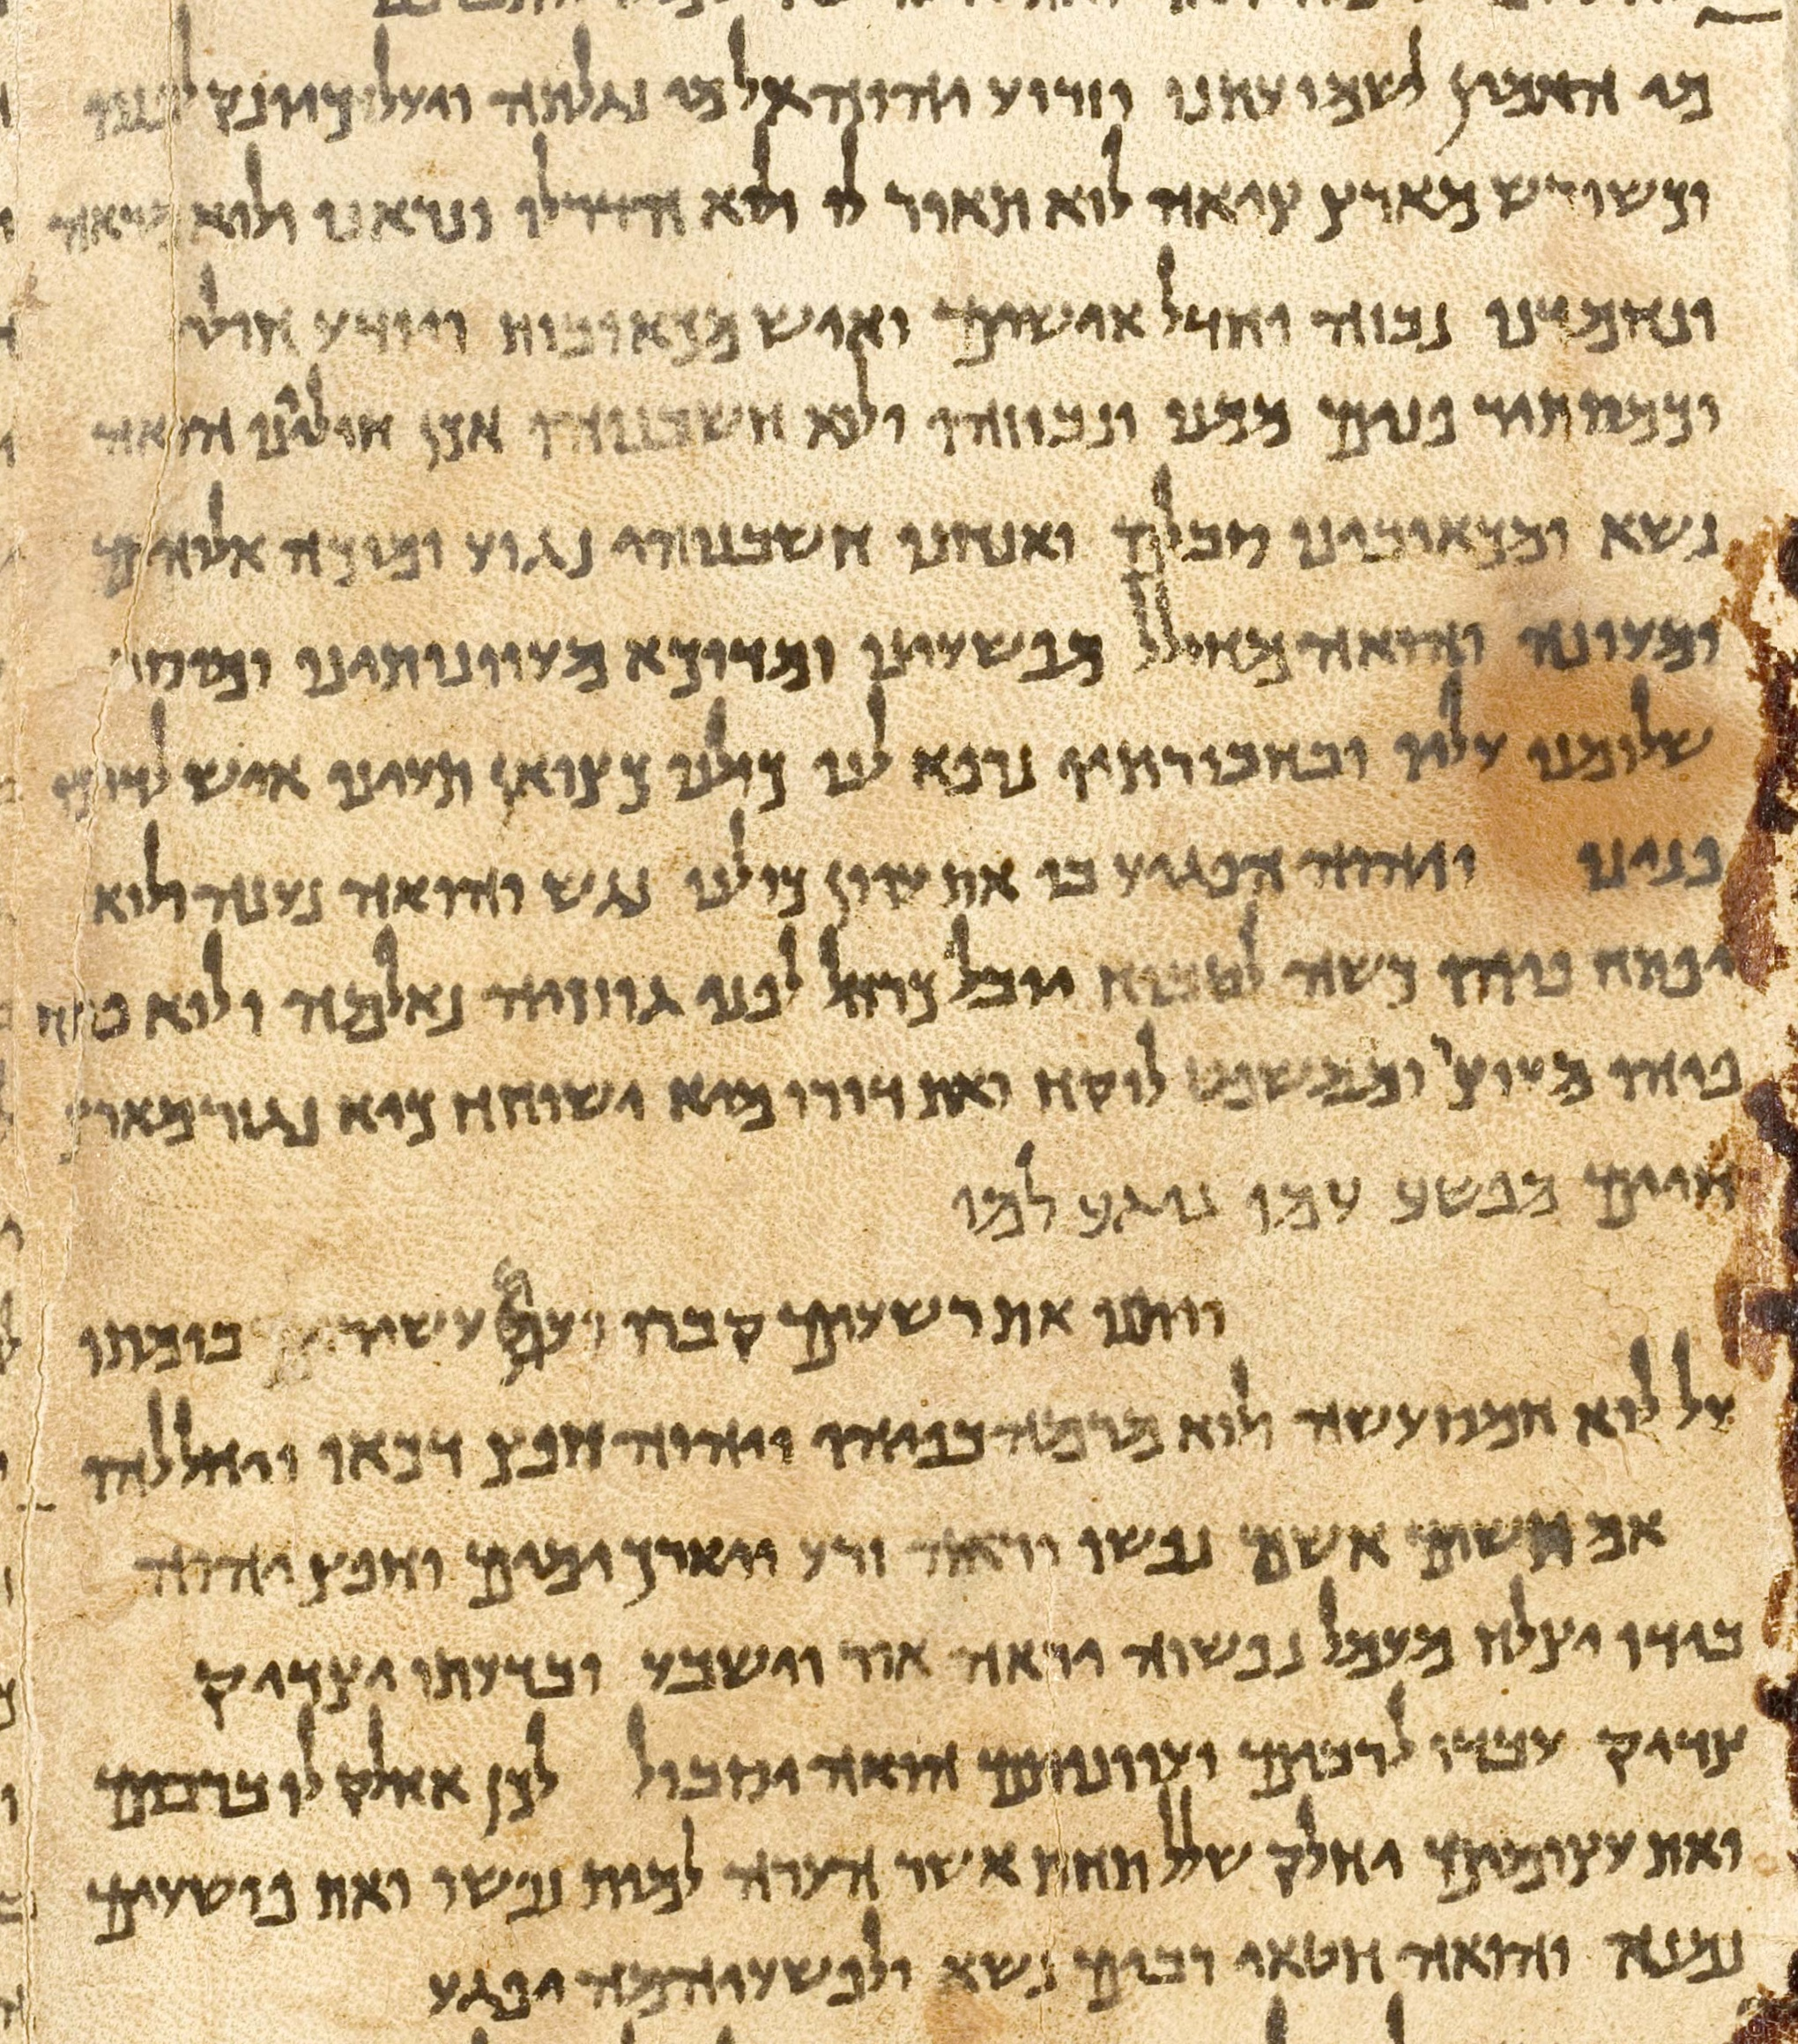
Isaiah 53
This picture shows all of Isaiah 53 in the Great Isaiah Scroll.*
The scroll is dated to the 2nd century BC.
The text is mostly identical to the later Masoretic version.
Notes:
Photography by Ardon Bar Hama
Portion of a photographic reproduction of the Great Isaiah Scroll, the best preserved of the biblical scrolls found at Qumran. It contains the entire Book of Isaiah in Hebrew, apart from some small damaged parts. This manuscript was probably written by a scribe of the Jewish sect of the Essenes around the second century BC. It is therefore over a 1000 years older than the oldest Masoretic manuscripts.
Google AI: There is one complete Great Isaiah Scroll discovered among the Dead Sea Scrolls, and approximately 18 other partial or complete scrolls and fragments of Isaiah dating before Jesus' birth, totaling at least 19 such documents found in various caves near Qumran and Wadi Muraba'at. The Great Isaiah Scroll, found in 1947, is the oldest known complete copy of the Book of Isaiah, and scholars have dated it to between 202 and 107 B.C.

Slide 10
Philip Preaches to the Ethiopian (Acts 8:26-40)
As they are going down the road, they come to some water and the Ethiopian asks, “See, here is water. What hinders me from being baptized?”
  How does he know he needs to be baptized?
  According to Acts 8:37, what does Philip answer, and what is the Ethiopian’s response? (cp. Mark 16:16; Romans 10:10).
  Is Acts 8:37 in your Bible?
“And both Philip and the eunuch went down into the water, and he baptized him.”
  What does this illustrate about the mode of baptism?
The Ethiopian went on his way rejoicing!
  Did the “good news” spread to Ethiopia at this time?
Notes:
Romans 10:9-10 that if you confess with your mouth the Lord Jesus and believe in your heart that God has raised Him from the dead, you will be saved. 10 For with the heart one believes unto righteousness, and with the mouth confession is made unto salvation.
Manuscript evidence for Acts 8:37 is mixed, with most early Greek manuscripts omitting the verse, while early Church Fathers (such as Irenaeus, Cyprian, and Augustine as well as some Latin manuscripts, like Old Latin versions) include it..

Slide 11
Philip preaches from Azotus to Caesarea (Acts 8:40)
“But Philip was found at Azotus. And passing through, he preached in all the cities till he came to Caesarea.” (Acts 8:40 cf. 21:8-9)
Notes:
Acts 21:8-9 On the next day we who were Paul's companions departed and came to Caesarea, and entered the house of Philip the evangelist, who was one of the seven, and stayed with him. 9 Now this man had four virgin daughters who prophesied.

Slide 12
Lessons for Us
Man is saved by hearing the gospel, not by the Holy Spirit talking to him directly or by the appearance of an angel (Romans 10:17; James 1:21).
“Preaching Jesus” involves preaching all of His salvation plan. You can’t preach “the Man” without preaching “His Plan!”
Notes:
.
A common phrase among modern evangelicals is “Preach the Man…not the plan.”
Philip illustrates the emptiness of such thinking.
In “Preaching Jesus,” Philip did not separate Jesus from the necessity of water baptism for salvation.
Jesus is the SAVIOR and this is HOW He saves!
To “preach the Man” is to “preach ALL the plan”
Acts 20:27 For I have not shunned to declare to you the whole counsel of God

