Slide 1

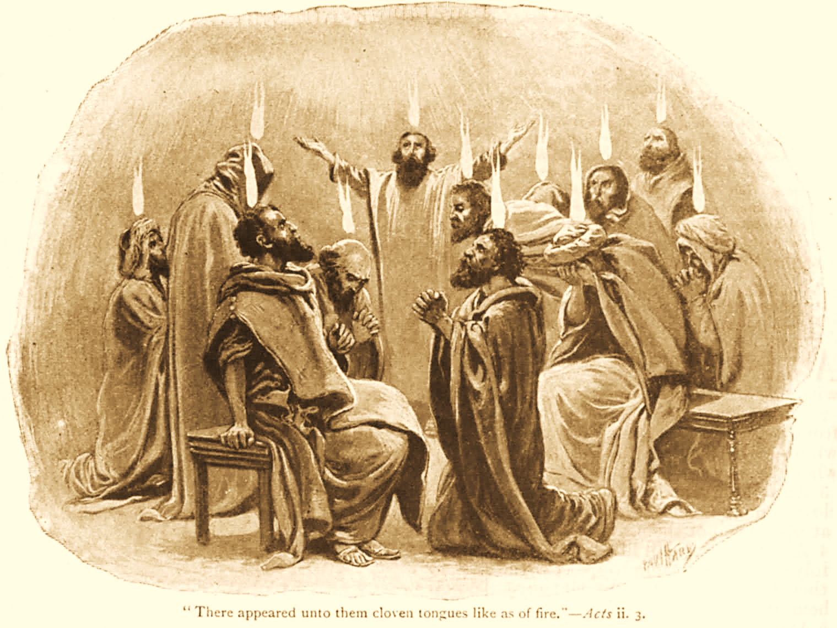
A C T S
Go Tell
the Good
News!
The Growth and
Development of the Early Church

Slide 2
A C T S
Lesson 13
Acts 9:1-22
Conversion of Saul

Slide 3
Severe Persecution Arises
(Acts 8:1-4)
Acts 26:9-11 “…many of the saints I shut up in prison, having received authority from the chief priests; and when they were put to death, I cast my vote against them. And I punished them often in every synagogue and compelled them to blaspheme; and being exceedingly enraged against them, I persecuted them even to foreign cities.”
REVIEW
Saul of Tarsus was leading a great persecution against the church
Saul makes havoc of the church
  Entering EVERY HOUSE
  Dragging off MEN and WOMEN
  Committing them to PRISON

Slide 4
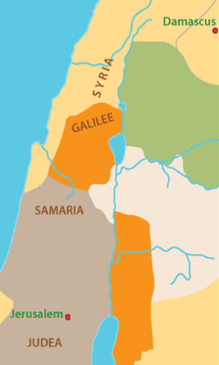
The Conversion of Saul (Acts 9:1-19; 22:1-16)
Saul continues to breathe “threats and murder” against the disciples.
He receives authority from the High Priest to travel to Damascus to arrest any disciples he finds in the synagogues. (cf. Acts 22:5)

Slide 5
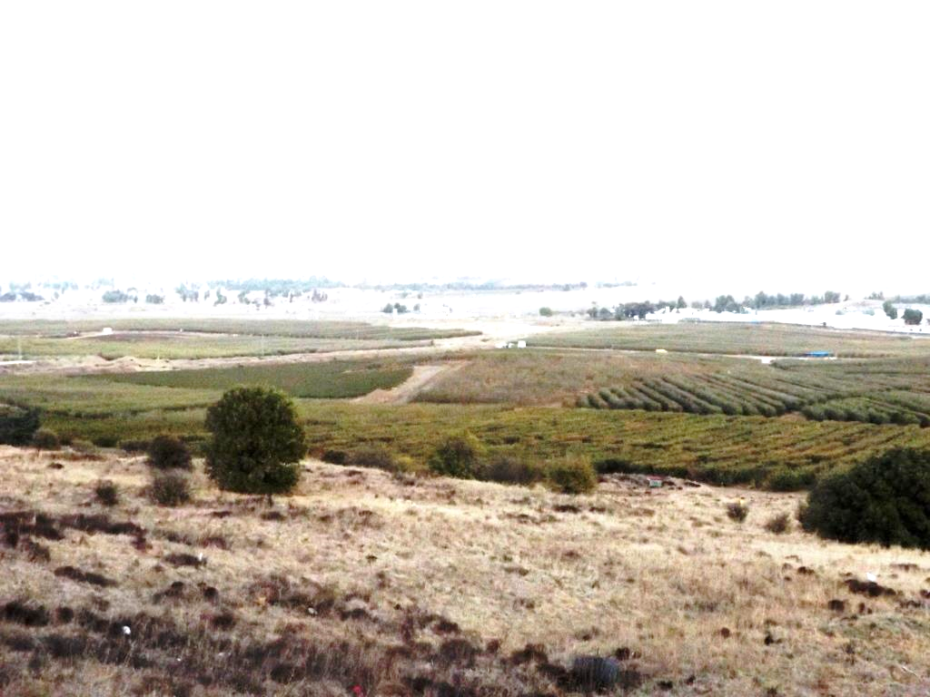
“As he journeyed he came near Damascus, and suddenly a light shone around him from heaven.” (Acts 9:3)
The road to Damascus
Israeli – Syrian border
11/03/16

Slide 6
The Conversion of Saul (Acts 9:1-19; 22:1-16; 26:15-18)
Saul falls to the ground and hears a voice asking “Saul, Saul, why are you persecuting Me?” (9:4)
  Note: Saul’s companions hear the sound of the voice but don’t understand the words (cp. Acts 9:7 with 22:9)
Saul asks the identity of the one who is speaking.
  “I am Jesus whom you are persecuting” (9:5).
  What does Jesus mean by, “It is hard for you to kick against the goads?”
Saul was “trembling and astonished” and asked, “What do you want me to do?” (9:6)
  The Lord tells him to go into Damascus and there he would be told what to do.
  The Lord informs Saul that He is sending him to the Gentiles; He is appearing to Saul to make him a witness (Acts 26:15-18).
Notes:
Acts 26:16-18 So I said, 'Who are You, Lord?' And He said, 'I am Jesus, whom you are persecuting. 16 But rise and stand on your feet; for I have appeared to you for this purpose, to make you a minister and a witness both of the things which you have seen and of the things which I will yet reveal to you. 17 I will deliver you from the Jewish people, as well as from the Gentiles, to whom I now send you, 18 to open their eyes, in order to turn them from darkness to light, and from the power of Satan to God, that they may receive forgiveness of sins and an inheritance among those who are sanctified by faith in Me.'

Slide 7
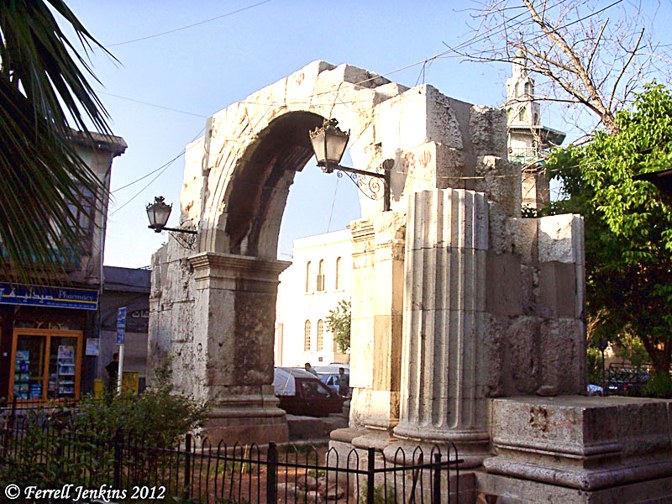
The Conversion of Saul (Acts 9:1-19; 22:1-16)
Saul is blinded, and his fellow travelers must lead him by the hand to Damascus, where he fasts for three days and nights (9:7-9; Ps. 51:17; Joel 2:12; Jonah 3:6-8)
Roman Gate on Straight Street, Damascus
PHOTO by Ferrell Jenkins
Notes:
Fasting and Repentance connected:
Psalms 51:17 The sacrifices of God are a broken spirit, A broken and a contrite heart—These, O God, You will not despise.
Joel 2:12 "Now, therefore," says the LORD, "Turn to Me with all your heart, With fasting, with weeping, and with mourning.“
Jonah 3:6-8 Then word came to the king of Nineveh; and he arose from his throne and laid aside his robe, covered himself with sackcloth and sat in ashes. 7 And he caused it to be proclaimed and published throughout Nineveh by the decree of the king and his nobles, saying, Let neither man nor beast, herd nor flock, taste anything; do not let them eat, or drink water. 8 But let man and beast be covered with sackcloth, and cry mightily to God; yes, let every one turn from his evil way and from the violence that is in his hands.

Slide 8
The Conversion of Saul (Acts 9:1-19; 22:1-16)
The Lord appears to Ananias in a vision and tells him to go to Saul (9:9-16)
  Ananias is reluctant, but when the Lord reveals his intentions for Saul, he goes.
Ananias lays hands on Saul who then receives his sight and is baptized (9:17-18).
  Saul is immediately baptized to wash away his sins (cf. 22:16). NOTE: He had not yet been saved.
  Saul was also to be “filled with the Holy Spirit.”
    Ananias announces this but does not directly impart it.
    Saul received ability to perform signs and wonders directly from the Lord (Romans 15:15-19; 2 Corinthians 12:12; 11:5).
Notes:
Romans 15:15-19 Nevertheless, brethren, I have written more boldly to you on some points, as reminding you, because of the grace given to me by God, 16 that I might be a minister of Jesus Christ to the Gentiles, ministering the gospel of God, that the offering of the Gentiles might be acceptable, sanctified by the Holy Spirit. 17 Therefore I have reason to glory in Christ Jesus in the things which pertain to God. 18 For I will not dare to speak of any of those things which Christ has not accomplished through me, in word and deed, to make the Gentiles obedient— 19 in mighty signs and wonders, by the power of the Spirit of God, so that from Jerusalem and round about to Illyricum I have fully preached the gospel of Christ.
2 Corinthians 12:12 Truly the signs of an apostle were accomplished among you with all perseverance, in signs and wonders and mighty deeds.
2 Corinthians 11:5 For I consider that I am not at all inferior to the most eminent apostles.

Slide 9
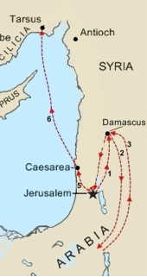
Saul’s early life as a Disciple (Acts 9:19-22; Gal.1:13-17)
Immediately Saul begins to preach in the synagogues of Damascus (9:19-22)
  He “confounds the Jews,” proving Jesus is the Christ.
  At some point, Paul travels to Arabia and returns to preach in Damascus (Gal. 1:15-17).
The Jews plot to kill Paul, but when the plot is uncovered, disciples help him escape (9:23-25).
Notes:
After his conversion, Saul is with the saints in Damascus 9:19b-22
The very ones he came to arrest…he now worships with !!
He immediately begins proclaiming Jesus in the synagogues v. 20
His complete change causes all to be amazed vv. 21-22
He came to Damascus to stop believers in Jesus…now, he confounds the Jews with truth, proving Jesus was indeed the promised Messiah
Galatians 1:13-17 For you have heard of my former conduct in Judaism, how I persecuted the church of God beyond measure and tried to destroy it. 14 And I advanced in Judaism beyond many of my contemporaries in my own nation, being more exceedingly zealous for the traditions of my fathers. 15 But when it pleased God, who separated me from my mother's womb and called me through His grace, 16 to reveal His Son in me, that I might preach Him among the Gentiles, I did not immediately confer with flesh and blood, 17 nor did I go up to Jerusalem to those who were apostles before me; but I went to Arabia, and returned again to Damascus.

Slide 10
Timeline of Paul’s Early Preaching (Galatians 1:15-18, Acts 9)
In Galatians, Paul explains that he did not immediately return to Jerusalem after obeying the gospel
  He went into Arabia, then returned to Damascus.
  His return to Jerusalem (9:23) would not occur for another three years.
  The “many days” of Acts 9:23 is most likely these 3 years in Galatians 1:18.
Notes:
Galatians 1:13-17 For you have heard of my former conduct in Judaism, how I persecuted the church of God beyond measure and tried to destroy it. 14 And I advanced in Judaism beyond many of my contemporaries in my own nation, being more exceedingly zealous for the traditions of my fathers. 15 But when it pleased God, who separated me from my mother's womb and called me through His grace, 16 to reveal His Son in me, that I might preach Him among the Gentiles, I did not immediately confer with flesh and blood, 17 nor did I go up to Jerusalem to those who were apostles before me; but I went to Arabia, and returned again to Damascus.

Slide 11
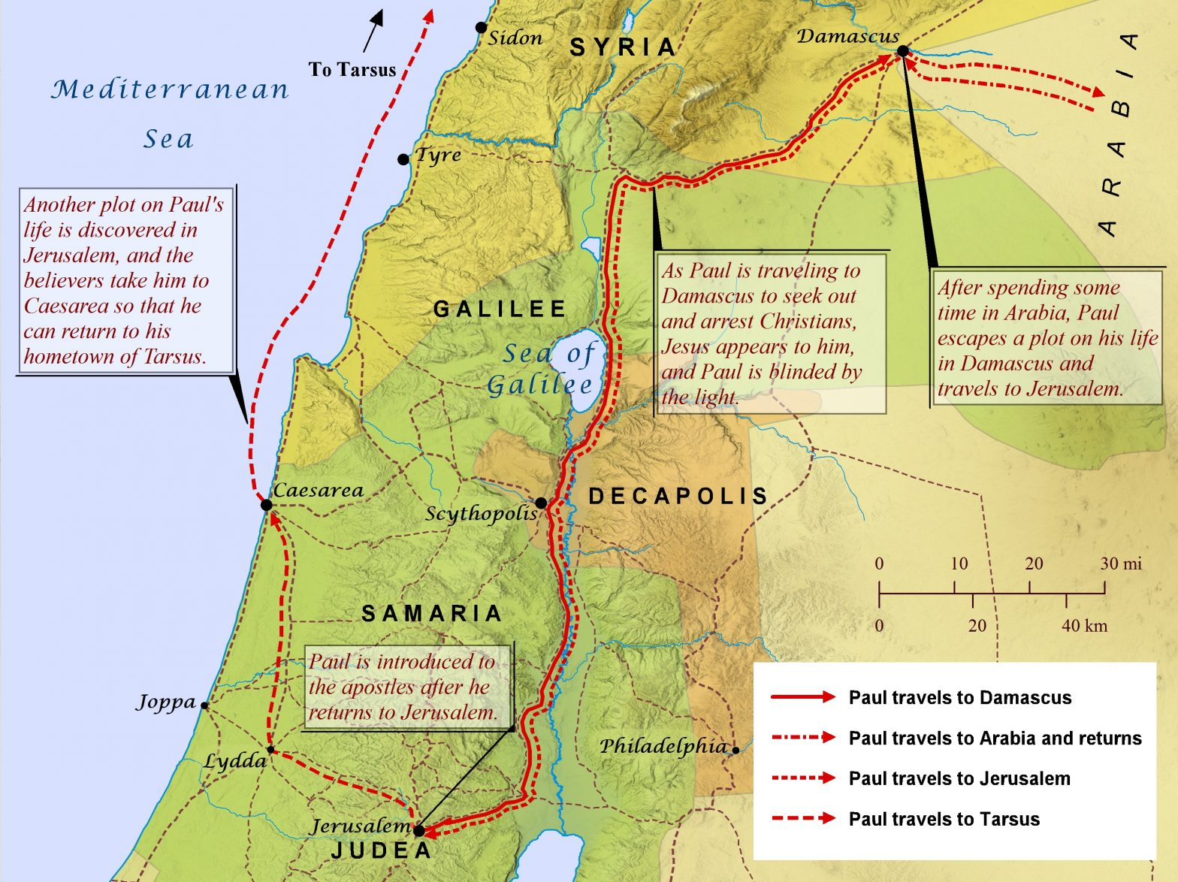

Slide 12
Lessons for Us
Jesus takes anything done to His disciples personally (Acts 9:5; cf. Matt 25:34-35).
Saul did not have a “salvation experience” on the road to Damascus.
  On the road, he was instructed to go into Damascus where, “…you will be told what you must do” (Acts 9:6; 22:10)!
Notes:
.
A common phrase among modern evangelicals is “Preach the Man…not the plan.”
Philip illustrates the emptiness of such thinking.
In “Preaching Jesus,” Philip did not separate Jesus from the necessity of water baptism for salvation.
Jesus is the SAVIOR and this is HOW He saves!
To “preach the Man” is to “preach ALL the plan”
Acts 20:27 For I have not shunned to declare to you the whole counsel of God

