Slide 1

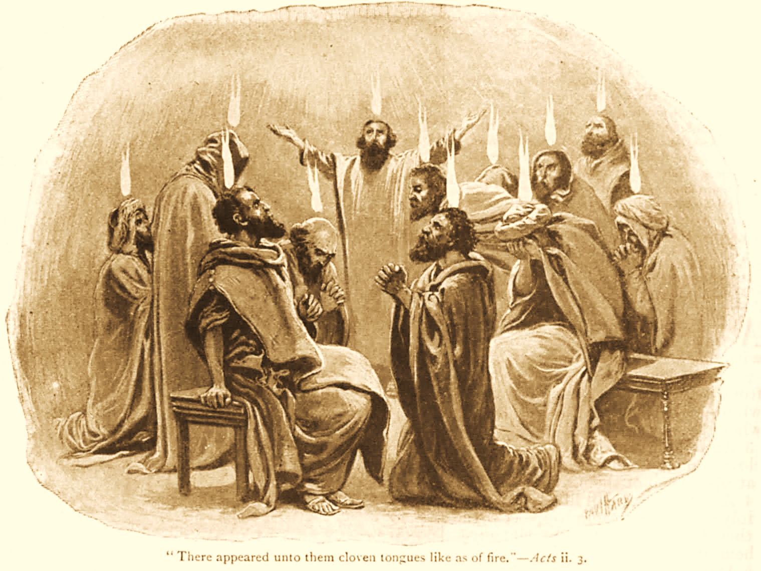
A C T S
Go Tell
the Good
News!
The Growth and
Development of the Early Church

Slide 2
A C T S
Lesson 14
Acts 9:23-42
Paul’s early work as an Apostle
Peter’s miracles among disciples

Slide 3
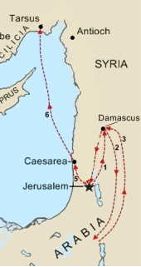
Saul’s early life as a Disciple (Acts 9:19-25; Gal.1:13-18)
Immediately Saul begins to preach in the synagogues of Damascus (9:19-22)
  He “confounds the Jews,” proving Jesus is the Christ.
  At some point, Paul travels to Arabia and returns to preach in Damascus (Gal. 1:15-17).
“After many days, the Jews plot to kill Paul, but the plot is uncovered, and disciples help him escape (9:23-25).
Notes:
After his conversion, Saul is with the saints in Damascus 9:19b-22
The very ones he came to arrest…he now worships with !!
He immediately begins proclaiming Jesus in the synagogues v. 20
His complete change causes all to be amazed vv. 21-22
He came to Damascus to stop believers in Jesus…now, he confounds the Jews with truth, proving Jesus was indeed the promised Messiah
Galatians 1:13-17 For you have heard of my former conduct in Judaism, how I persecuted the church of God beyond measure and tried to destroy it. 14 And I advanced in Judaism beyond many of my contemporaries in my own nation, being more exceedingly zealous for the traditions of my fathers. 15 But when it pleased God, who separated me from my mother's womb and called me through His grace, 16 to reveal His Son in me, that I might preach Him among the Gentiles, I did not immediately confer with flesh and blood, 17 nor did I go up to Jerusalem to those who were apostles before me; but I went to Arabia, and returned again to Damascus.

Slide 4
Timeline of Paul’s Early Preaching (Acts 9:19-25; Gal.1:13-18)
In Galatians, Paul explains that he did not immediately return to Jerusalem after obeying the gospel.
  He went into Arabia, then returned to Damascus.
  His return to Jerusalem (9:23) would not occur for another three years.
    The “many days” of Acts 9:23 likely includes these 3 years in Galatians 1:18.
Notes:
Galatians 1:13-17 For you have heard of my former conduct in Judaism, how I persecuted the church of God beyond measure and tried to destroy it. 14 And I advanced in Judaism beyond many of my contemporaries in my own nation, being more exceedingly zealous for the traditions of my fathers. 15 But when it pleased God, who separated me from my mother's womb and called me through His grace, 16 to reveal His Son in me, that I might preach Him among the Gentiles, I did not immediately confer with flesh and blood, 17 nor did I go up to Jerusalem to those who were apostles before me; but I went to Arabia, and returned again to Damascus.
Galatians 1:18 Then after three years I went up to Jerusalem to see Peter, and remained with him fifteen days.

Slide 5
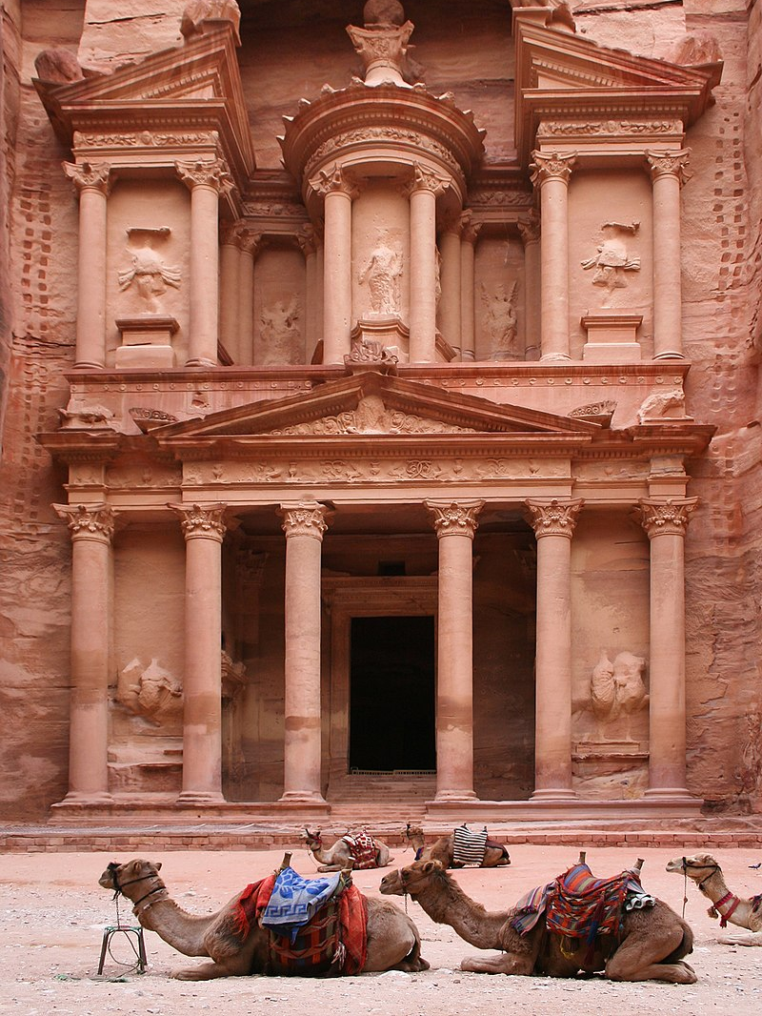
Paul of Arabia
Paul spent three years in Arabia after his conversion and then returned to Damascus (Galatians 1:15-18).
The governor of Damascus, under King Aretas, sought to arrest Paul (2 Cor. 11:32-33).
Notes:
2 Corinthians 11:32-33 In Damascus the governor, under Aretas the king, was guarding the city of the Damascenes with a garrison, desiring to arrest me; 33 but I was let down in a basket through a window in the wall, and escaped from his hands.
NOTE: Paul was to preach to kings and suffer as a result (Acts 9:15-16).

Slide 6
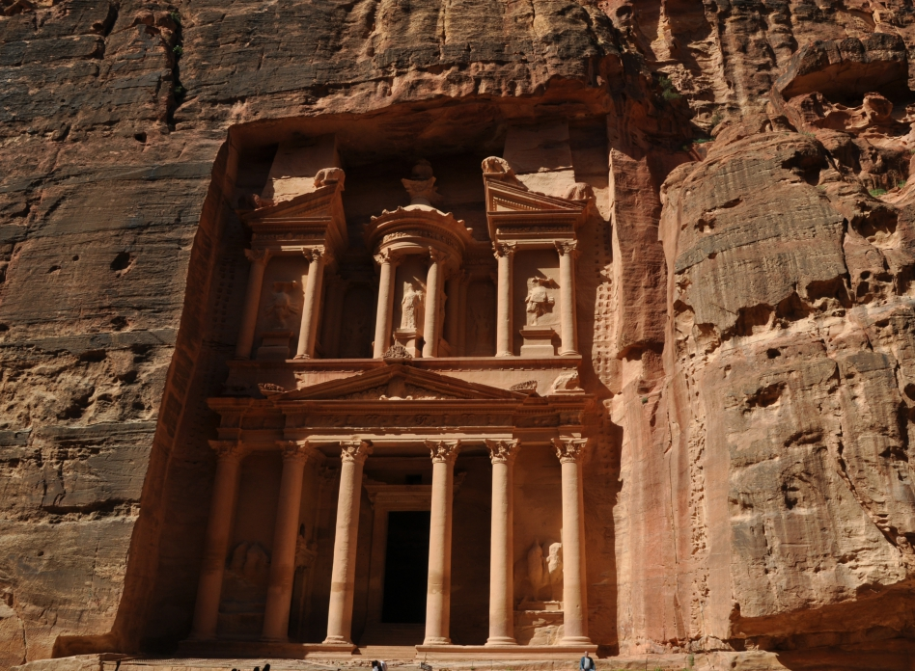
Petra

Slide 7
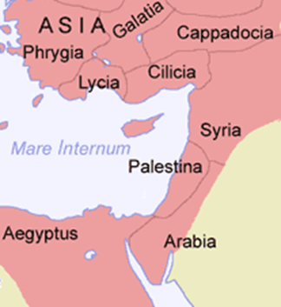
The Roman Province of Arabia

Slide 8
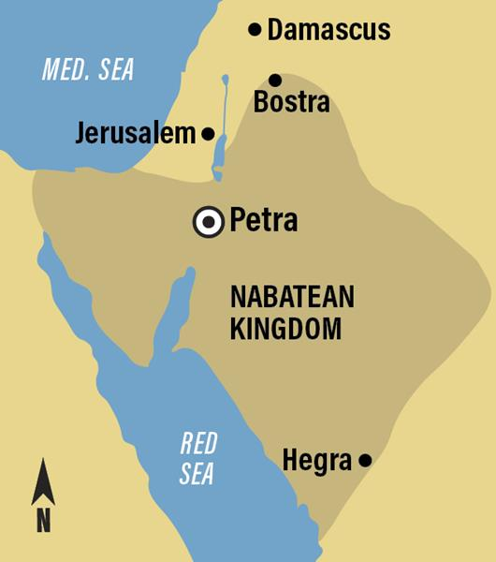
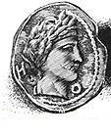
Aretas IV Philopatris was the King of the Nabataeans from roughly 9 BC to AD 40.
Notes:
Aretas IV Philopatris was the King of the Nabataeans from roughly 9 BC to AD 40.
The capital of his kingdom was a prosperous trading city, Petra, some 170 miles south of Amman. Petra is famous for the many monuments carved into the rose-red sandstone. Some of this region had belonged to Edom in the Old Testament, but the power of the Nabateans expanded and eventually extended over the caravan routes south and east of Judea, from the seventh century BC to the second century AD.
Aretas' daughter, Phasaelis of Nabataea, married Herod Antipas, otherwise known as Herod the Tetrarch. Phasaelis fled to her father when she discovered her husband intended to divorce her in order to take a new wife, Herodias, mother of Salome. Herodias was already married to his brother, Philip. Antipas married Herodias. It was opposition to this marriage that led to the beheading of John the Baptist (Matthew 14:3-12). History also records that the armies of Aretas attacked Herod and would probably have destroyed him had not the Romans intervened.
Did Paul preach in Petra? Did he run afoul of Aretas?
Acts 9:15-16 But the Lord said to him, "Go, for he is a chosen vessel of Mine to bear My name before Gentiles, kings, and the children of Israel. 16 For I will show him how many things he must suffer for My name's sake."

Slide 9
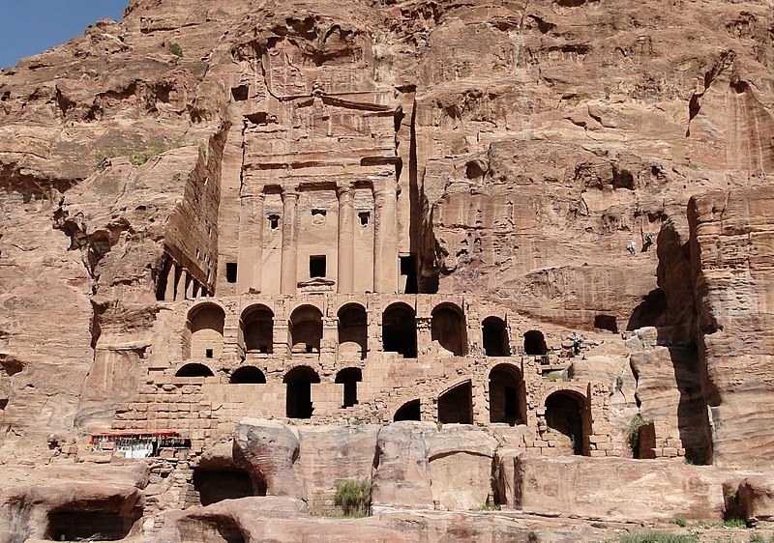
Petra

Slide 10
Saul’s early life as a Disciple (Acts 9:26-31; Galatians 1:13-18)
Saul returns to Jerusalem at least three years after leaving for Damascus, but he is not initially received by the disciples (9:26-31, Gal. 1:18).
  Barnabas helps Paul gain acceptance.
  Paul preaches boldly, but after just 15 days, an attempt is made to kill him, so he is sent to Tarsus.
There was peace among the churches, and they multiplied, walking in the fear of the Lord.

Slide 11
Peter preaches in Lydda & Sharon
(Acts 9:32-35)
Peter “went here and there among them all” (ESV).
He finds Aeneas, paralyzed for eight years, and heals him (9:33-34).
This led to many turning to the Lord (9:35).

Slide 12
Peter raises Dorcas from the dead (Acts 9:36-43)
At Joppa there was a disciple named Tabitha (Dorcas), a woman full of good works and charitable deeds.
She became sick and died.
Her friends send for Peter, who is in Lydda, imploring him not to delay.

Slide 13
Peter raises Dorcas from the dead (Acts 9:36-43)
Peter comes and witnesses the results of Tabitha’s deeds.
Peter puts her friends out of the house, prays, and tells her to arise.
She is presented alive.
It became known and many believed.

Slide 14
Lessons for Us
Paul was to preach to kings and suffer as a result (Acts 9:15-16).
  We will also suffer persecution if we live for Jesus (2 Timothy 3:12).*
Saul’s attempt to join the Jerusalem church illustrates the pattern for local church membership.
  Note the difference between membership in the universal church (the body of Christ) and a local congregation (Acts 2:41, 47; 9:26; 18:27; 2 Corinthians 3:1)
Notes:
Universal Church
*Dedicating your life to the Lord may turn you into a basket case (like Paul), but it is a basket of joy (Matthew 5:11-12).
As the Head, only Jesus can affect this church’s membership
He adds members upon their obedience Acts 2:41b, 47b
A decision made based on a specific location (live, work)
The individual initiates, and the church accepts/rejects Acts 9:26 Acts 18:27 And when he (Apollos) desired to cross to Achaia, the brethren wrote, exhorting the disciples to receive him; and when he arrived, he greatly helped those who had believed through grace;
2 Corinthians 3:1 Do we begin again to commend ourselves? Or do we need, as some others, epistles of commendation to you or letters of commendation from you?

