Slide 1

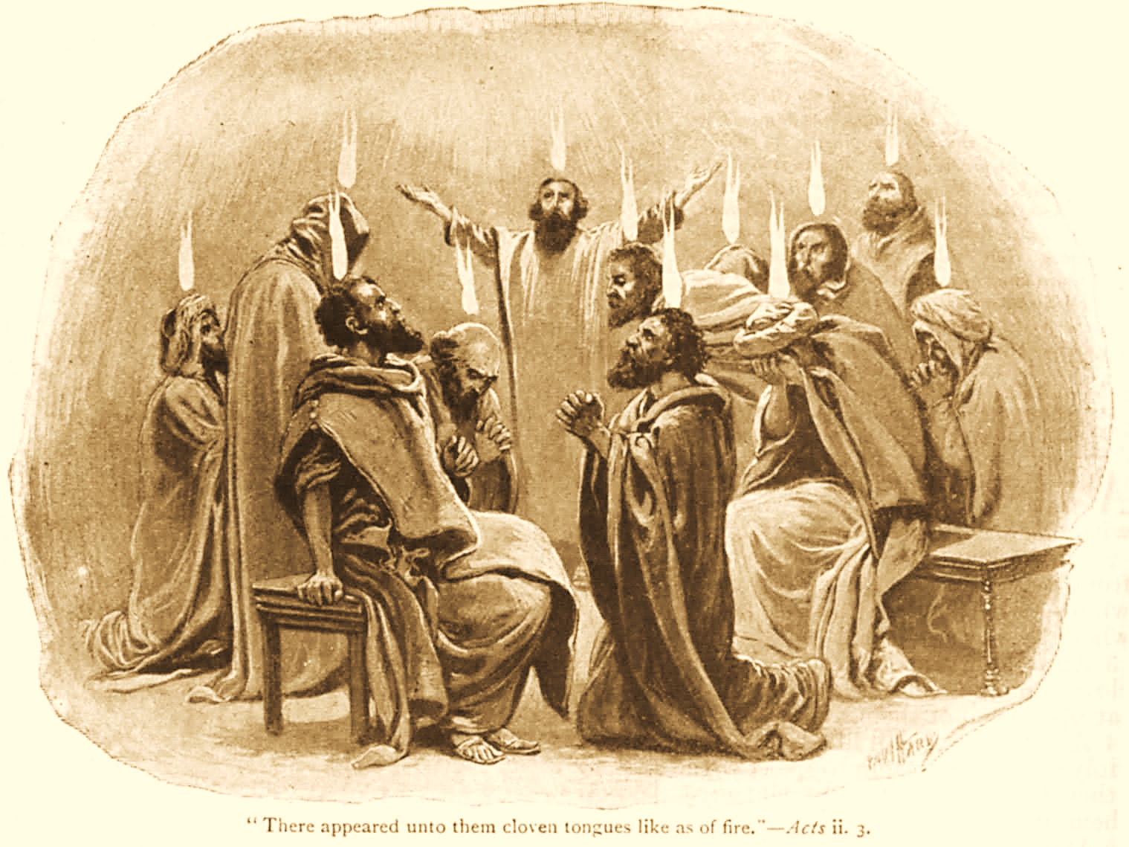
A C T S
Go Tell
the Good
News!
The Growth and
Development of the Early Church

Slide 2
A C T S
Lesson 15
Acts 10:1-23
Peter is sent to preach the gospel to the Gentiles

Slide 3
The Conversion Of Cornelius An Overview
The conversion of Cornelius is a key Biblical milestone; this event opens the door to our salvation!
God promised salvation for all through the Seed of Abraham (Gen. 12:3; Gal. 3:8, 16)
The prophets had announced salvation would come to the Gentiles (Amos 9:11-12; Acts 15:13-17; Isaiah 49:6; 60:3).
Jesus’ own death had bridged the gap between Jews and Gentiles (John 10:16; Ephesians 2:11-16).
Notes:
Amos 9:11-12 "On that day I will raise up The tabernacle of David, which has fallen down, And repair its damages; I will raise up its ruins, And rebuild it as in the days of old; 12 That they may possess the remnant of Edom, And all the Gentiles who are called by My name," Says the LORD who does this thing.
Acts 15:13-17 And after they had become silent, James answered, saying, "Men and brethren, listen to me: 14 Simon has declared how God at the first visited the Gentiles to take out of them a people for His name. 15 And with this the words of the prophets agree, just as it is written: 16 'After This I Will Return And Will Rebuild The Tabernacle Of David, Which Has Fallen Down; I Will Rebuild Its Ruins, And I Will Set It Up; 17 So That The Rest Of Mankind May Seek The Lord, Even All The Gentiles Who Are Called By My Name, Says The Lord Who Does All These Things.'
Isaiah 49:6 Indeed He says, 'It is too small a thing that You should be My Servant To raise up the tribes of Jacob, And to restore the preserved ones of Israel; I will also give You as a light to the Gentiles, That You should be My salvation to the ends of the earth.“
Isaiah 60:3 The Gentiles shall come to your light, And kings to the brightness of your rising.
John 10:16 And other sheep I have which are not of this fold; them also I must bring, and they will hear My voice; and there will be one flock and one shepherd.

Slide 4
Peter is sent to the Gentiles (Acts 10:1-23)
A certain man named Cornelius dwelt in Caesarea…
A Centurion of the Italian Regiment.
A devout man
One who feared God with his household
Gave alms generously
Prayed to God always
Notes:
A centurion -- a military commander of 100 men
Devout -- pious; dutiful towards God; godly
Feared God -- to revere; reverential obedience
Gave many alms -- charitable; generous
Prayed to God continually -- to make supplication to God
If nothing else was known about Cornelius’ story, what might the average person conclude?

Slide 5
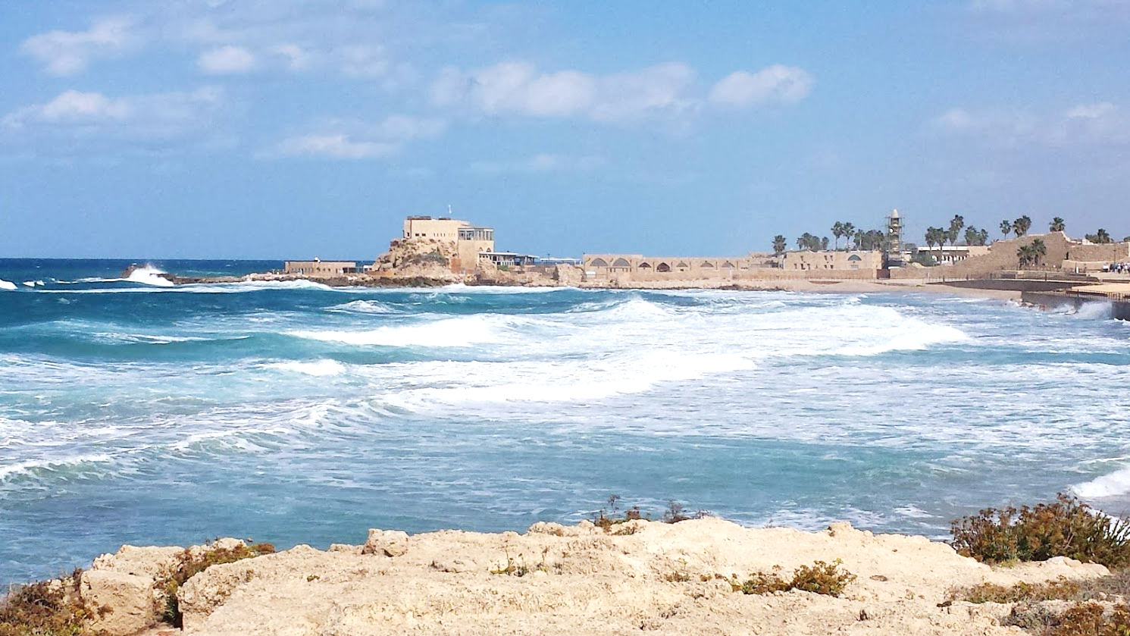
Caesarea

Slide 6
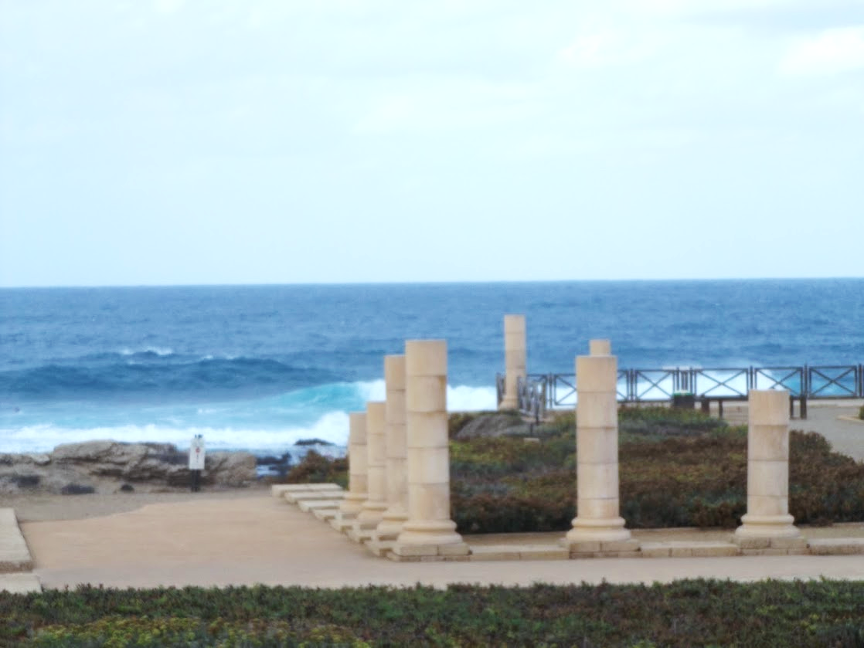
Caesarea

Slide 7
The Vision of Cornelius (Acts 10:1-8)
An angel visits Cornelius
Cornelius is fasting and praying (cf. vs. 30) about the 9th hour (~3:00 PM).
He observes a man in bright clothing (an angel of God, vs. 3).
His “prayers and alms have come up for a memorial before God.”
Notes:
A memorial is a reminder – it brings something to mind.
What did Cornelius’s prayers bring to God’s mind? The promises and prophecies of the OT concerning the gentiles.

Slide 8
The Vision of Cornelius (Acts 10:1-8)
An angel visits Cornelius.
He tells Cornelius to “send men to Joppa, and send for Simon Peter.
He is lodging with Simon, a tanner* whose house is by the sea.
He will tell you what you must do."
Cornelius calls two of his household servants and a devout soldier, explains to them “all things” and sends them to Joppa.
Notes:
The work of a leather maker was considered unclean and demeaning from a Jewish perspective, with tanners being placed on a social level below dung collectors. Simon's work brought him into regular contact with the dead bodies of animals, meaning that he would be in a constant state of 'ceremonial impurity’
From the Jewish Virtual Library: tanneries had to be located on the outskirts of the towns, far from residential quarters. According to the Mishnah (BB 2:9) a tannery should be situated on the east side of the town only, at least 50 cubits from the outskirts…. the tanner's status in society was low. Of all the sages of the Talmud only *Yose b. Ḥalafta is known to have been a tanner. Like fullers and coppersmiths, tanners are exempted from appearing at the Temple on pilgrimage festivals because their unpleasant odor prevents them from going up with all the men (Ḥag. 7b).
According to Ketubbot 9:10, a tanner (as well as a collector of dung for tanning), whether he plied his trade before marriage or took it up afterward, may be compelled to divorce his wife if she demands it. Rabbi *Meir was of the opinion that even if a wife had agreed before the wedding to put up with her husband's trade, she must be allowed a divorce if she later found that she could not tolerate it. The example is given of a tanner who died, leaving a brother, also a tanner, who should therefore take the dead man's wife in levirate marriage. It was ruled that she might say: "I could endure your brother, but cannot endure you."

Slide 9
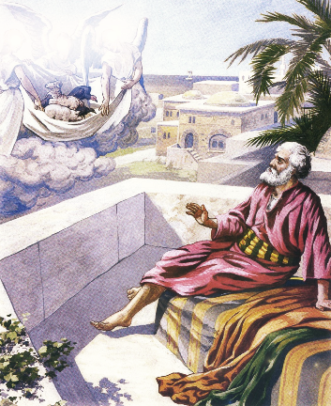
Peter’s Vision (Acts 10:9-16)
Peter went up on the housetop to pray about the 6th hour (~noon)
He became hungry and then fell into a trance.*
He sees heaven opened and a great sheet bound at the corners descends.
It is filled with four-footed animals, wild beasts, creeping things, birds.
Notes:
Trance is from ἔκστασις (ecstasy)
While Cornelius’ messengers traveled to Joppa, Peter fell into a trance after he became hungry, waiting for the noon meal vv. 9-10
In this trance, he had a vision vv. 11-16
A large, sheet-like object descended from heaven…on it were all sorts of 4-footed animals, crawling creatures & birds vv. 11-12
God commanded Peter to kill & eat…Peter refused on the basis he had never eaten anything unholy or unclean vv. 13-14
One must conclude these animals were on the “forbidden list” under the Law of Moses (unlawful to eat) Lev 11 Deut 14

Slide 10
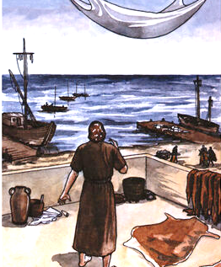
Peter’s Vision (Acts 10:9-16)
A voice instructs Peter to kill and eat.
Peter replies, “Not so, Lord! For I have never eaten anything common or unclean.”*
The Lord responds, “What God has cleansed you must not call common.”
This is repeated 3x, and then the object is taken up into heaven.
Notes:
Food permitted and forbidden under the old law: Leviticus 11:2-27, Deuteronomy 14:3-20
Peter’s misunderstanding was two-fold: v. 15
O.T. dietary restrictions were no longer valid because the Law was no longer binding…what was “unclean” was now “clean”
We also know God intended Peter to make a much bigger and more important application than just lawful vs. unlawful foods -- Gentiles were no longer outsiders to the Covenant (cf. Acts 10:28, “But God has shown me that I should not call any man common or unclean…”

Slide 11
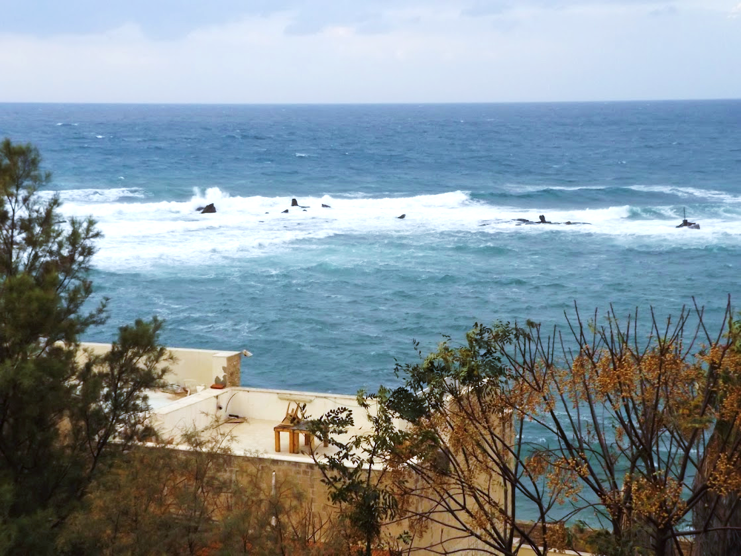
Houses by the Sea at Joppa

Slide 12
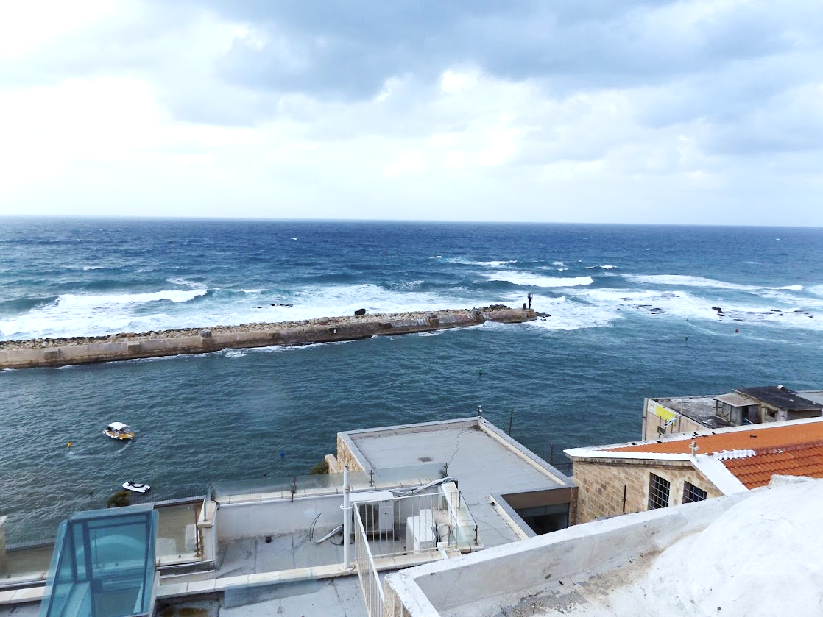
Houses by the Sea at Joppa

Slide 13
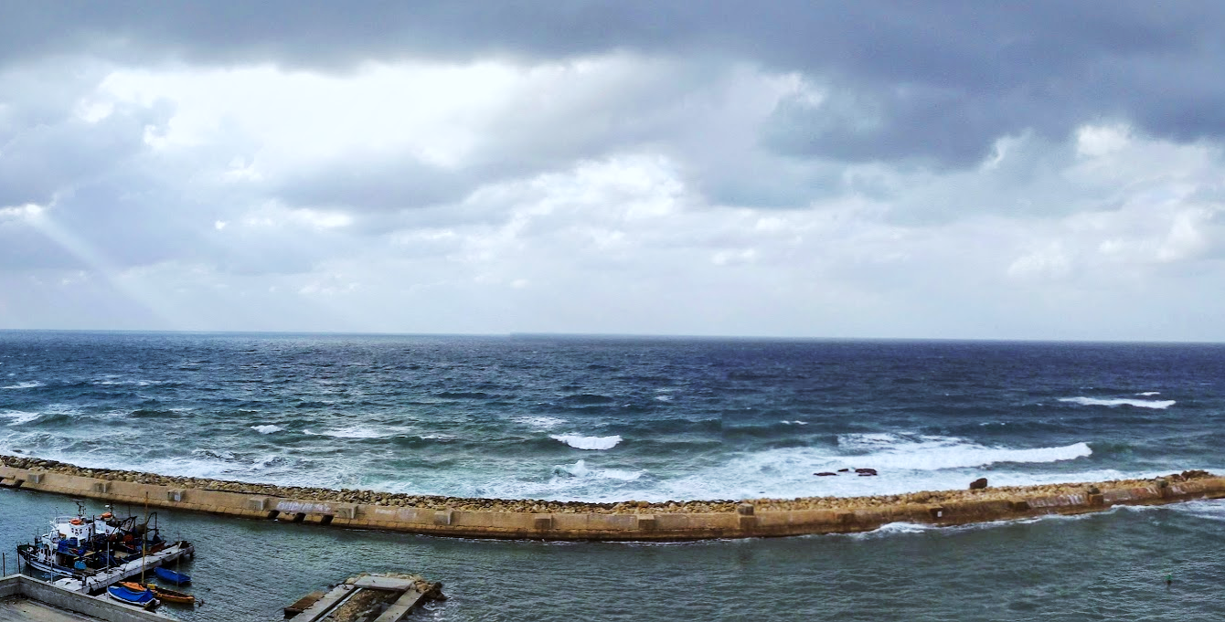
Peter meets the men sent from Cornelius
As Peter wonders about the meaning of the vision, those sent by Cornelius arrive.
The Spirit tells Peter to go down and go with them, “doubting nothing; for I have sent them.”
Peter asks why they have come, invites them in, and lodges them.
On the next day, Peter and others from Joppa go to Caesarea.

Slide 14
Lessons for Us
Just being “good” is not good enough for one’s eternal destiny.
If “good people” are seeking God, they will have the attitude of Cornelius.
The Law of Moses is no longer in force (cf. Colossians 2:14-17).
Notes:
Could anyone doubt Cornelius’ goodness?
There is a difference between being good (as man sees it) and being saved (according to God’s plan of redemption)
There is no difference between a good lost person & a bad lost person
It is pointless to discuss Cornelius’ “goodness”…the focus is on whether or not he had complied with the apostolic teaching re: salvation
The main point in Peter’s vision was the Gentiles, not unclean foods, but the vision indicates God had removed the dietary restrictions He had imposed through Moses (Lev 11; Deut 14)
The Law is no longer binding…an important part of N.T. teaching (Gal 3:19a, 23-25 Col 2:14, 16 Heb 8:1-3
A distinction many religious people do not understand nor practice
Colossians 2:14 having wiped out the handwriting of requirements that was against us, which was contrary to us. And He has taken it out of the way, having nailed it to the cross.
Colossians 2:16-17 So let no one judge you in food or in drink, or regarding a festival or a new moon or sabbaths, 17 which are a shadow of things to come, but the substance is of Christ.

