Slide 1

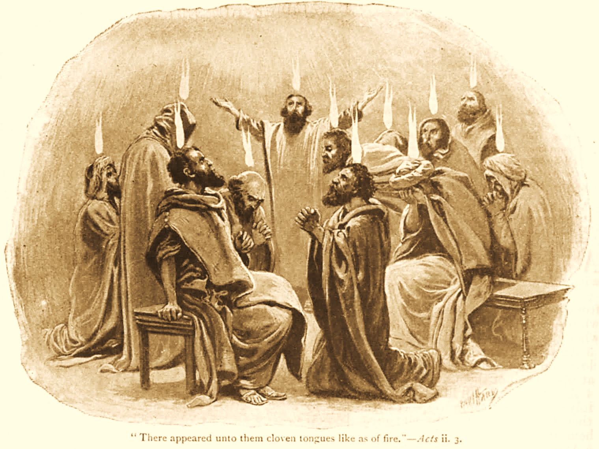
A C T S
Go Tell
the Good
News!
The Growth and
Development of the Early Church

Slide 2
A C T S
Lesson 16
Acts 10:24-48
The Conversion of Cornelius

Slide 3
The Conversion Of Cornelius An Overview
The conversion of Cornelius is a key Biblical milestone; this event opens the door to our salvation!
God promised salvation for all through the Seed of Abraham (Gen. 12:3; Gal. 3:8, 16)
The prophets had announced salvation would come to the Gentiles (Amos 9:11-12; Acts 15:13-17; Isaiah 49:6; 60:3).
Jesus’ own death had bridged the gap between Jews and Gentiles (John 10:16; Ephesians 2:11-16).
Notes:
Amos 9:11-12 "On that day I will raise up The tabernacle of David, which has fallen down, And repair its damages; I will raise up its ruins, And rebuild it as in the days of old; 12 That they may possess the remnant of Edom, And all the Gentiles who are called by My name," Says the LORD who does this thing.
Acts 15:13-17 And after they had become silent, James answered, saying, "Men and brethren, listen to me: 14 Simon has declared how God at the first visited the Gentiles to take out of them a people for His name. 15 And with this the words of the prophets agree, just as it is written: 16 'After This I Will Return And Will Rebuild The Tabernacle Of David, Which Has Fallen Down; I Will Rebuild Its Ruins, And I Will Set It Up; 17 So That The Rest Of Mankind May Seek The Lord, Even All The Gentiles Who Are Called By My Name, Says The Lord Who Does All These Things.'
Isaiah 49:6 Indeed He says, 'It is too small a thing that You should be My Servant To raise up the tribes of Jacob, And to restore the preserved ones of Israel; I will also give You as a light to the Gentiles, That You should be My salvation to the ends of the earth.“
Isaiah 60:3 The Gentiles shall come to your light, And kings to the brightness of your rising.
John 10:16 And other sheep I have which are not of this fold; them also I must bring, and they will hear My voice; and there will be one flock and one shepherd.

Slide 4
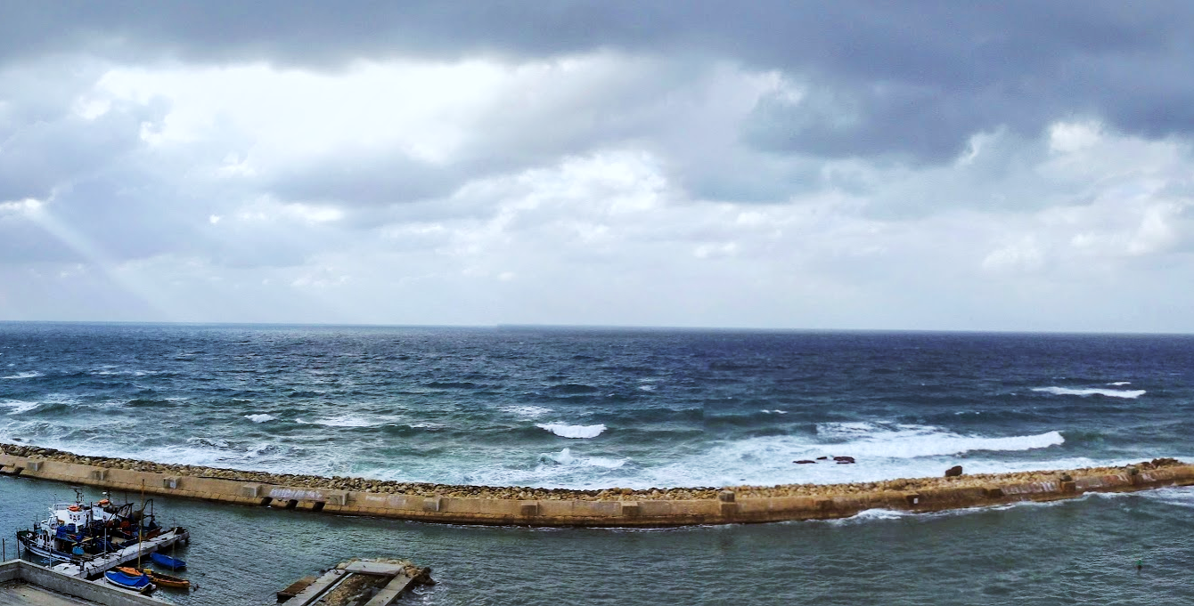
Peter meets the men sent from Cornelius
As Peter wonders about the meaning of the vision he has just seen, the men sent by Cornelius arrive.
The Spirit tells Peter to go down and go with them, “doubting nothing; for I have sent them.”
Peter asks why they have come, invites them in, and lodges them.
On the next day, Peter and others from Joppa go to Caesarea.

Slide 5
Peter Arrives in Caesarea (Acts 10:24-27)
Cornelius had called together his close friends and relatives in anticipation of Peter’s visit.
As Peter enters, Cornelius meets him and falls down at his feet to worship him.
Peter lifts him up and tells him that he is a man also.
Notes:
From Joppa to Caesarea is about 35 miles along the Via Maris.

Slide 6
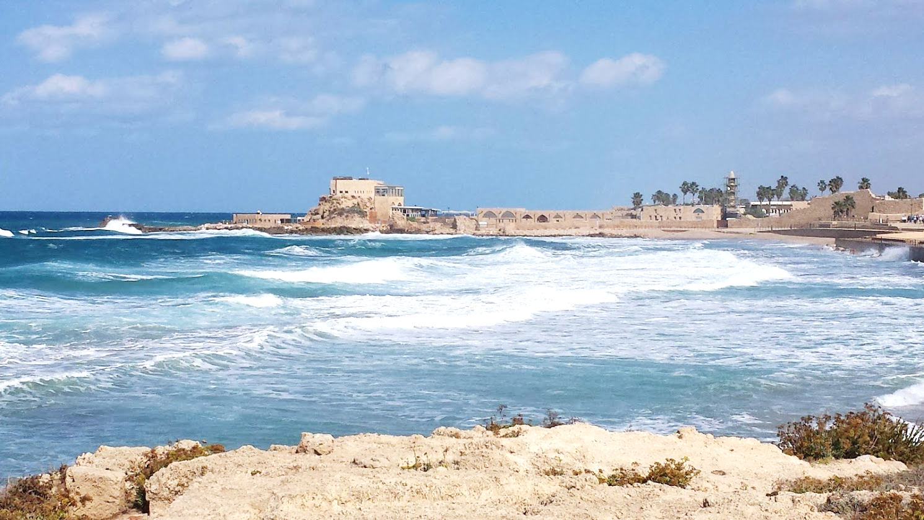
Peter Arrives in Caesarea
Peter explains to the gathering that he had come even though it was unlawful for a Jewish man to keep company or go to one of another nation. “But God has shown me that I should not call any man common or unclean.”
Therefore, he came without objection; but why had Cornelius sent for him?

Slide 7
Peter preaches to the Household of Cornelius (Acts 10:17-48)
Cornelius explains his vision and observes that Peter has done well to come (vs. 30-33).
“Now therefore, we are all present before God, to hear all the things commanded you by God.”
Peter begins to understand the purpose of the visions, and now he announces the plain conclusions:
“In truth I perceive that God shows no partiality. But in every nation whoever fears Him and works righteousness is accepted by Him” (vs. 34-35; Acts 10:28; 2:39; Matthew 28:19; Ephesians 2:13).
Notes:
He began with announcing his fresh understanding of the breadth of God’s grace: God-fearing, truth-seeking Gentiles would now be acceptable to God, His kingdom vv. 34-35
Proselytes were already members (Acts 2:5,10; 6:5 “Nicolas, a proselyte from Antioch”; 8:27, the Ethiopian)
He “now” understood Gentiles were accepted (“God has shown me that I should not call any man common or unclean. 10:28; cp. v. 15).
In “every nation”…even “afar off”
Peter had said this before, but may not have comprehended it: Acts 2:39 For the promise is to you and to your children, and to all who are afar off, as many as the Lord our God will call.“
Matt 28:19 Go therefore and make disciples of all the nations,
Ephesians 2:13 But now in Christ Jesus you who once were far off have been brought near by the blood of Christ.
In harmony with God’s original plans for blessing all men Gen 12:3

Slide 8
Peter preaches to the Household of Cornelius (Acts 10:17-48)
Peter continues to preach Jesus: His work and ministry, His death, and His resurrection (vs. 36-41).
The word God sent to be preached (“peace through Jesus Christ”) was initially sent only to the children of Israel (v. 36; cp. 13:46).
That word had been preached in Judea and Galilee by John and Jesus.
It would have been known by Cornelius and his guests.
The miracles of Jesus would also have been widely proclaimed (vs. 37-38).
Notes:
Acts 13:46-47 Then Paul and Barnabas grew bold and said, "It was necessary that the word of God should be spoken to you first; but since you reject it, and judge yourselves unworthy of everlasting life, behold, we turn to the Gentiles. 47 For so the Lord has commanded us: 'I HAVE SET YOU AS A LIGHT TO THE GENTILES, THAT YOU SHOULD BE FOR SALVATION TO THE ENDS OF THE EARTH.' "
Chronologically, it has been possibly 5-10 years since the church began (Acts 2)…8-13 years since Jesus’ ministry
Peter states those in Caesarea “knew” what had taken place in Judea & Galilee (vv. 37-38)
– So, Peter uses a Different approach than 2:16-36; 7:2-53; 13:16-41
Remember…Jesus traveled all throughout Judea, Samaria, and Galilee during His 3-year ministry
Time & distance has not been that long to prevent them from remembering what they had heard or known about what Peter mentions

Slide 9
Peter preaches to the Household of Cornelius (Acts 10:17-48)
The apostles were witnesses, chosen of God, and commanded to testify to all of the things Jesus did – including His crucifixion and resurrection (vs. 39-41).
They were commanded to preach to the people and to testify… “it is He who was ordained by God to be Judge of the living and the dead. To Him all the prophets witness that, through His name, whoever believes in Him will receive remission of sins“ (vs. 42-43).
Notes:
Peter returns to previous & familiar preaching themes vv. 39-41
The apostles were witnesses of all this activity v. 39a 2:32b 3:15
Jesus was put to death v. 39b 2:23, 36 3:15 (no direct indictment of murdering the Christ)
God raised Him 3 days later, showing Him openly…the apostles were witnesses of the resurrected Lord as well vv. 40-41 2:32a 3:15
The apostles were commissioned to preach the risen Jesus as the Judge God has appointed over all mankind v. 42 cp. 17:31
The prophets had also borne witness…one who believed Jesus was the promised Christ would have forgiveness of sins v. 43 3:22-24

Slide 10
Peter preaches the gospel to the Household of Cornelius (Acts 10:17-48)
While Peter was still speaking, the Holy Spirit fell upon those who heard the word (vs. 44; cp. 11:15*).
Those of the circumcision who believed were astonished…the gift of the Holy Spirit had been poured out on the Gentiles also!
They heard them speak with tongues and magnify God!
Peter asks, "Can anyone forbid water, that these should not be baptized who have received the Holy Spirit just as we have?" (vs. 47)
Notes:
Acts 11:15 And as I began to speak, the Holy Spirit fell upon them, as upon us at the beginning.
Pausing to understand the significance of what happened…
Receiving the Holy Spirit had nothing to do with the individual salvation of Cornelius & these particular Gentiles cp. 8:16-17
Peter’s only point of reference was what had taken place at Jerusalem on Pentecost 2:1-4 11:15-17a
CONCLUSION God signified there would be NO difference between Jew & Gentile re: the gospel & salvation in Jesus Christ vv. 34-35

Slide 11
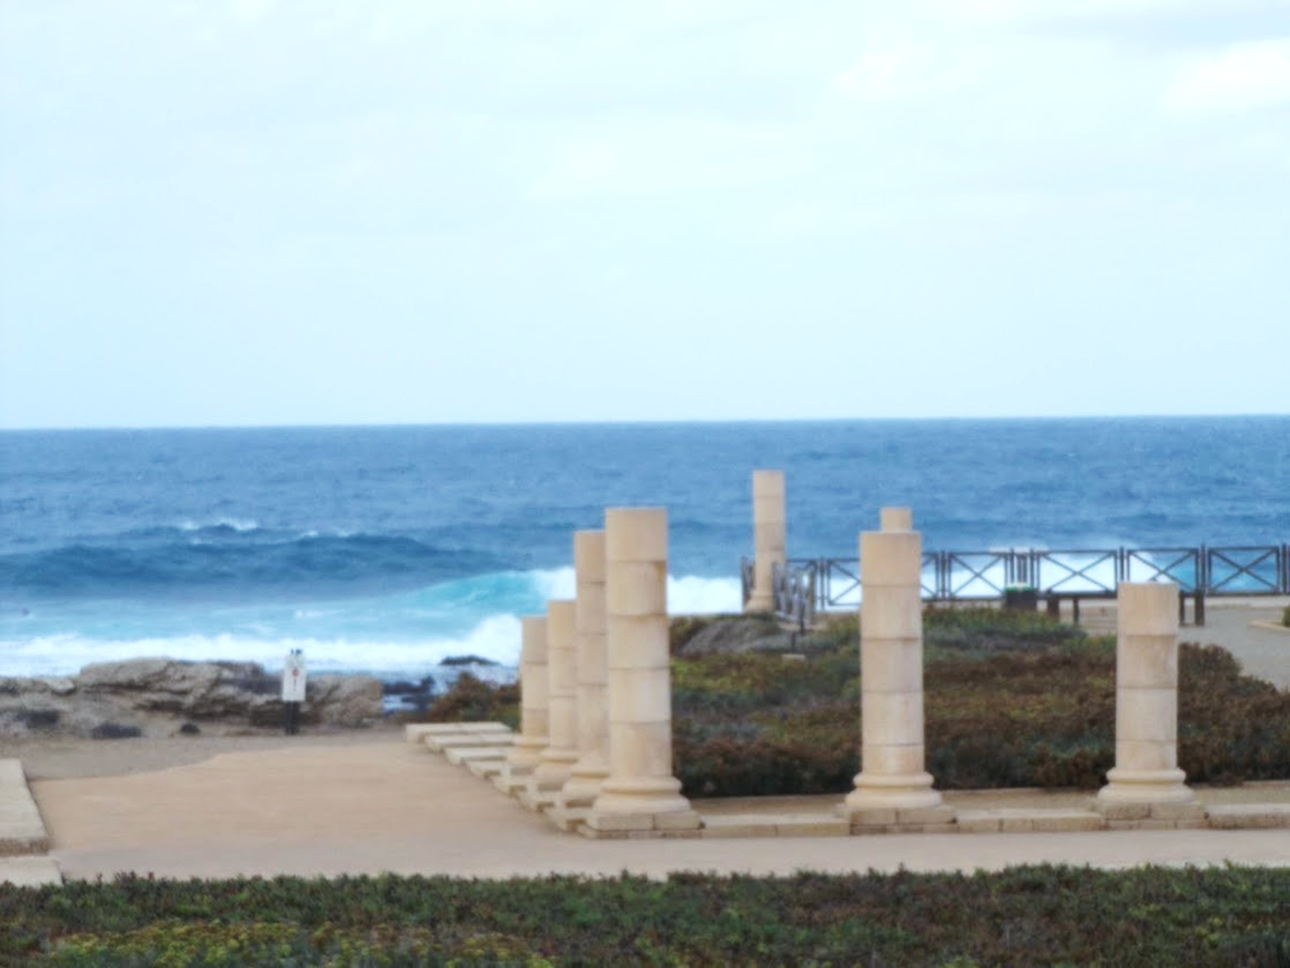
“And he commanded them to be baptized in the name of the Lord” (Acts 10:48).
The good news has come to the Gentiles!

Slide 12
Lessons for Us
The Holy Spirit baptism of Cornelius was unique and extraordinary, and yet deemed necessary by God for His purpose – to certify that Gentiles could be saved just like Jews (Acts 11:2-3; 15-17)
Cornelius had to obey the gospel just like everyone else.
His apparent “goodness” would not be enough to save him.
Notes:
It was “unique” in that it had happened only 1 other time…upon the apostles on the day of Pentecost (2:1-4)
Luke 24:49 Behold, I send the Promise of My Father upon you; but tarry in the city of Jerusalem until you are endued with power from on high.“
Acts 1:4-5 (the only event Peter could compare it to)
It had nothing to do directly with Cornelius’ salvation
It served ONE purpose: it showed God now viewed the Gentiles equal with the Jews…they had the same access to Christ’s kingdom
The only baptism relevant today is baptism into Christ for the remission of sins
There is one baptism. Eph 4:5
Galatians 3:27 For as many of you as were baptized into Christ have put on Christ
Rom 6:3-4, 6
Could anyone doubt Cornelius’ goodness? There is a difference between being good (as man sees it) and being saved (according to God’s plan of redemption). There is no difference between a good lost person & a bad lost person
He heard the Lord’s word Acts 10:33 11:14
He believed what he heard Acts 10:43 Rom 10:17
He repented of sin Acts 11:18 Matt 3:8
He was baptized for the remission of sin Acts 10:47-48 Mk 16:16
The main point in Peter’s vision was the Gentiles, not unclean foods, but the vision indicates God had removed the dietary restrictions He had imposed through Moses (Lev 11; Deut 14)
The Law is no longer binding…an important part of N.T. teaching (Gal 3:19a, 23-25 Col 2:14, 16 Heb 8:1-3
A distinction many religious people do not understand nor practice
Colossians 2:14 having wiped out the handwriting of requirements that was against us, which was contrary to us. And He has taken it out of the way, having nailed it to the cross.
Colossians 2:16-17 So let no one judge you in food or in drink, or regarding a festival or a new moon or sabbaths, 17 which are a shadow of things to come, but the substance is of Christ.

