Slide 1

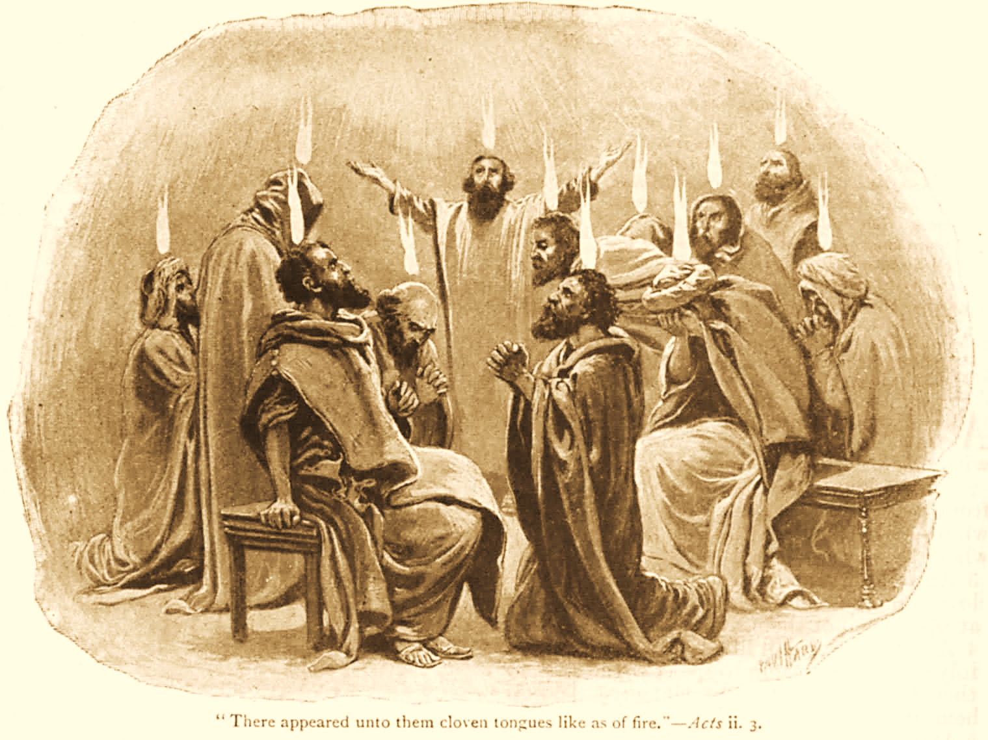
A C T S
Go Tell
the Good
News!
The Growth and
Development of the Early Church

Slide 2
A C T S
Lesson 17
Acts 11:1-30
Peter defends God’s grace to the Gentiles.
Paul & Barnabas in Antioch

Slide 3
Peter’s defense of God’s grace
(Acts 11:1-18)
News of the Gentiles’ conversion spreads to Jerusalem (11:1).
Peter is confronted by Jewish Christians: “You went in to uncircumcised men and ate with them!” (11:2-3)
Peter explains what happened (11:4-15).
  His vision on the roof top.
  The arrival of the men from Caesarea, and the Spirit’s instruction to go with them.
  Meeting Cornelius; the angel had told him that Peter would speak saving words to him.
  Holy Spirit fell on them “as I began to speak…”

Slide 4
Peter’s defense of God’s grace
(Acts 11:1-18)
  “The Holy Spirit fell upon them, as upon us at the beginning.”
  “Then I remembered the word of the Lord…”
“If therefore God gave them the same gift as he gave us…who was I that I could withstand God?”
They became silent, then answered, “Then God has also granted to the Gentiles repentance to life.”

Slide 5
“The Holy Spirit fell upon them…”
(Acts 10:44; 11:15)
Two specific instances when the Holy Spirit came upon men directly (Acts 2:1-4; 10:44-46).
    Holy Spirit baptism is never credited with saving the person who received it.
    Those who received the Holy Spirit were doing nothing to try to get the Holy Spirit at the time.
  A special reason was given why the Holy Spirit fell on these two occasions:
    On the Apostles (Acts 1:8; 26:16): to enable them to be qualified witnesses.
    On Cornelius (Acts 11:18): to convince the Jews that God had granted repentance to the Gentiles.
Notes:
Acts 1:8 But you shall receive power when the Holy Spirit has come upon you; and you shall be witnesses to Me in Jerusalem, and in all Judea and Samaria, and to the end of the earth.“
Acts 26:16 But rise and stand on your feet; for I have appeared to you for this purpose, to make you a minister and a witness both of the things which you have seen and of the things which I will yet reveal to you.

Slide 6
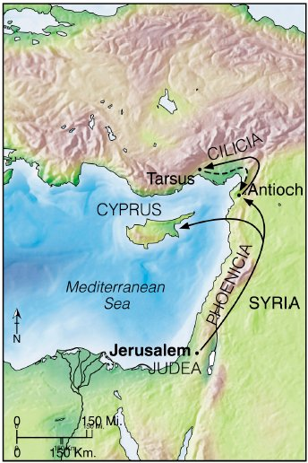

Acts 11:19
“Now those who were scattered that arose after the persecution that arose over Stephen traveled as far as Phoenicia, Cyprus, and Antioch… preaching the word to no one but the Jews only.”
“Those who were scattered went everywhere preaching the word” (Acts 8:4).
Notes:
1) Stephen’s stoning continued to impact the early church vv. 19-21
2) Luke writes of more of the saints who scattered because of the persecution that came after Stephen’s death 8:1, 4
Some (origin unknown) went to Phoenicia, Cyprus, & Antioch (Syria) but only spoke to Jews v. 19
Either they were unaware of what had happened in Caesarea with Cornelius, or unaccepting ??

Slide 7
Barnabas & Saul at Antioch
(Acts 11:19-26)
Some of the men from Cyprus and Cyrene came to Antioch and preached Jesus to the Hellenists.
  The hand of the Lord was with them and a great number believed and turned to the Lord.
The church at Jerusalem sent out Barnabas to go as far as Antioch.
  When he saw the grace of God, he was glad and encouraged them to continue with the Lord.
A great many people were added to the Lord (11:24).
Notes:
Others from Cyprus & Cyrene also came to Antioch (Syria) and spoke to the Greeks (Greek speaking Jews or Hellenists) vv. 20-21
The “hand of the Lord was with them” and they enjoyed great success as “a large number who believed turned to the Lord”
Jerusalem sends teaching help to Antioch vv. 22-26
The apostles (and possibly elders) received good news re: Antioch…they decide to send someone who could help in this new work v. 22
Fortunately, they had one who was well-equipped at encouraging the brethren (new converts)
Barnabas vv. 23-24a cp. 4:36
Barnabas’ efforts were very successful…“considerable numbers were brought to the Lord” v. 24b

Slide 8

Barnabas & Saul at Antioch (Acts 11:19-26)
Barnabas departed for Tarsus to seek Saul, found him, and brought him back to Antioch.
They stayed in Antioch for 1 year and assembled with the church and taught many people.
“And the disciples were first called Christians in Antioch” (11:26).
Notes:
His success seemed to force him to make a decision…he left Antioch, went to Tarsus, and brought back Saul to help him v. 25
These 2 servants of God worked for a year in Antioch and taught “considerable numbers” v. 26a
“Called” Christians Χρηματίζω chrēmatizō -- Found 9x in the NT. Often of a revelation from God
Matthew 2:12 Then, being divinely warned in a dream that they should not return to Herod, they departed for their own country another way.
Matthew 2:22 But when he heard that Archelaus was reigning over Judea instead of his father Herod, he was afraid to go there. And being warned by God in a dream, he turned aside into the region of Galilee.
Luke 2:26 And it had been revealed to him (Simeon) by the Holy Spirit that he would not see death before he had seen the Lord's Christ.
Acts 10:22 And they said, "Cornelius the centurion, a just man, one who fears God and has a good reputation among all the nation of the Jews, was divinely instructed by a holy angel to summon you to his house, and to hear words from you.“
Hebrews 8:5 who serve the copy and shadow of the heavenly things, as Moses was divinely instructed when he was about to make the tabernacle. For He said, "See that you make all things according to the pattern shown you on the mountain."

Slide 9
Relief to Judea
(Acts 11:27-30)
Prophets came to Antioch from Jerusalem.
  Agabus* prophesied that there would be a famine throughout all the world (cf. 21:10-11).
  Happened in the days of Claudius Caesar (~A.D. 41-54).
“Then the disciples, each according to his ability, determined to send relief* to the brethren dwelling in Judea. This they also did, and sent it to the elders by the hands of Barnabas and Saul” (11:29-30).
Notes:
Acts 21:10-11 And as we stayed many days, a certain prophet named Agabus came down from Judea. 11 When he had come to us, he took Paul's belt, bound his own hands and feet, and said, "Thus says the Holy Spirit, 'So shall the Jews at Jerusalem bind the man who owns this belt, and deliver him into the hands of the Gentiles.’ “
“Relief” is translated from διακονία (a from of diakonos, deacon) and means in this context “the ministration of those who render to others the offices of Christian affection especially those who help meet need by either collecting or distributing of charities”

Slide 10
Lessons for Us from Acts 11
If God shows no partiality in who can receive His grace, then we should show no partiality in our thoughts and actions toward others.
  We can’t allow prejudices to dictate who we share the good news with.
  We need to have purpose of heart if we are to be faithful to the Lord (Acts 11:23).
    “Purpose of heart” indicates intentionality.
  Brethren suffering from famine or drought should be shown compassion and given relief.

