Slide 1

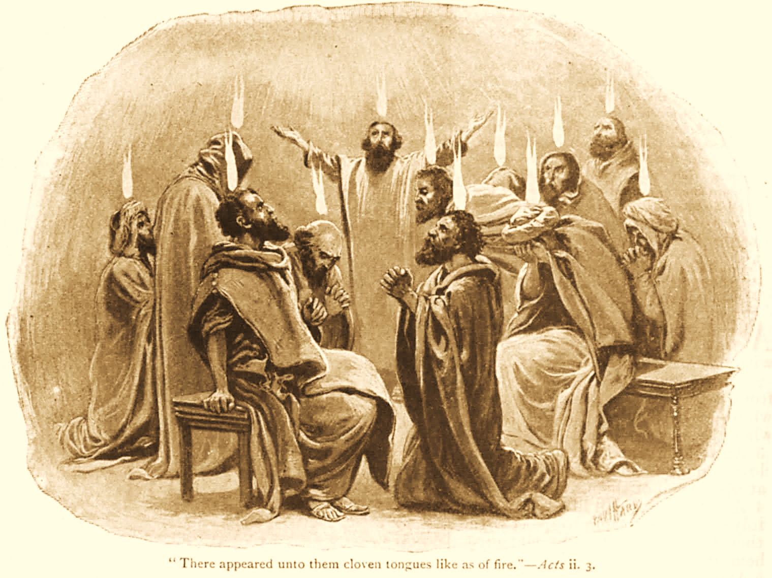
A C T S
Go Tell
the Good
News!
The Growth and
Development of the Early Church

Slide 2
A C T S
Lesson 18
Acts 12:1-24
Herod persecutes the church:
James martyred
Peter arrested and freed
Herod’s death

Slide 3
Herod Persecutes the Church (Acts 12:1-19)
These events occur circa 44 A.D., the year Herod Agrippa died, which was about 15 years after the establishment of the church in Acts 2.
Claudius Caesar reigned 41-54 AD. (cp. Acts 11:28). He gave Herod the rule of Syria and Judea in 41 A.D.
“Now about that time Herod the king stretched out his hand to harass some from the church. Then he killed James the brother of John with the sword” (12:1-2).
The killing of James marks a further escalation in the persecution of Christians.
Notes:
The brother of John…executed with the sword (beheaded). James had been in the inner circle of Jesus:
Matthew 4:21-22 Going on from there, He saw two other brothers, James the son of Zebedee, and John his brother, in the boat with Zebedee their father, mending their nets. He called them, 22 and immediately they left the boat and their father, and followed Him.
Mark 3:17 James the son of Zebedee and John the brother of James, to whom He gave the name Boanerges, that is, "Sons of Thunder";
Matthew 17:1 Now after six days Jesus took Peter, James, and John his brother, led them up on a high mountain by themselves; and He was transfigured before them…
Mark 13:3-4 Now as He sat on the Mount of Olives opposite the temple, Peter, James, John, and Andrew asked Him privately, 4 "Tell us, when will these things be? And what will be the sign when all these things will be fulfilled?“
Mark 14:33 And He took Peter, James, and John with Him, and He began to be troubled and deeply distressed.
The first apostle to suffer death…his brother. John would be the last. God allowed James to die, yet God will spare Peter…WHY??

Slide 4
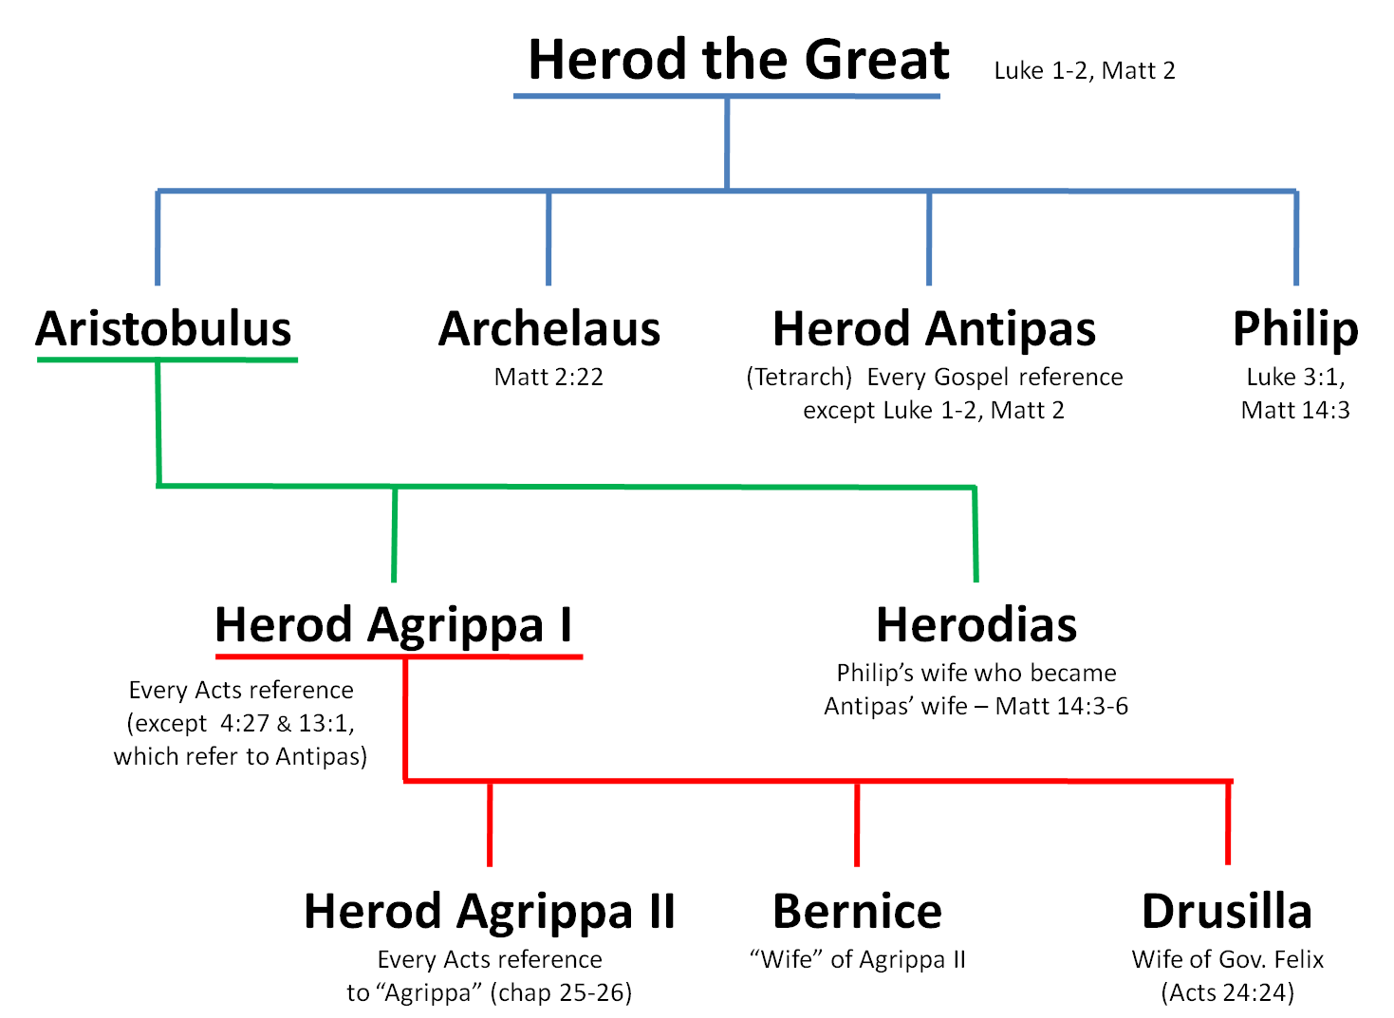
The Herods

Slide 5
Herod Persecutes the Church (Acts 12:1-19)
Herod imprisons Peter to please the Jews (12:3-5)
During the feast of Unleavened Bread.
Security on Peter was especially tight.
This is Peter’s third arrest in Acts (cf. Luke 21:12).
His previous escape could be a factor in the added security (5:18-23).
Herod intended to bring Peter before the people after Passover.*
Constant prayer was offered by the church (cf. Colossians 4:2; Philippians 1:19).
Notes:
This was his 3rd arrest (Acts 4:3; 5:18; 12:3).
Jesus had prepared him for this: Luke 21:12 But before all these things, they will lay their hands on you and persecute you, delivering you up to the synagogues and prisons. You will be brought before kings and rulers for My name's sake.
* Mistranslated “Easter” in the KJV
Colossians 4:2 Continue earnestly in prayer, being vigilant in it with thanksgiving;
Philippians 1:19 For I know that this will turn out for my deliverance through your prayer and the supply of the Spirit of Jesus Christ,

Slide 6
Herod Persecutes the Church (Acts 12:1-19)
The Lord sends an angel to free Peter (12:6-11)
This occurred the night before Herod planned to deliver Peter to the Jews.
Chains, soldiers and guards could not prevent Peter’s liberation!
The entire event seems surreal to Peter, but when he is freed, he realizes that God has delivered him from Herod and the Jews.
Notes:
–Peter was asleep, chained between 2 guards…other guards stood watch
–An angel appeared, waking Peter by striking his side & rousing him
–When instructed to “Get up quickly” his chains fell off by themselves
–He was instructed to take the time to put on sandals, wrap his cloak
–He was escorted right past the guard watch, apparently undetected
–The prison gates opened by themselves
-- Once they were outside on a street, the angel vanished
– Though this was all real, Peter thought he was having another vision

Slide 7
Peter Appears to the Disciples (Acts 12:12-19)
Peter goes to the house of Mary.
She was the mother of John Mark.
John Mark plays a minor (but nonetheless significant) role in the Acts narrative (Acts 12:25; 15:39).
Mark later becomes a trusted co-worker of both Peter and Paul (Colossians 4:10; 2 Timothy 4:11; 1 Peter 5:13).
Mark is the inspired writer of the gospel that bears his name.*
Notes:
Colossians 4:10 Aristarchus my fellow prisoner greets you, with Mark the cousin of Barnabas (about whom you received instructions: if he comes to you, welcome him),
2 Timothy 4:11 Only Luke is with me. Get Mark and bring him with you, for he is useful to me for ministry.
1 Peter 5:13 She who is in Babylon, elect together with you, greets you; and so does Mark my son.
AUTHORSHIP OF MARK
Papias tradition: The earliest argument comes from Papias, a bishop of Hierapolis writing around A.D. 100. He quoted an earlier source, John the Elder, who stated that Mark wrote the gospel based on Peter's teachings. This tradition was passed down through church historians like Eusebius.
Widespread agreement: While the Gospels were originally anonymous, this tradition was widely accepted by later church figures like Clement of Alexandria and Tertullian, who both identified Mark as Peter's scribe.
Lack of dissenting voices: There is no significant opposing tradition that attributes the gospel to someone else, suggesting a strong consensus developed early on.

Slide 8
Peter Appears to the Disciples (Acts 12:12-19)
Peter goes to the house of Mary
Disciples are gathered there praying
It was still night (cf. 12:6, 18)
A girl named Rhoda fails to open the door for Peter immediately.
“She recognizes Peter's voice, but because of her gladness she did not open the gate but ran in and announced that Peter stood before the gate.”
The disciples could not believe it! When they opened the door, they were astonished!
Peter tells them how the Lord freed him; he instructs them to tell the news to James and the brethren.
Notes:
.

Slide 9
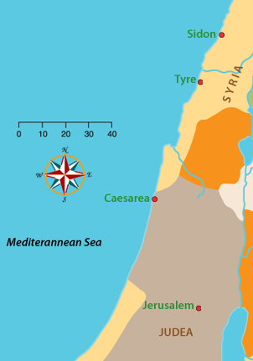
The Death of Herod Agrippa I (Acts 12:19-25)
Dominion of Herod Agrippa
Herod has Peter’s guards executed and returns to Caesarea.
A crowd from Tyre and Sidon assemble to seek Herod’s favor.
Herod allows them to deify him.
An angel strikes Herod and he dies.

Slide 10
Josephus records Herod’s death Antiquities 19.8.2 (343-361)
“Presently his flatterers cried out, one from one place, and another from another, that he was a god; and they added, ‘Be thou merciful to us; for although we have hitherto reverenced thee only as a man, yet shall we henceforth own thee as superior to mortal nature.’ Upon this the king neither rebuked them nor rejected their impious flattery.”
“A severe pain arose in his belly, striking with a most violent intensity. He therefore looked upon his friends, and said, ‘I, whom you call a god, am commanded presently to depart this life.’ ”

Slide 11
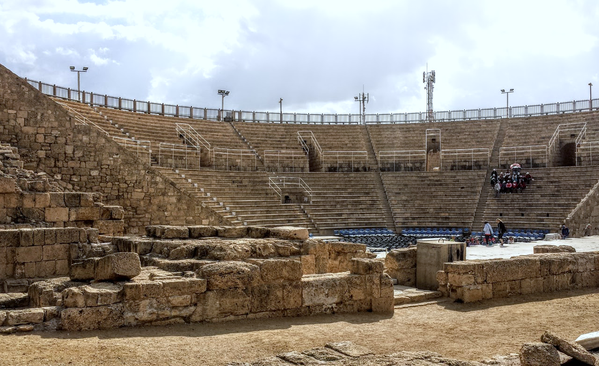
Theater in Caesarea

Slide 12
“But the word of God grew and multiplied.”
(Acts 12:24)
Notes:
If Luke’s record re: this kingdom has proven anything, it has shown God will not allow it to be thwarted or stopped by EXTERNAL threats or INTERNAL strife cp. 5:38-39

Slide 13
Lessons for Us from Acts 12
God’s wisdom and timing are unsearchable and past finding out. Our lot is to trust Him.
Fervent prayers are powerful (James 1:5-8; 5:16).
Notes:
His ways are “…past finding out” Romans 11:33 Oh, the depth of the riches both of the wisdom and knowledge of God! How unsearchable are His judgments and His ways past finding out!
Why did He allow James (an apostle) to be killed, and later rescue Peter (another apostle)? After Jesus had told Peter the manner of death he would die to glorify God, John 21:21-22 Peter, seeing (a fellow disciple), said to Jesus, "But Lord, what about this man?" 22 Jesus said to him, "If I will that he remain till I come, what is that to you? You follow Me."
This emphasizes TRUST/FAITH on our part, accepting that He knows best in every situation Isaiah 55:8-9 "For My thoughts are not your thoughts, Nor are your ways My ways," says the LORD. 9 "For as the heavens are higher than the earth, So are My ways higher than your ways, And My thoughts than your thoughts. (cf. Jer 10:23)
Beyond that, all we can do is pray according to His will 1 John 5:14-15 Now this is the confidence that we have in Him, that if we ask anything according to His will, He hears us. 15 And if we know that He hears us, whatever we ask, we know that we have the petitions that we have asked of Him.
IMPLIED -- the Christians gathered at Mary’s house were hoping for Peter’s release…else, why gather and pray?? When he was delivered, they doubted in unbelief??
James 1:5-8 If any of you lacks wisdom, let him ask of God, who gives to all liberally and without reproach, and it will be given to him. 6 But let him ask in faith, with no doubting, for he who doubts is like a wave of the sea driven and tossed by the wind. 7 For let not that man suppose that he will receive anything from the Lord; 8 he is a double-minded man, unstable in all his ways.
James 5:16b The effective, fervent prayer of a righteous man avails much.

