Slide 1

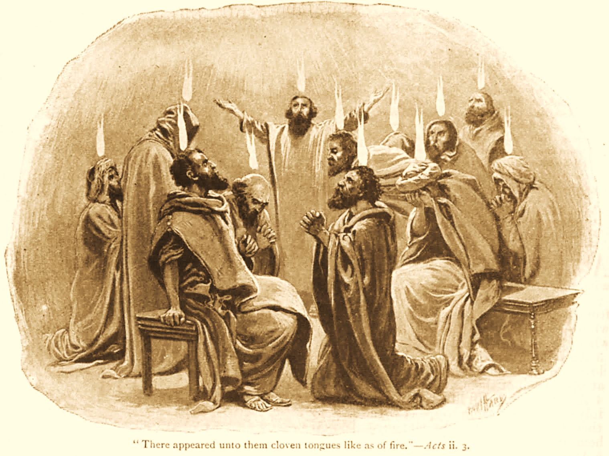
A C T S
Go Tell
the Good
News!
The Growth and
Development of the Early Church

Slide 2
A C T S
Lesson 3
Acts 2:1-21
Baptism Of The Holy Spirit
The Crowd’s Reaction and Peter’s Reply

Slide 3
The Baptism Of The Holy Spirit Acts 2:1-4
“The Day of Pentecost had fully come.”
  50 days after Passover (Lev. 23:15-17).
    “Not many days” after the ascension (1:5).
  One of the three major annual feasts for the Jews (Exodus 23:15-17).
    Feast of Passover
    Feast of Harvest or Feast of Weeks (Pentecost)
    Feast of Ingathering (Tabernacles)
Notes:
Exodus 23:15-17 You shall keep the Feast of Unleavened Bread (you shall eat unleavened bread seven days, as I commanded you, at the time appointed in the month of Abib, for in it you came out of Egypt; none shall appear before Me empty); 16 and the Feast of Harvest, the firstfruits of your labors which you have sown in the field; and the Feast of Ingathering at the end of the year, when you have gathered in the fruit of your labors from the field. 17 "Three times in the year all your males shall appear before the Lord GOD.
Leviticus 23:15-17 'And you shall count for yourselves from the day after the Sabbath, from the day that you brought the sheaf of the wave offering: seven Sabbaths shall be completed. 16 Count fifty days to the day after the seventh Sabbath; then you shall offer a new grain offering to the LORD. 17 You shall bring from your dwellings two wave loaves of two-tenths of an ephah. They shall be of fine flour; they shall be baked with leaven. They are the firstfruits to the LORD.
God’s wisdom evident for selecting this day to usher in the kingdom.
Jerusalem would be filled with a large representation of Jewish people from all over the known world.

Slide 4
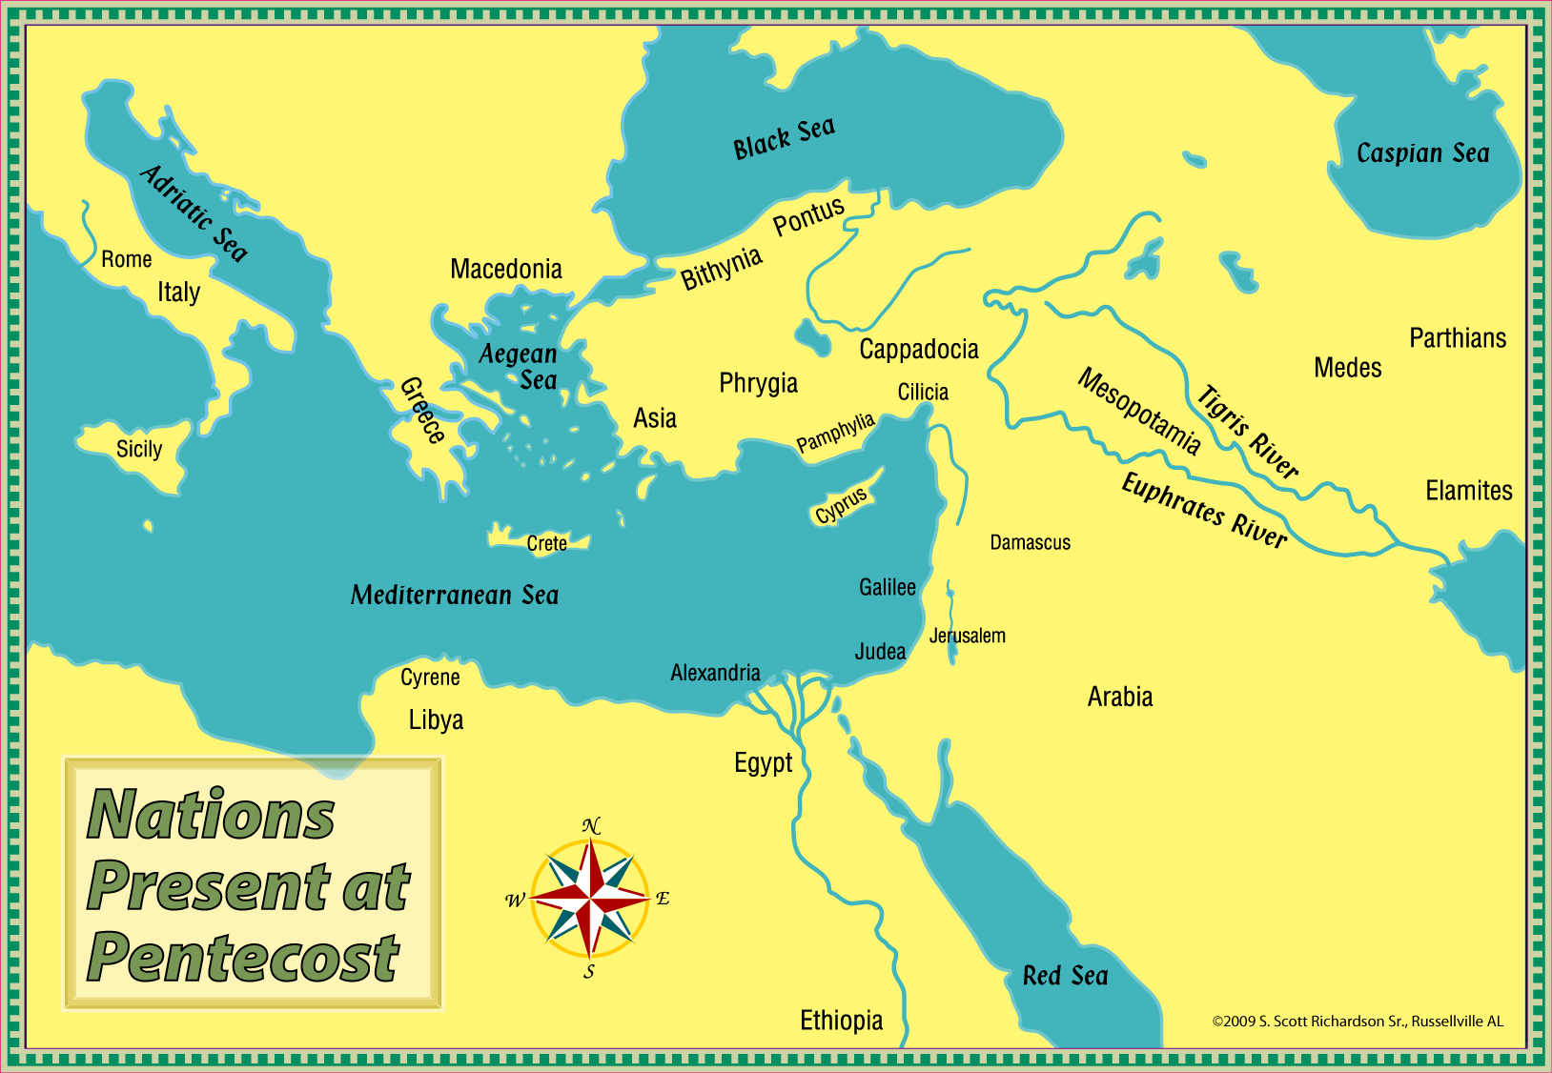

Slide 5
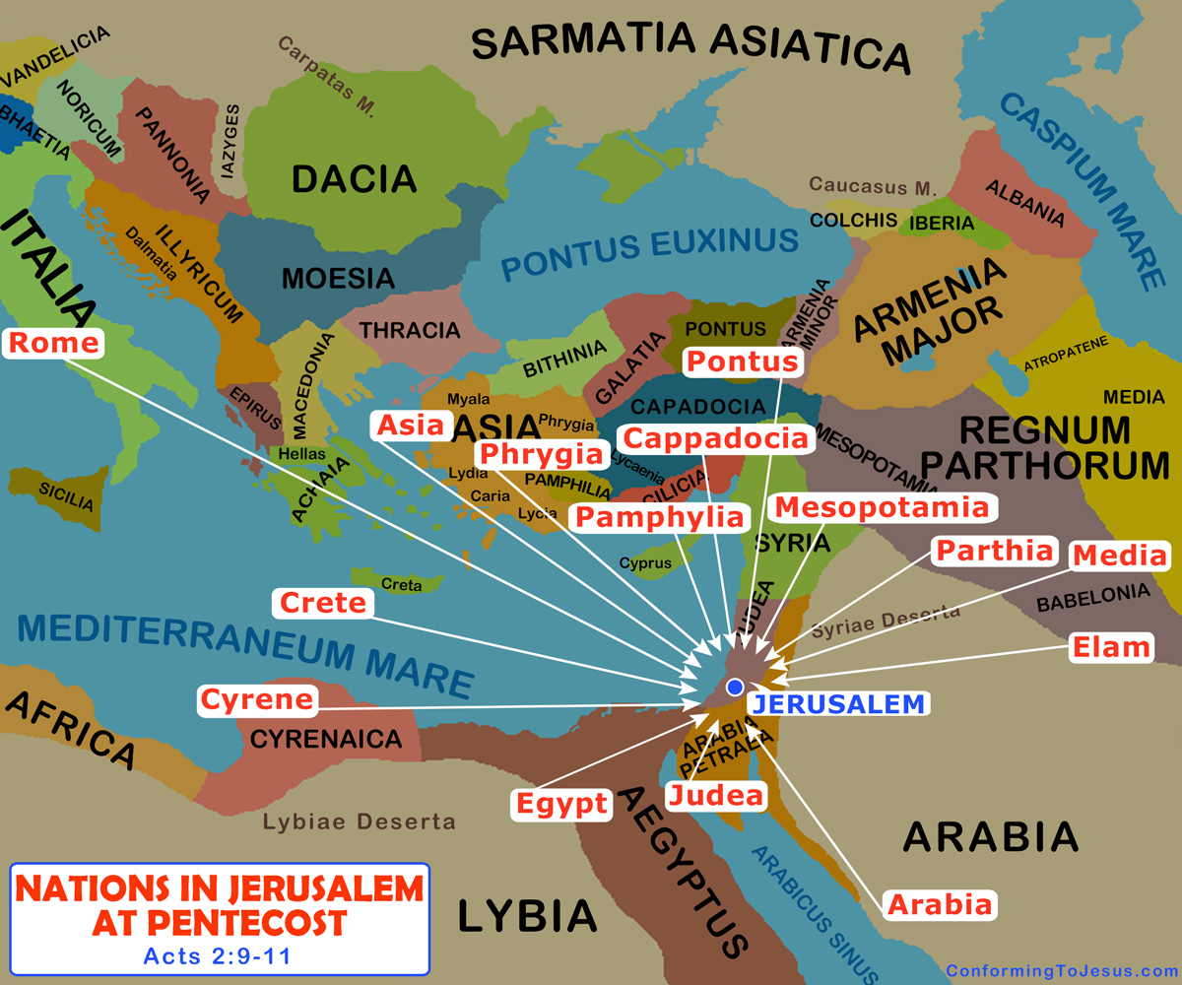
Attendees from widely separated places meant different languages.
Notes:
What part will this play in Acts 2? (cp. Mk. 16:20)
The various nations and languages begins to fulfill prophecy concerning all nations participating in the Messiah’s kingdom, and they necessitate communication of the gospel in multiple languages.

Slide 6
The Baptism Of The Holy Spirit Acts 2:1-4
WHO received Holy Spirit baptism?
To whom does “they” and “them” refer?
  The apostles! Acts 1:26 contains the antecedent to “they” and “them.” An “antecedent” is a proper noun nearest preceding a pronoun.
  Matthias “was numbered with the eleven apostles.” “…they were all with one accord in one place. And suddenly there came a sound from heaven, as of a rushing mighty wind, and it filled the whole house where they were sitting. Then there appeared to them divided tongues, as of fire, and one sat upon each of them. And they were all filled with the Holy Spirit and began to speak with other tongues, as the Spirit gave them utterance” (Acts 1:26–2:1-4).
Notes:
“An antecedent is the noun that comes before the pronoun that the pronoun refers to”

Slide 7
The Baptism Of The Holy Spirit Acts 2:1-4
This baptism…
  …fulfilled Jesus’ promises of the “Helper” (John 14:16-17; 15:26; 16:7-8, 13).
  …was the reason the apostles stayed in Jerusalem (Luke 24:49, Acts 1:4-5, 8).
Things accompanying this baptism:
  Visible and audible phenomena: A “mighty” or “violent” rushing wind and tongues “as of fire” that sat on each of the apostles.
  Miraculous activity: Speaking in tongues as the Spirit gave utterance (intelligible, known languages…not “gibberish,” cf. Acts 2:6, 11).
Notes:
John 14:26 But the Helper, the Holy Spirit, whom the Father will send in My name, He will teach you all things, and bring to your remembrance all things that I said to you.
John 15:26 "But when the Helper comes, whom I shall send to you from the Father, the Spirit of truth who proceeds from the Father, He will testify of Me.
John 16:7 Nevertheless I tell you the truth. It is to your advantage that I go away; for if I do not go away, the Helper will not come to you; but if I depart, I will send Him to you.
John 16:13 However, when He, the Spirit of truth, has come, He will guide you into all truth; for He will not speak on His own authority, but whatever He hears He will speak; and He will tell you things to come.
Luke 24:49 Behold, I send the Promise of My Father upon you; but tarry in the city of Jerusalem until you are endued with power from on high."

Slide 8
The Crowd’s Reaction
Acts 2:5-13
Devout men were dwelling Jerusalem (2:5).
  They had come for a religious holy day; they were keeping their covenant with God!
They had just witnessed an extraordinary event that drew their attention (2:6-11).
  They had heard the “sound of wind,” and now they hear Galileans speaking other languages.
  They are confused because each one is hearing in his native language.
They reacted in two different ways (2:12-13).
  Some were “amazed and perplexed,” wondering, “Whatever could this mean?”
  Others mocked, accusing the apostles of drunkenness.

Slide 9
Peter’s Explanation
Acts 2:14-21
Peter refutes the false charge of drunkenness
  It was too early to be drunk [9:00 a.m.]
  Peter’s clear speech also demonstrated sobriety.
What was happening was a fulfillment of prophecy the prophet Joel (2:16-21).
  Joel spoke of the deliverance of the “remnant” of Israel in “the last days” (Joel 2:28-32; cf. Isaiah 2:1-4; Micah 4:1-5).
  The “last days” in Bible prophecy often refers to the final dispensation of time in God’s dealings with man.
    We are NOW living in these days (Heb. 1:1-2).
Notes:
Joel Prophesied about 830 BC.
Isaiah and Micah about 100+ years later
Isaiah 2:2-3 Now it shall come to pass in the latter days That the mountain of the LORD's house Shall be established on the top of the mountains, And shall be exalted above the hills; And all nations shall flow to it. 3 Many people shall come and say, "Come, and let us go up to the mountain of the LORD, To the house of the God of Jacob; He will teach us His ways, And we shall walk in His paths." For out of Zion shall go forth the law, And the word of the LORD from Jerusalem.
Hebrews 1:1-2 God, who at various times and in various ways spoke in time past to the fathers by the prophets, 2 has in these last days spoken to us by His Son, whom He has appointed heir of all things, through whom also He made the worlds;

Slide 10
Peter’s Explanation
Acts 2:14-21
What was happening was a fulfillment of prophecy the prophet Joel (2:16-21).
  God had just “…poured forth His Spirit on all mankind” (Acts 2:17a).
    Not every single human, but on all classes; more would be included (cf. Acts 11:15-17).
  The miraculous activity Joel predicted had now begun to take place (Acts 2:17b-19a, cf. 21:8-9; Revelation 1:9-10).
Notes:
Acts 11:15-17 And as I began to speak, the Holy Spirit fell upon them, as upon us at the beginning. 16 Then I remembered the word of the Lord, how He said, 'John indeed baptized with water, but you shall be baptized with the Holy Spirit.' 17 If therefore God gave them the same gift as He gave us when we believed on the Lord Jesus Christ, who was I that I could withstand God?“
Acts 21:8-9 On the next day we who were Paul's companions departed and came to Caesarea, and entered the house of Philip the evangelist, who was one of the seven, and stayed with him. 9 Now this man had four virgin daughters who prophesied.
Revelation 1:9-10 I, John, both your brother and companion in the tribulation and kingdom and patience of Jesus Christ, was on the island that is called Patmos for the word of God and for the testimony of Jesus Christ. 10 I was in the Spirit on the Lord's Day, and I heard behind me a loud voice, as of a trumpet,

Slide 11
Peter’s Explanation
Acts 2:14-21
What was happening was a fulfillment of prophecy the prophet Joel (2:16-21).
  It would also pave the way for eventual Divine judgment -- upon Jerusalem in A.D. 70 and/or end-of-the-world judgment (Acts 2:19-20; cf. Isaiah 13:10-11, Matthew 24:29).
  The only way to escape this Divine judgment would be for one to “…call upon the name of the Lord” (2:16-21).
    Not merely calling His name (Matt. 7:21).
    Seeking His will…doing only what He commands or authorizes (Matt. 7:22-23; Acts 22:16).
Notes:
Isaiah 13:10-11 For the stars of heaven and their constellations Will not give their light; The sun will be darkened in its going forth, And the moon will not cause its light to shine. 11 "I will punish the world for its evil, And the wicked for their iniquity; I will halt the arrogance of the proud, And will lay low the haughtiness of the terrible.
Matthew 24:29 "Immediately after the tribulation of those days the sun will be darkened, and the moon will not give its light; the stars will fall from heaven, and the powers of the heavens will be shaken.
Peter’s explanation of what had just occurred set the stage for his preaching
– The very first gospel sermon Acts 2:22-36 Lk 24:46-47 Isa 2:3
– Peter will now “unlock the doors of the kingdom” Matt 16:19

Slide 12
Important Lesson
The baptism of the Holy Spirit was unique.
  There are only two recorded instances – Acts 2 & Acts 10-11.
  Each accomplished a unique purpose: The empowerment of the apostles for their mission and the certification of the gospel to the Gentiles.
Notes:
Important to know, properly understand to refute false teaching
Some claim they receive such a baptism & ability to work miracles
Will these same ones also claim to see similar signs to Acts 2:1-4?
No one other than the apostles were ever promised such a baptism
They needed such Divine help to accomplish their apostolic work
Yes, Cornelius would later receive this baptism…but he was never promised it Acts 10:44-47 11:15-17a
There is only ONE baptism in effect today Eph 4:5

