Slide 1

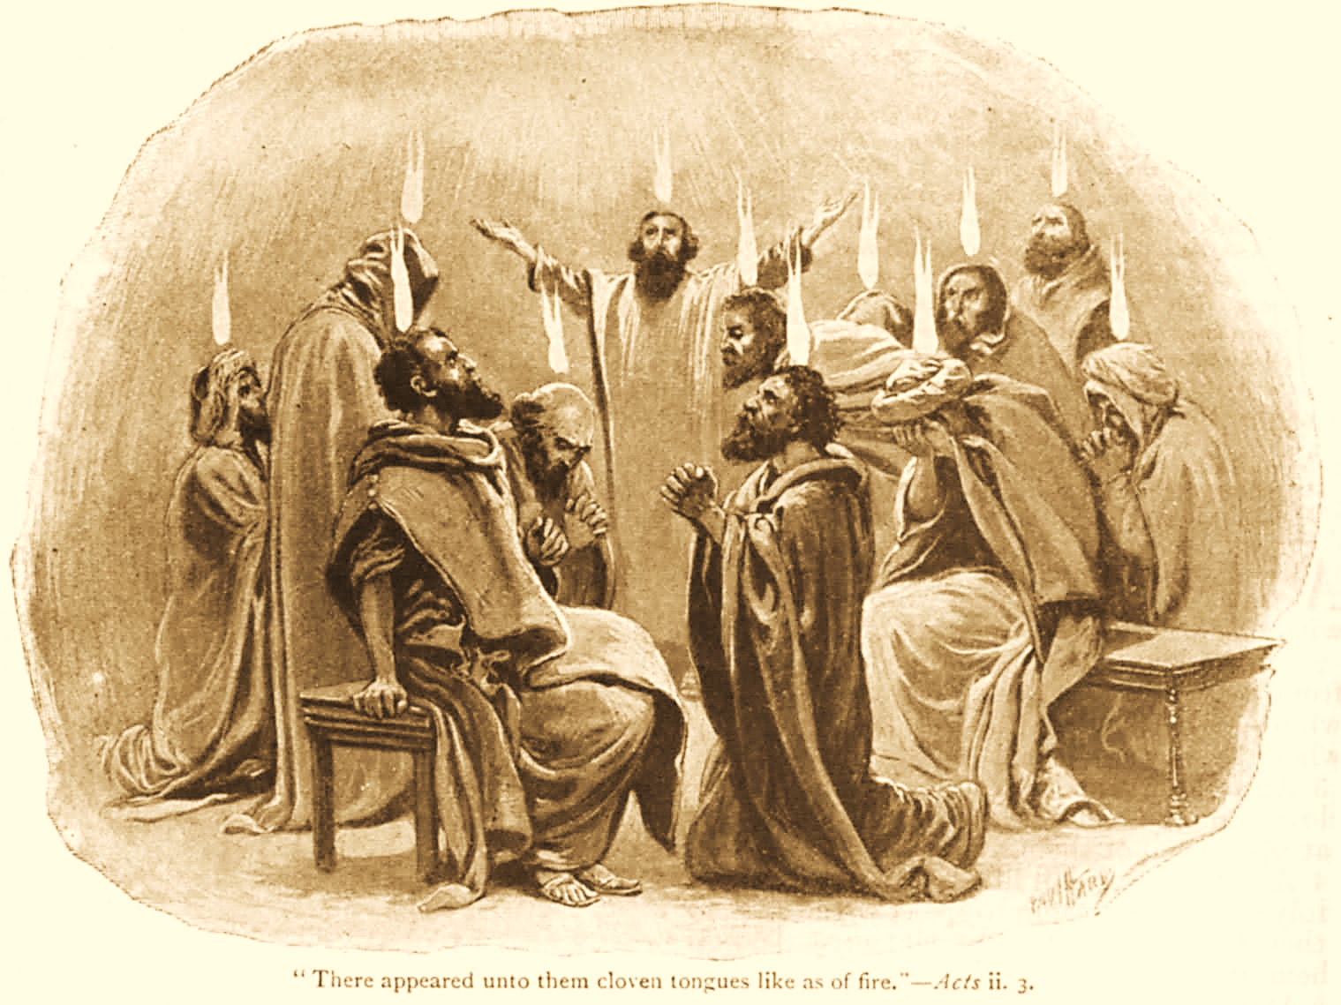
A C T S
Go Tell
the Good
News!
The Growth and
Development of the Early Church

Slide 2
A C T S
Lesson 4
Acts 2:22-47
Peter’s Sermon
3,000 converted

Slide 3
Peter’s Explanation
Acts 2:14-21
What was happening was a fulfillment of prophecy the prophet Joel (2:16-21).
  God had just “…poured forth His Spirit on all mankind” (Acts 2:17a).
    Not every single human, but on all classes; more would be included (cf. Acts 11:15-17).
  The miraculous activity Joel predicted had now begun to take place (Acts 2:17b-19a, cf. 21:8-9; Revelation 1:9-10).
Notes:
Acts 11:15-17 And as I began to speak, the Holy Spirit fell upon them, as upon us at the beginning. 16 Then I remembered the word of the Lord, how He said, 'John indeed baptized with water, but you shall be baptized with the Holy Spirit.' 17 If therefore God gave them the same gift as He gave us when we believed on the Lord Jesus Christ, who was I that I could withstand God?“
Acts 21:8-9 On the next day we who were Paul's companions departed and came to Caesarea, and entered the house of Philip the evangelist, who was one of the seven, and stayed with him. 9 Now this man had four virgin daughters who prophesied.
Revelation 1:9-10 I, John, both your brother and companion in the tribulation and kingdom and patience of Jesus Christ, was on the island that is called Patmos for the word of God and for the testimony of Jesus Christ. 10 I was in the Spirit on the Lord's Day, and I heard behind me a loud voice, as of a trumpet,

Slide 4
Peter’s Explanation
Acts 2:14-21
What was happening was a fulfillment of prophecy the prophet Joel (2:16-21).
  It would also pave the way for eventual Divine judgment -- upon Jerusalem in A.D. 70 and/or end-of-the-world judgment (Acts 2:19-20; cf. Isaiah 13:10-11, Matthew 24:29).
  The only way to escape this Divine judgment would be for one to “…call upon the name of the Lord” (2:16-21).
    Not merely calling His name (Matt. 7:21).
    Seeking His will…doing only what He commands or authorizes (Matt. 7:22-23; Acts 22:16).
Notes:
Isaiah 13:10-11 For the stars of heaven and their constellations Will not give their light; The sun will be darkened in its going forth, And the moon will not cause its light to shine. 11 "I will punish the world for its evil, And the wicked for their iniquity; I will halt the arrogance of the proud, And will lay low the haughtiness of the terrible.
Matthew 24:29 "Immediately after the tribulation of those days the sun will be darkened, and the moon will not give its light; the stars will fall from heaven, and the powers of the heavens will be shaken.
Peter’s explanation of what had just occurred set the stage for his preaching
– The very first gospel sermon Acts 2:22-36 Lk 24:46-47 Isa 2:3
– Peter will now “unlock the doors of the kingdom” Matt 16:19

Slide 5
Peter’s Sermon
Acts 2:22-36
The proposition and summation of Peter’s sermon is found in Acts 2:36 – “Let all the house of Israel know assuredly that God has made this Jesus, whom you crucified, both Lord and Christ.”
  Peter presents evidence that Jesus is both Lord and Christ (miracles, resurrection, fulfilled prophecy).
  He indicts the Jews of murdering Jesus (2:23, 36).
  In this, he does by the Holy Spirit what Jesus had promised (John 16:7-9).
  NOTE: Technically, this is not the first gospel sermon, but it is the first in which the gospel was preached in all its fullness (cf. Luke 7:22; 20:1).
Notes:
John 14:26 But the Helper, the Holy Spirit, whom the Father will send in My name, He will teach you all things, and bring to your remembrance all things that I said to you.
John 15:26 "But when the Helper comes, whom I shall send to you from the Father, the Spirit of truth who proceeds from the Father, He will testify of Me.
John 16:7-8 Nevertheless I tell you the truth. It is to your advantage that I go away; for if I do not go away, the Helper will not come to you; but if I depart, I will send Him to you. 8 And when He has come, He will convict the world of sin, and of righteousness, and of judgment:
Luk_7:22 Jesus answered and said to them, "Go and tell John the things you have seen and heard: that the blind see, the lame walk, the lepers are cleansed, the deaf hear, the dead are raised, the poor have the gospel preached to them.
Luk_20:1 Now it happened on one of those days, as He taught the people in the temple and preached the gospel, that the chief priests and the scribes, together with the elders, confronted Him

Slide 6
Peter’s Sermon
Acts 2:22-36
Five Proofs that Jesus is Lord and Christ
1. His miracles, signs and wonders (2:22).
  These were attestation from God to Jesus’ identity.
  They were done “in your midst.” Many saw them. “…you yourselves know also know.”
  Yet, they had murdered Jesus (2:23).
    It was done through “…the hands of godless men” (i.e. the Romans, cf. John 18:31-32).
    It was in accordance with the “determined purpose and foreknowledge of God” (contrary to premillennial false doctrine).
Notes:
John 18:31-32 Then Pilate said to them, "You take Him and judge Him according to your law." Therefore the Jews said to him, "It is not lawful for us to put anyone to death," 32 that the saying of Jesus might be fulfilled which He spoke, signifying by what death He would die.

Slide 7
Peter’s Sermon
Acts 2:22-36
Five Proofs that Jesus is Lord and Christ
2. God raised Jesus from the dead (2:24a).
  If Jesus was not raised, He would become an unsuccessful martyr (as others had, Acts 5:35-38).
  In raising Jesus, God “loosed the pains of death” and ultimately “released those who through fear of death were all their lifetime subject to bondage” (Hebrews 2:14-15).
  It’s impossible for God to be held in death’s power (2:24b; Matthew 16:18).
Notes:
Acts 5:35-39 And he said to them: "Men of Israel, take heed to yourselves what you intend to do regarding these men. 36 For some time ago Theudas rose up, claiming to be somebody. A number of men, about four hundred, joined him. He was slain, and all who obeyed him were scattered and came to nothing. 37 After this man, Judas of Galilee rose up in the days of the census, and drew away many people after him. He also perished, and all who obeyed him were dispersed. 38 And now I say to you, keep away from these men and let them alone; for if this plan or this work is of men, it will come to nothing; 39 but if it is of God, you cannot overthrow it—lest you even be found to fight against God.“
Hebrews 2:14-15 Inasmuch then as the children have partaken of flesh and blood, He Himself likewise shared in the same, that through death He might destroy him who had the power of death, that is, the devil, 15 and release those who through fear of death were all their lifetime subject to bondage.

Slide 8
Peter’s Sermon
Acts 2:22-36
Five Proofs that Jesus is Lord and Christ
3. Fulfilled Prophecy (2:25-35)
  This is a primary component of Peter’s sermon – proving from Scripture that Jesus is Lord and Christ.
    Resurrected: “You will not leave my soul in hades…” (Acts 2:25-28 → Psalm 16:8-11).
    Enthroned: “God had sworn with an oath” that He would “raise up the Christ” (David’s descendant) “to sit on His throne” (Acts 2:29-31 → 2 Sam 7:11-12).
    Exalted. “The Lord said to my Lord, “Sit at My right hand, till I make your enemies your footstool” (Acts 2:32-35 → Psalm 110:1).
Notes:
These are texts his audience would have been familiar with.
Psalms 16:8-11 I have set the LORD always before me; Because He is at my right hand I shall not be moved. 9 Therefore my heart is glad, and my glory rejoices; My flesh also will rest in hope. 10 For You will not leave my soul in Sheol, Nor will You allow Your Holy One to see corruption. 11 You will show me the path of life; In Your presence is fullness of joy; At Your right hand are pleasures forevermore.
2 Samuel 7:12-13 "When your days are fulfilled and you rest with your fathers, I will set up your seed after you, who will come from your body, and I will establish his kingdom. 13 He shall build a house for My name, and I will establish the throne of his kingdom forever.

Slide 9
Peter’s Sermon
Acts 2:22-36
Five Proofs that Jesus is Lord and Christ
4. Witnesses had seen the resurrected Jesus (2:32).
  The apostles (John 20:19-29; 1 John 1:1-3; Acts 1:21-22).
  Many others also (Luke 24:18, 32-33; 1 Cor. 15:6)
  Eyewitnesses establish truth (fact) in a matter (Deut. 19:15; Matt. 18:16).
Notes:
1 John 1:1-3 That which was from the beginning, which we have heard, which we have seen with our eyes, which we have looked upon, and our hands have handled, concerning the Word of life— 2 the life was manifested, and we have seen, and bear witness, and declare to you that eternal life which was with the Father and was manifested to us— 3 that which we have seen and heard we declare to you, that you also may have fellowship with us; and truly our fellowship is with the Father and with His Son Jesus Christ.
Deuteronomy 19:15 "One witness shall not rise against a man concerning any iniquity or any sin that he commits; by the mouth of two or three witnesses the matter shall be established.
Matthew 18:16 But if he will not hear, take with you one or two more, that 'BY THE MOUTH OF TWO OR THREE WITNESSES EVERY WORD MAY BE ESTABLISHED.'

Slide 10
Peter’s Sermon
Acts 2:22-36
Five Proofs that Jesus is Lord and Christ
5. The outpouring of the Holy Spirit (2:33).
  This had just been explained (Joel’s prophecy; 2:14-21).
  The audience could not argue against what they themselves had seen and heard.
  This confirmed the preaching of a resurrected Christ (cf. Mark 16:20).
Notes:
Mark 16:20 And they went out and preached everywhere, the Lord working with them and confirming the word through the accompanying signs. Amen.

Slide 11
The Response to Peter’s Sermon
Acts 2:37-47
Now when they heard this…
  They were cut to the heart.*
  They said to Peter and the rest of the apostles, “Men and brethren, what shall we do?”
Peter answers their question.
  “Repent, and let every one of you be baptized in the name of Jesus Christ for the remission of sins.”
  “You shall receive the gift of the Holy Spirit.”*
  The promise of salvation is for anyone who will answer the gospel’s call (2 Thess. 2:14).
  With many other words he exhorted them, saying, “Be saved from this perverse generation.”
Notes:
*Facts are meant to produce emotion, not the other way around.
Acts 5:32 And we are His witnesses to these things, and so also is the Holy Spirit whom God has given to those who obey Him.“
Romans 5:5 Now hope does not disappoint, because the love of God has been poured out in our hearts by the Holy Spirit who was given to us.
2 Corinthians 5:5 Now He who has prepared us for this very thing is God, who also has given us the Spirit as a guarantee.
1Th_4:8 Therefore he who rejects this does not reject man, but God, who has also given us His Holy Spirit.
2Ti_1:7 For God has not given us a spirit of fear, but of power and of love and of a sound mind.
1Jn_3:24 Now he who keeps His commandments abides in Him, and He in him. And by this we know that He abides in us, by the Spirit whom He has given us.
1Jn_4:13 By this we know that we abide in Him, and He in us, because He has given us of His Spirit.
2 Corinthians 1:22 who also has sealed us and given us the Spirit in our hearts as a guarantee.
Galatians 4:6 And because you are sons, God has sent forth the Spirit of His Son into your hearts, crying out, "Abba, Father!“
2 Thessalonians 2:14 “He called you by our gospel, for the obtaining of the glory of our Lord Jesus Christ.

Slide 12
The Response to Peter’s Sermon
Acts 2:37-47
Obedience to the faith (2:42).
  3,000 who gladly received his word were baptized!
  And they continued steadfastly in…
    the apostles' doctrine and fellowship
    in the breaking of bread
    and in prayers.
Reverence and loving unity (2:43-44).
  “Fear came upon every soul…”
  “All who believed were together, and had all things in common…”

Slide 13
The Response to Peter’s Sermon
Acts 2:37-47
Corporate worship, personal association, praise to God, and favor with all the people (2:45-47a)
  The first converts to Christ acted like family.
  They enjoyed worshipping together inside the assembly and socializing together outside the assembly (Heb 10:24-25; 13:1-2; Rom. 12:10).
  They took care of each other as a true family (1 John 3:16-18).
“And the Lord added to the church daily those who were being saved.”
Notes:
Hebrews 10:24-25 And let us consider one another in order to stir up love and good works, 25 not forsaking the assembling of ourselves together, as is the manner of some, but exhorting one another, and so much the more as you see the Day approaching.
1 John 3:17-18 But whoever has this world's goods, and sees his brother in need, and shuts up his heart from him, how does the love of God abide in him? 18 My little children, let us not love in word or in tongue, but in deed and in truth.
Hebrews 13:1-2 Let brotherly love continue. 2 Do not forget to entertain strangers, for by so doing some have unwittingly entertained angels.
Romans 12:10 Be kindly affectionate to one another with brotherly love, in honor giving preference to one another;
Romans 12:13 distributing to the needs of the saints, given to hospitality.

