Slide 1

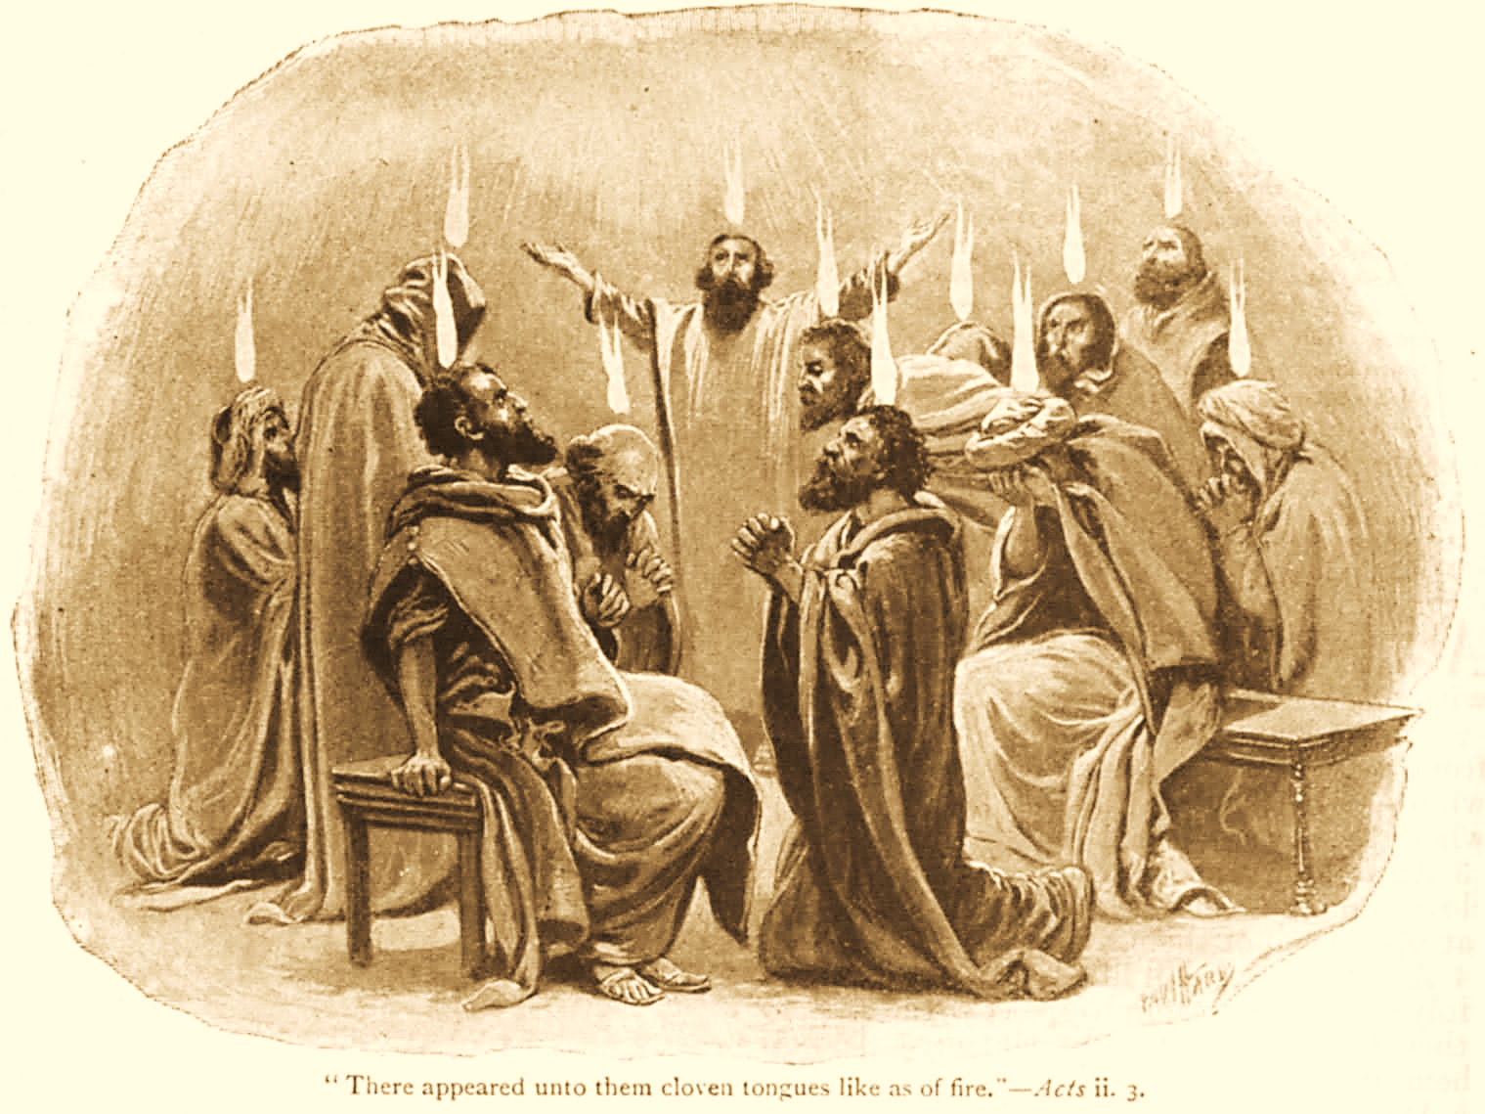
A C T S
Go Tell
the Good
News!
The Growth and
Development of the Early Church

Slide 2
A C T S
Lesson 5
Acts 3:1---4:4
Healing Lame Man
Peter’s 2nd Sermon
Response

Slide 3
Response to Peter’s First Sermon
Acts 2:37-47
Obedience to the faith (2:42).
  3,000 who gladly received his word were baptized!
  “And they continued steadfastly in…
    the apostles' doctrine and fellowship*
    in the breaking of bread
    and in prayers.”
Reverence and loving unity (2:43-44).
  “Fear came upon every soul…”
  “All who believed were together, and had all things in common…”
Notes:
koinōnia
Thayer Definition:
1) fellowship, association, community, communion, joint participation, intercourse
1a) the share which one has in anything, participation
1b) intercourse, fellowship, intimacy
1b1) the right hand as a sign and pledge of fellowship (in fulfilling the apostolic office)
1c) a gift jointly contributed, a collection, a contribution, as exhibiting an embodiment and proof of fellowship

Slide 4
Response to Peter’s First Sermon
Acts 2:37-47
The first converts were characterized by corporate worship, personal association, praise to God, and favor with all the people (2:45-47a).
  They acted like family!
  They enjoyed worshipping together inside the assembly and socializing together outside the assembly (Heb 10:24-25; 13:1-2; Rom. 12:10).
  They took care of each other as a true family (1 John 3:16-18).
“And the Lord added to the church daily those who were being saved” (Acts 2:47b).
Notes:
Hebrews 10:24-25 And let us consider one another in order to stir up love and good works, 25 not forsaking the assembling of ourselves together, as is the manner of some, but exhorting one another, and so much the more as you see the Day approaching.
1 John 3:17-18 But whoever has this world's goods, and sees his brother in need, and shuts up his heart from him, how does the love of God abide in him? 18 My little children, let us not love in word or in tongue, but in deed and in truth.
Hebrews 13:1-2 Let brotherly love continue. 2 Do not forget to entertain strangers, for by so doing some have unwittingly entertained angels.
Romans 12:10 Be kindly affectionate to one another with brotherly love, in honor giving preference to one another;
Romans 12:13 distributing to the needs of the saints, given to hospitality.

Slide 5
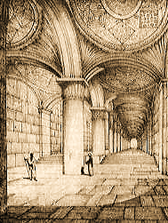
A Lame Beggar is Healed
Acts 3:1-10
Peter and John go up to the temple at the hour of prayer (3pm).*
A beggar, lame from birth, is carried and laid at the Beautiful Gate.
  Note: Many wonders and signs were being done by the apostles (2:43).
Notes:
*This hour was set as a regular practice. “We read in Scripture of three specified hours of prayer, in accordance with which the Psalmist speaks of his own custom (Psa_55:17), “Evening, and morning, and at noon, will I pray.” And in like manner Daniel prayed “three times a day” (Dan_6:10). The hour of morning prayer was the third hour, and Peter went up to the housetop to pray (Act_10:9) about the sixth hour, which was noon, and the evening prayer was this to which Peter and John were going up.” (Cambridge Bible Commentary)
The Beautiful Gate is likely known to history as the “double gate.”
The picture on the slide is an artist’s rendition of the area when it was first built.
Leen Ritmeyer writes: “A reconstruction drawing of the Double Gate of Herod's Temple Mount in Jerusalem. Most of the elements have been preserved, including the domes inside the double passageway. Some researchers have proposed that this beautifully decorated gateway was the Beautiful Gate of the Temple, mentioned in Acts 3.10.” © Leen Ritmeyer

Slide 6
A Lame Beggar is Healed
Acts 3:1-10
Crippled since birth, His infirmity was public knowledge for 40+ years (3:2, 16; 4:16, 22).
He asks alms of Peter and John.
Peter demands his attention – “Look at us!”
  “Silver and gold I do not have, but what I do have I give you: In the name of Jesus Christ of Nazareth, rise up and walk.”
  Peter took him by the right hand, lifted him up, and immediately his feet and ankle bones received strength.
  He leaps up and enters the temple with Peter and John – “walking, leaping, and praising God.”
Notes:
These events occurred in a highly trafficked area at a time when many were coming for worship, attract a crowd.
Acts 3:9-10 And all the people saw him walking and praising God. 10 Then they knew that it was he who sat begging alms at the Beautiful Gate of the temple; and they were filled with wonder and amazement at what had happened to him.

Slide 7
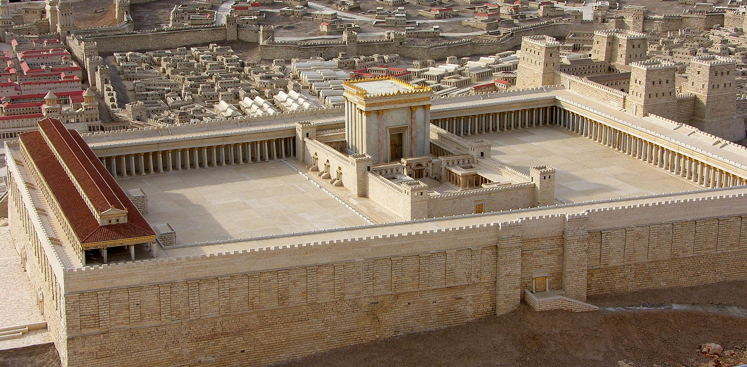
Herod’s Temple
Notes:
The Temple WAS NOT HANDICAP ACCESSIBLE
Solomons porch or portico was a covered colonnade along the eastern end of the court of the Gentiles (along the front of the picture)..
The Beautiful Gate was probably the Double Gate on the south side (left in the picture) that led up by a stairway into the court of the Gentiles.

Slide 8
The Crowd’s Reaction to the Healing
Acts 3:9-11
“All the people saw him walking and praising God.”
  These events, occurring in a highly trafficked area at a time when many were coming for worship, attract a crowd.
  “They knew that it was he who sat begging alms at the Beautiful Gate… and they were filled with wonder and amazement.”
  “As the lame man who was healed held on to Peter and John, all the people ran together to them in the porch which is called Solomon's, greatly amazed.”
Notes:
These events occurred in a highly trafficked area at a time when many were coming for worship, attract a crowd.
Acts 3:9-10 And all the people saw him walking and praising God. 10 Then they knew that it was he who sat begging alms at the Beautiful Gate of the temple; and they were filled with wonder and amazement at what had happened to him.

Slide 9
Peter’s Second Sermon
Acts 3:12-26
Peter questions their reaction and downplays the apostles’ part (3:12).
Peter preaches Jesus -- the One who empowered the miracle (Acts 3:13-16).
  He begins by crediting the “God of our fathers.”
  This same God “glorified” the One they had “delivered up and denied.”
    He reminds them that Pilate wanted to let Jesus go (Lk. 23:4, 13-16, 22).
  They had “killed the Prince of life, whom God raised from the dead” – Peter and John were witnesses!
Notes:
They shouldn’t have been amazed at all
Thought Question: were some also present at his 1st sermon, seeing something spectacular then, too? 2:12
The apostles themselves deserved no credit. Peter deflects any glory
Prince = Author (originator, chief leader).

Slide 10
Peter’s Second Sermon
Acts 3:12-26
Peter declares that “His name, through faith in His name, has made this man strong, whom you see and know” (3:16).
  Did the lame man have faith? Probably.*
  Peter and John certainly had faith to work the miracle (Mark 16:17-18).
Notes:
Peter made the lame give him attention as he had said “In the name of Jesus Christ of Nazareth, rise up and walk.”
Mark 16:17-18 And these signs will follow those who believe: In My name they will cast out demons; they will speak with new tongues; 18 they will take up serpents; and if they drink anything deadly, it will by no means hurt them; they will lay hands on the sick, and they will recover."

Slide 11
Peter’s Second Sermon
Acts 3:12-26
Peter clarifies their condition and their need.
  They and their rulers had murdered Jesus in ignorance (3:17).
    God thus fulfilled what He had said through the prophets – that the Christ would suffer (3:18).
    Their ignorance was no excuse.
  They must “repent…and be converted” so that…
    their sins may be blotted out
    times of refreshing may come from the presence of the Lord (3:19-20).
  The faith in Jesus that healed the lame man could save them from their sins!

Slide 12
Peter’s Second Sermon
Acts 3:12-26
God had said through the prophets that Christ would remain in heaven till the time of restoration (Acts 3:21, cf. Ps. 110:1).
  Through Moses, God had said that His people must obey the prophet and lawgiver like Moses whom He would send, or they would be destroyed (Acts 3:22-23; Deuteronomy 18:15-19).
    All the prophets, from Samuel forward, spoke of these days (Acts 3:24, 2 Samuel 7:12).
  They were the “sons of the prophets” and of the seed promise God had made to Abraham (Acts 3:25; Genesis 22:18).
Notes:
Psalms 110:1 A Psalm of David. The LORD said to my Lord,"Sit at My right hand, Till I make Your enemies Your footstool."
Moses -- Deuteronomy 18:15 "The LORD your God will raise up for you a Prophet like me from your midst, from your brethren. Him you shall hear,
Deuteronomy 18:18-19 I will raise up for them a Prophet like you from among their brethren, and will put My words in His mouth, and He shall speak to them all that I command Him. 19 And it shall be that whoever will not hear My words, which He speaks in My name, I will require it of him.
Samuel 2 Samuel 7:12
Abraham Genesis 12:3; 22:18 In your seed all the nations of the earth shall be blessed,

Slide 13
Peter’s Second Sermon
Acts 3:26
The Jews listening to Peter on Solomon’s porch were being given a tremendous privilege and opportunity.
  “To you first, God, having raised up His Servant Jesus, sent Him to bless you, in turning away every one of you from your iniquities."

