Slide 1

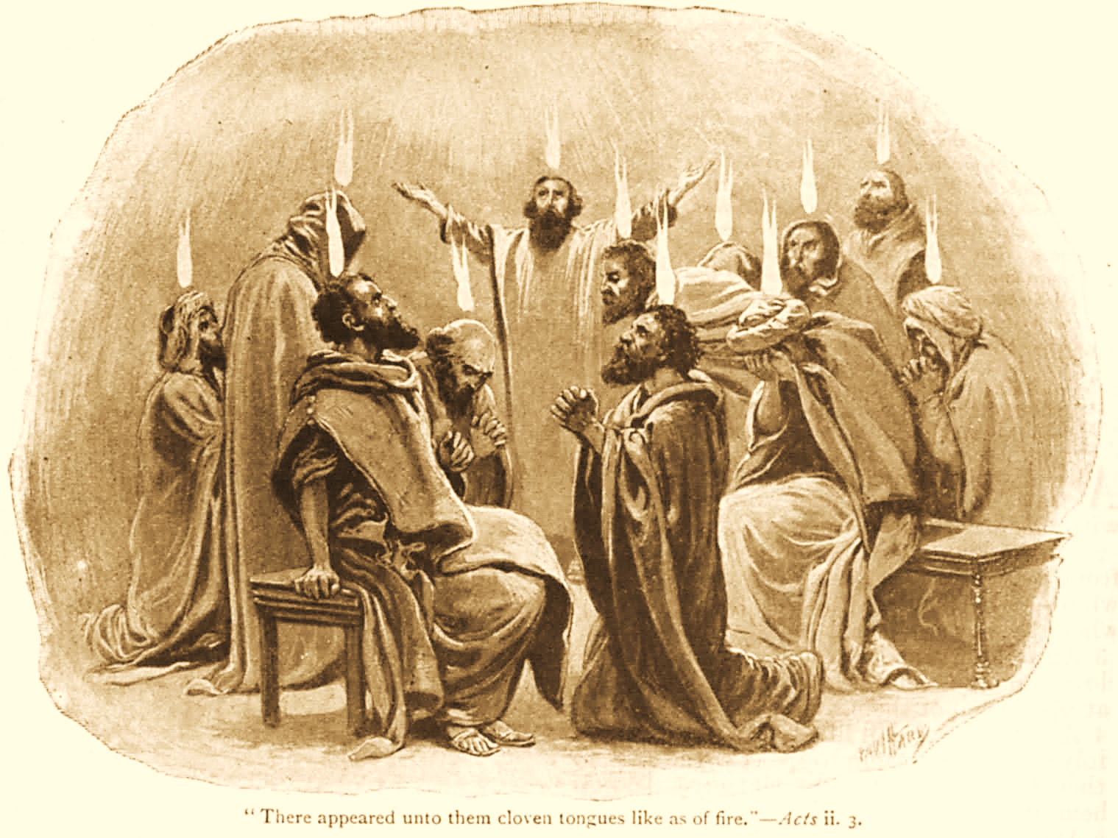
A C T S
Go Tell
the Good
News!
The Growth and
Development of the Early Church

Slide 2
A C T S
Lesson 6
Acts 4:1-31
Peter & John Arrested
Their Defense before the Council
A Prayer Meeting

Slide 3
Peter and John Arrested
Acts 4:1-4
Priests, the commander of the temple guard, and the Sadducees come upon Peter and John.
  Each of these had a vested interest in keeping order in the temple.
  The Sadducees in particular would have a hostile reaction to the preaching of the resurrection.
Peter and John are arrested and put in jail till morning (cf. Mark 13:9; Matthew 10:18).
“But many of those who had listened to the message believed, and the number of the men came to about five thousand.”
Notes:
Jesus had clearly told the apostles that this would occur
Mark 13:9 "But watch out for yourselves, for they will deliver you up to councils, and you will be beaten in the synagogues. You will be brought before rulers and kings for My sake, for a testimony to them.
From the receptive audience v. 4
5,000 men = more than likely 10,000+ (women & children) cp. 2:41
The opposition’s response represented the first overt persecution to come upon the N.T. church

Slide 4
Peter & John before the Council
Acts 4:5-12
Peter and John are brought before the Sanhedrin Council (4:5-7).
  Not long before, these same apostles witnessed a similar gathering (Luke 22:54; John 18:12-16).
  The Council demands to know by what name (authority) the apostles had done “this” (healed the lame man).
Peter addresses the rulers (4:8-9).
  His response is aided by the Holy Spirit (Lk. 12:11-12).
  He clarifies the question being asked; were they asking how “this” good deed done to a sick man was accomplished?
Notes:
Luke 22:54 Having arrested Him, they led Him and brought Him into the high priest's house. But Peter followed at a distance.
John 18:12-16 Then the detachment of troops and the captain and the officers of the Jews arrested Jesus and bound Him. 13 And they led Him away to Annas first, for he was the father-in-law of Caiaphas who was high priest that year. 14 Now it was Caiaphas who advised the Jews that it was expedient that one man should die for the people. 15 And Simon Peter followed Jesus, and so did another disciple. Now that disciple was known to the high priest, and went with Jesus into the courtyard of the high priest. 16 But Peter stood at the door outside. Then the other disciple, who was known to the high priest, went out and spoke to her who kept the door, and brought Peter in.
Luke 12:11-12 But when they bring you before the synagogues, the rulers, and the authorities, do not worry about how you should make your defense or what you should say, 12 for the Holy Spirit will teach you at that moment what you must say.”
“Inquiry” = a repetitious asking (possible “peppering” questions)
Again, reminiscent of something familiar Matt 21:23

Slide 5
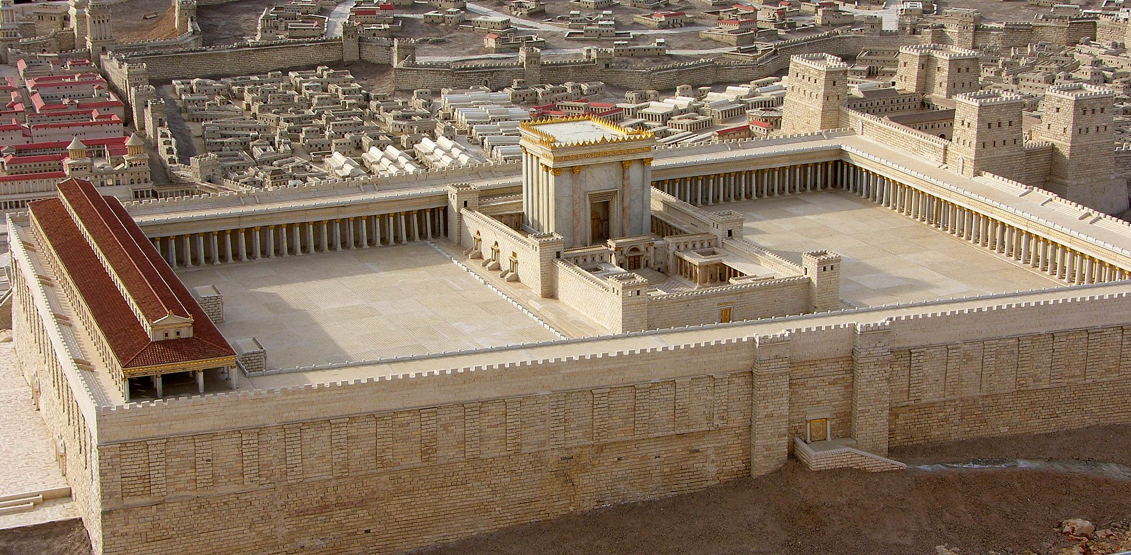
Herod’s Temple
Notes:
The Temple WAS NOT HANDICAP ACCESSIBLE
Solomons porch or portico was a covered colonnade along the eastern end of the court of the Gentiles (along the front of the picture)..
The Beautiful Gate was probably the Double Gate on the south side (left in the picture) that led up by a stairway into the court of the Gentiles.

Slide 6
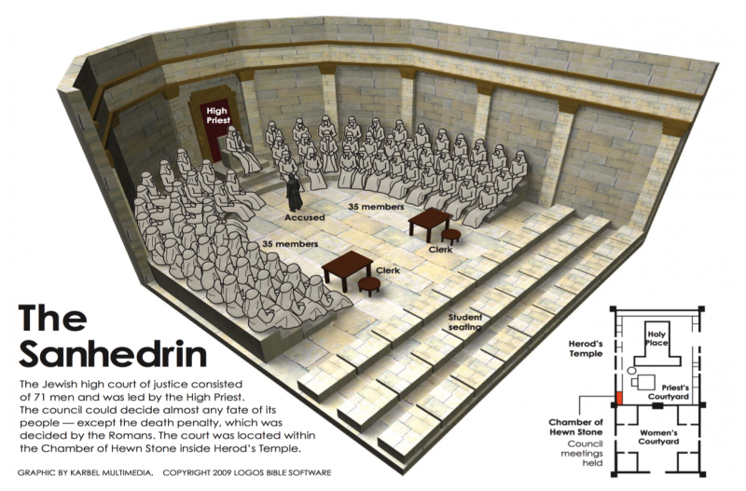

Slide 7
Peter & John before the Council
Acts 4:5-12
Peter answers the rulers (4:10-12).
  The name the Council inquired about was “Jesus Christ of Nazareth!”
    The One whom they had crucified.
    The One whom God had raised up.
    The One who is the prophetic Cornerstone (Ps. 118:22; Matt 21:23, 42; 1 Peter 2:4-8).
    The One who alone offers salvation (Jn. 14:6).
      Peter seized the moment and spoke about salvation in Jesus.
      We must also “redeem the time” and take advantage of opportunities (Col. 4:5-6).
Notes:
Psalms 118:22 The stone which the builders rejected Has become the chief cornerstone.
Jesus had answered a similar question in the same way!
Matthew 21:23 Now when He came into the temple, the chief priests and the elders of the people confronted Him as He was teaching, and said, "By what authority are You doing these things? And who gave You this authority?“
Jesus responds, asking them about John’s baptism (from heaven or men), and telling the parables of the two sons and the vinedressers.
Matthew 21:42 Jesus said to them, "Have you never read in the Scriptures: 'THE STONE WHICH THE BUILDERS REJECTED HAS BECOME THE CHIEF CORNERSTONE. THIS WAS THE LORD'S DOING, AND IT IS MARVELOUS IN OUR EYES’ ?
1 Peter 2:4-8 Coming to Him as to a living stone, rejected indeed by men, but chosen by God and precious, 5 you also, as living stones, are being built up a spiritual house, a holy priesthood, to offer up spiritual sacrifices acceptable to God through Jesus Christ. 6 Therefore it is also contained in the Scripture, "BEHOLD, I LAY IN ZION A CHIEF CORNERSTONE, ELECT, PRECIOUS, AND HE WHO BELIEVES ON HIM WILL BY NO MEANS BE PUT TO SHAME." 7 Therefore, to you who believe, He is precious; but to those who are disobedient, "THE STONE WHICH THE BUILDERS REJECTED HAS BECOME THE CHIEF CORNERSTONE," 8 and "A STONE OF STUMBLING AND A ROCK OF OFFENSE." They stumble, being disobedient to the word, to which they also were appointed.
Colossians 4:5-6 Walk in wisdom toward those who are outside, redeeming the time. 6 Let your speech always be with grace, seasoned with salt, that you may know how you ought to answer each one.

Slide 8
The Council Deliberates
Acts 4:13-22
The Council’s Dilemma (4:13-14).
    The apostles’ boldness put the Council on the defensive.
    Although uneducated and untrained, the Council realized they had been with Jesus.
    The man who had been healed was standing with Peter and John, and the council “could say nothing against it.”
Notes:
Uneducated is from ἀγράμματος – “illiterate, unlearned” (Thayer). They didn’t have formal education.
“Untrained” (“common” ESV, “ignorant” ASV) is from ἰδιώτης “in the NT, an unlearned, illiterate, man as opposed to the learned and educated: one who is unskilled in any art” (Thayer)

Slide 9
The Council Deliberates
Acts 4:13-22
The Council dismisses Peter and John to deliberate in private (4:15).
  They realize that “a notable miracle has been done through them is evident to all who dwell in Jerusalem, and we cannot deny it” (4:16).
  But to keep the apostles’ teaching from spreading “further among the people” they decide to “severely threaten them, that from now on they speak to no man in this name” (4:17).
  “They called them and commanded them not to speak at all nor teach in the name of Jesus” (4:18).

Slide 10
The Council Deliberates
Acts 4:13-22
The Apostles’ response
  “Whether it is right in the sight of God to listen to you more than to God, you judge.”*
  “For we cannot but speak the things which we have seen and heard.”
The Council threatens the apostles further but lets them go (4:22).
  They could not punish the apostles because the people “all glorified God for what had been done.”
Notes:
A lot of people have problems deciding whether they should listen to God or man. The choice isn’t really that hard see.
The apostles were compelled by conviction to preach the gospel.

Slide 11
The Prayer Meeting
Acts 4:23-31
Peter and John return to their own* company of fellow workers and report what happened (4:23).
They lift their collective voice in prayer (4:24-28).
  They praise God as the Creator of all.
  They cite Scripture which questions why rulers would do something so futile as to gather to stand against the LORD and His Christ (Ps. 2:1-2).
    They recognize that this is what the rulers had done to Jesus.
    And yet, those rulers had only managed to accomplish God’s “purpose.”
Notes:
The Greek is literally “own” (idios) and is an adjective with no noun supplied in the text. Translations thus vary: “fellow believers” (NET) – “company” (ASV), -- “companions” NKJV; “friends” ESV.
Their prayer is one of PRAISE – acknowledging God’s power in Creation and in human affairs AND then making REQUEST for His help in boldly proclaiming His word.
Psalms 2:1-2 Why do the nations rage, And the peoples meditate a vain thing? 2 The kings of the earth set themselves, And the rulers take counsel together, Against Jehovah, and against his anointed, saying,

Slide 12
The Prayer Meeting
Acts 4:23-31
Their prayer REQUEST (4:29-30).
  They ask God to take note of the Council’s threats.
  They request, “grant to Your servants that with all boldness they may speak Your word…”
    By stretching out His hand to heal.
    By working signs and wonders through the name of Jesus.*
  God’s ANSWER: “When they had prayed, the place where they were assembled together was shaken; and they were all filled with the Holy Spirit, and they spoke the word of God with boldness” (4:31).
Notes:
These works of God had been the reason people had heard and heeded the apostle’s words, and that the leaders could not successfully challenge their work.
The place where they prayed shook (physical evidence cp. 2:2-3)
The apostles were once again filled with the Holy Spirit (confirmation of what had occurred earlier cp. 2:4)
The apostles “…spoke the word of God with boldness” (exactly what they had requested in prayer)
NOTE from Jeff Smith: The apostles prayed effectively and properly.
Their request focused on how God could further help them accomplish their work for Him
Our petitions must be in accordance with His will (1 Jn 5:14-15, James 5:16b-18)

