Slide 1

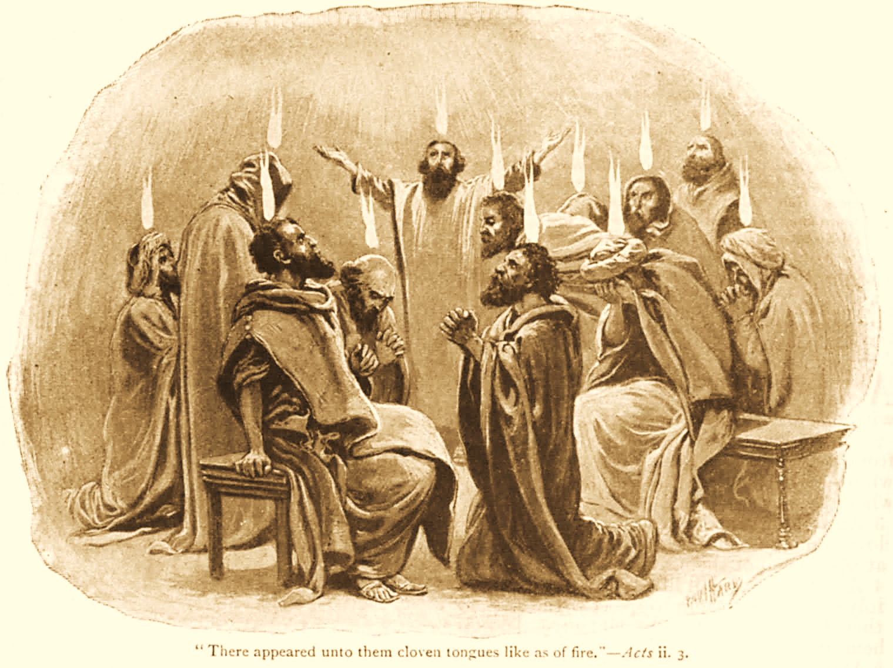
A C T S
Go Tell
the Good
News!
The Growth and
Development of the Early Church

Slide 2
A C T S
Lesson 7
Acts 4:32--5:11
Two Attitudes regarding Benevolence:
Barnabas
Ananias & Sapphira

Slide 3
The Disciples Share their Possessions (Acts 4:32-35)
The believers were of “one heart” and willingly shared their possessions.
  Their unity stands out (cf. 2:44-46).
  Special circumstances in the early church had resulted in many being in need (Acts 2:5, 41).
  This is the second reference in Acts to benevolence being provided to needy saints (Acts 2:42-45).
    Being benevolent (charitable) is problematic without love for others and the proper attitude toward one’s possessions (1 John 3:16-18).
    Throughout the New Testament, we see disciples being taught to give up possessions to meet “urgent needs” (Luke 12:33-34; Titus 3:14; Ephesians 4:28; 1 Timothy 6:17-19).
Notes:
John 3:16-18 By this we know love, because He laid down His life for us. And we also ought to lay down our lives for the brethren. 17 But whoever has this world's goods, and sees his brother in need, and shuts up his heart from him, how does the love of God abide in him? 18 My little children, let us not love in word or in tongue, but in deed and in truth.
Luke 12:33-34 Sell what you have and give alms; provide yourselves money bags which do not grow old, a treasure in the heavens that does not fail, where no thief approaches nor moth destroys. 34 For where your treasure is, there your heart will be also.
Titus 3:14 And let our people also learn to maintain good works, to meet urgent needs, that they may not be unfruitful.
Ephesians 4:28 Let him who stole steal no longer, but rather let him labor, working with his hands what is good, that he may have something to give him who has need.
1 Timothy 6:17-19 Command those who are rich in this present age not to be haughty, nor to trust in uncertain riches but in the living God, who gives us richly all things to enjoy. 18 Let them do good, that they be rich in good works, ready to give, willing to share, 19 storing up for themselves a good foundation for the time to come, that they may lay hold on eternal life.

Slide 4
The Disciples Share their Possessions (Acts 4:32-35)
With great power the apostles gave witness to the resurrection of the Lord Jesus.
  The continual testimony of the apostles may account for the charitable attitude of so many.
  This resurrection-based testimony, coupled with the believers’ display of unselfishness, brought “abundant grace” upon them all.
    No one lacked!
    This caring and sharing mindset moved believers to act in accordance with their attitudes.
  The apostles served as distributing agents.
    Distribution was based upon need. It was not a guaranteed income.
Notes:
This resurrection-based testimony, coupled with the believers’ display of unselfishness, brought about “abundant grace

Slide 5
Barnabas exemplifies a selfless attitude (Acts 4:36-37)
Joses was also named “Barnabas” by the apostles.
  Barnabas means “Son of Encouragement.”
  He was a Levite of the country of Cyprus.
  Barnabas is an example of what many others apparently were doing:
    Having land, he sold it and brought the money and laid it at the apostles' feet (cf. 4:34-35).
    With this account, Barnabas is introduced into the narrative as a man of inspirational convictions (cp. Acts 11:22-24)
Notes:
Acts 11:22-24 Then news of these things came to the ears of the church in Jerusalem, and they sent out Barnabas to go as far as Antioch. 23 When he came and had seen the grace of God, he was glad, and encouraged them all that with purpose of heart they should continue with the Lord. 24 For he was a good man, full of the Holy Spirit and of faith. And a great many people were added to the Lord.
We do not know under what conditions he obeyed the gospel
– Who baptized him, where, when?
– Could he have been in Jerusalem on Pentecost as a faithful Jew? 2:41
– Though not stated, Cyprus being represented in Jerusalem on that day is not entirely unbelievable 2:9-11

Slide 6
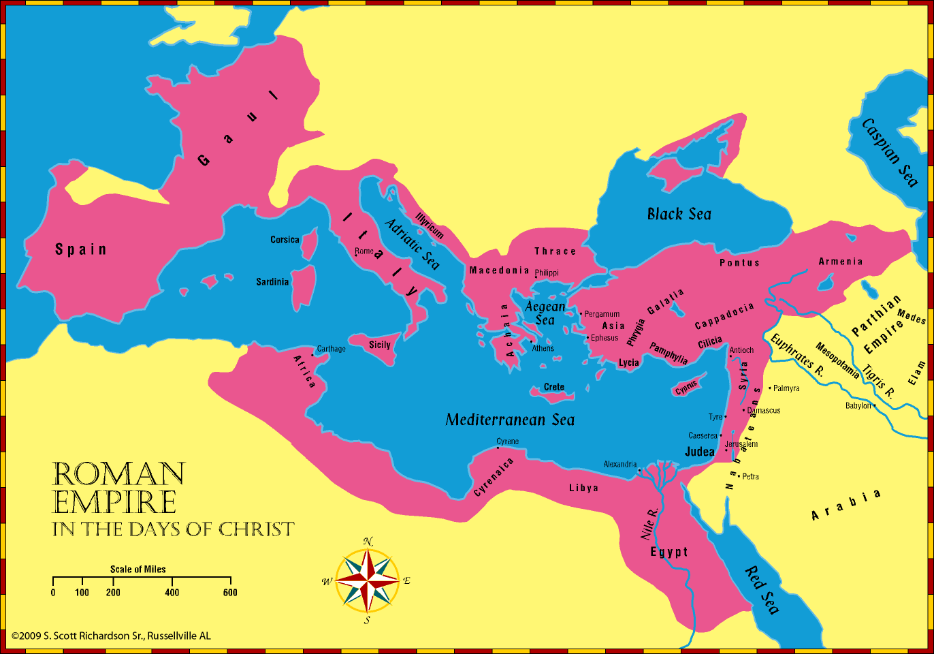

Slide 7
Ananias & Sapphira display a selfish attitude (Acts 5:1-11)
“But” Ananias and Sapphira sell a possession and keep back part of the proceeds.
Peter confronts Ananias with rhetorical questions uncovering the motive and foolishness of his sin:
  Why had Satan filled his heart to lie to the Holy Spirit and keep back part of the price of the land?
  “While it remained, was it not your own? And after it was sold, was it not in your own control? Why have you conceived this thing in your heart?”
“You have not lied to men but to God!”*
Notes:
The divinity of the Holy Spirit is proven by Peter’s words (Acts 5:3-4)

Slide 8
Ananias & Sapphira display a selfish attitude (Acts 5:1-11)
Then Ananias, hearing these words, fell down and breathed his last.
  So great fear came upon all those who heard these things.
  The young men arose and wrapped him up, carried him out, and buried him.

Slide 9
Ananias & Sapphira display a selfish attitude (Acts 5:1-11)
About three hours later Sapphira comes in, not knowing what had happened.
Peter asks if she sold the land for a certain price and she answers, "Yes."
Then Peter said to her, "How is it that you have agreed together to test* the Spirit of the Lord?”
  Those who had buried her husband would carry her out as well.
  Immediately she fell down at his feet and breathed her last.
  The young men came in and found her dead, and carrying her out, buried her by her husband.
So great fear came upon all the church and upon all who heard these things.*
Notes:
*Satan’s desire is for us to make choices that put God to the test (daring Him to act as He has said He will)
Matthew 4:6-7 and said to Him, "If You are the Son of God, throw Yourself down. For it is written: 'HE SHALL GIVE HIS ANGELS CHARGE OVER YOU,' and, IN THEIR HANDS THEY SHALL BEAR YOU UP, LEST YOU DASH YOUR FOOT AGAINST A STONE.' " 7 Jesus said to him, "It is written again, 'YOU SHALL NOT TEMPT THE LORD YOUR GOD.' "
They likely wanted the admiration faithful brethren were receiving for their loving sacrificial gifts toward the needy
Their problem was they weren’t willing to sacrifice to the same extent to receive such admiration honorably
Their lies exposed a sinful attitude → greed 1 Timothy 6:10 For the love of money is a root of all kinds of evil, for which some have strayed from the faith in their greediness, and pierced themselves through with many sorrows.
Satan played the major role in their plans to defraud
Not giving all the proceeds from the sale was not sinful.
Peter’s Holy Spirit-led ability exposed their fraudulence

Slide 10
Lessons for Us
The love of money results in all manner of evil consequences (1 Timothy 6:10).
Lying is a sin with eternal consequences.
  It is the work of the devil (John 8:44).
  Unrepentant liars will not spend eternity with God. (Eph. 4:25; Col. 3:9; Rev. 21:8, 27).
Punishing sin is necessary for the offender and instructive for others.
  Fear that results from seeing evil punished is a good (Acts 5:5, 11; 1 Cor. 5:6; 1 Tim. 5:20).
Notes:
Ephesians 4:25 Therefore, putting away lying, "LET EACH ONE OF YOU SPEAK TRUTH WITH HIS NEIGHBOR," for we are members of one another.
Colossians 3:9 Do not lie to one another, since you have put off the old man with his deeds,
Revelation 21:8 But the cowardly, unbelieving, abominable, murderers, sexually immoral, sorcerers, idolaters, and all liars shall have their part in the lake which burns with fire and brimstone, which is the second death.“
Revelation 21:27 But there shall by no means enter it anything that defiles, or causes an abomination or a lie, but only those who are written in the Lamb's Book of Life.
1 Corinthians 5:6 Your glorying is not good. Do you not know that a little leaven leavens the whole lump?
1 Timothy 5:20 Those who are sinning rebuke in the presence of all, that the rest also may fear.

Slide 12
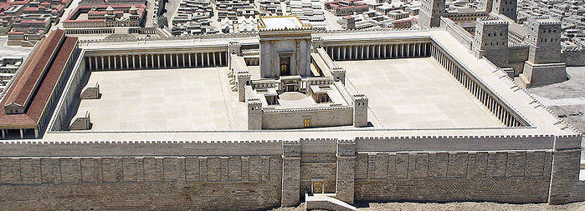
The Apostles Continue their Work (Acts 5:12-16)
The disciples are together on Solomon’s porch.
The apostles continue to perform many miracles, attracting people from other Judean cities (2:43; 3:6-9; 4:33)
Although none of the “rest” dared join them, the saints were highly esteemed by the people. Multitudes of believers are added to the Lord.

Slide 13
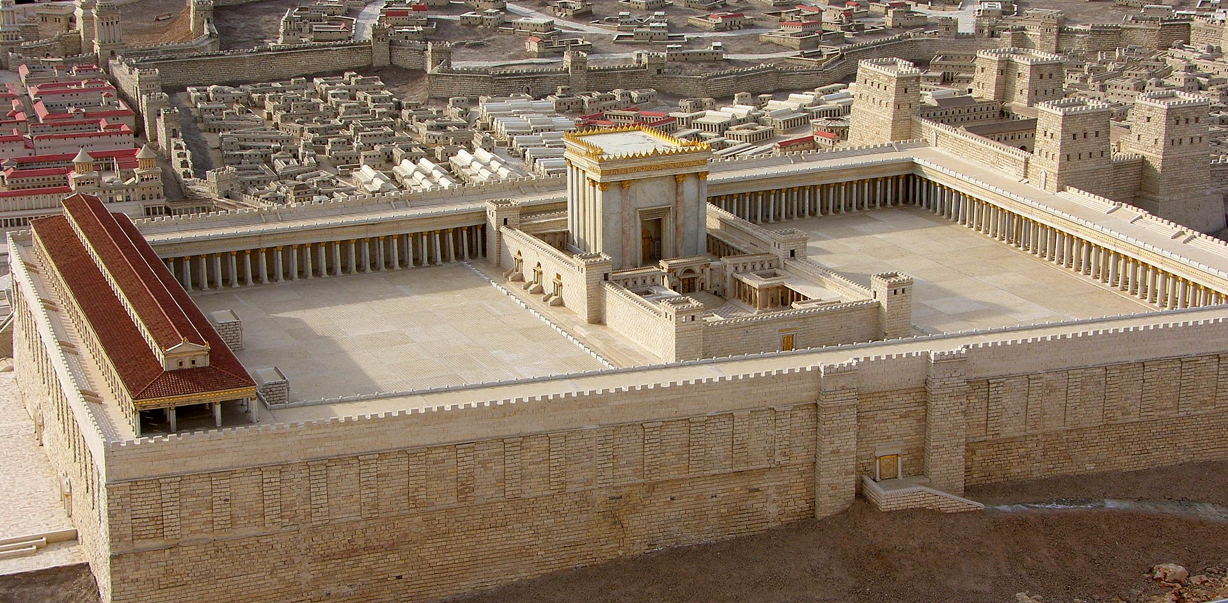
Herod’s Temple
Notes:
The Temple WAS NOT HANDICAP ACCESSIBLE
Solomons porch or portico was a covered colonnade along the eastern end of the court of the Gentiles (along the front of the picture)..
The Beautiful Gate was probably the Double Gate on the south side (left in the picture) that led up by a stairway into the court of the Gentiles.

