Slide 1

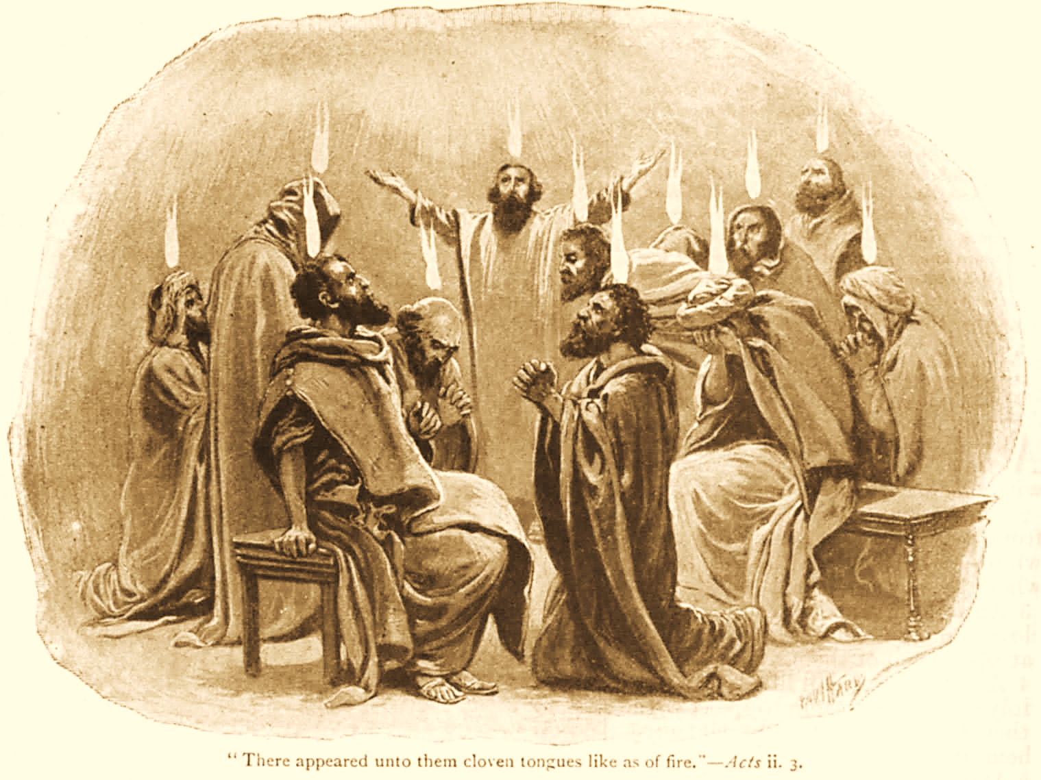
A C T S
Go Tell
the Good
News!
The Growth and
Development of the Early Church

Slide 2
A C T S
Lesson 8
Acts 5:12-42
The apostles’ second appearance before the Sanhedrin council

Slide 3
The Apostles Continue their Work (Acts 5:12-16)
The disciples are together on Solomon’s porch.
The apostles continue to perform many miracles, attracting people from other Judean cities (Acts 5:16, cf. 2:43; 3:6-9; 4:33; 1:8)
  Although “none of the rest”* dared join them, the saints were highly esteemed by the people (cf. John 12:42-43).
Multitudes of believers were increasingly added to the Lord, both men and women.
Many were brought for healing. They were laid in the streets hoping that at least Peter’s shadow would fall on them as he passed by – “and they were all healed!”
Notes:
Remember these previous points made…
The apostles had requested God work signs & wonders through them – this would give them courage (boldness) to keep preaching Acts 4:24-30
The purpose of miracles – to confirm, authenticate, and certify the word. Mark 16:20 And they went out and preached everywhere, the Lord working with them and confirming the word through the accompanying signs. Amen.
The “rest” are likely Jewish leaders and the upper crust of society, who would have status and power to lose.
Barnes notes: The phrase “the rest” denotes sometimes what is more excellent, or which is superior in value or importance to something else. See Luk_12:26.
And that “the great, though they believed on Jesus, were afraid to come forth publicly and profess him before people. See Joh_12:42-43; Joh_5:44.”
John 12:42 Nevertheless even among the rulers many believed in Him, but because of the Pharisees they did not confess Him, lest they should be put out of the synagogue;

Slide 4
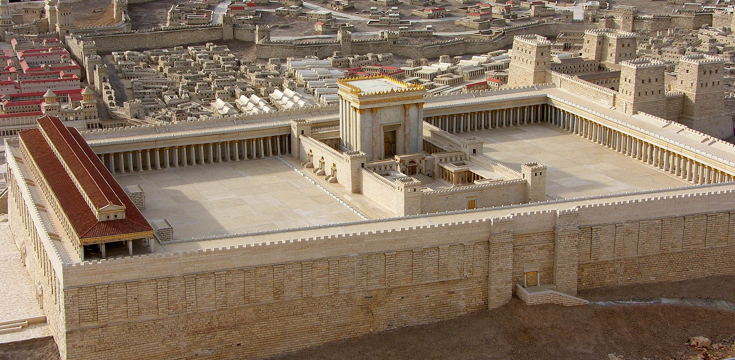
Herod’s Temple
Notes:
Solomons porch or portico was a covered colonnade along the eastern end of the court of the Gentiles (along the front of the picture)..
The Hall of Hewn stone, where the Sanhedrin meets, is in the wall of the sanctuary.
The Beautiful Gate was probably the Double Gate on the south side (left in the picture) that led up by a stairway into the court of the Gentiles.

Slide 5
The Apostles are Arrested
(Acts 5:17-42)
The High Priest and Sadducees are “filled with indignation” and have the apostles imprisoned.
An angel frees the apostles at night.
  He commands them to “Go and stand in the temple and speak to the people all the words of this Life.”
  At daybreak they enter the temple and teach.
The High Priest and the council send officers to bring the apostles out of prison.
  The officers return and report that they found the prison locked and guards at the doors, but no one inside.
  Someone informs the “perplexed” council that “The men whom you put in prison are standing in the temple and teaching the people.”
Notes:
“Indignation” (“jealousy”, ESV) is translated from “zelos” often translated zeal, but here with the meaning of “1a2) the fierceness of indignation, punitive zeal
1b) an envious and contentious rivalry, jealousy” (Thayer’s Lexicon).

Slide 6
The Apostles on Trial
(Acts 5:17-42)
The captain and the officers go to the temple and bring the apostles before the council.
  But they do so “without violence, for they feared the people, lest they should be stoned.”
The high priest accuses the apostles of…
  Disregarding the council’s command “not to teach” in the name of Jesus.
  Filling Jerusalem with their doctrine and intending to bring Jesus’ blood on the Jews (cp. Matt. 27:24-25).
Notes:
Matthew 27:24-25 When Pilate saw that he could not prevail at all, but rather that a tumult was rising, he took water and washed his hands before the multitude, saying, "I am innocent of the blood of this just Person. You see to it." 25 And all the people answered and said, "His blood be on us and on our children."

Slide 7
The Apostles on Trial
(Acts 5:17-42)
Peter responds to the charges (5:29-32):
  “We ought to obey God rather than men.”
  You murdered Jesus, but God raised Him.
  God exalted Jesus to be Prince and Savior – enabling Israel to repent and be forgiven.
  The apostles and the Holy Spirit are witnesses.
Notes:
Prince is translated from “ἀρχηγός” Thayer Definition:1) the chief leader, prince 2) one that takes the lead in any thing and thus affords an example, a predecessor in a matter, pioneer 3) the author
Acts 3:15 and killed the Prince of life, whom God raised from the dead, of which we are witnesses.
Hebrews 2:10 For it was fitting for Him, for whom are all things and by whom are all things, in bringing many sons to glory, to make the captain of their salvation perfect through sufferings.

Slide 8
The Apostles on Trial
(Acts 5:17-42)
The reaction of the council (5:33).
  They are furious and plot to kill the apostles.
Gamaliel advises restraint and caution (5:34-40).
  He is described as Pharisee and a “teacher of the law held in respect by all the people” (5:34).
  He notes that insurrections led by Theudus* and Judas of Galilee* came to nothing.
  “If it is of God, you cannot overthrow it.”
Notes:
Furios (cut to the heart), from διαπρίω 1) to saw asunder or in two, to divide by a saw 2) to be sawn through mentally, i.e. to be rent with vexation (Thayer).
He also reasoned from practical reality:
– Movements from men will always fade INFERIOR origin
-- Movements from God will always succeed SUPERIOR origin (e.g. the Hebrews multiplying in Egypt despite Pharaoh’s efforts, Ex 1:8-12, 15-17, and the success of John the Baptist, Matt 21:23-27)
Nothing is known of this Theudus, although Josephus mentions a later rebellion under a man by this name.
Judas of Galilee "With this account agrees the history of Josephus (Antiq. xviii. 1. 1), except that, as has been already noticed, he calls Judas a Gaulonite, but as when speaking of the same man again (xx. 5. 2) he calls him Judas of Galilee, and in the same sentence alludes to the history before narrated “as we have shewn in a foregoing book,” we can have no hesitation in accepting Gamaliel’s story as the correct one, while at the same time we may learn from this example what value we ought to place on the accuracy of Josephus when we have to weigh his statements against those of the New Testament.
in the days of the taxing] Not the same which is mentioned Luk_2:2. That was rather an enrolment or census-taking preliminary to taxation. The revolt of Judas, about seven years later, was caused by the actual imposition of a tax. Josephus says of it (xviii. 1. 1): “Cyrenius came into Judæa to take an account of their substance,” and afterwards “Judas said that this taxation was no better than an introduction to slavery, and exhorted the nation to assert their liberty.”
drew away much people after him] The Greek word rendered much is wanting in the best MSS. Read, drew away [some of the] people after him. he also perished] Josephus gives no notice of the fate of Judas and his party, though he mentions the revolt several times and says (B. J. ii. 8. 1) that this “Judas was a teacher of a peculiar sect of his own.

Slide 9
The Apostles on Trial
(Acts 5:17-42)
Gamaliel is known outside the Bible in the writings of Josephus and in the Jewish Talmud.
Saul of Tarsus was one of his pupils (Acts 22:3).
Noted scholar J.B. Lightfoot states, “This was Rabban Gamaliel the first; commonly, by way of distinction, called Rabban Gamaliel the elder. He was president of the council after the death of his own father, Rabban Simeon, who was the son of Hillel…He died eighteen years before the destruction of Jerusalem, his son Simeon succeeding him in the chair, who perished in the ruins of the city.”
The Jewish Mishnah records, “Since Rabban Gamaliel the Elder died, there has been no more reverence for the law, and purity and piety died out ” (Sotah 15:8)

Slide 10
The Apostles are Beaten and Released (Acts 5:17-42)
  “…and when they had called for the apostles and beaten them, they commanded that they should not speak in the name of Jesus, and let them go. So they departed from the presence of the council, rejoicing that they were counted worthy to suffer shame for His name. And daily in the temple, and in every house, they did not cease teaching and preaching Jesus as the Christ.” (Acts 5:40-42 cf. Matthew 5:10-12)
Notes:
Matthew 5:10-12 Blessed are those who are persecuted for righteousness' sake, For theirs is the kingdom of heaven. 11 "Blessed are you when they revile and persecute you, and say all kinds of evil against you falsely for My sake. 12 Rejoice and be exceedingly glad, for great is your reward in heaven, for so they persecuted the prophets who were before you.

Slide 11
Lessons for Us
Suffering for Jesus is a privilege that brings joy.
  This requires and develops spiritual maturity (James 1:2-4; 1 Peter 1:6-9).
One cannot successfully oppose God.
  The apostles noted this in their prayer after their first encounter with the Council (Acts 4:25-26; cf. Psalm 2).
  To be on the opposing side of God is to face His wrath in the end (Hebrews 10:31; Galatians 6:7).
Notes:
James 1:2-4 My brethren, count it all joy when you fall into various trials, 3 knowing that the testing of your faith produces patience. 4 But let patience have its perfect work, that you may be perfect and complete, lacking nothing.
1 Peter 1:6-9 In this you greatly rejoice, though now for a little while, if need be, you have been grieved by various trials, 7 that the genuineness of your faith, being much more precious than gold that perishes, though it is tested by fire, may be found to praise, honor, and glory at the revelation of Jesus Christ, 8 whom having not seen you love. Though now you do not see Him, yet believing, you rejoice with joy inexpressible and full of glory, 9 receiving the end of your faith—the salvation of your souls.
It is a fearful thing to fall into the hands of the living God.
Gal 6:7 “Be not deceived, God is not mocked…”

