Slide 1
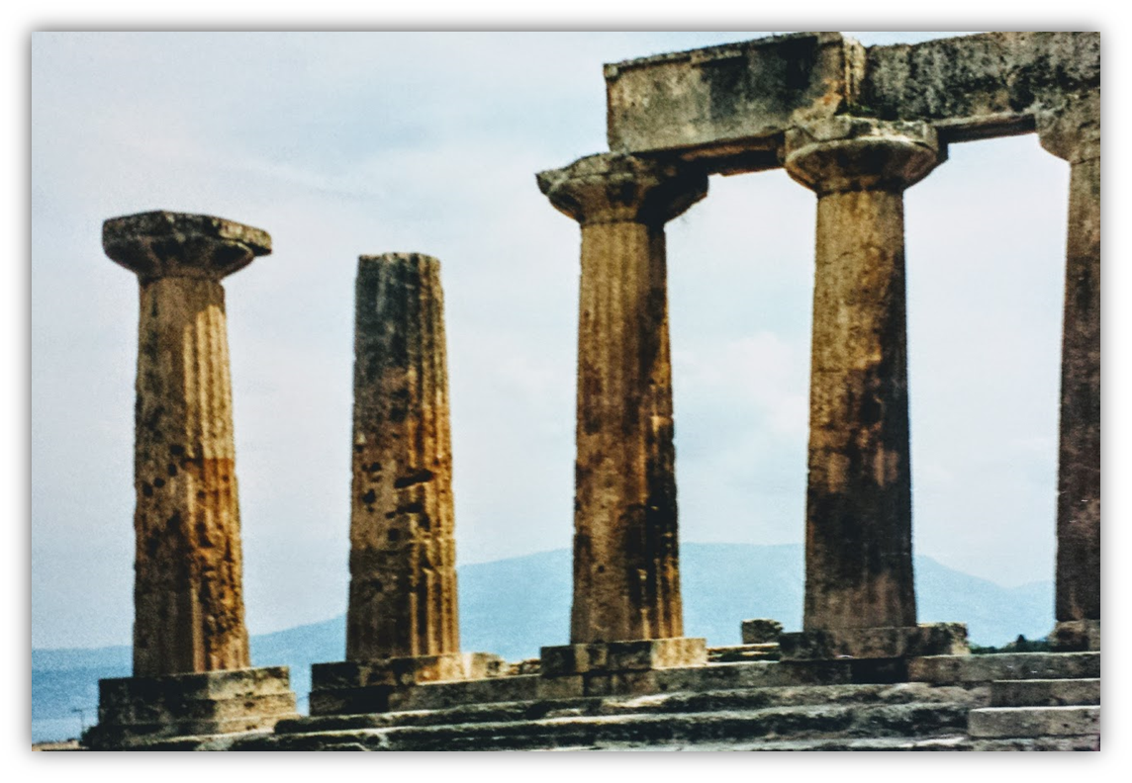
The Epistle of Second Corinthians

Slide 2
Outline of 2nd Corinthians
Explanation of Paul’s Apostolic Ministry (1:1—6:10)
Greetings from “an apostle…by the will of God” (1:1-2)
Past events in Paul’s ministry
Trouble in Asia, but comfort from God (1:3-11)
Plans for visiting Corinth (1:12-24)
Writing out of love produces sorrow, yields forgiveness (2:1-11)
Nature of the word Paul ministered
Dual aroma of the gospel (2:12-17)
The word is ministered thru the Corinthians’ changed lives (3:1-5)
A ministry of the Spirit (3:6-18)
God’s treasure in earthen vessels (4:1-7)
Motivation for ministering
An eternal perspective (4:8-18)
A future expectation (5:1-11)
The love of Christ (5:12-16)
Reconciling men to God (5:17-21)
Proof that Paul is a minister of God (6:1-10)

Slide 3
Outline of 2nd Corinthians
Exhortations to the Corinthians (6:11—9:15)
Concerning fellowshipping darkness
The Corinthians must open their hearts and separate from the world (6:11—7:3)
Comfort and confidence in the Corinthians’ obedience (7:4-16)
Concerning the collection for the saints. The Corinthians are to do the following:
Follow the examples of Christ and the Macedonian churches (8:1-9)
Complete what had been planned and purposed (8:10-15)
Prove themselves (8:16—9:5)
Sow that they might reap, in order to have more to sow (9:6-15)

Slide 4
Outline of 2nd Corinthians
Exoneration of Paul’s Apostleship (10:1—13:10)
Paul not to be measured “according to the flesh” (10:1-18)
Paul must boast:
His selflessness excludes others from being regarded as apostles (11:1-15)
His willingness to suffer (11:16-33)
His exaltation due to his revelations is tempered by infirmity (12:1-10)
His miracles (12:11-13)
He spent and was spent so as not to burden the Corinthians (12:14-18)
His desire for their edification (12:19—13:10)
Conclusion (13:11-14)

Slide 5
Challenges to the Corinthians: Follow-through with Plans for Giving (2 Corinthians 8:10-9:5)
The Corinthians’ Opportunity to Prove Themselves
Ultimately, both Macedonia and Achaia were pleased to make this contribution (Romans 15:26)
Paul had sent brethren ahead to Corinth to ensure that the Corinthians desire to give would come to fruition (9:5)
Paul’s efforts to encourage the Corinthians to give was not “extortion” (ASV).
Their gift was not compelled by Paul, but by their own “love,” “willingness” and “desire” to help needy saints.
Notes:
Romans 15:26 For it pleased those from Macedonia and Achaia to make a certain contribution for the poor among the saints who are in Jerusalem.
Other translation have “exaction” (ESV), “grudging obligation” (NKJV) and “covetousness” (KJV)

Slide 6
Challenges to the Corinthians: Sowing to Reap to Sow more Abundantly (2 Corinthians 9:5-15 )
Each one will reap as he sows (9:5)
This truth has important spiritual applications (Galatians 6:7-8), but here it is connected to giving to help the needy (Proverbs 11:24-25; 19:17; 22:9; Luke 6:38)
Giving should be decided in the heart (9:6)
It can be done without reluctance or regret because (a) we will reap as we have sown, and (b) God loves a cheerful giver.
Notes:
Galatians 6:7-8 Do not be deceived, God is not mocked; for whatever a man sows, that he will also reap. 8 For he who sows to his flesh will of the flesh reap corruption, but he who sows to the Spirit will of the Spirit reap everlasting life.
Proverbs 11:24-25 There is one who scatters, yet increases more; And there is one who withholds more than is right, But it leads to poverty. 25 The generous soul will be made rich, And he who waters will also be watered himself.
Proverbs 19:17 He who has pity on the poor lends to the LORD, And He will pay back what he has given.
Proverbs 22:9 He who has a generous eye will be blessed, For he gives of his bread to the poor.
Luke 6:38 Give, and it will be given to you: good measure, pressed down, shaken together, and running over will be put into your bosom. For with the same measure that you use, it will be measured back to you.“

Slide 7
Challenges to the Corinthians: Sowing to Reap to Sow more Abundantly (2 Corinthians 9:5-15 )
God is able to provide us with all that we need to “abound in every good work” (9:7-9)
We are stewards, using what God entrusts to us for His purposes & His glory (1 Peter 4:10; 1 Chron. 29:12-14)
To verify that God provides bountifully for the one who gives, Paul quotes Psalm 112 which describes the blessings that the Lord heaps upon the righteous and the charitable*
Paul desires that the Corinthians be blessed by the principles of sowing and reaping (9:10-11)
To enable them to be “generous in every way”
So that “thanksgiving to God” would be produced.
Notes:
1 Peter 4:10 As each has received a gift, use it to serve one another, as good stewards of God's varied grace:
1 Chronicles 29:12-14 Both riches and honor come from You, And You reign over all. In Your hand is power and might; In Your hand it is to make great And to give strength to all. 13 "Now therefore, our God, We thank You And praise Your glorious name. 14 But who am I, and who are my people, That we should be able to offer so willingly as this? For all things come from You, And of Your own we have given You.
SEE Psalm 112: 1, 3-5, 9

Slide 8
Challenges to the Corinthians: Sowing to Reap to Sow more Abundantly (2 Corinthians 9:5-15 )
The contribution would not only supply the needs of the saints but cause God to be glorified (9:12-14)
God would be glorified by saints for the Corinthians’ obedience to the gospel and their abundant charity.
The sharing of the Corinthians would be with the saints and “all men.”
Does this mean that the churches involved in this contribution were giving to help those who were not saints? If so, could churches not do the same today?

Slide 9
Who can churches help? Who DID churches help in the New Testament?
“All that believed” (Acts 2:44-45)
“Them that believed” (Acts 4:32, 34-35)
“Widows” among “disciples” (Acts 6:1-6)
“Widows indeed” (1 Timothy 5:16)
“Brethren” (Acts 11:27-30)
“Saints” (Romans 15:25-26)
“Saints” (1 Corinthians 16:1-2)
“Saints” (2 Corinthians 8:4)
“Saints” (2 Corinthians 9:12-14)

Slide 10
Why doesn’t “all men” in 2 Corinthians 9:13 include non-saints?
Consider the stated purpose of the contribution:
The contribution was “for the saints” (1 Cor. 16:1) and “for the poor saints…at Jerusalem” (Romans 15:25-26)
Its object was “ministering to the saints” (2 Cor. 8:4)
It supplied the “needs of the saints” (2 Cor. 9:12)
Consider the possible meanings of “all men.”
Note that “men” is in italics in the KJV, which means it is not in the original Greek text.
“All” must be limited! – Or else the contribution and its benefits are far too extensive.

Slide 11
Why doesn’t “all men” in 2 Corinthians 9:13 include non-saints?
Consider that those who received the distribution prayed to God and were thankful for His grace (2 Corinthians 9:14).
This could not include unbelievers!
Consider that Paul prayed to be delivered from those “in Judea who do not believe” and that the contribution he carried would be “acceptable to the saints” (Romans 15:30-31).
Why would he need to be delivered from people to whom he was giving????

Slide 12
Why doesn’t “all men” in 2 Corinthians 9:13 include non-saints?
Consider these comments:
David Lipscomb: “Seeing their obedience and fidelity to the gospel of Christ, and their liberality to the poor saints in Jerusalem in the offerings they made, prompted them to glorify God for the subjection to the gospel of Christ and beneficence to all men, for their liberality showed that they excluded no Christian from their fellowship.” (A Commentary on the NT Epistles)

Slide 13
Our Help of Needy Saints Produces Thanksgiving and Glory to God!
Consider how many times words like “thanksgiving” and “glorifying” are used in this context
8:19 and not only that, but who was also chosen by the churches to travel with us with this gift, which is administered by us to the glory of the Lord Himself
8:23 If anyone inquires about Titus, he is my partner and fellow worker concerning you. Or if our brethren are inquired about, they are messengers of the churches, the glory of Christ.
9:13 while, through the proof of this ministry, they glorify God for the obedience of your confession to the gospel of Christ, and for your liberal sharing with them and all men
9:11 while you are enriched in everything for all liberality, which causes thanksgiving through us to God.
9:12 For the administration of this service not only supplies the needs of the saints, but also is abounding through many thanksgivings to God,
9:15 Thanks be to God for His indescribable gift!

Slide 14
Lesson Schedule for our study of Second Corinthians Eastside Auditorium Winter Quarter 2017-18

