Slide 1
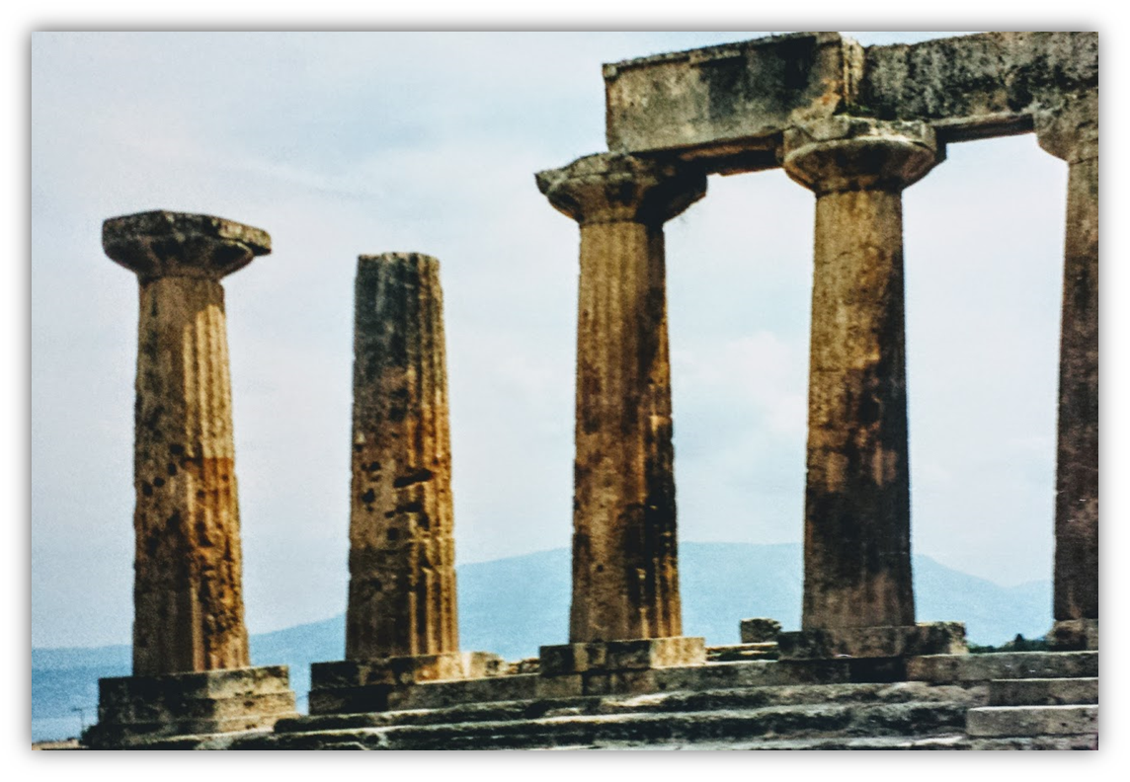
The Epistle of Second Corinthians

Slide 2
Outline of 2nd Corinthians
Explanation of Paul’s Apostolic Ministry (1:1—6:10)
Greetings from “an apostle…by the will of God” (1:1-2)
Past events in Paul’s ministry
Trouble in Asia, but comfort from God (1:3-11)
Plans for visiting Corinth (1:12-24)
Writing out of love produces sorrow, yields forgiveness (2:1-11)
Nature of the word Paul ministered
Dual aroma of the gospel (2:12-17)
The word is ministered thru the Corinthians’ changed lives (3:1-5)
A ministry of the Spirit (3:6-18)
God’s treasure in earthen vessels (4:1-7)
Motivation for ministering
An eternal perspective (4:8-18)
A future expectation (5:1-11)
The love of Christ (5:12-16)
Reconciling men to God (5:17-21)
Proof that Paul is a minister of God (6:1-10)

Slide 3
Outline of 2nd Corinthians
Exhortations to the Corinthians (6:11—9:15)
Concerning fellowshipping darkness
The Corinthians must open their hearts and separate from the world (6:11—7:3)
Comfort and confidence in the Corinthians’ obedience (7:4-16)
Concerning the collection for the saints. The Corinthians are to do the following:
Follow the examples of Christ and the Macedonian churches (8:1-9)
Complete what had been planned and purposed (8:10-15)
Prove themselves (8:16—9:5)
Sow that they might reap, in order to have more to sow (9:6-15)

Slide 4
Outline of 2nd Corinthians
Exoneration of Paul’s Apostleship (10:1—13:10)
Paul’s ministry cannot be measured “according to the flesh” (10:1-18)
Paul must boast:
His selflessness excludes others from being regarded as apostles (11:1-15)
His willingness to suffer (11:16-33)
His exaltation due to his revelations is tempered by infirmity (12:1-10)
His miracles (12:11-13)
He spent and was spent so as not to burden the Corinthians (12:14-18)
His desire for their edification (12:19—13:10)
Conclusion (13:11-14)

Slide 5
Exoneration of Paul’s Apostleship: Paul’s ministry is not carnal (2 Corinthians 10:1-18)
Paul pleads for the Corinthians to correct their attitudes before he visits them (10:1-2)
He had the reputation among some of acting timid while among them, but bold when away* (cf. 10:10).
He does not want to have to show them the boldness that some think he only shows while away.
His weapons are not carnal (10:3-6)
Spiritual war is being waged (1 Timothy 6:12)
Paul’s ministry used God’s weapons! (2 Cor. 6:4, 7)*
These weapons could destroy “strongholds” – i.e. human arguments and elitist reasoning that prevented men from truly knowing God.
Notes:
*NIV translation
1 Timothy 6:12 Fight the good fight of the faith. Take hold of the eternal life to which you were called and about which you made the good confession in the presence of many witnesses.
The word translated weapons here is the same as in 6:7 (where the NKJV has armor), but it Thayer says it means “arms used in warfare, weapons”

Slide 6
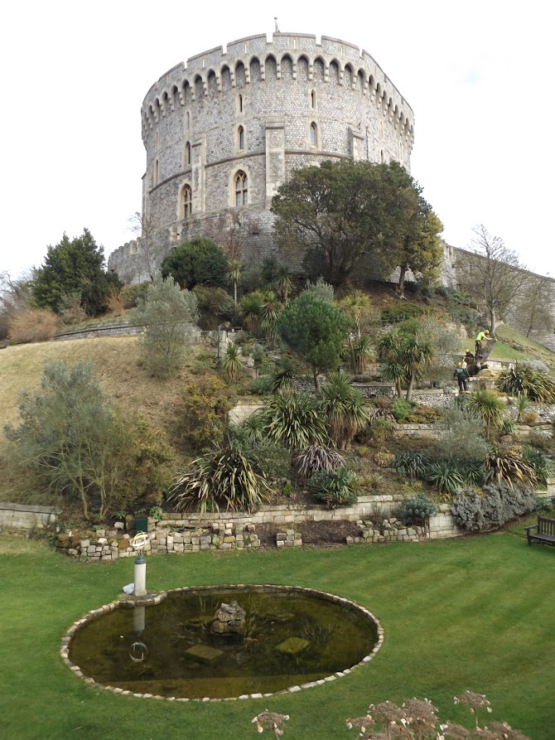
Exoneration of Paul’s Apostleship: Paul’s ministry is not carnal (2 Corinthians 10:1-18)
Paul’s Spiritual Weapons
They could bring every thought into captivity to the obedience of Christ
Paul was ready to use these weapons to punish those who remained in disobedience when the Corinthians themselves were brought to full obedience (2:9; Romans 16:17-18; Titus 3:10; 3 John 10)
Notes:
Titus 3:10 Reject a divisive man after the first and second admonition,
3 John 1:10 Therefore, if I come, I will call to mind his deeds which he does, prating against us with malicious words. And not content with that, he himself does not receive the brethren, and forbids those who wish to, putting them out of the church.
Romans 16:17-18 Now I urge you, brethren, note those who cause divisions and offenses, contrary to the doctrine which you learned, and avoid them. 18 For those who are such do not serve our Lord Jesus Christ, but their own belly, and by smooth words and flattering speech deceive the hearts of the simple.

Slide 7
Exoneration of Paul’s Apostleship: Paul’s ministry is not carnal (2 Corinthians 10:1-18)
Paul’s authority for building up the church (10:7-11)
The Corinthians were looking at things according to (carnal) appearances.*
If those who considered themselves to be Christ’s would reconsider, they would acknowledge that Paul was also Christ’s.
He is not ashamed to boast about His legitimate authority – it was given to him by the Lord for edification, not destruction.
If needed, Paul would use his authority just as boldly in their presence as he did in his letters.
Notes:
Barnes says that “the false teachers…valued themselves on their external advantages, and laid claim to special honor in the work of the ministry, because they were superior in personal appearance, in rank, manners, or eloquence to Paul. Paul reproves them for thus judging…”

Slide 8
Exoneration of Paul’s Apostleship: Paul’s ministry is not carnal (2 Corinthians 10:1-18)
The sphere of Paul’s authority (10:12-16)
Paul’s position and power were not determined by comparing himself with others – which was the method Paul’s detractors used.
Paul’s sphere of authority was appointed Him by God and included the Corinthians in particular!
He was the one who first came to Corinth with the gospel.
Others were staking claims to his labors, Paul was not and would not boast in another’s accomplishment.
He was not thinking more highly of himself than he should, but was considering what God had dealt him (Rom. 12:3ff.)
His hope was that as their faith grew, their higher regard for him would facilitate the further spread of the gospel.
Notes:
Romans 12:3 For I say, through the grace given to me, to everyone who is among you, not to think of himself more highly than he ought to think, but to think soberly, as God has dealt to each one a measure of faith….

Slide 9
Exoneration of Paul’s Apostleship: Paul’s ministry is not carnal (2 Corinthians 10:1-18)
Glory in the Lord, not self (10:17-18)
But HE WHO GLORIES, LET HIM GLORY IN THE LORD. For not he who commends himself is approved, but whom the Lord commends. (cf. Jeremiah 9:23-24; 1 Corinthians 1:31)
Notes:
Jeremiah 9:23-24 Thus says the LORD: "Let not the wise man glory in his wisdom, Let not the mighty man glory in his might, Nor let the rich man glory in his riches; 24 But let him who glories glory in this, That he understands and knows Me, That I am the LORD, exercising lovingkindness, judgment, and righteousness in the earth. For in these I delight," says the LORD.
1 Corinthians 1:31 that, as it is written, "HE WHO GLORIES, LET HIM GLORY IN THE LORD."

Slide 10
Lesson Schedule for our study of Second Corinthians Eastside Auditorium Winter Quarter 2017-18

