Slide 1
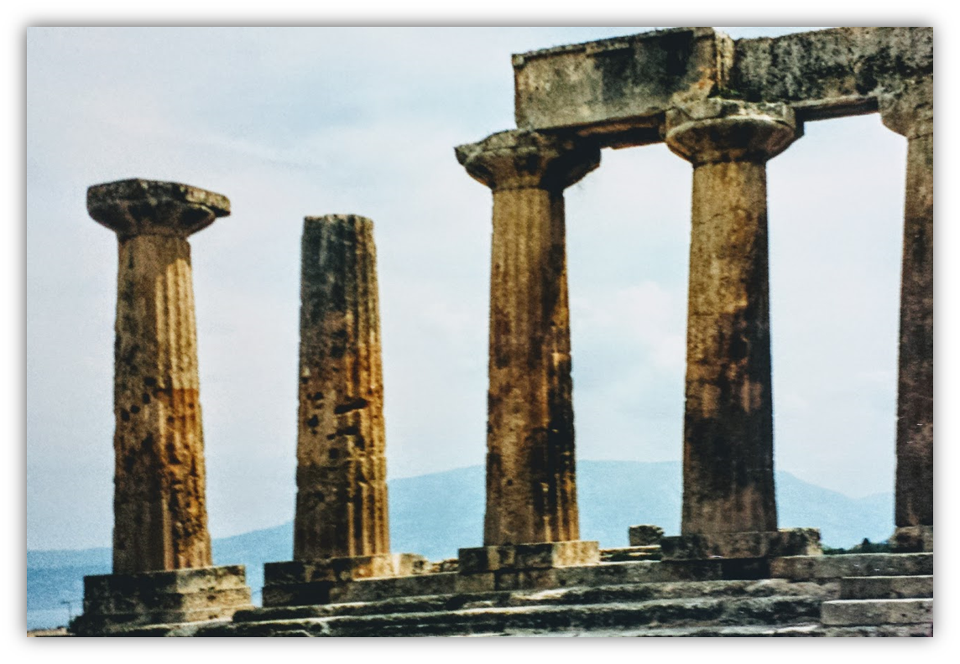
The Epistle of Second Corinthians

Slide 2
Outline of 2nd Corinthians
Explanation of Paul’s Apostolic Ministry (1:1—6:10)
  Greetings from “an apostle…by the will of God” (1:1-2)
  Past events in Paul’s ministry
    Trouble in Asia, but comfort from God (1:3-11)
    Plans for visiting Corinth (1:12-24)
    Writing out of love produces sorrow, yields forgiveness (2:1-11)
  Nature of the word Paul ministered
    Dual aroma of the gospel (2:12-17)
    The word is ministered thru the Corinthians’ changed lives (3:1-5)
    A ministry of the Spirit (3:6-18)
    God’s treasure in earthen vessels (4:1-7)
  Motivation for ministering
    An eternal perspective (4:8-18)
    A future expectation (5:1-11)
    The love of Christ (5:12-16)
    Reconciling men to God (5:17-21)
  Proof that Paul is a minister of God (6:1-10)

Slide 3
Outline of 2nd Corinthians
Exhortations to the Corinthians (6:11—9:15)
Concerning fellowshipping darkness
  The Corinthians must open their hearts and separate from the world (6:11—7:3)
  Comfort and confidence in the Corinthians’ obedience (7:4-16)
Concerning the collection for the saints. The Corinthians are to do the following:
  Follow the examples of Christ and the Macedonian churches (8:1-9)
  Complete what had been planned and purposed (8:10-15)
  Prove themselves (8:16—9:5)
  Sow that they might reap, in order to have more to sow (9:6-15)

Slide 4
Outline of 2nd Corinthians
Exoneration of Paul’s Apostleship (10:1—13:10)
Paul’s ministry cannot be measured “according to the flesh” (10:1-18)
Paul must boast:
  His selflessness excludes others from being regarded as apostles (11:1-15)
  His willingness to suffer (11:16-33)
  His exaltation due to his revelations is tempered by infirmity (12:1-10)
  His miracles (12:11-13)
  He spent and was spent so as not to burden the Corinthians (12:14-18)
  His desire for their edification (12:19—13:10)
Conclusion (13:11-14)

Slide 5
Exoneration of Paul’s Apostleship:
Performing Miracles & Making Sacrifices
(2 Corinthians 12:11-21)
  Paul was compelled to foolish boasting (12:11)
    The Corinthians themselves should have been the ones commending Paul (Proverbs 27:2; 2 Corinthians 5:12; 1 Corinthians 9:1-2)
    Paul was not inferior to the super-apostles* at Corinth in anything, although he himself is nothing (cf. 11:5; 1 Corinthians 3:6-7)
      What is Paul implying here about the power behind the great work he had done at Corinth? (cf. 12:9)
    Paul had continually demonstrated himself to be a true apostle by performing signs, wonders, and mighty deeds (miracles) (12:12; Acts 2:22)
Notes:
Proverbs 27:2 Let another man praise you, and not your own mouth; A stranger, and not your own lips.
2 Corinthians 5:12 For we do not commend ourselves again to you, but give you opportunity to boast on our behalf, that you may have an answer for those who boast in appearance and not in heart.
1 Corinthians 9:1-2 Am I not an apostle? Am I not free? Have I not seen Jesus Christ our Lord? Are you not my work in the Lord? 2 If I am not an apostle to others, yet doubtless I am to you. For you are the seal of my apostleship in the Lord.
12:11b “For I was not at all inferior to these super-apostles, even though I am nothing.” (ESV)
The ESV, NIV, NASB, NRSV all have “true apostle” here
These same three words are used to describe the miracles performed by Jesus to authenticate that He was approved of God: Acts 2:22 "Men of Israel, hear these words: Jesus of Nazareth, a Man attested by God to you by miracles, wonders, and signs which God did through Him in your midst, as you yourselves also know—

Slide 6
Exoneration of Paul’s Apostleship:
Performing Miracles & Making Sacrifices
(2 Corinthians 12:11-21)
    The Corinthians had benefited from Paul’s apostleship as fully as any church, except that he had not allowed them the privilege of supporting him (12:13-16; 11:7-8; 1 Cor. 9:11-12)
      As Paul readies himself to come to Corinth a third time, he reaffirms that he will not be a financial burden to them; “I seek not what is yours, but you” (ESV, cf. 11:9)
      Parents should save up for the children (cp. 1 Tim. 5:4; Matthew 15:4-5)
      Paul is willing to “spend and be spent.”
      The Corinthians had not returned the love Paul had shown them (2 Corinthians 6:11-12; 7:2; Prov. 19:26)
Notes:
1 Corinthians 9:11-12 If we have sown spiritual things for you, is it a great thing if we reap your material things? 12 If others are partakers of this right over you, are we not even more? Nevertheless we have not used this right, but endure all things lest we hinder the gospel of Christ.
1 Timothy 5:4 But if a widow has children or grandchildren, let them first learn to show godliness to their own household and to make some return to their parents, for this is pleasing in the sight of God.
2 Corinthians 7:2 Open your hearts to us. We have wronged no one, we have corrupted no one, we have cheated no one.
2 Corinthians 6:11-12 O Corinthians! We have spoken openly to you, our heart is wide open. 12 You are not restricted by us, but you are restricted by your own affections.
Proverbs 19:26 He who mistreats his father and chases away his mother Is a son who causes shame and brings reproach.

Slide 7
Exoneration of Paul’s Apostleship:
Performing Miracles & Making Sacrifices
(2 Corinthians 12:11-21)
    Neither Paul nor his fellow workers had taken advantage of or burdened the Corinthians (12:16-19)
      With strong irony Paul says, “being crafty, I caught you by cunning.” (12:16)
        He had of course done the opposite – liberating them by the gospel in truth and sincerity (1:12; 2:17)
      Paul, Titus, and their fellow workers had conducted themselves with exemplary honor and selflessness.
      Paul makes no excuses for their behavior, for they had done all things for the edification of the beloved Corinthians. (2 Corinthians 4:11-12, 15)
Notes:
2 Corinthians 1:12 For our boasting is this: the testimony of our conscience that we conducted ourselves in the world in simplicity and godly sincerity, not with fleshly wisdom but by the grace of God, and more abundantly toward you.
2 Corinthians 2:17 For we are not, as so many, peddling the word of God; but as of sincerity, but as from God, we speak in the sight of God in Christ.
2 Corinthians 4:11-12 For we who live are always delivered to death for Jesus' sake, that the life of Jesus also may be manifested in our mortal flesh. 12 So then death is working in us, but life in you.
2 Corinthians 4:15 For all things are for your sakes, that grace, having spread through the many, may cause thanksgiving to abound to the glory of God.

Slide 8
Exoneration of Paul’s Apostleship:
Performing Miracles & Making Sacrifices
(2 Corinthians 12:11-21)
    Paul’s fear is that when he comes to Corinth, he will find them living in carnality (12:20-21)
      IF that is the case, the Corinthians will not like how they find Paul either – rebuking and mourning (13:2; 1 Corinthians 4:21)
      Paul does not want to find “contentions, jealousies, outbursts of wrath, selfish ambitions, backbitings, whisperings, conceits, tumults”*
      Nor does he wish to discover that some of the Corinthians had not truly repented of the immorality they had practiced before in the form “uncleanness, fornication, and lewdness.”
Notes:
1 Corinthians 4:21 What do you want? Shall I come to you with a rod, or in love and a spirit of gentleness?
2 Corinthians 4:15 For all things are for your sakes, that grace, having spread through the many, may cause thanksgiving to abound to the glory of God.
Contentions – “Debates” (KJV) “quarreling” (ESV) (eris): “contention, strife, wrangling” (Thayer 249).
Jealousies “Envyings” (KJV) (zēlos): “an envious and contentious rivalry, jealousy” (Thayer 270).
Outbursts of wrath (thumos): “anger” (ESV) “passion, angry heat, anger forthwith boiling up and soon subsiding again” (Thayer 293).
Selfish ambitions “Strifes” (KJV) “hostility” (ESV) (eritheia): “a courting distinction, a desire to put one’s self forward, a partisan and factious spirit which does not disdain low arts; partisanship, factiousness” (Thayer 249).
Backbitings (katalalia): “slander” (ESV) “defamation, evil-speaking” (Thayer 332).
Whisperings (psithurismos): “Gossip” (ESV) “whispering, secret slandering” (Thayer 676).
Conceits – Swellings (KJV) (phusiōsis): “a puffing up of soul, loftiness, pride” (Thayer 661).
Tumults, “disorder” (ESV) (akatastasia): “instability, a state of disorder, disturbance, confusion” (Thayer 21

Slide 9
Lesson Schedule for our study of Second Corinthians
Eastside Auditorium Winter Quarter
2017-18

